Slide 1
Dynamic Land Surface Classification in Microwave Frequencies
Yudong Tian, Hasan Jackson, Christa D. Peters-Lidard, and Kenneth W. Harrison

Slide 2
Motivation: S1 uses TELSEM-based static surface classes. They will miss dynamic changes: snow, freeze/thaw, flooding, etc.
Method: some Tb indices can tell surface characteristics in real-time.
Data: AMSR-E Tb

Slide 3
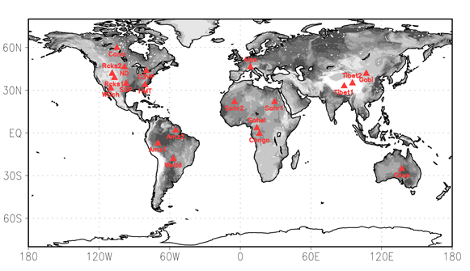
Two Tb indices can jointly differentiate different surface types
SSI=Tb18V-Tb36V

Slide 4
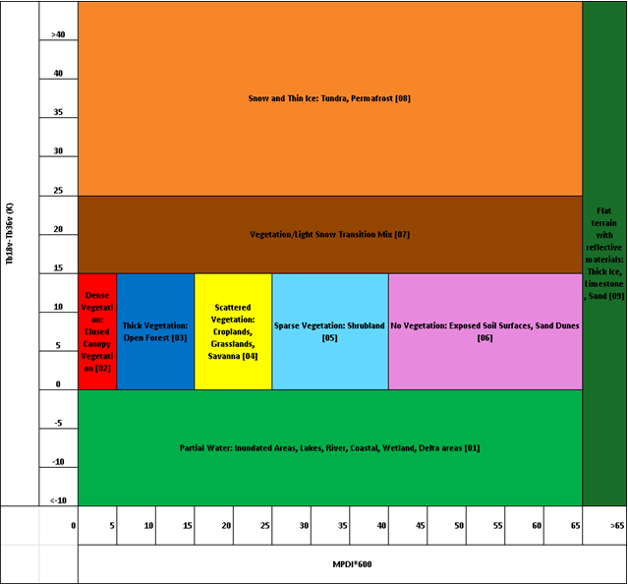
Partition of MPDI-SSI space into 9 classes

Slide 5
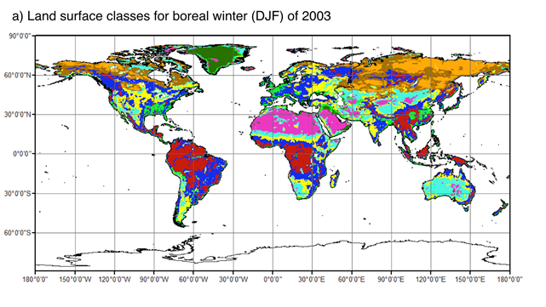
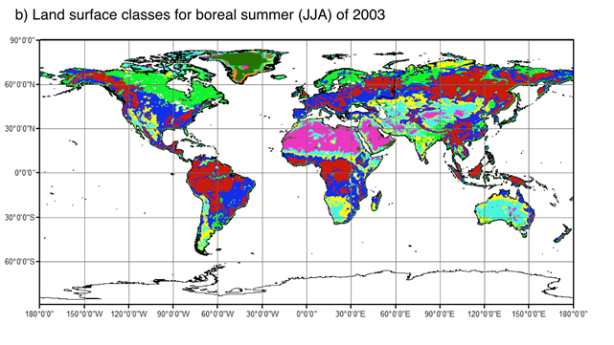

Slide 6
Summary:
1. Proposed and tested a new classification scheme
2. Can be used in real-time with Tb data only.
3. Can capture day-to-day class variations.

