Slide 1

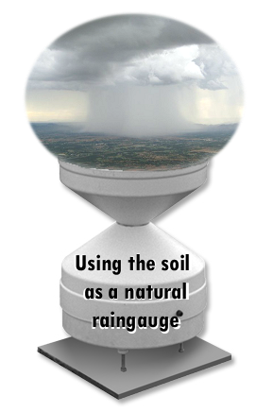
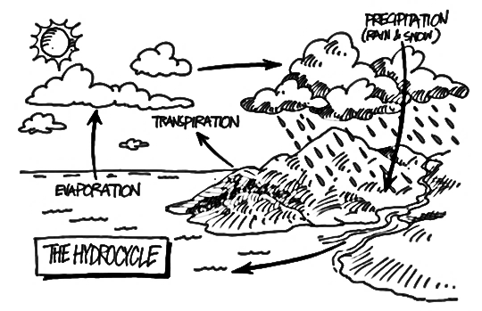
A new “bottom up” perspective for estimating rainfall from satellite soil moisture observations
SM2RAIN
1
Notes:
With this term we refer to the relative wetness or dryness of a watershed. In Mediterranean regions they are high variable and can have significant effect on the flow response in these systems during wet weather

Slide 2
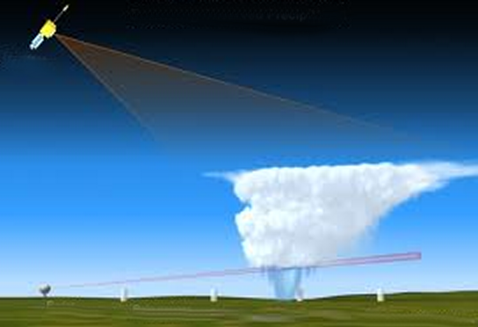
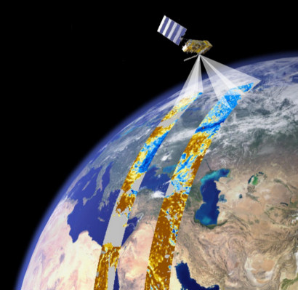

SM2RAIN concept
Remote sensing of rainfall
Remote sensing of soil moisture
Is it raining?
TOP-DOWN PERSPECTIVE
radar
raingauge
BOTTOM-UP PERSPECTIVE: CAN WE USE SOIL MOISTURE DATA TO INFER THE AMOUNT OF WATER FALLING INTO THE SOIL?
2
Notes:
2

Slide 3

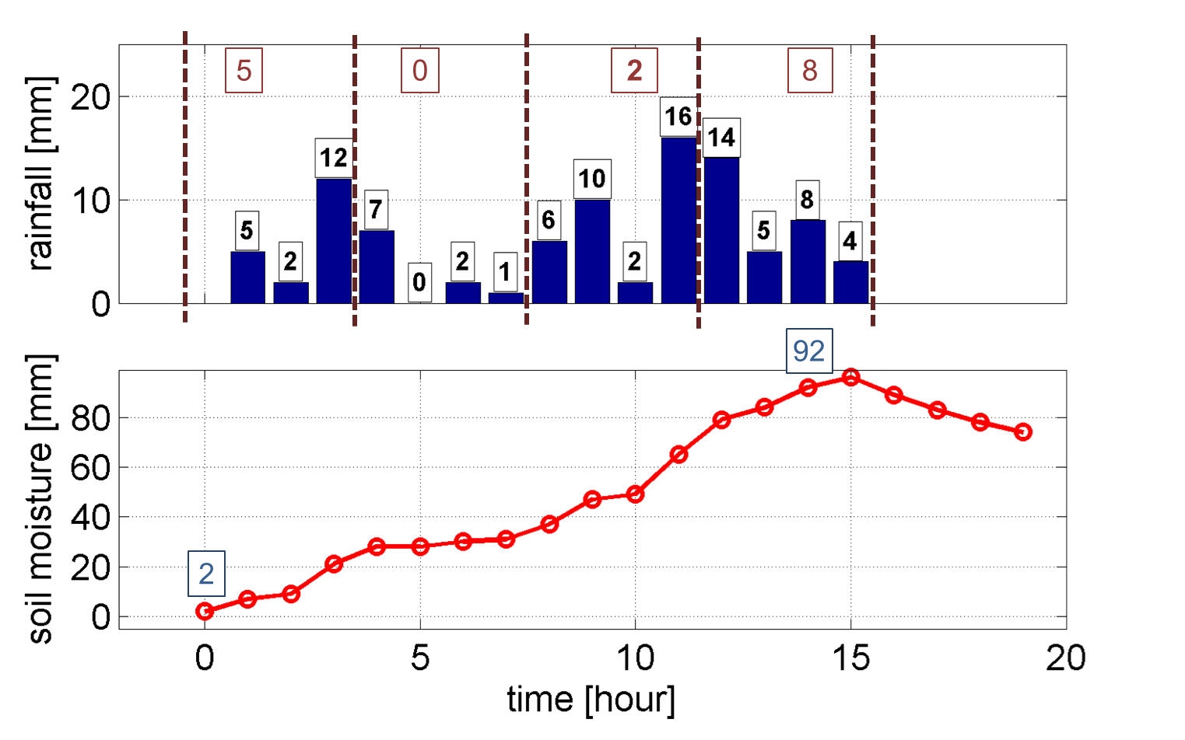

“Top down” vs “Bottom up” perspective
GPM
SMAP
TOP DOWN PERSPECTIVE
Ptop-down=(5+0+2+8)*4= 60 mm
The underestimation is due to the satellite overpasses in period with low rainfall
Ptrue=94 mm
With only two overpasses the bottom up approach provides a better estimate of the accumulated rainfall
Pbottom-up=(92-2)= 90 mm
3
BOTTOM UP PERSPECTIVE
Notes:
3

Slide 4
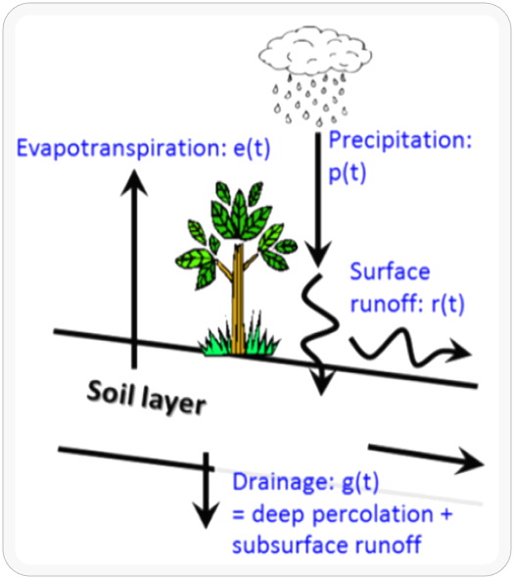

SM2RAIN algorithm
relative saturation
surface runoff
precipitation
drainage
Soil water balance equation
soil water capacity
= soil depth X porosity
evapotranspiration
Inverting for p(t):
Assuming:
+
+
during rainfall
4
Notes:
4

Slide 5
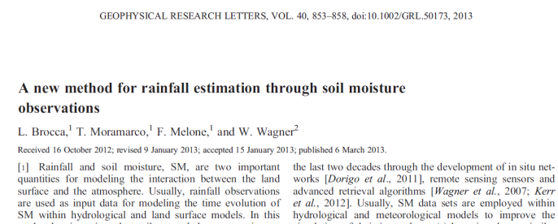
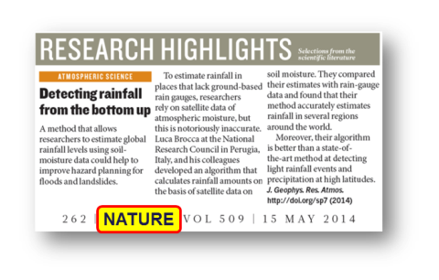
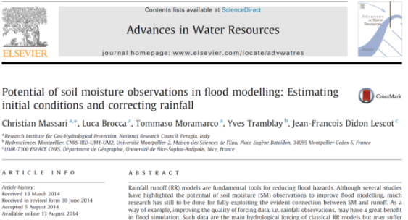
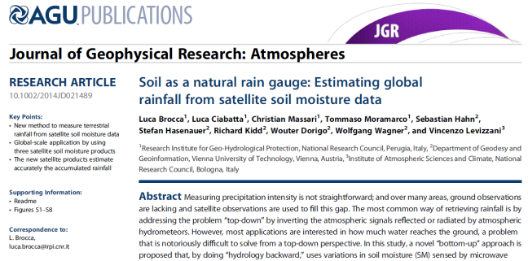
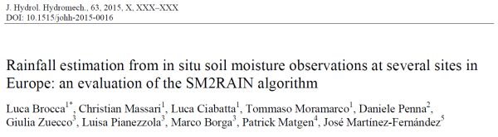
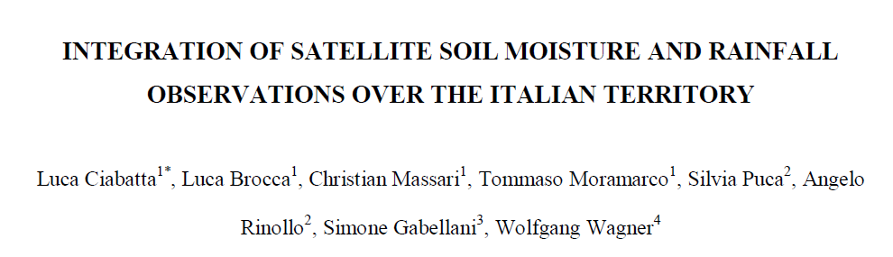
SM2RAIN papers…so far!
2013
2014
2015
Journal of Hydrometeorology, in press
SM2RAIN dataset from ASCAT, 0.25°, 2007-2013, freely available
5
Notes:
5

Slide 6
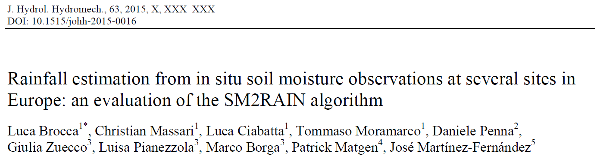
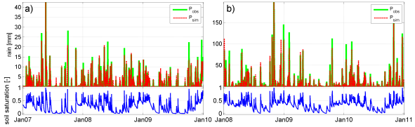
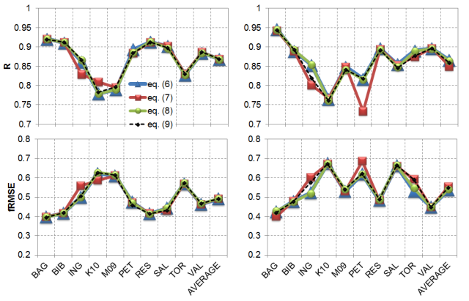
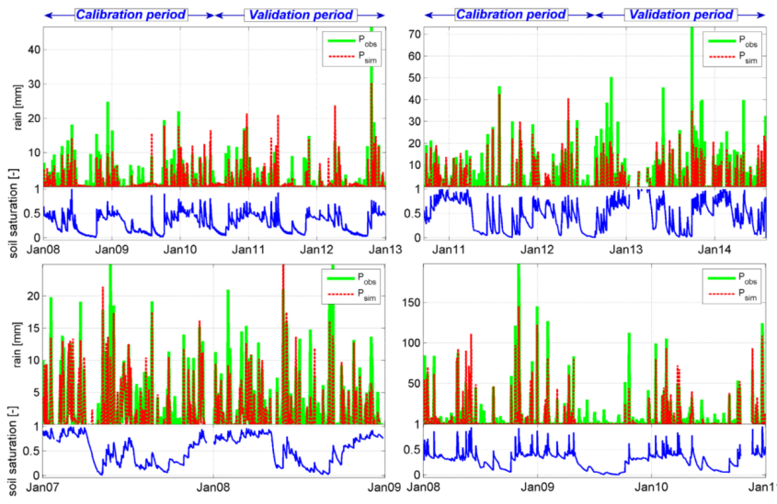
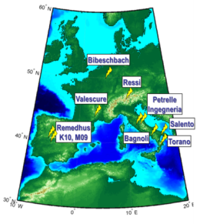
SM2RAIN: in situ observations
Synthetic data
Real data
Average daily correlation=0.94!
calibration
validation
In situ soil moisture observations
0.75<R<0.95
6
Notes:
6

Slide 7
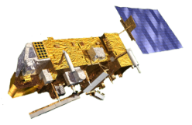
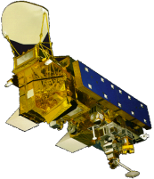

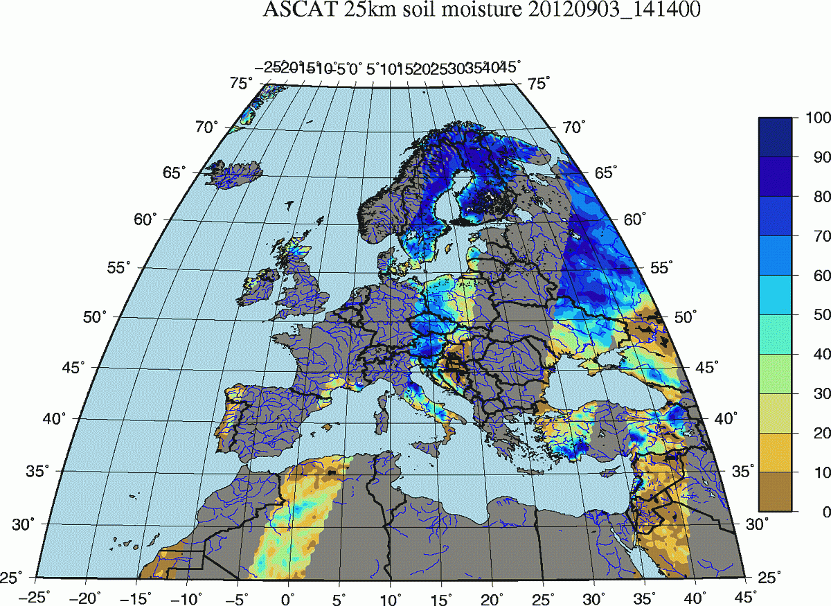
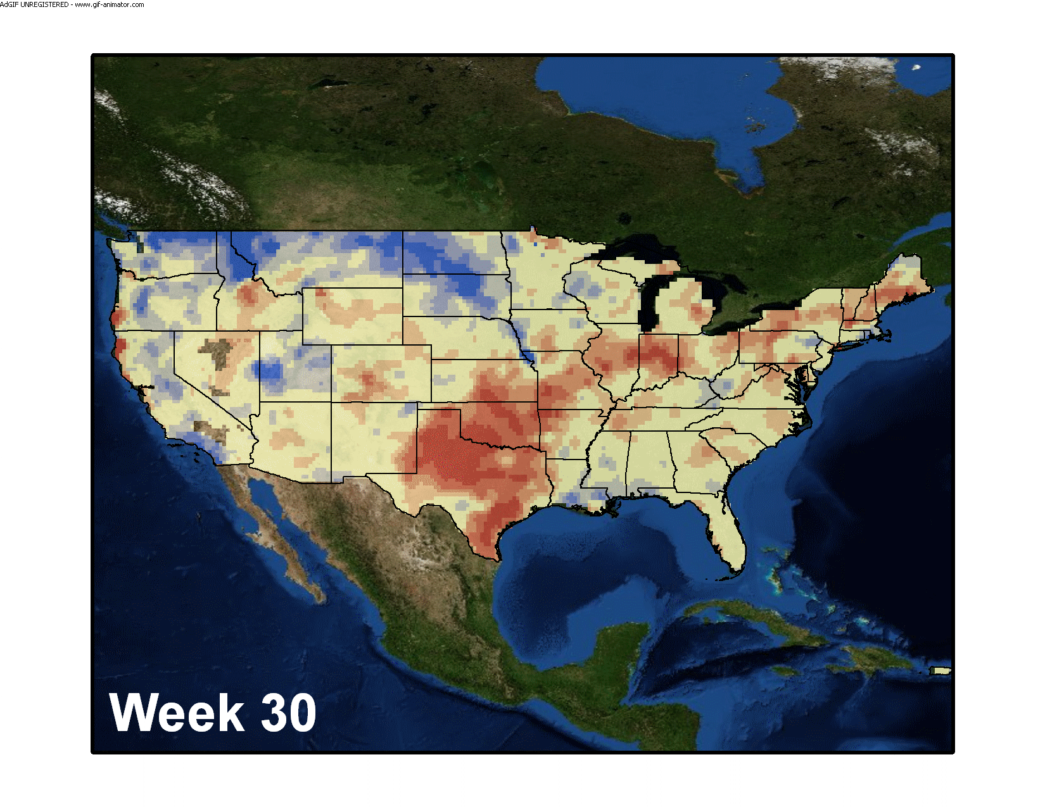
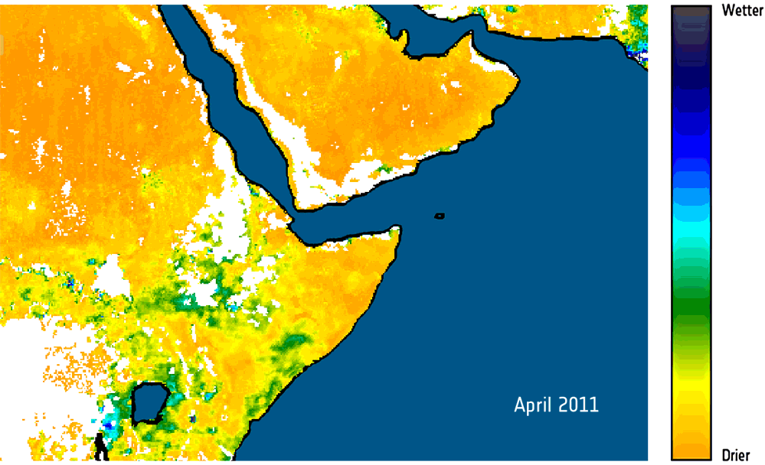
SM2RAIN: satellite soil moisture
ASCAT
METOP A-B
AMSR-E
AQUA
MIRAS
SMOS
scatterometer (active microwave)
C-band (5.7 GHz)
VV polarization
resolution 50/25 km
daily coverage
2006 - ongoing
radiometer (passive microwave)
6.9 - 10.7 - 18.7 - 36.5 GHz
HH and VV polarization
74x43 (6.9), 14x8 (36.5) km
daily coverage
2002 - 2011
radiometer (passive microwave)
L-band (1.4 GHz)
full polarization
43 km
2/3 day coverage
2010 - ongoing
SENSOR
ALGORITHM
LPRM algorithm: Land parameter retrieval model from VUA+NASA.
L-MEB algorithm :L-band Microwave Emission of the Biosphere model.
Change detection algorithm from TU-Wien.
Wagner et al. (1999, RSE)
Owe et al. (2008, JGR)
Kerr et al. (2012, IEEE TGRS)
7
Notes:
7

Slide 8
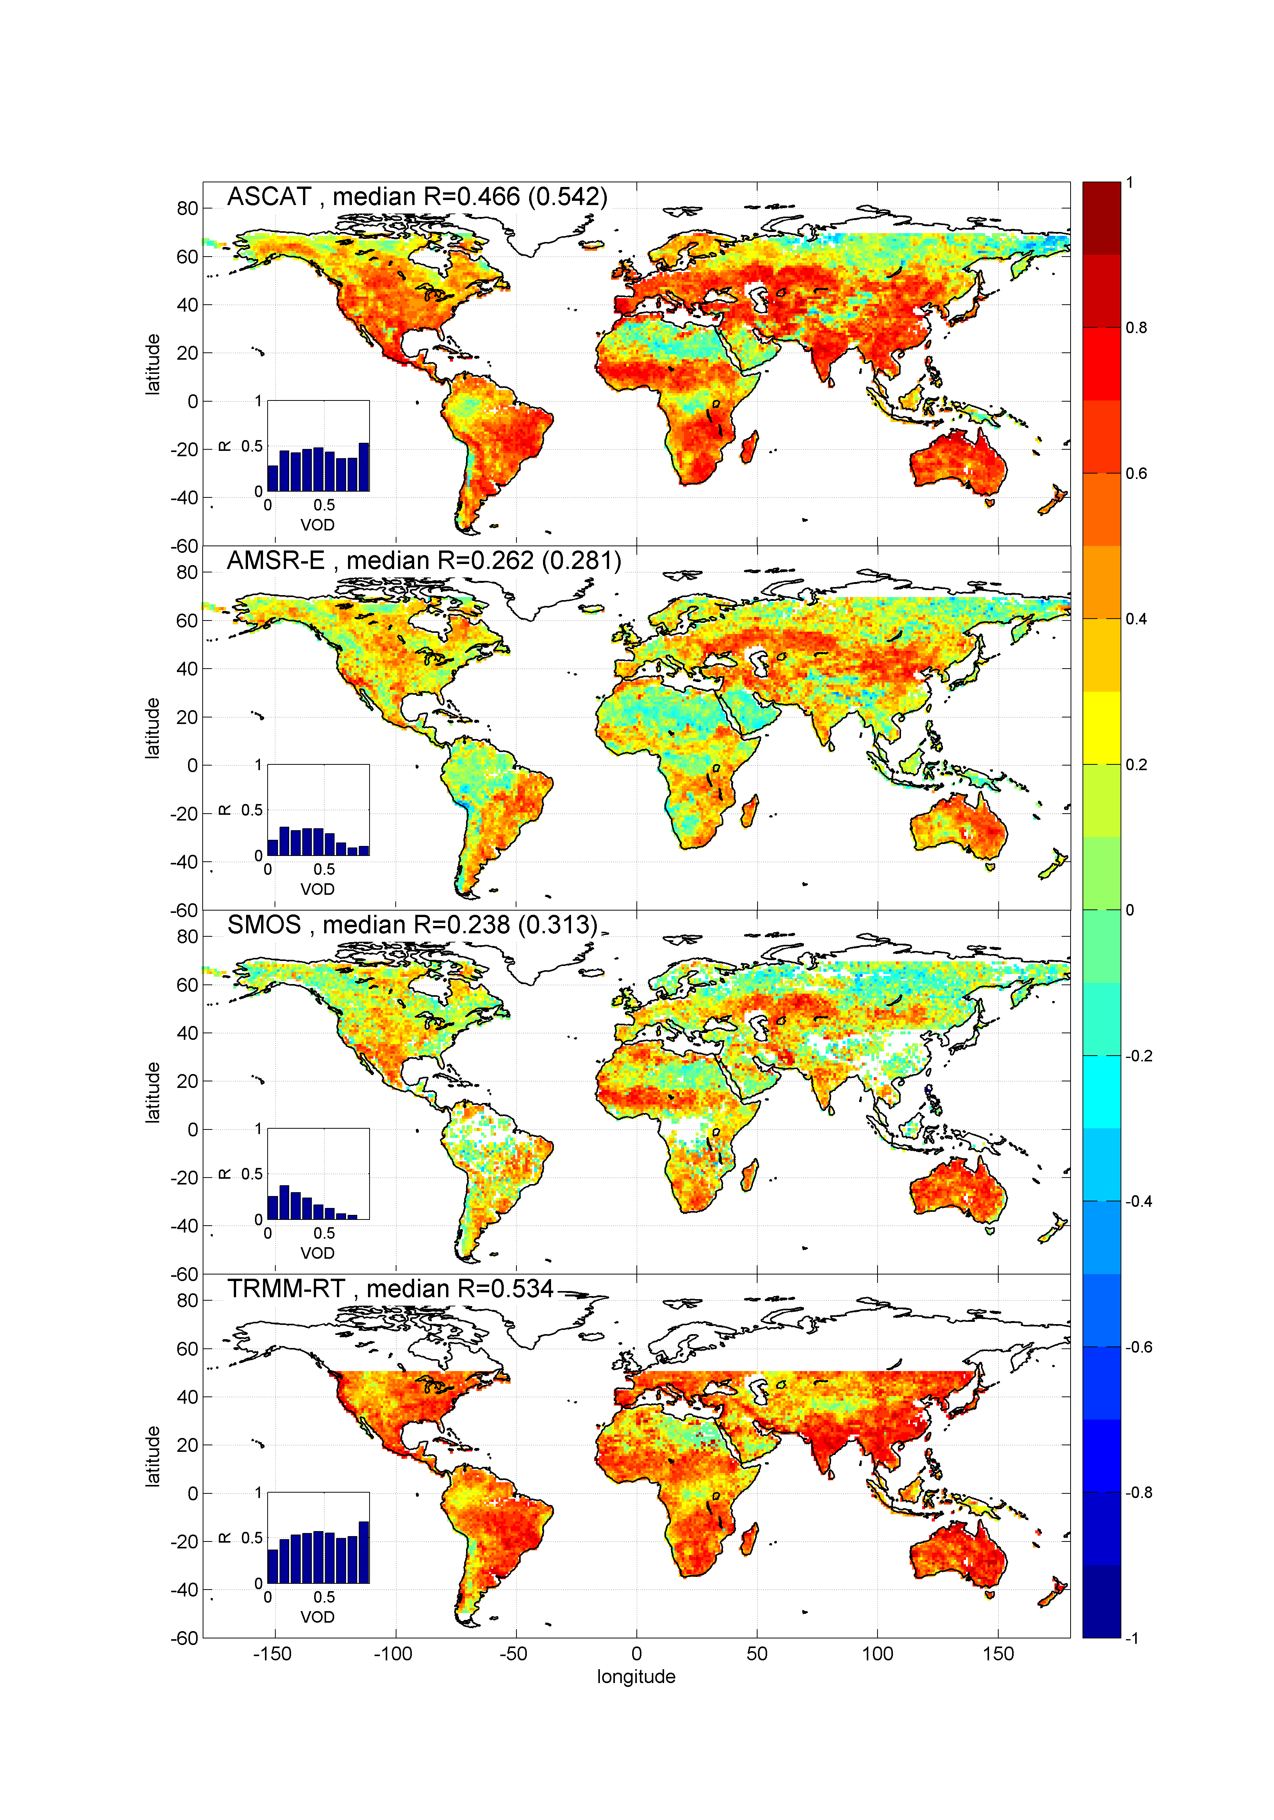
Global scale: correlation
Correlation map between 5-day rainfall from GPCC and the rainfall product obtained from the application of SM2RAIN algorithm to ASCAT, AMSR-E and SMOS data plus TMPA 3B42RT
(VALIDATION period 2010-2011)
Brocca, L., Ciabatta, L., Massari, C., Moramarco, T., Hahn, S., Hasenauer, S., Kidd, R., Dorigo, W., Wagner, W., Levizzani, V. (2014). Soil as a natural rain gauge: estimating global rainfall from satellite soil moisture data. Journal of Geophysical Research, 119(9), 5128-5141.
8
Notes:
8

Slide 9
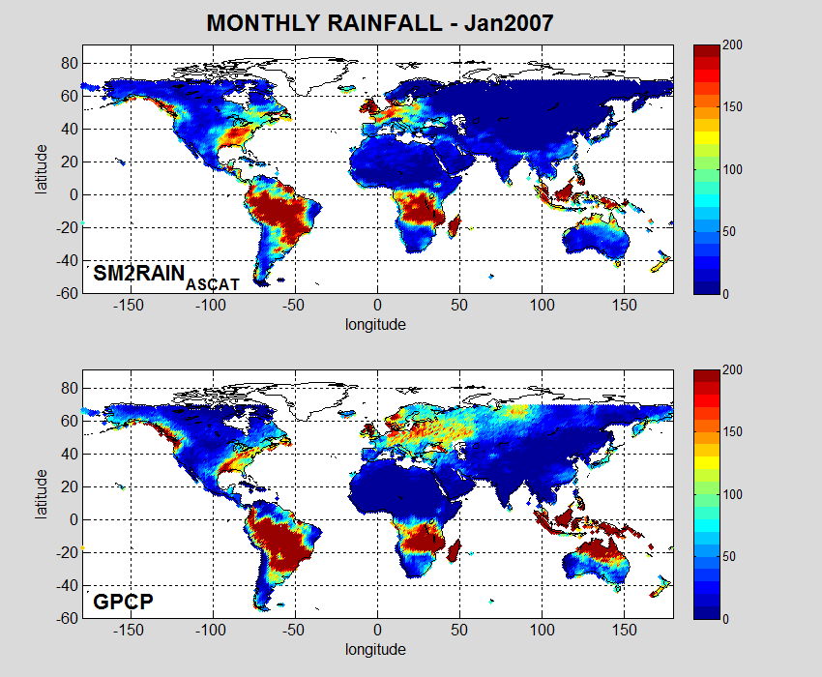
Global monthly rainfall
9
Notes:
9

Slide 10
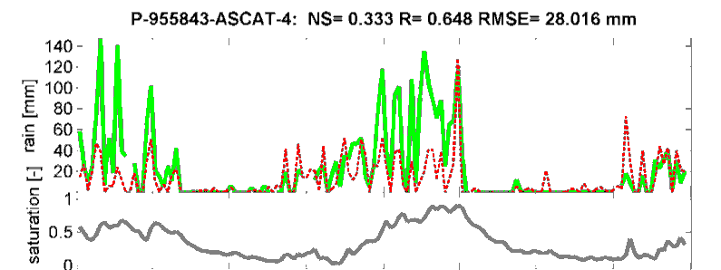
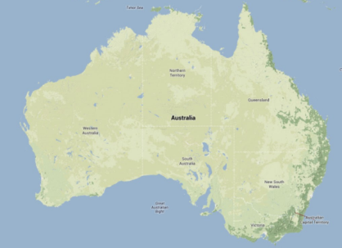
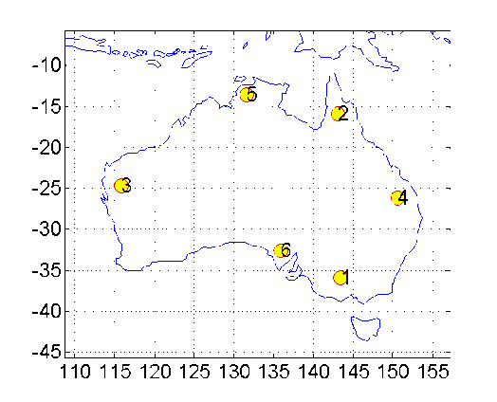
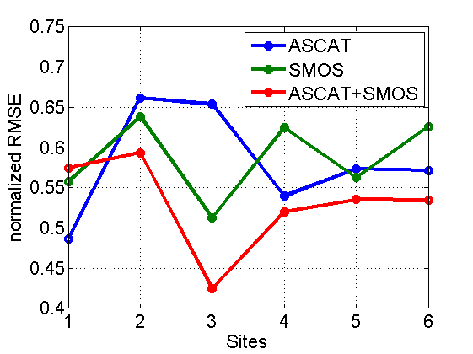
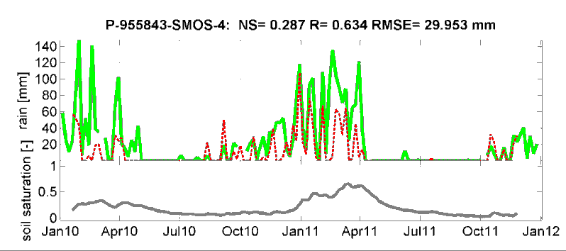
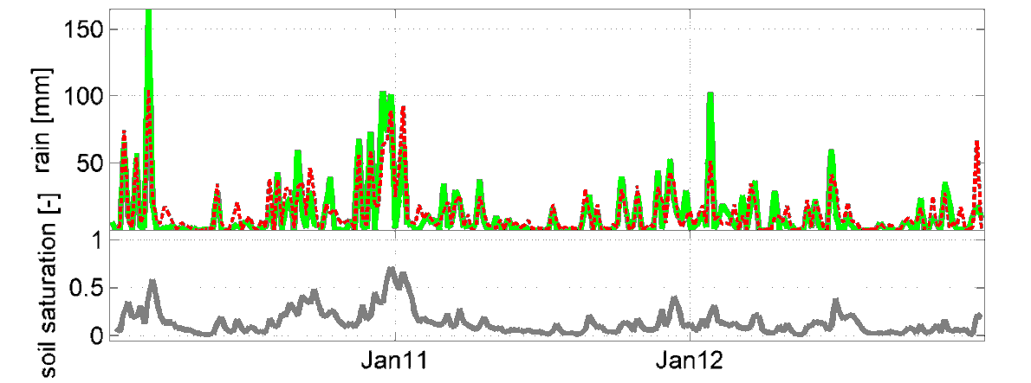
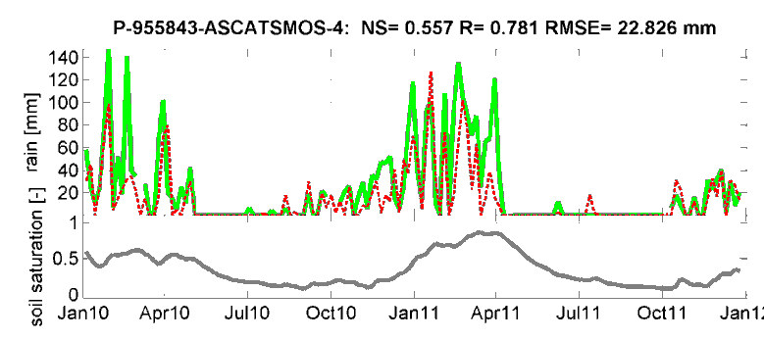
SM2RAIN: merging multiple products
EXTENDED PERIOD: 2010-2012
ASCAT
Mean values
0.58
0.59
0.53
SMOS
Estimation of 5-day rainfall for 2-year data
ASCAT+ SMOS
R increases from 0.65 (0.63) to 0.78
RMSE decreases from 28.0 (30.0) to 22.8 mm (28%)
10

Slide 11
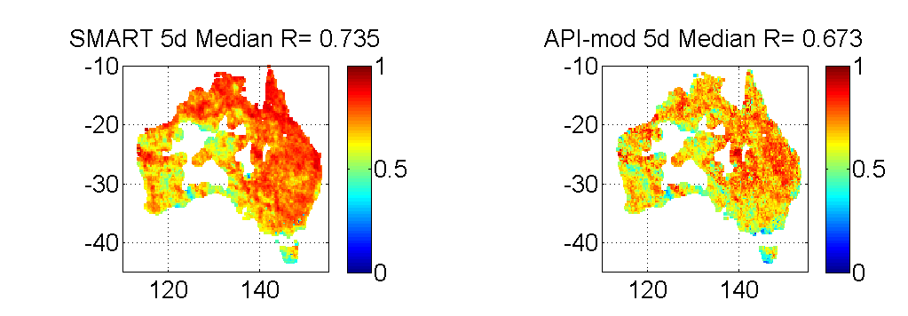
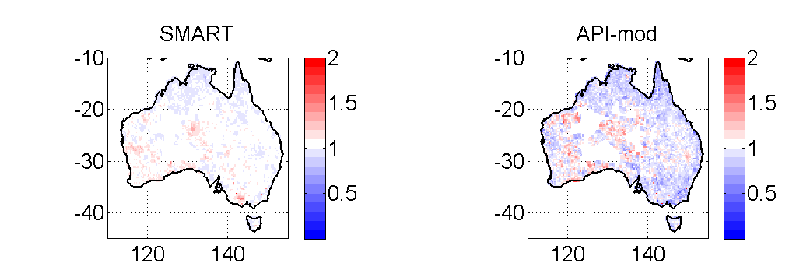
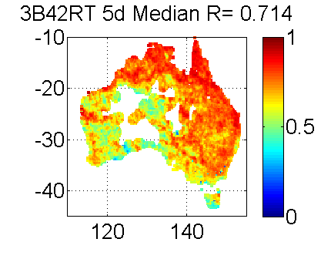
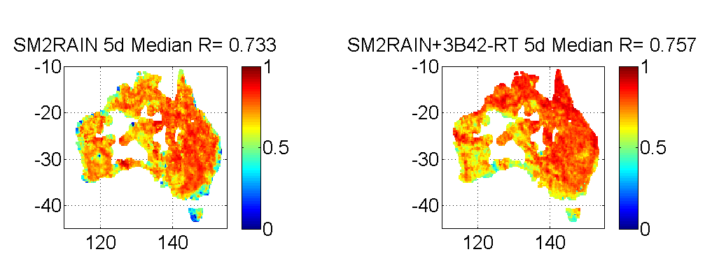
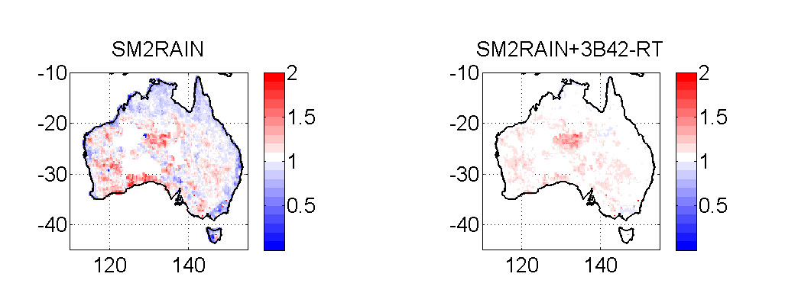
“Top down” & “bottom up” integration
Correlation maps for 5-day rainfall accumulation
R Estimation
R Benchmark
11

Slide 12
A new “bottom up” perspective for estimating rainfall from satellite soil moisture observations
SM2RAIN
FOR FURTHER INFORMATION
URL: http://hydrology.irpi.cnr.it/people/l.brocca
URL IRPI: http://hydrology.irpi.cnr.it
12
Notes:
With this term we refer to the relative wetness or dryness of a watershed. In Mediterranean regions they are high variable and can have significant effect on the flow response in these systems during wet weather

