Slide 1
PMM land surface group presentation 3/11/15
Nick Carr and Pierre Kirstetter

Slide 2
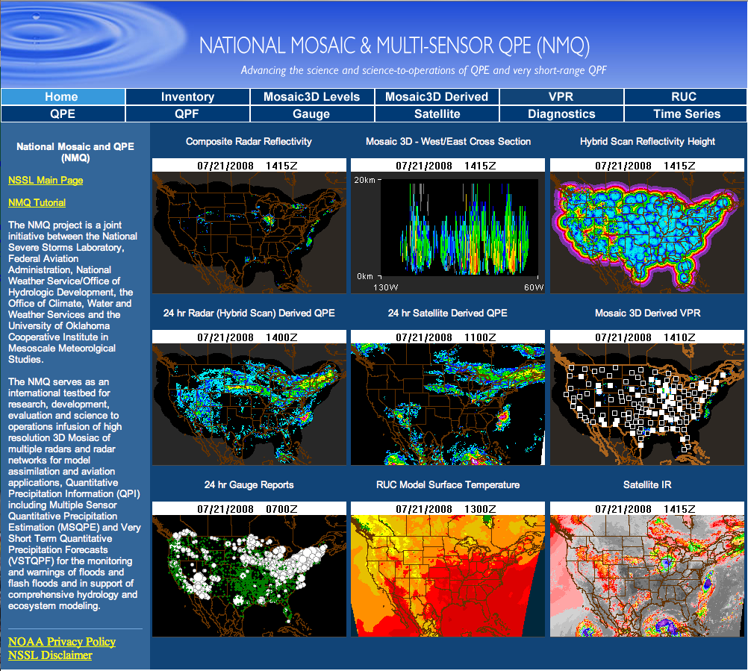
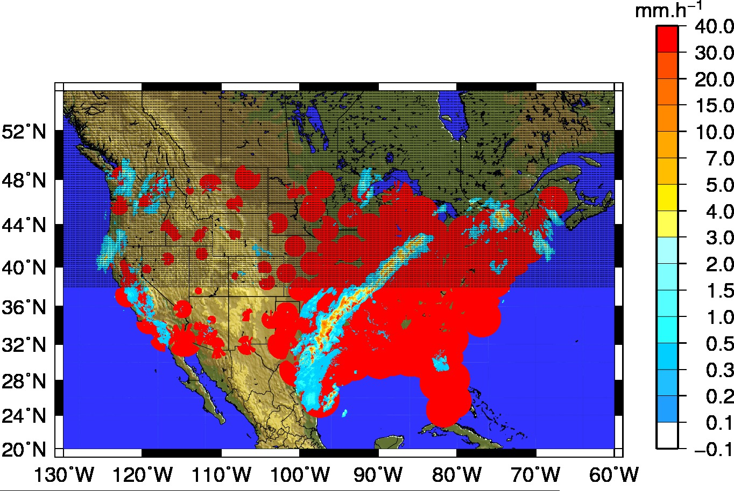
Reference dataset MRMS-Q3
High resolution (~ 5 min, 1km) merged quality controlled radar and gauge precipitation estimates.
Radar-derived precipitation classification scheme
One of the sources used to generate the at-launch apriori database for GPROF 2014.
Notes:
Brief description of the reference dataset used to evaluate the passive microwave products, visit http://mrms.ou.edu for more information/products

Slide 3
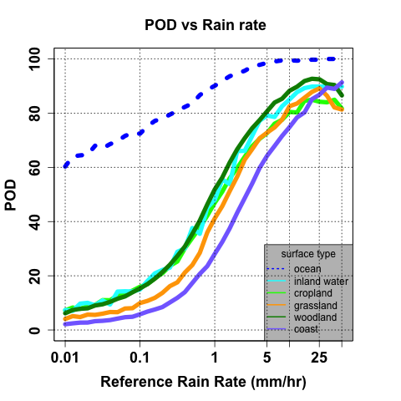
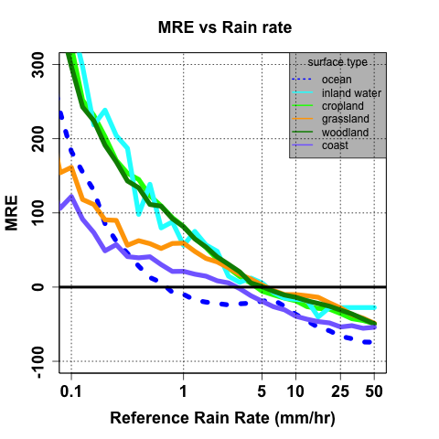
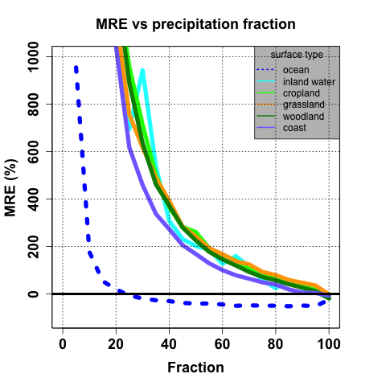
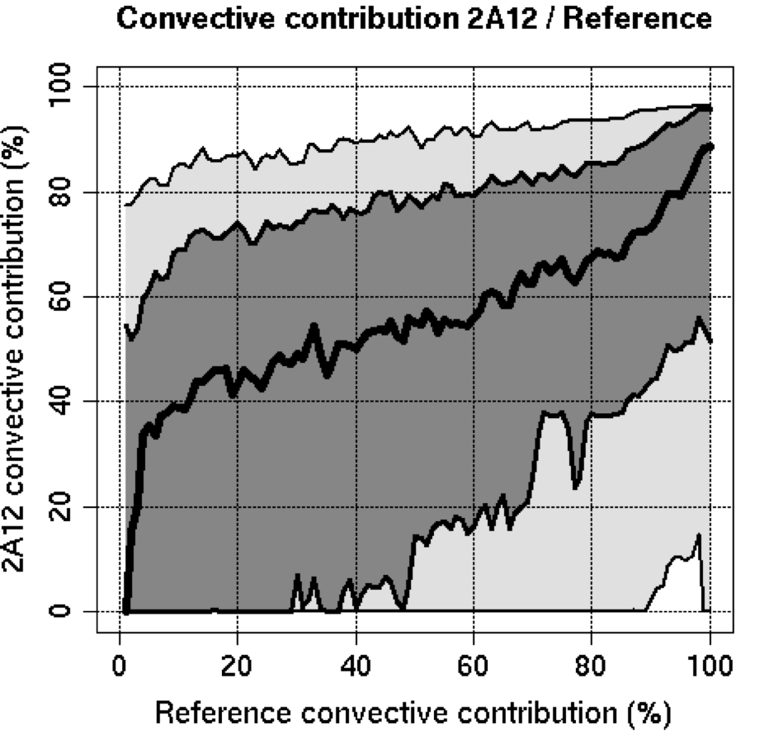
TRMM 2A12 evaluation
Notes:
This slide gives a brief overview of some of the work done comparing the TRMM 2A12 v7 algorithm with the reference (MRMS) dataset, as a function of MODIS’ surface classification and various precipitation properties. POD=Probability of Detection (H/H+M), MRE= Mean Relative error, ((sensor-reference/reference))*100 ,Precipitation fraction = number of reference pixels with positive rain rates within the TMI pixel. Convective contribution = percentage of precipitation volume classified as convective by either the reference or TMI.

Slide 4
Some Conclusions
There did appear to be surface influences on the 2A12 precipitation products
As expected these influences were most apparent at lower rain rates, where the precipitation signal (at 85 GHz) is weaker.
However, the surface influences possibly still manifested themselves through the precipitation classification algorithm (which utilizes lower frequency channels).
Notes:
Some brief conclusions regarding the 2A12 analysis)

Slide 5
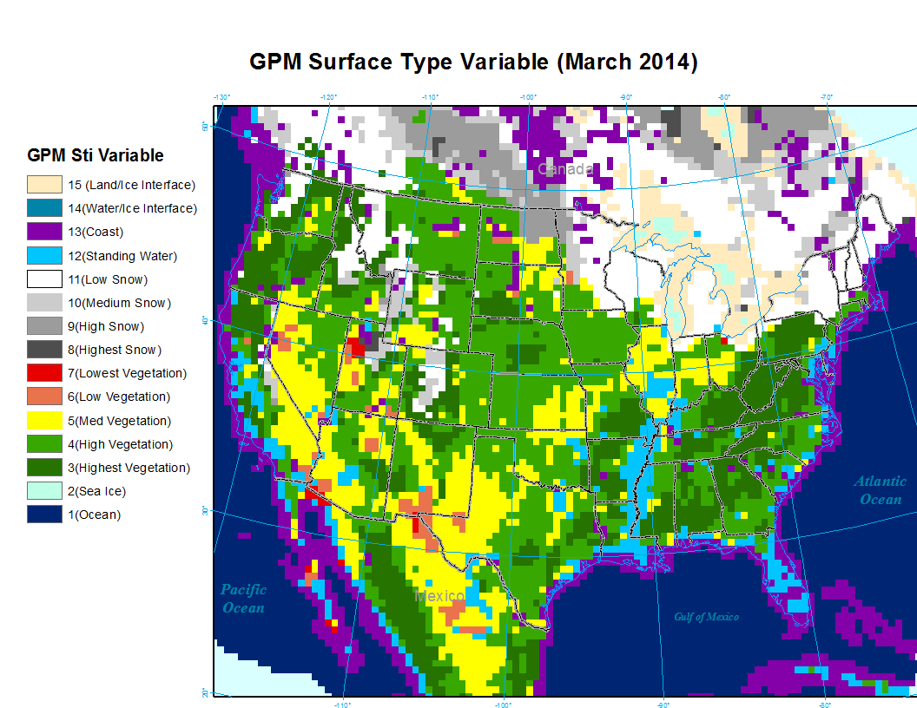
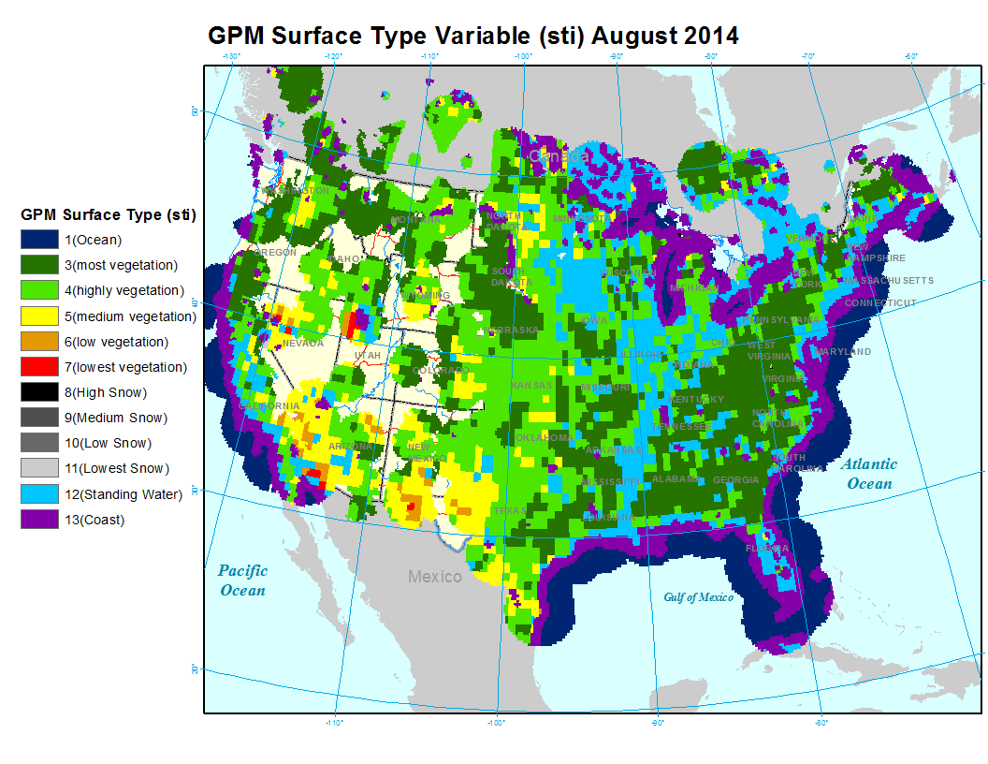
GPM STI variable
Notes:
Sample sti maps for two random months, illustrating that the STI variable can vary temporally for a given point.

Slide 6
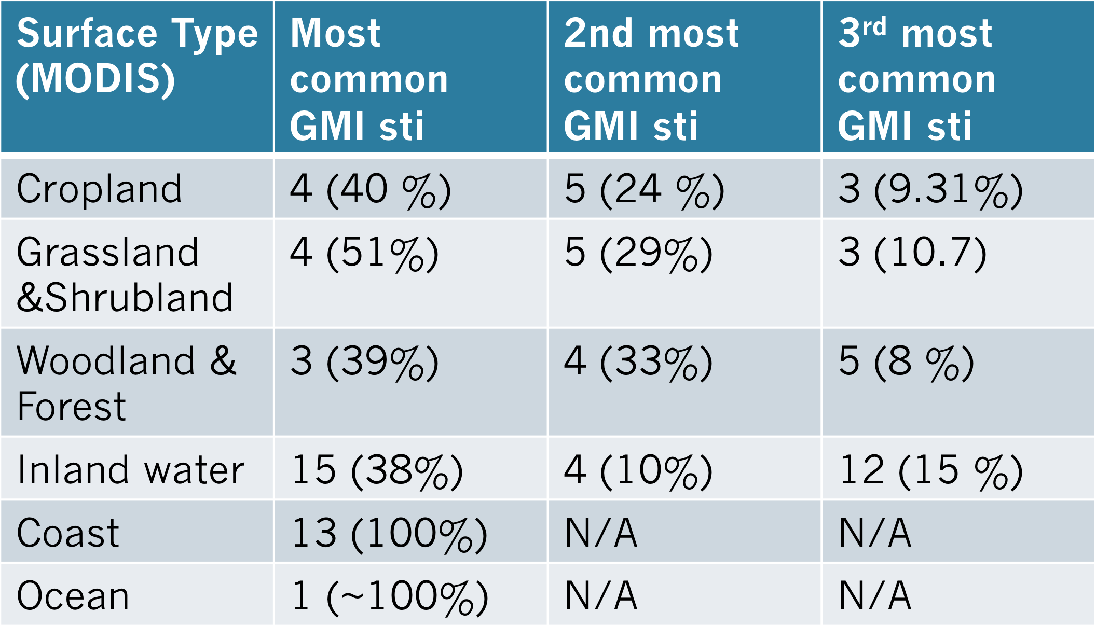
Linking MODIS to STI
Notes:
Table illustrating the most common STI surface classifications corresponding to a given MODIS classification. The percentage gives the percent of MODIS pixels falling within a given GPM STI.

Slide 7
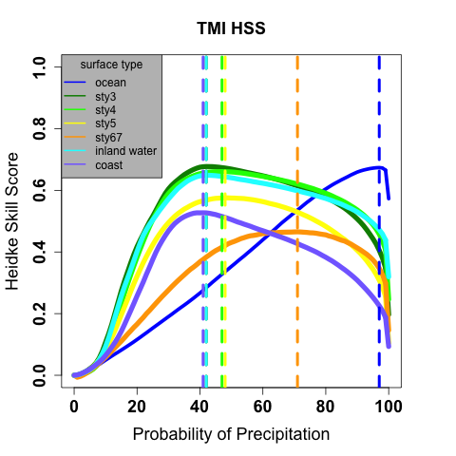
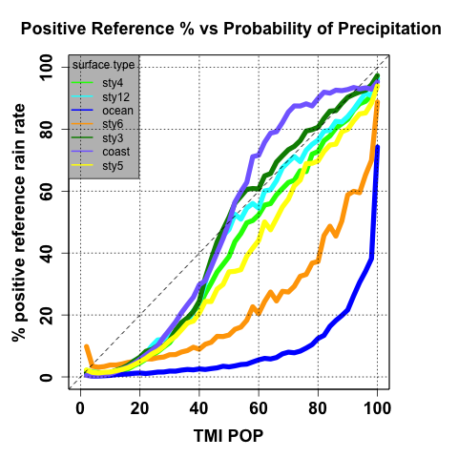
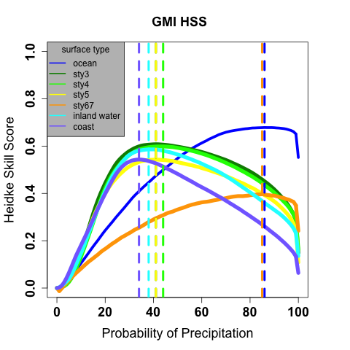
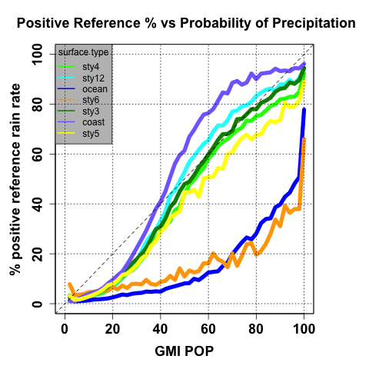
GPM-era POP variable
Notes:
Plots evaluating TMI/GMI probability of precipitation (POP) variable. The first plot displays Heidke Skill Scores (HSS) for the GPM STI classes, the dotted lines correspond to the POP where detection skill is maximized. The second plot shows the mean proportion of raining reference pixels for a given POP, this is probably the most “straightforward” evaluation of the POP variable.

Slide 8
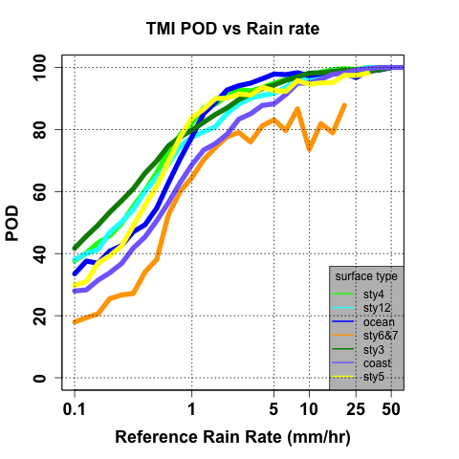
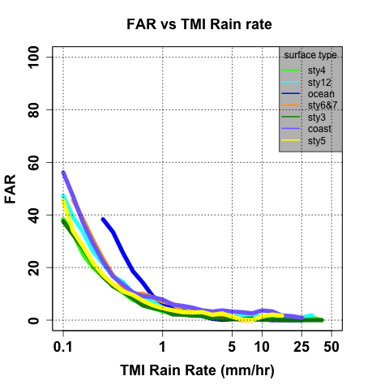
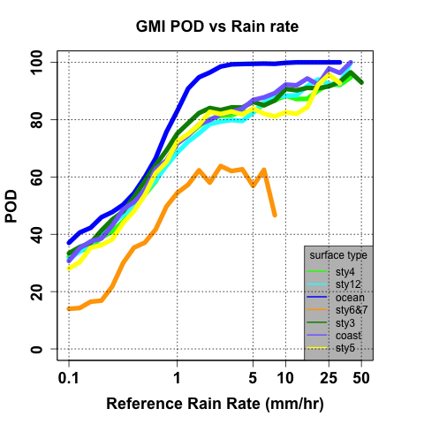
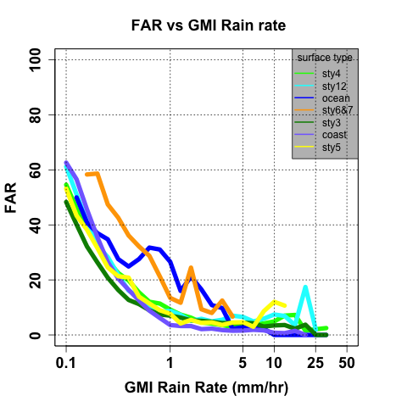
GPM-era Detection
Notes:
Plots evaluating TMI/GMI detection capabilities utilizing the POP corresponding to the maximum Heidke Skill Score (HSS) as the detection threshold.

Slide 9
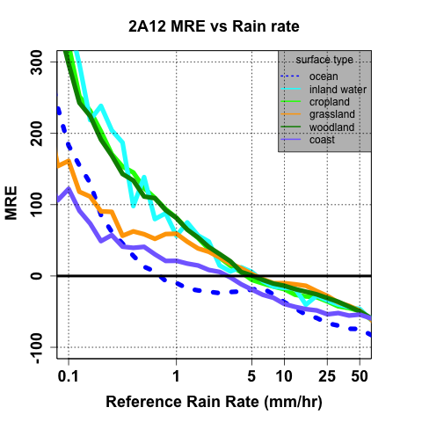
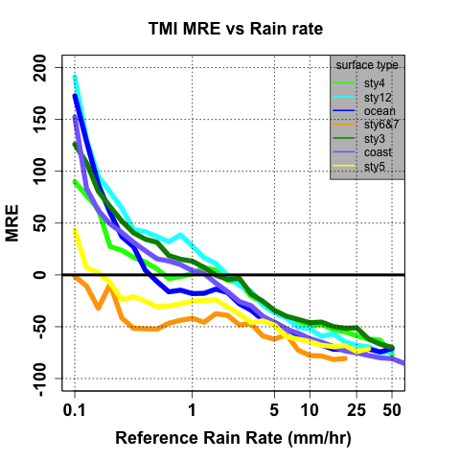
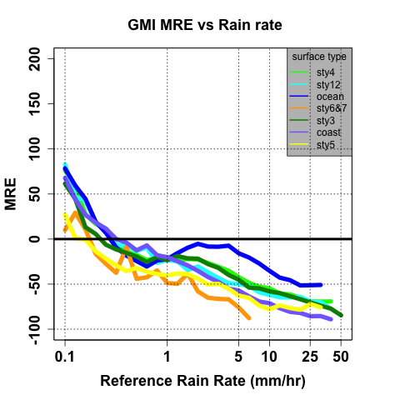
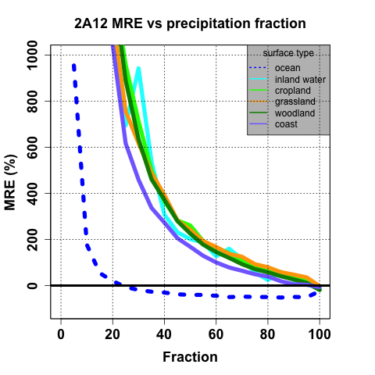
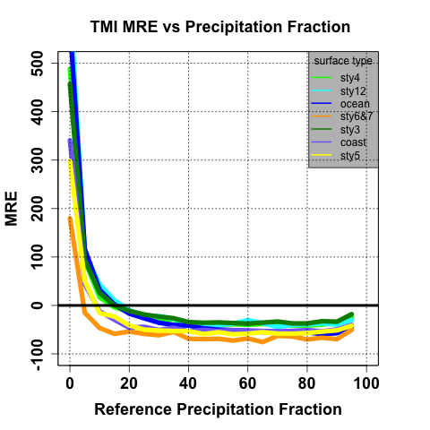
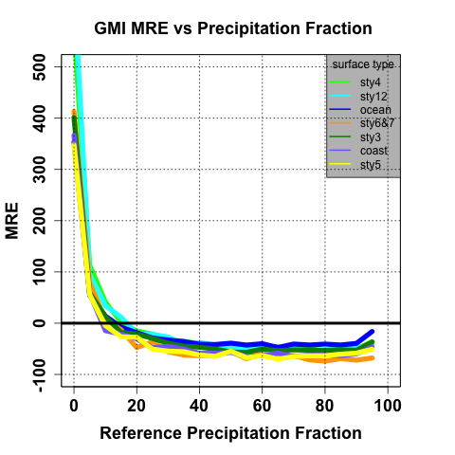
Precipitation Quantification
Notes:
Plots displaying MRE as a function of Reference Rain Rate/ Precipitation Fraction for (from left to right) TMI 2A12 v7, TMI GPROF 2014, GMI GPROF 2014. Hence these plots compare both sensors (TMI and GMI) and algorithms (2A12 and GPROF 2014)

Slide 10
Conclusions
There appears to be improvement over 2A12 v7, regarding both precipitation detection and quantification over all surface types.
This improvement is magnified at lower rain rates.
Biggest surface influences appear to be over pixels classified as surface types 6 and 7 (less vegetated)
Notes:
Some Conclusions

Slide 11
Future Research
Influence of snow or ice covered surfaces on retrievals.
Potential influence of underlying surface characteristics on precipitation characteristics, which could compound influences on retrievals.
Notes:
Slide detailing potential ideas for future research

