Slide 1
Update on Surface Characterization in the GPM Combined Algorithm
Joe Munchak
With help from Bob Meneghini, Mircea Grecu, and Bill Olson

Slide 2
Objectives
Basic idea is to move from using independent (TELSEM-based) emissivities and SRT-based PIA to internally-consistent emissivities and σ₀.
Use σ₀ directly as observational constraint, instead of SRT or dSRT PIA
This should make better use of both GMI and DPR observations by restricting the initial ensemble to realistic combinations of emissivity and σ₀.
The computed σ₀ includes surface variability and PIA variability in the ensemble.
Adding wind (ocean) and emissivity (land) to the retrieval output will also be useful for constellation database generation.

Slide 3
Approach (Land)
Develop GMI emissivity retrieval for non-precipitating pixels
Generate databases of emissivity and σ₀, including covariances (currently using same surface classification as GPROF)
Modify retrieval by randomly perturbing EOFs of emissivity/σ₀ during ensemble generation, adding multi-channel emissivity to the retrieval variables (x), and replacing PIA with (or use in conjunction with) σ₀ in the observations (y)

Slide 4
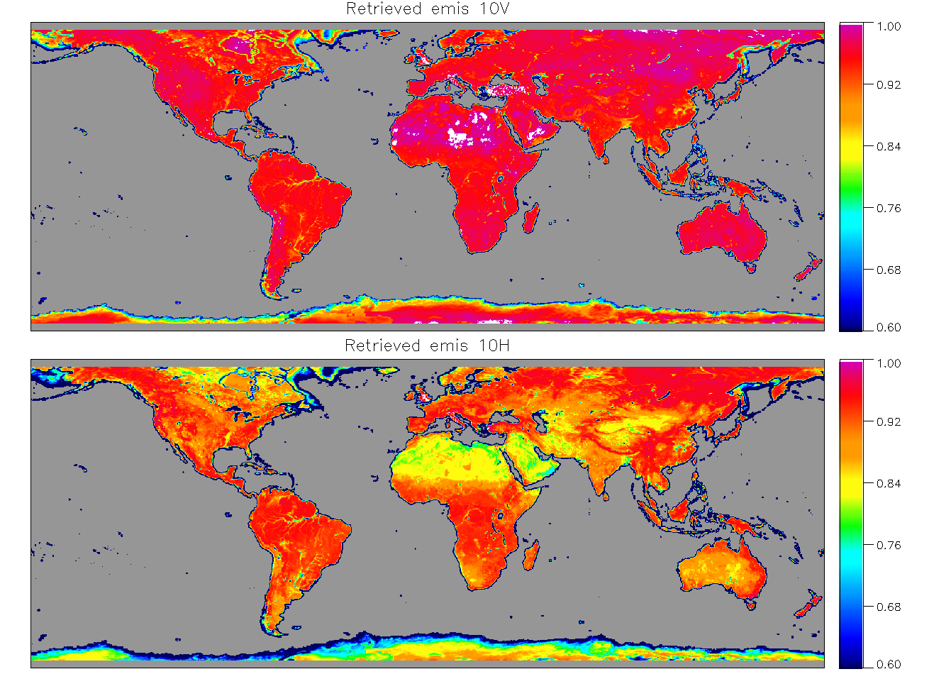

Slide 5
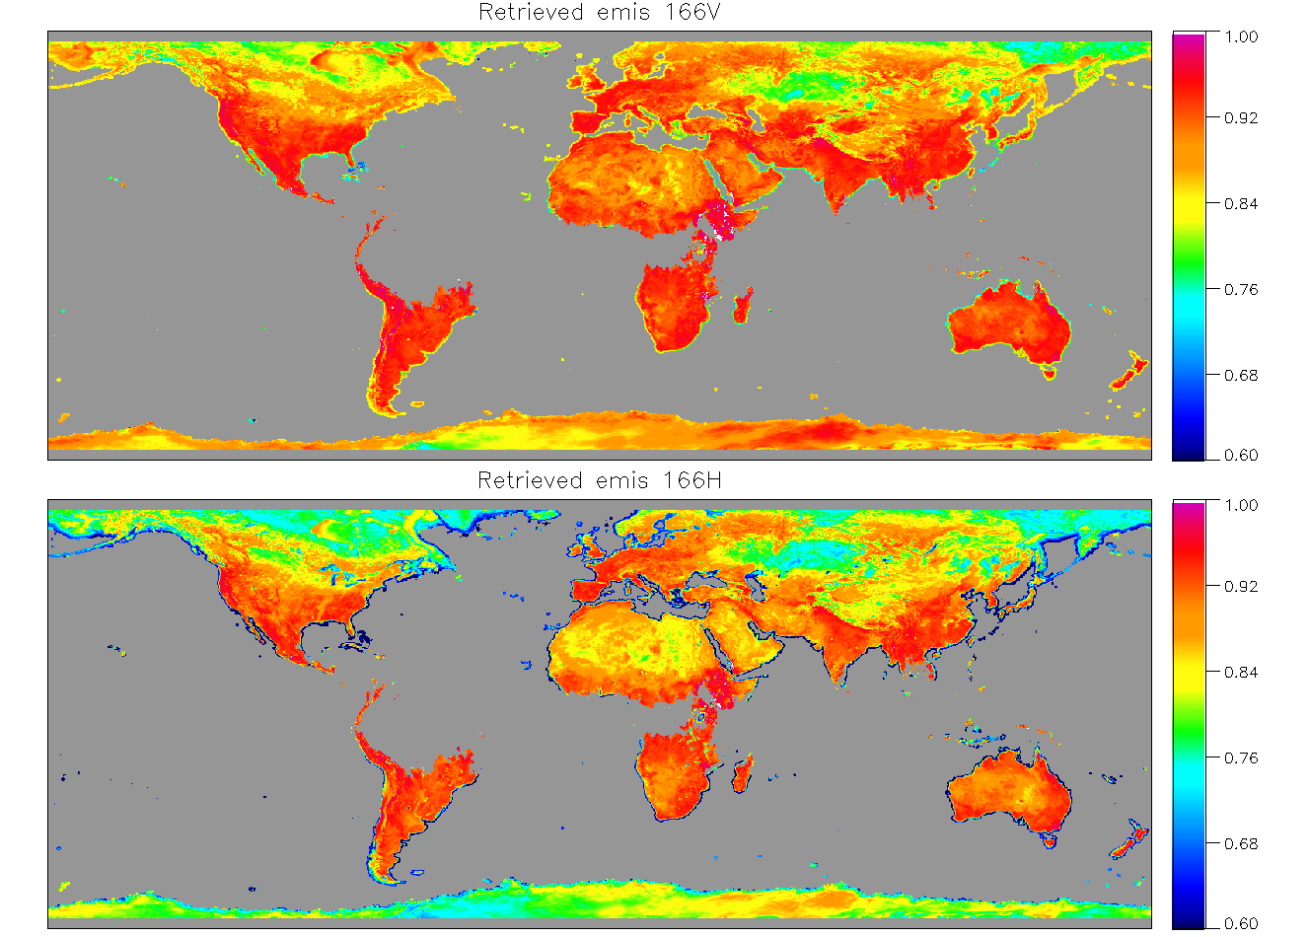

Slide 6
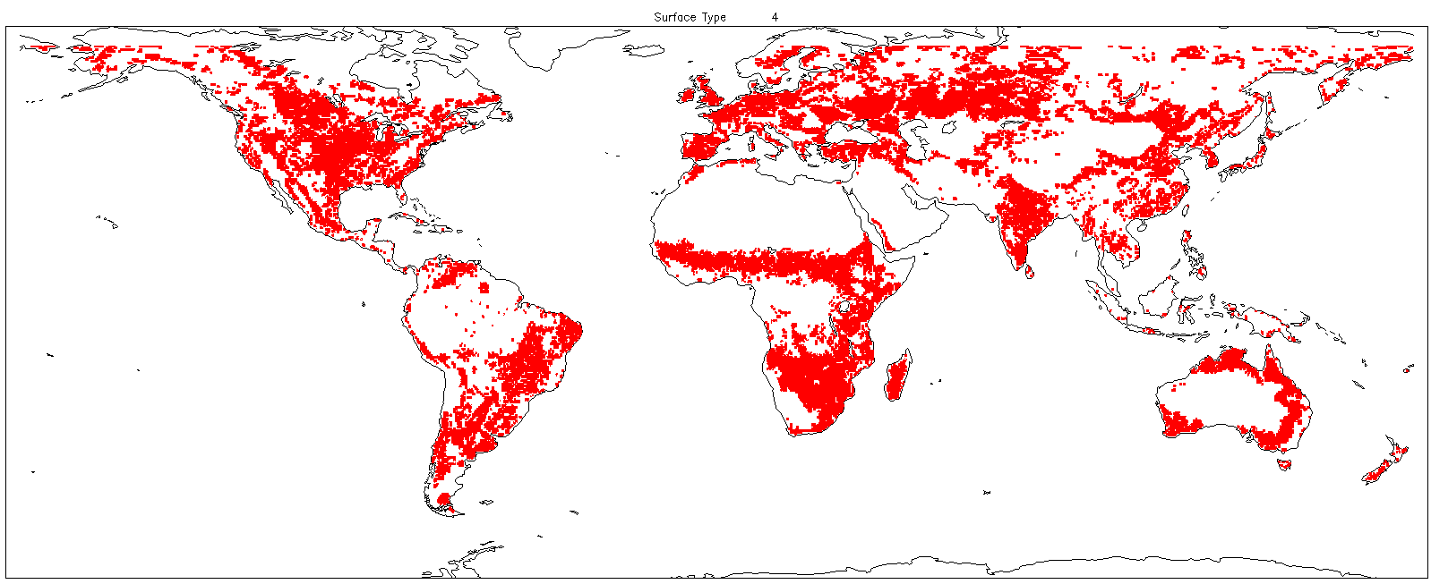
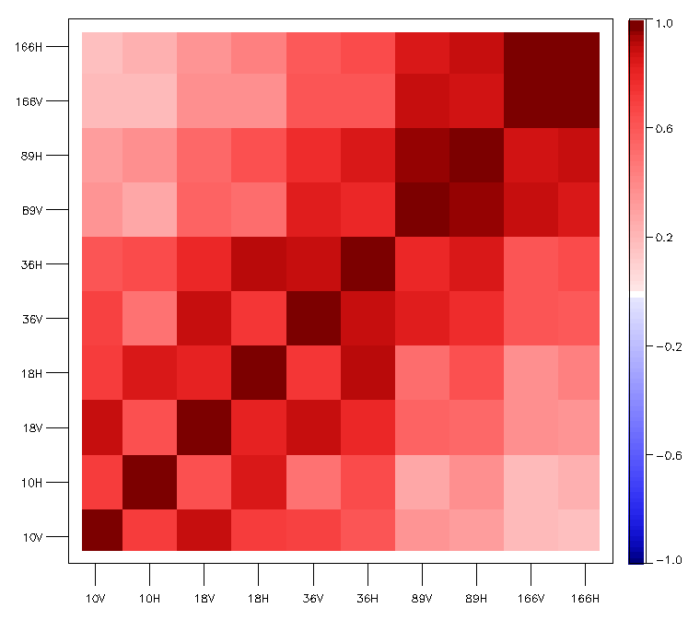
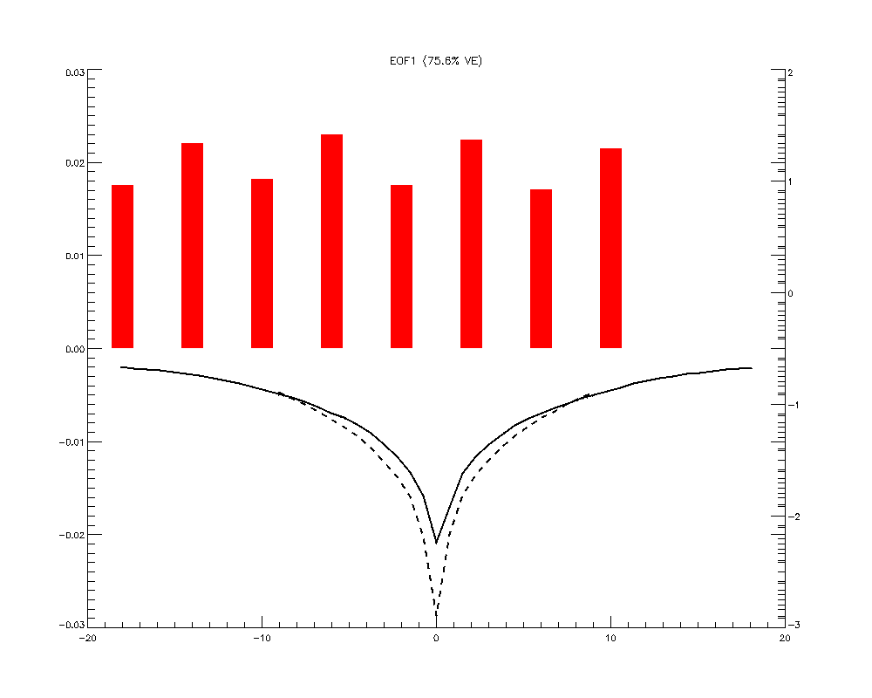
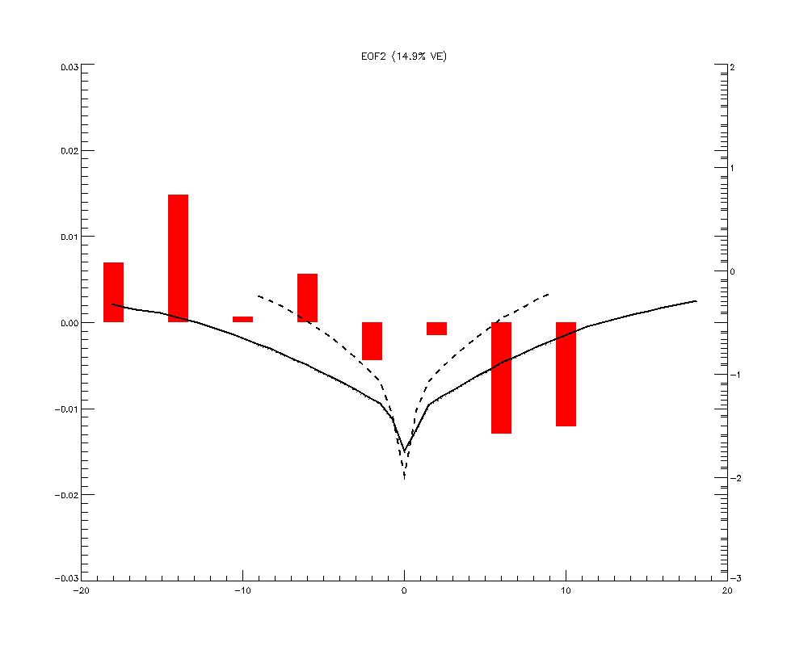
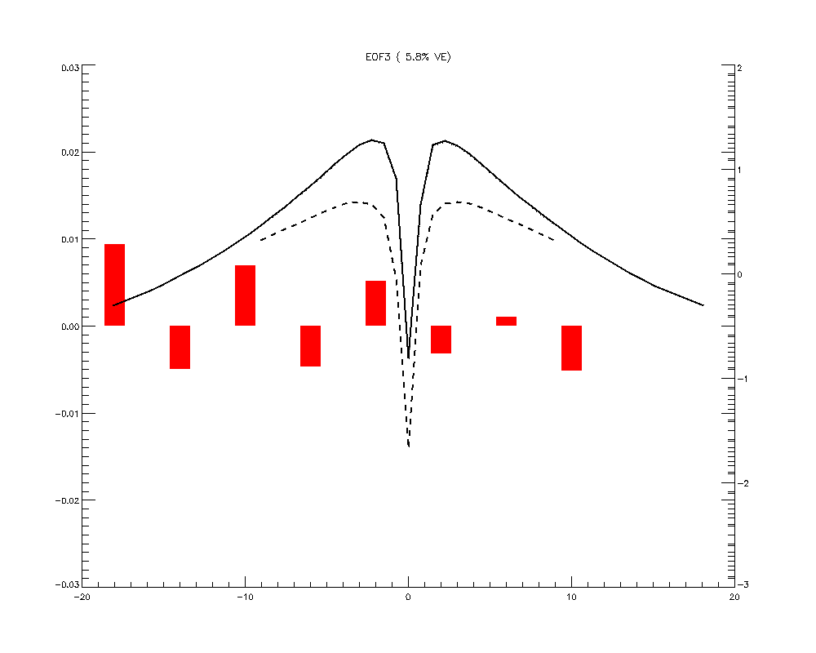
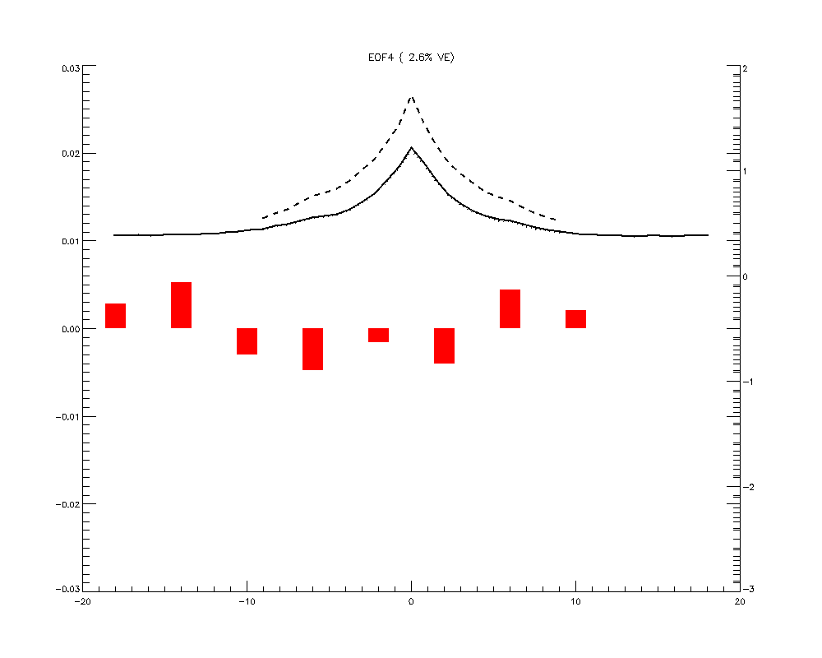
Vegetation Class Example
EOF1
EOF2
EOF3
EOF4

Slide 7
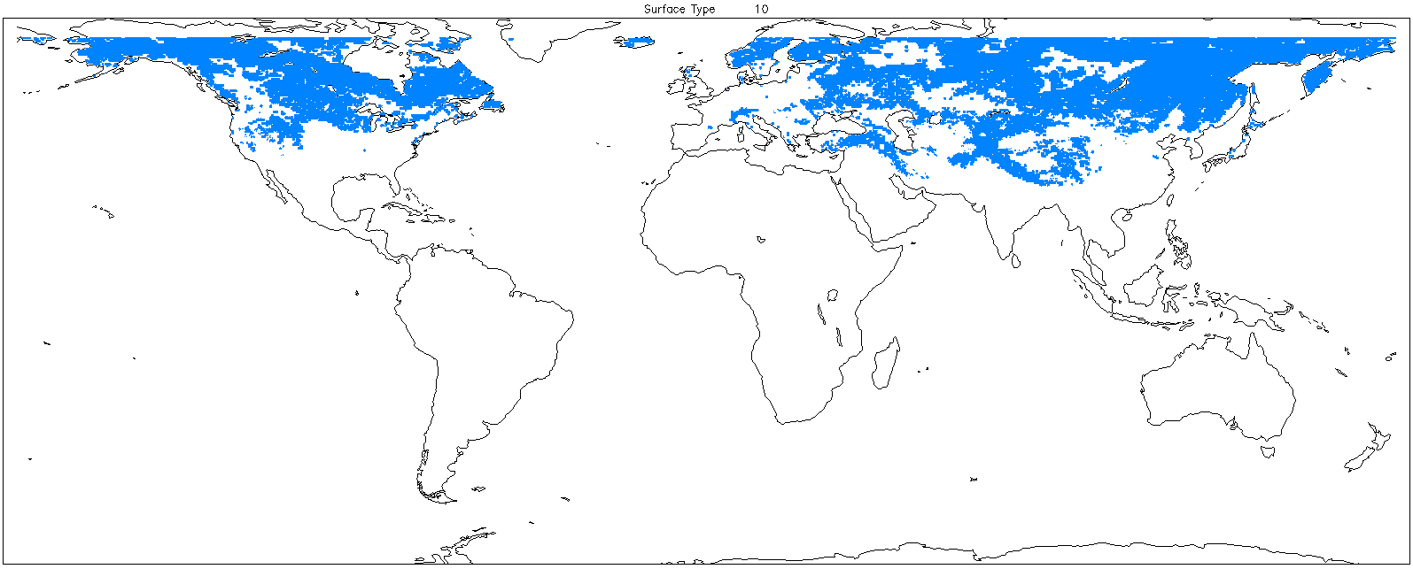
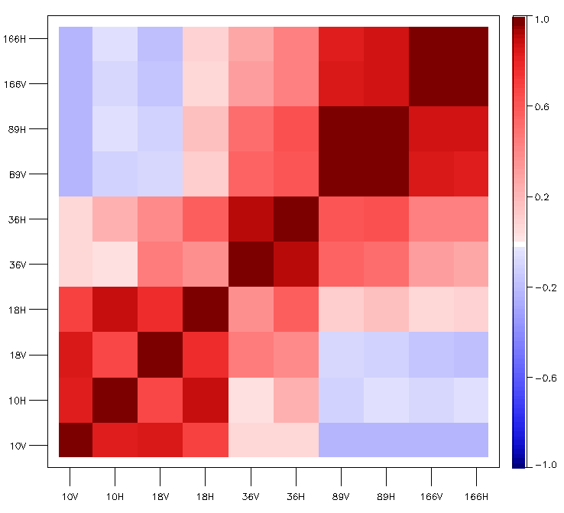
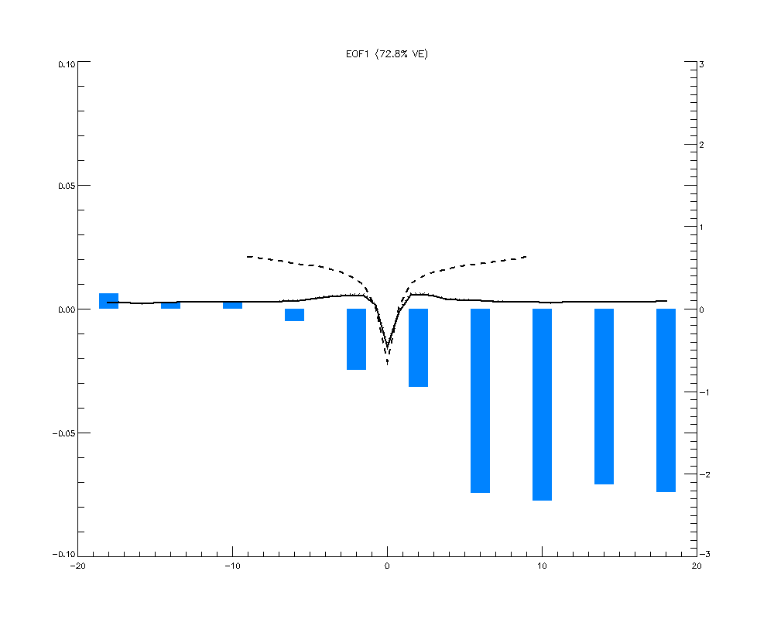
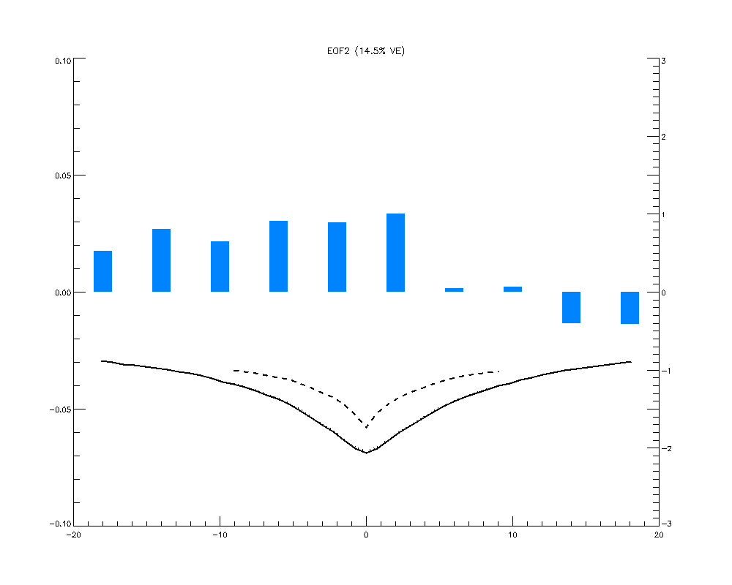
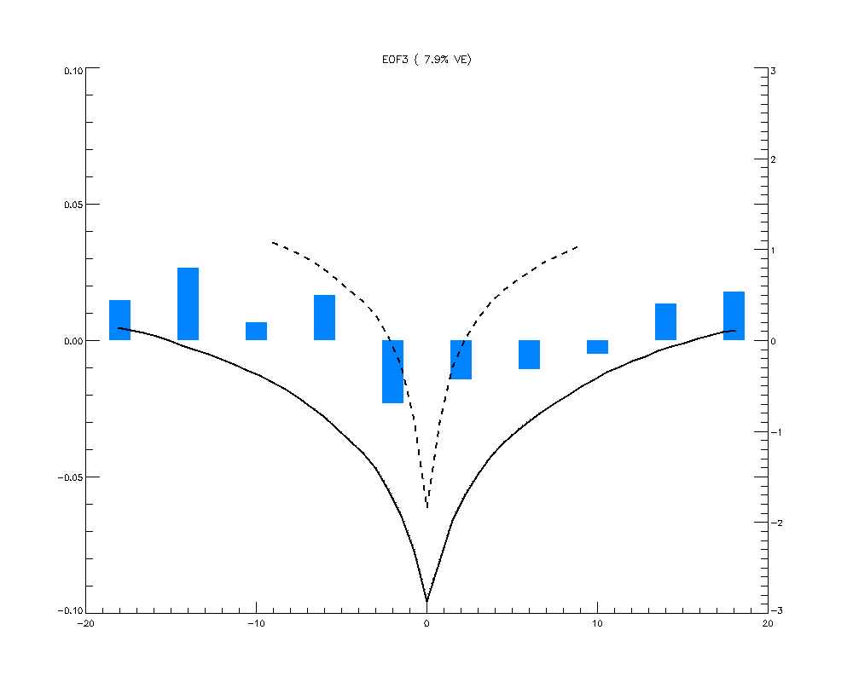
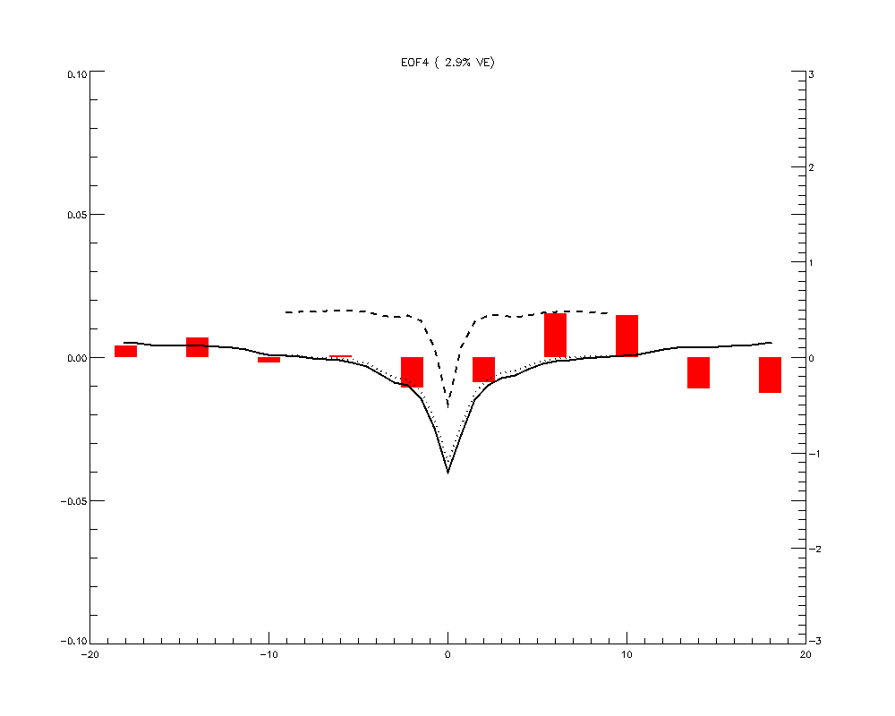
Snow Class Example
EOF1
EOF2
EOF3
EOF4

Slide 8
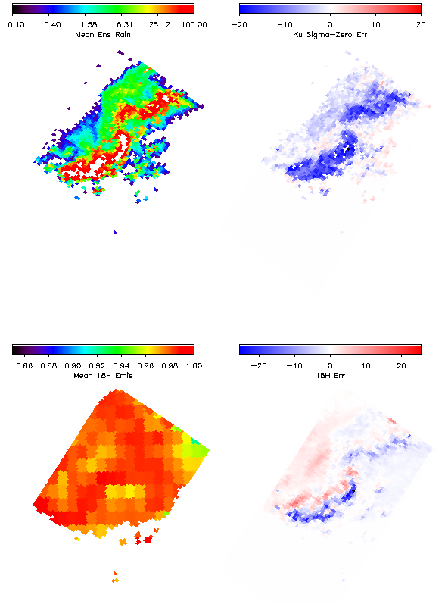
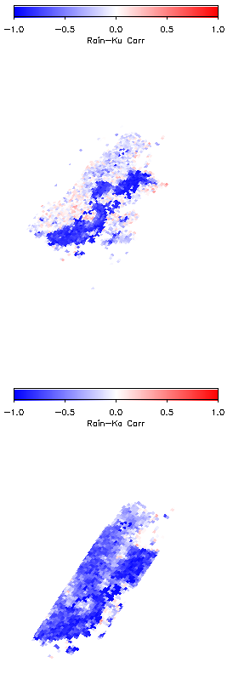
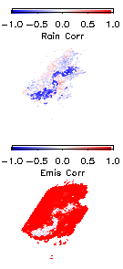
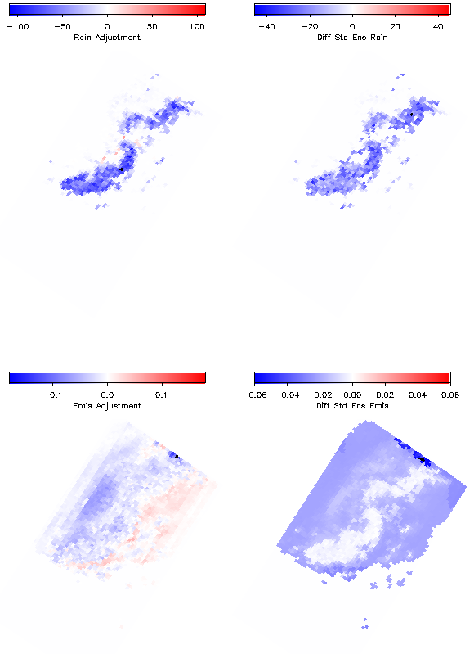
Algorithm mechanics – generate ensemble and covariances, then filter ensemble
+ Ensemble covariances
Initial Ensemble
(Mean and Obs. Error)
Rain adjustment (mean and σ)
Rain-Ku
Rain-10V
Mean Rain
Ku σ₀ error
Emis adjustment (mean and σ)
Rain-Ka
Emis-10V
Mean 18H Emis
18H error

Slide 9
Summary
Land retrieval currently being tested for possible inclusion in PPS Version 4 (late 2015/early 2016 release)
Using GPROF surface classification (14 classes)
Sigma_zero used in addition to PIA
Emissivity retrieval part of output
Impact on precipitation output being evaluated for one month (September 2014)
Future Steps:
Explore alternate land classifications (joint emissivity-sigma_zero classes?)
Evaluate ancillary data for dynamic surface classification
The more tightly we can constrain the surface (without over-constraining it), the better the precipitation signal is represented in the sample covariances in the ensemble filter

