Slide 1
Use of Land Temperatures in GPROF Retrieval Algorithm
Wes Berg
Colorado State University

Slide 2
Algorithm Considerations
Database stratification
Uses SST (Reynolds) and TPW (GANAL/ERA-I) over oceans
Previously used surface temperature and TPW (GANAL/ERA-I) over land
Changed to using 2m temperature and TPW
Consistency issues
Three versions of GPROF are run
Near real-time (uses JMA forecast data)
Standard product (uses GANAL data)
“Climate” product (uses ERA-I data)

Slide 3
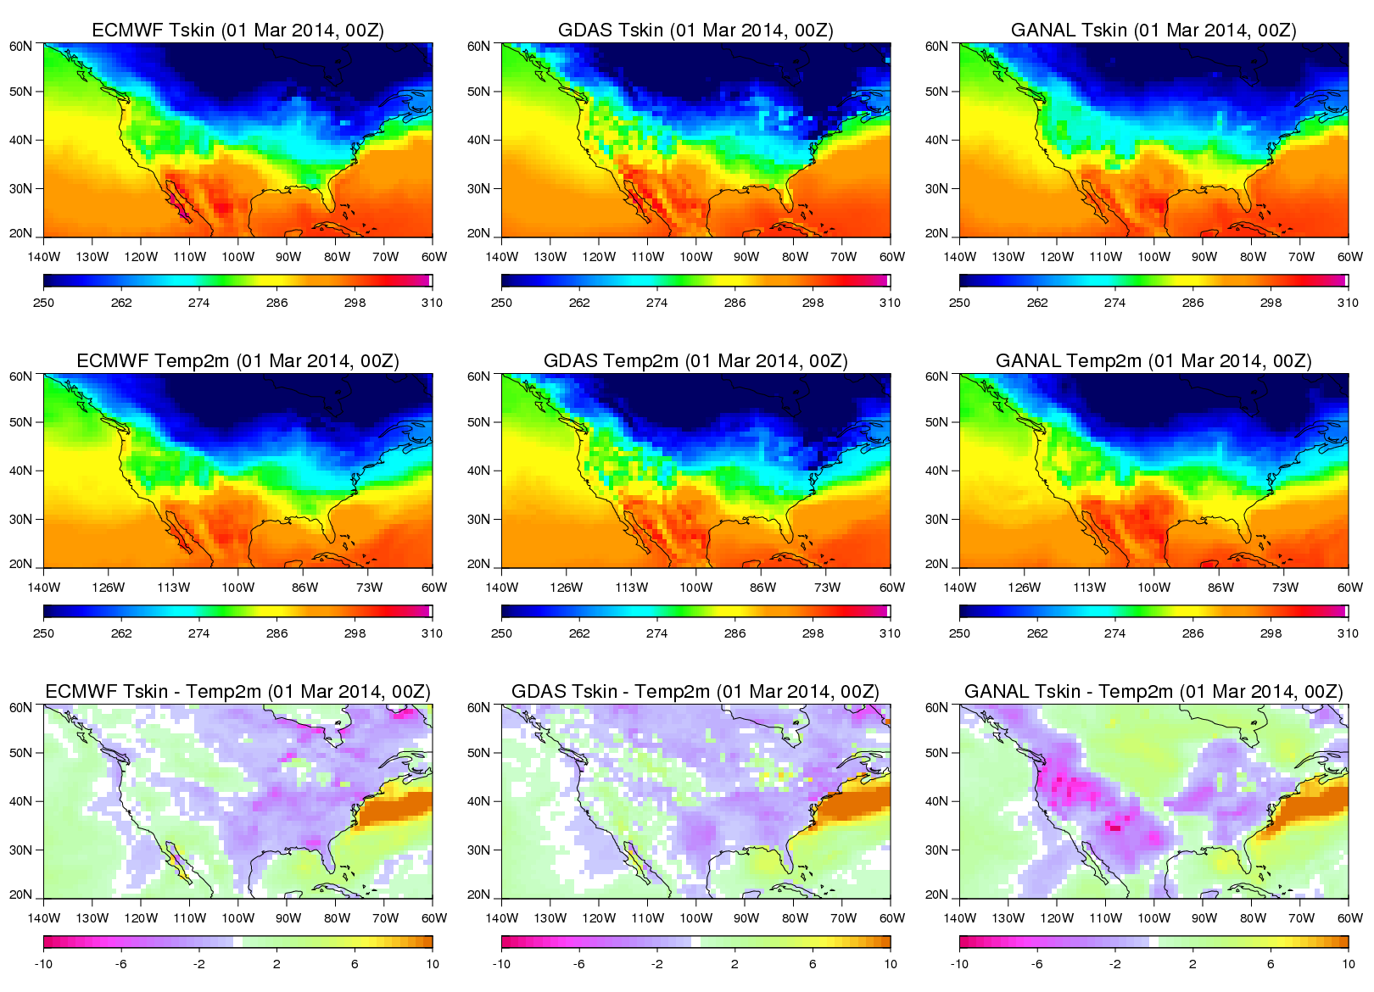

Slide 4
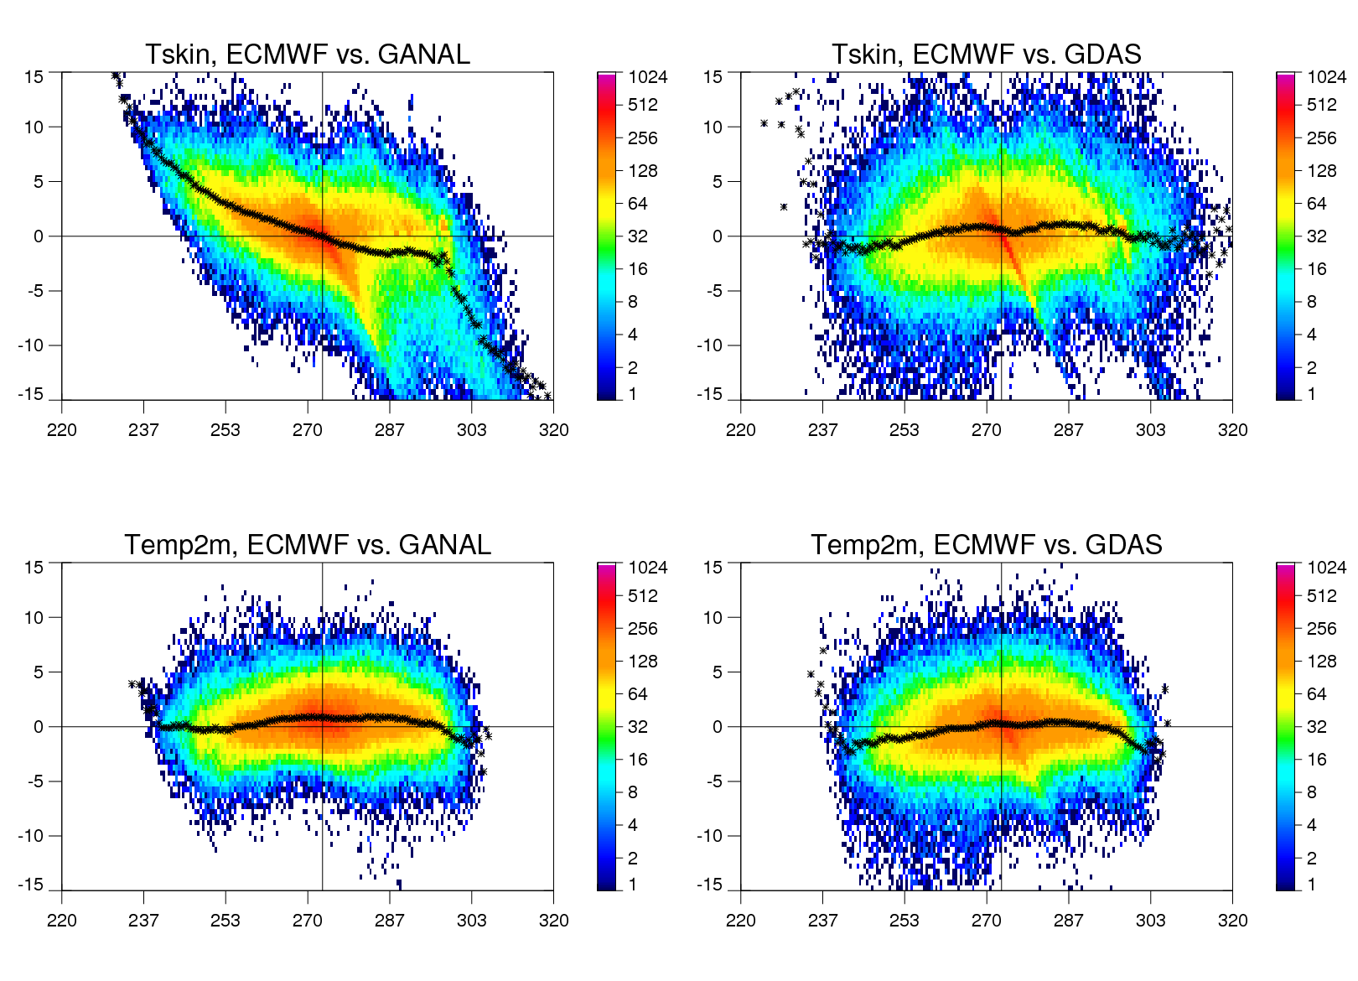

Slide 5
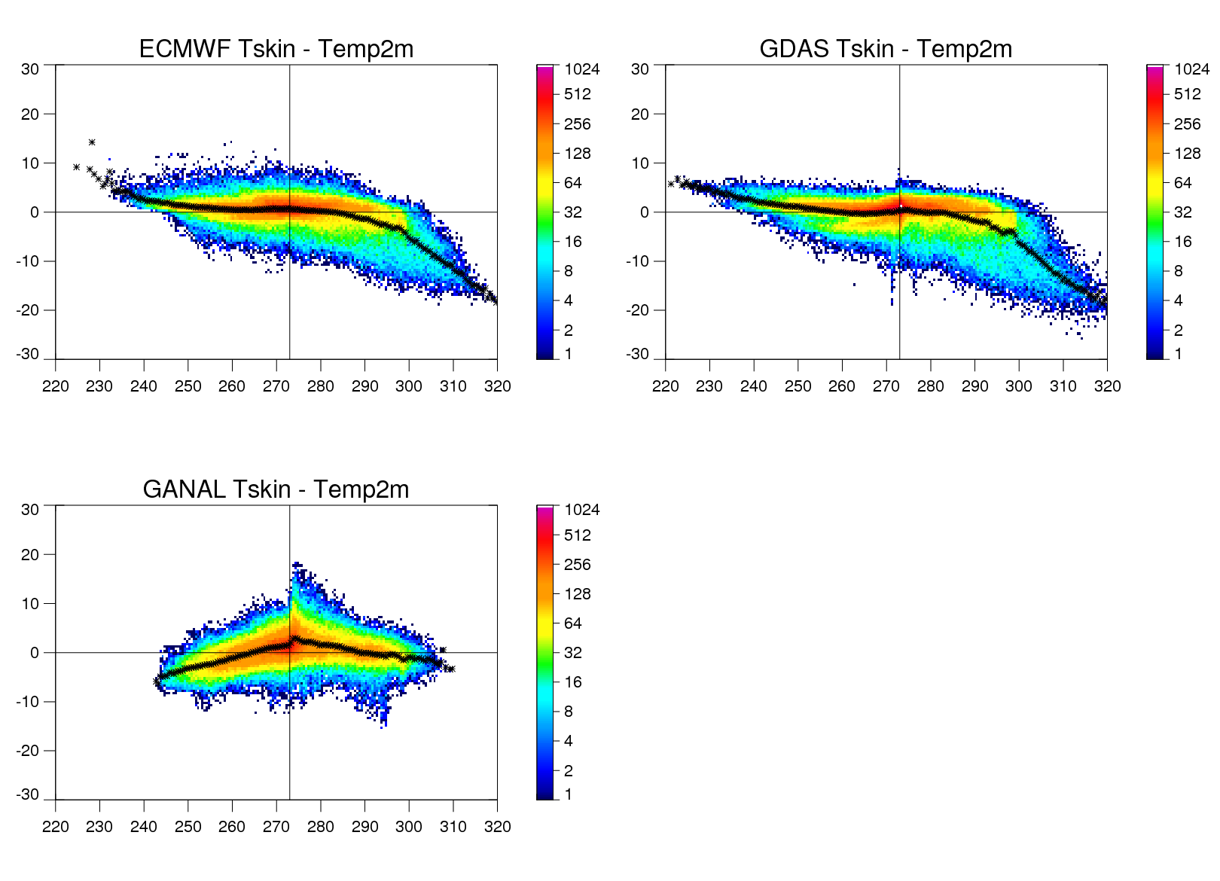

Slide 6
Questions for Discussion
How well does stratifying the database by TPW and 2m temperature help capture regional variability.
Are there known issues with biases in TPW, surface temperature, and/or 2m temperature the global analyses used by the retrieval algorithm?
Are there better, more consistent datasets that could be used?
Are there other variables that might make more sense for stratifying the database over land that are readily available from global analysis or other global data sources?

