Slide 1
Development of a Satellite Passive Microwave Snowfall Detection Algorithm
Cezar Kongoli¹, Huan Meng², Jun Dong¹, Ralph Ferraro²,
¹University of Maryland/ESSIC/Cooperative Institute for Climate and Satellites
²NOAA/National Environmental Satellite, Data, and Information Service

Slide 2
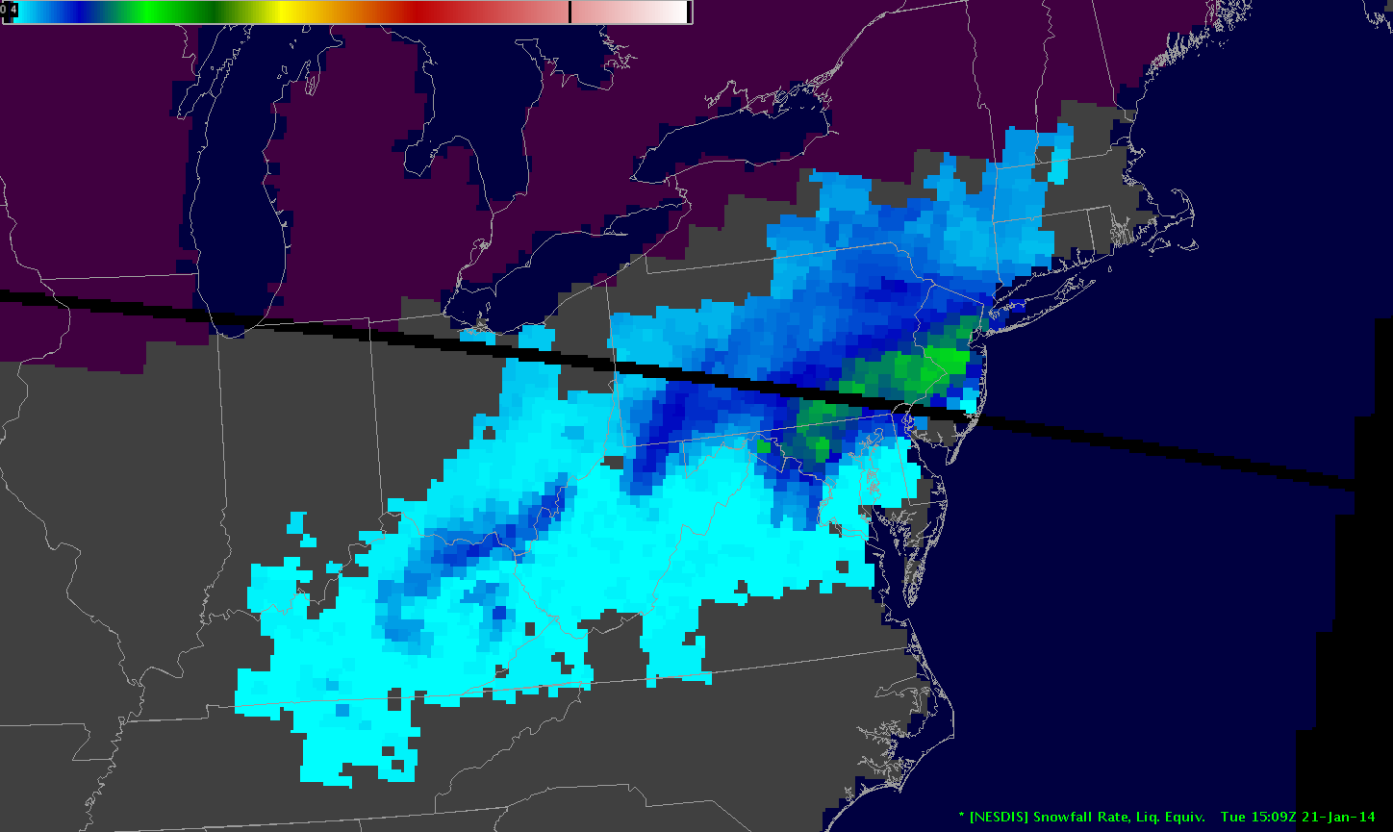
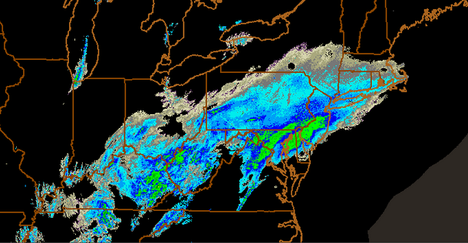
Product Overview
Probability-based Snowfall Detected (SD) area over global land;
Snowfall mask for 1DVAR-based SnowFall Rate (SFR) (Meng et al. 2016, submitted to JGR) generated from AMSU/MHS sensor pair (POES/Metop) and ATMS (S-NPP and the future JPSS satellites);
The five satellites produce up to ten snowfall rate estimates per day at mid-latitudes and more estimates at higher latitudes;
A similar SSMIS-based SD/SFR product is under development.
Retrieved Snowfall Rate
NEXRAD Reflectivity
2

Slide 3
A Brief Historical Perspective (1)
Operational snow cover algorithms from VIS/IR and passive MW have over 40-year history.
Real progress on snowfall determinations began only with the launch of satellites carrying AMSU-A/B/MHS instruments. WHY?
Very difficult to discriminate winter snowfall from no-snowfall clouds or snow on the ground using VIS/IR measurements;
Passive MW measurements at 89 GHz and above are sensitive to snowfall-sized ice particles. WV channels around 180 GHz are even better since WV screens out surface effects.

Slide 4
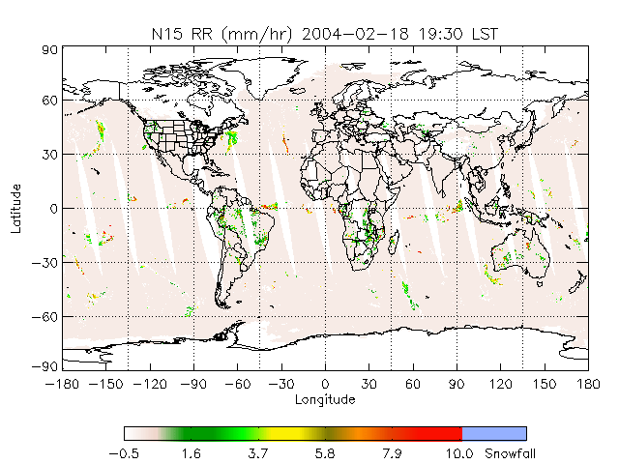
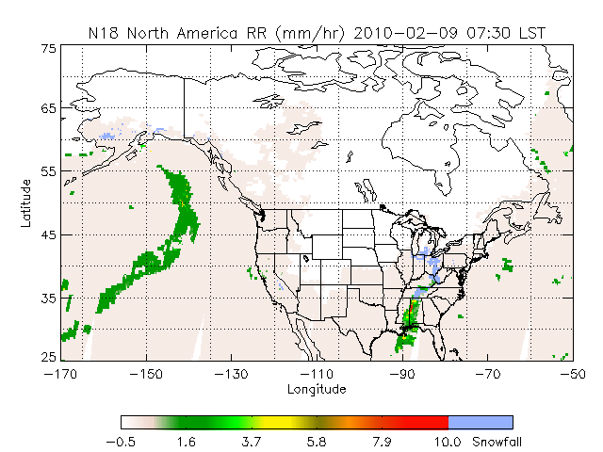
A Brief Historical Perspective (2)
MSPPS AMSU snowfall detection algorithm was the first operational product (Kongoli et al., 2003; Ferraro et al. 2005). Historical MSPPS images available at: http://www.star.nesdis.noaa.gov/corp/scsb/mspps/
A decision tree binary classification with retrievals limited to warmer weather. Colder weather retrievals were found too noisy and removed from the product.

Slide 5
New Snowfall Detection Algorithm
Coupled principal components and logistic regression model (Kongoli et al., 2015);
Input data: 53.6 GHz and all high frequency channels above 89 (MHS) /88.2 GHz (ATMS);
Model output is the probability of snowfall; preset thresholds for snowfall;
Training data sets are composed of matching satellite and ground snowfall observation data;
Snowfall Freq. vs. 2 m RH
Additional filters and screenings to improve the accuracy of snowfall detection.

Slide 6
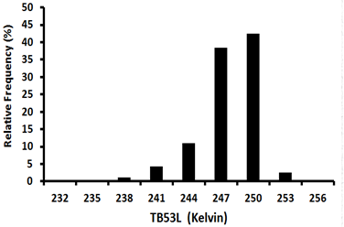
Extension to Cold Regime
Satellite measurements exhibit different characteristics depending on atmospheric conditions:
Scattering signal dominates in relatively warm and moist atmosphere
Emission signal dominates in cold and dry atmosphere (or with abundant supercooled liquid water)
Limb-corrected temperature sounding channel 53.6 GHz (Tb53L) as a proxy for atmospheric temperature
Tb53L is used to define retrieval regimes:
Too warm, no snow (> 252K)
Warm regime (244K ~ 252K)
Cold regime (240K ~ 244K)
Too cold, no retrieval (< 240K)
SD models are trained separately for cold and warm regimes.
Snowfall Freq. vs. Tb53L

Slide 7
Tb53L a strong predictor of near surface temperature
Snowfall
No-Snowfall

Slide 8
Two-Regime Hypothesis
Strong Empirical Evidence: Change of direction in
the correlation between measured SFR and TBs
Variable | SFR (mm/hr)
 | Regime 1 Regime 2
temp | 0.13 | 0.10
hum | 0.06 | 0.10
TB89 | -0.07 | 0.09
TB165 | -0.20 | 0.08
TB176 | -0.23 | 0.06
TB179 | -0.23 | 0.04
TB180 | -0.21 | 0.03
TB181 | -0.17 | 0.03
TB182 | -0.05 | -0.01
TB53L | 0.10 | 0.10

Slide 9
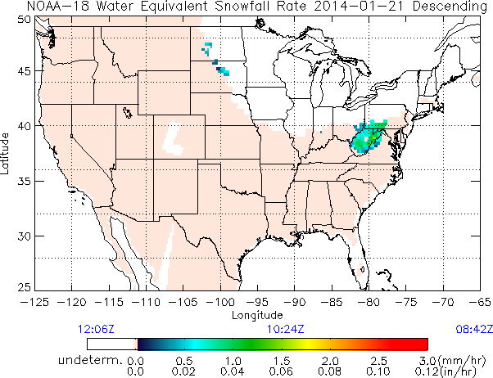
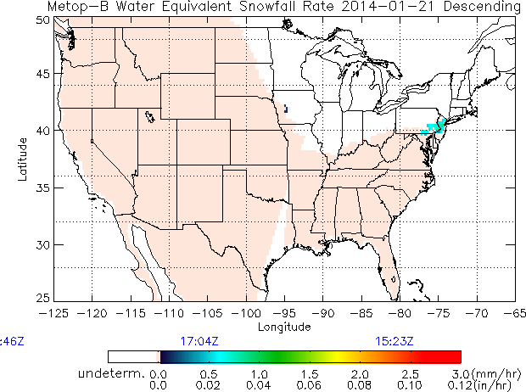
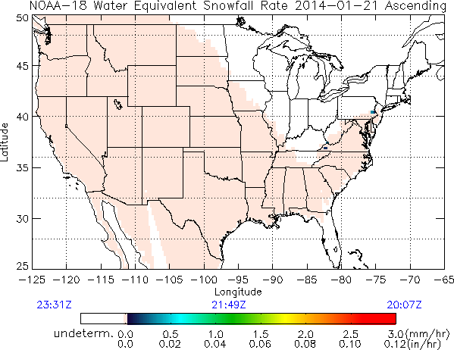
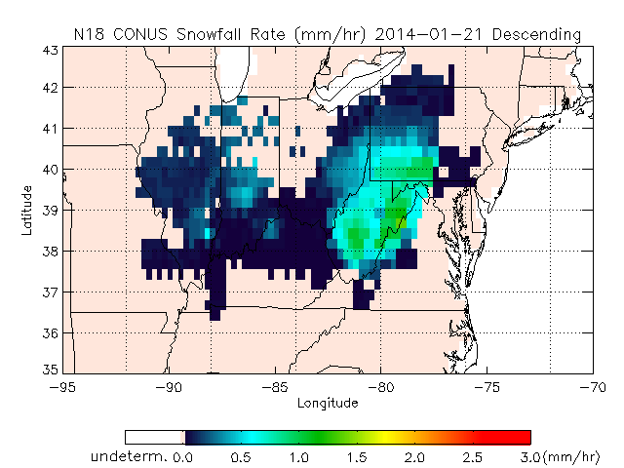
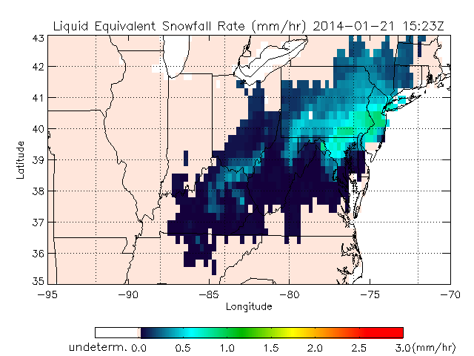
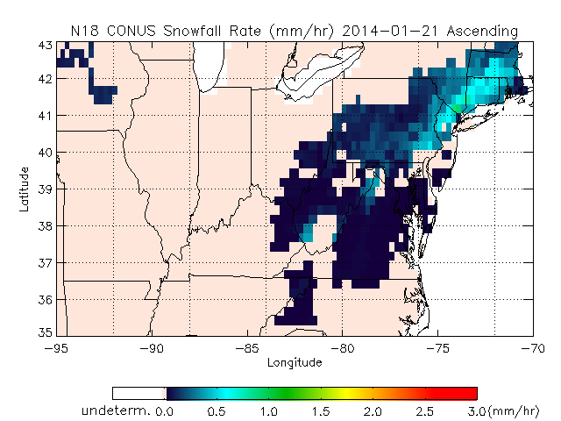
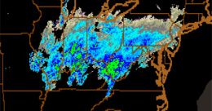
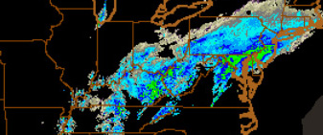
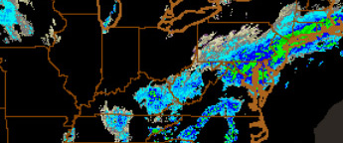
Extension to Cold Regime
Cold regime extension is a new development for ATMS SFR, also applied to the AMSU/MHS algorithm
No Cold Extension
With Cold Extension
Radar Reflectivity

Slide 10
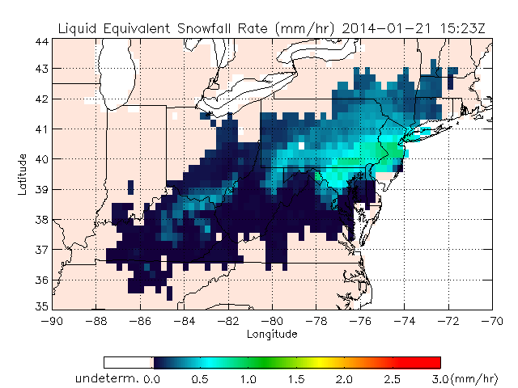
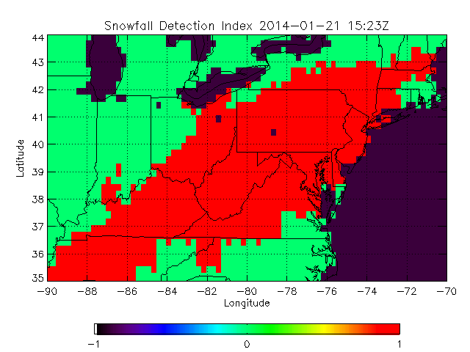
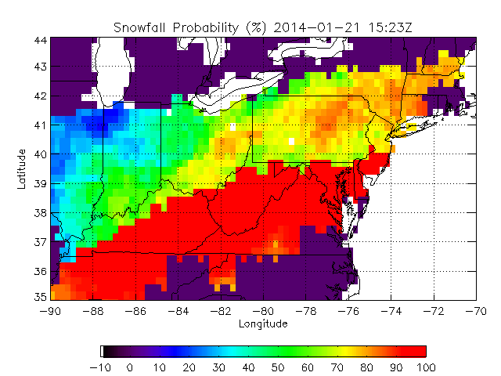
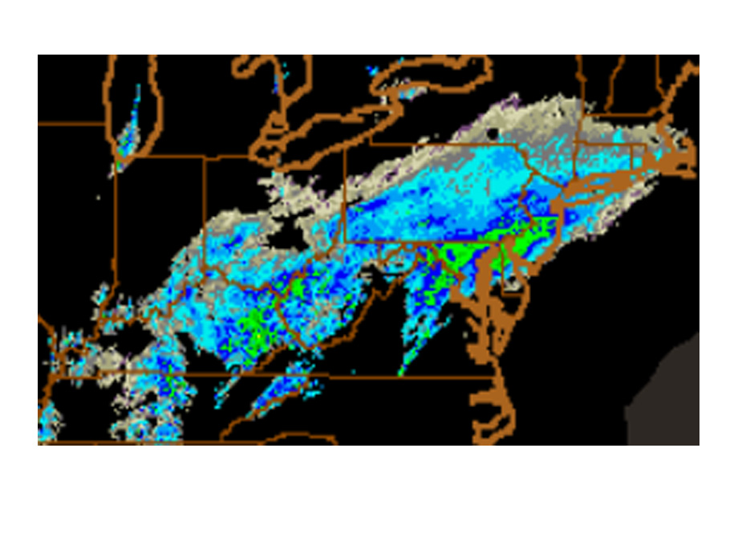
New Snowfall Detection Procedure
SD Procedure
Apply filters and determine snowfall regime;
Run the statistical model to derive snowfall probability;
Compare with probability threshold to obtain Snowfall Detection Index
Apply NWP based screening to derive the final SD ‘product’.
Snowfall Rate
Snowfall Probability
Snowfall Detection Index
NEXRAD Composite Reflectivity

Slide 11
SD Validation (1)
SD algorithm was evaluated with in-situ data as ground truth for snowfall events over CONUS and Alaska that spread out over different regions and time of year;
62% of ground truth data is very light snowfall reported as “trace” – challenging to detect for satellite product;
Evaluation included an investigation of error sources and sensitivity to the probability of snowfall, snowfall intensity, elevation, zenith angle and additional model-based screening.
Statistics:
Probability of Detection (%) | False Alarm Rate (%) | Heidke Skill Score
51 | 9.5 | 0.45

Slide 12
SD Validation (2)
Other Conclusions
SD performance is comparable over high and low elevation areas;
Statistics improve with snowfall rate;
Statistics degrade for shallow to moderate cloud snowfall;
The most effective screening parameters are cloud thickness and relative humidity;

Slide 13
On-going/Future Work
Hybrid weather forecast-satellite snowfall detection model
Probability Logistic Regression model based on Numerical Weather Prediction (NWP) model data;
Coupled Principal Components and Probability Logistic Regression model based on satellite TBs;
Hybrid model: Optimal weighting of both:
Prob_hybrid = W₁*Prob_wea +W₂*Prob_sat
W₁+W₂ = 1

Slide 14
Weather-based Model Statistics
GFS-derived weather variables considered: cloud thickness, relative humidity and vertical velocity at 1,2 and 3 km height, cloud top height and temperature;
1-km relative humidity and cloud thickness the most statistically significant to discriminate snowfall from no-snowfall cases including moderate to shallow-cloud snowfall (cloud thickness less than 3.5 km).

Slide 15
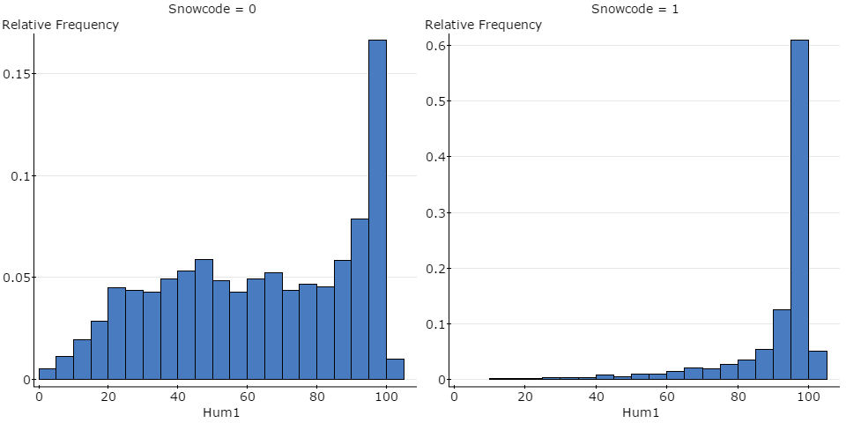
Weather-based model Statistics (2)
No-snowfall
Snowfall
Forecast relative humidity histograms at 1 km height for no-snowfall (left) and snowfall (right) cases. For rel. humidity at and above 90 %, 75% of all snowfall cases are detected with 25% false alarm.

Slide 16
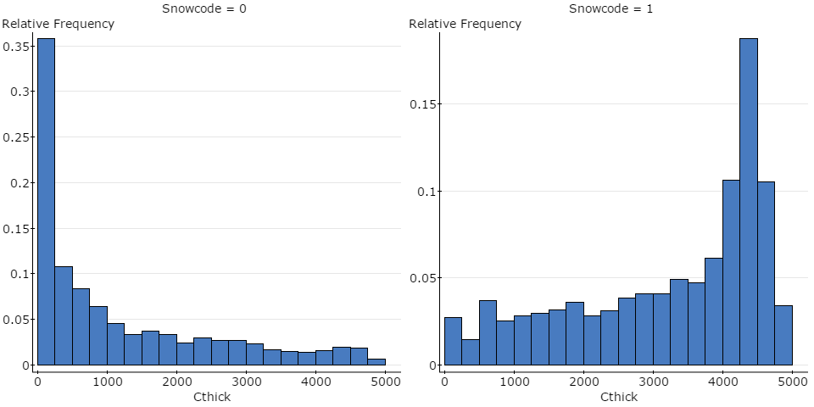
Weather-based Model Statistics (3)
No-snowfall
Snowfall
GFS-derived cloud thickness for no-snowfall (left) and snowfall (right) cases. For cloud height over 3500 m, 55% of all snowfall cases are detected with less than 10% false alarm

Slide 17
Weather-based Model Statistics (4)
Variables in the Equation
 |  | B | S.E. | Wald | df | Sig. | Exp(B)
Step 6ª | Hum1 | .033 | .001 | 1440.086 | 1 | .000 | 1.033
 | Hum3 | -.004 | .001 | 29.394 | 1 | .000 | .996
 | hum | .034 | .001 | 606.497 | 1 | .000 | 1.035
 | V2 | .000 | .000 | 88.362 | 1 | .000 | 1.000
 | V3 | -.001 | .000 | 214.769 | 1 | .000 | .999
 | Cthick | .001 | .000 | 1182.353 | 1 | .000 | 1.001
 | Constant | -6.908 | .131 | 2761.055 | 1 | .000 | .001
Classification Tableª
 | Observed |  | Predicted
 |  |  | Snowcode |  | Percentage Correct
 |  |  | 0 | 1
Step 6 | Snowcode | 0 | 22535 | 4546 | 83.2
 |  | 1 | 4644 | 11777 | 71.7
 | Overall Percentage |  |  |  | 78.9
a. The cut value is .500

Slide 18
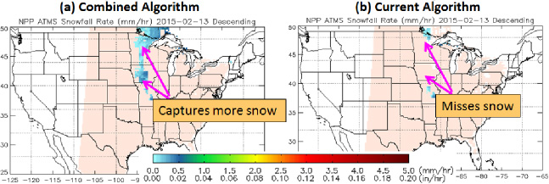
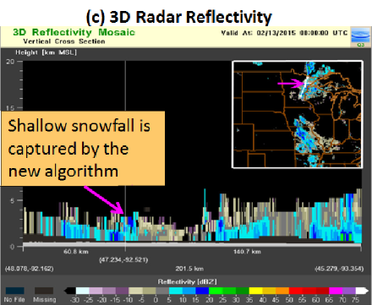
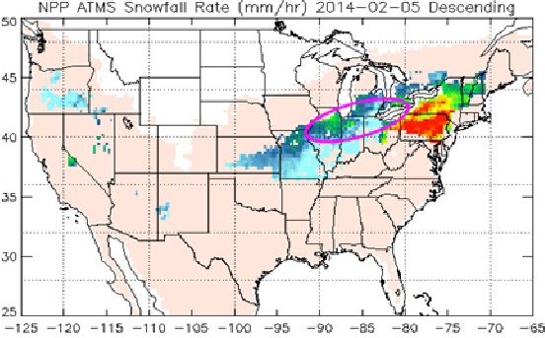
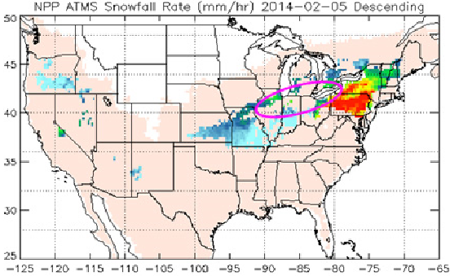
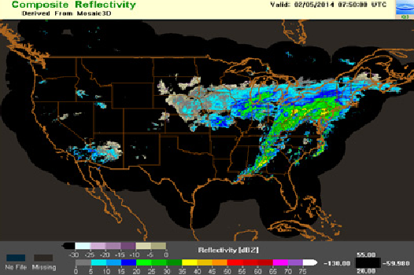
Hybrid Model Application Examples
The blended (0.5:0.5) weather-satellite snowfall detection model for both shallow and thick-cloud snowfall
Shallow-Cloud
Snowfall Case
Deep-Cloud
Snowfall Case
Deep-Cloud
Snowfall Case
Radar Reflectivity

Slide 19
Future Development
Development of SSMIS and GMI algorithms
Development of ocean algorithms

Slide 20
Acknowledgement
JPSS Proving Ground and Risk Reduction Program
NOAA/NESDIS
NASA
Thank You!

