Slide 1
GPM Combined Algorithm: What’s new in V5
Joe Munchak, Bill Olson, Mircea Grecu, and the PPS radar/combined team

Slide 2
Outline
Changes to inputs
Calibration changes
Ancillary data: Now getting snow/ice flag from DPR
Changes in processing
NUBF parameterization
Ice scattering
Surface Emissivity
Changes to outputs
New fields
Use of fields that were “missing” in V4
Evaluation

Slide 3
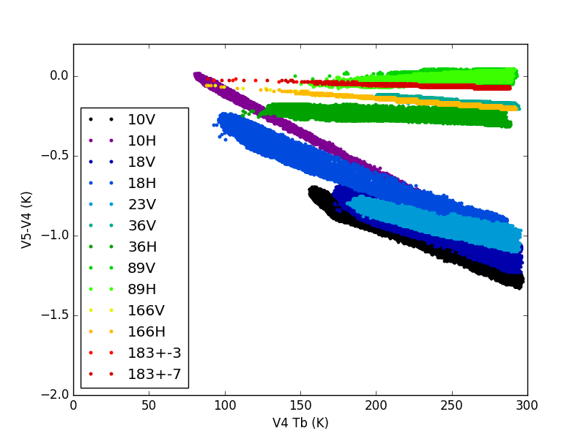
Calibration Changes
GMI
DPR
Relative to V4:
Z_{Ku}’ = Z_{Ku} + 1.1 dB (previously + 1.7 dB)
Z_{Ka}’ = Z_{Ka} + 1.2 dB (previously + 1.2 dB)

Slide 4
Non-uniform beam filling parameterization
V4: NUBF variability depended on ocean/land, convective/stratiform classification
V5: NUBF variability constant for all pixels – but simulated Ka-band PIA is modified according to local variability in SRT PIA:

Slide 5
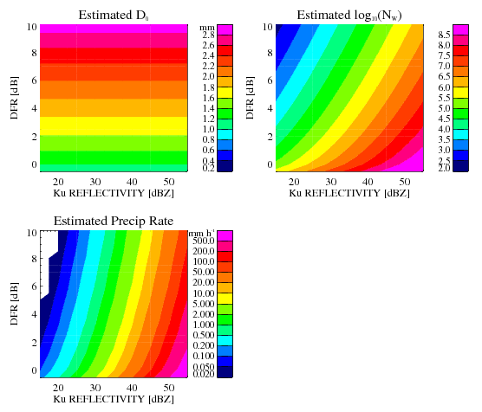
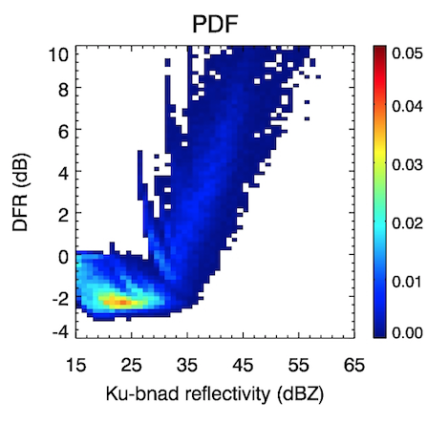
DPR/PR Calibration Impact
These are simple
diagrams showing
the estimated D_{o},
log₁₀(N_{w}), and
R for different
combinations of
DFR and Z_{Ku}. They’re
based on Mie
tables with
= 2.
The pdf of DFR vs.
Z_{Ku} is from Liang
Liao’s disdrometer
analysis (note axes
are slightly
different).
Courtesy of Bill Olson
Notes:
These “estimates” are just diagrams based on the scattering tables for rain with mu = 2. Most of the observed points fall between the lower left and upper right corners of the
diagram.

Slide 6
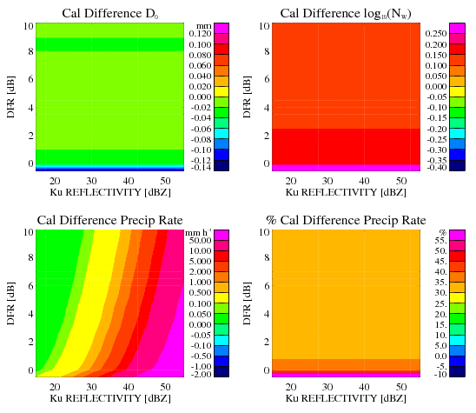
DPR/PR Calibration Impact
New cal revision:
Now we add
+1.1 dB to Z_{Ku}
and +1.2 dB to
Z_{Ka}. At right
are the changes
of D_{o}, log₁₀(N_{w}),
and R, as well as
the % change of
R, plotted as
functions of the
original calibration
DFR and Z_{Ku} values.
Courtesy of Bill Olson
Notes:
Here are the changes in the estimates due to the new calibration change. Note that % increases in rain rates are in the 30-35% range.

Slide 7
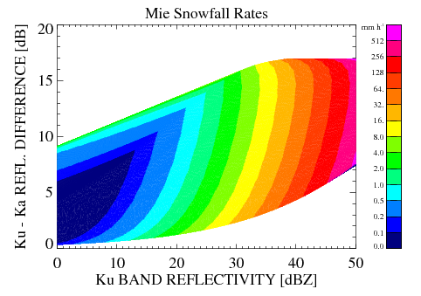
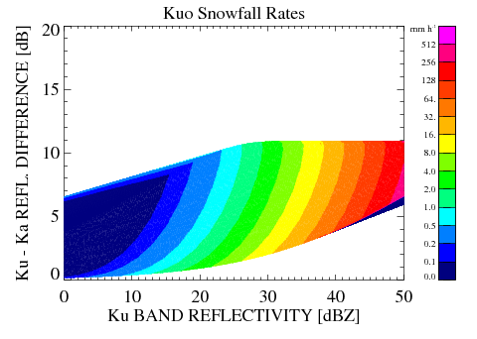
Nonspherical Ice Particle Tables
• Mie is 0.1 g cm⁻³ homogeneous spheres.
• Kuo is average of Kuo’s nonspherical particle database with
new calculations to 5 mm liquid equivalent diamater particles (~20 mm max dim.)
• PSD is normalized gamma distribution with range of N_{w} values (8 x 10⁴ – 8 x 10⁷ m⁻⁴)
and μ = 2.
• please ignore artificial contours at upper left (non-convex region).
• see general decrease in snow rates with nonspherical relative to 0.1 g cm⁻³ spheres.
Courtesy of Bill Olson
Notes:
Generally, Nw’s of decrease, while Dm slightly increase, with nonspherical particles for a given Zku, DFR pair.

Slide 8
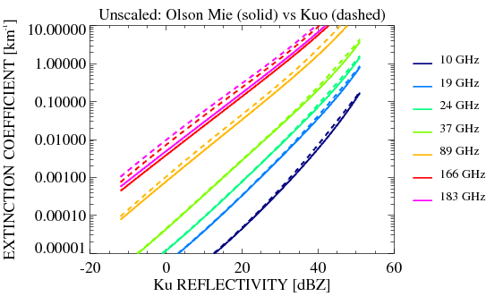
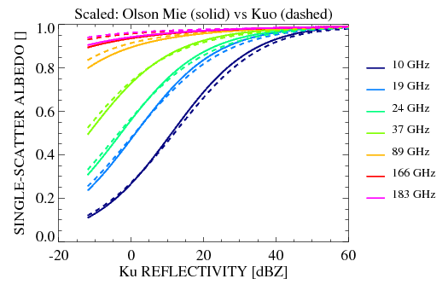
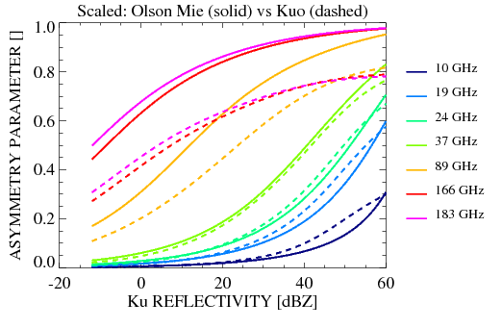
Nonspherical Ice Particle Tables
• solid are Mie snow and dashed are
Kuo nonspherical snow DDA calculations.
• extinction and scattering increase
at higher frequencies with Kuo particles.
• asymmetry parameter is much lower
at higher frequencies with Kuo particles.
=> greater TB scattering signatures.
Courtesy of Bill Olson

Slide 9
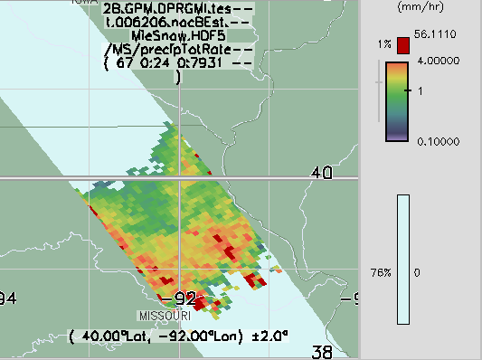
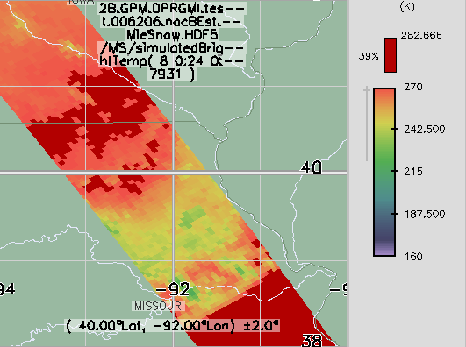
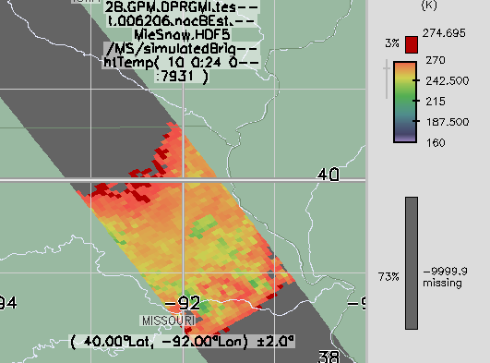
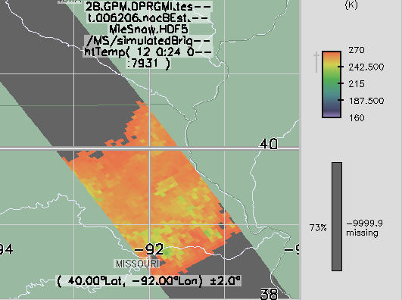
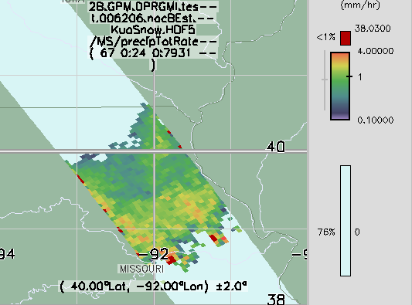
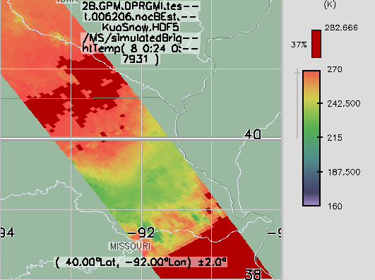
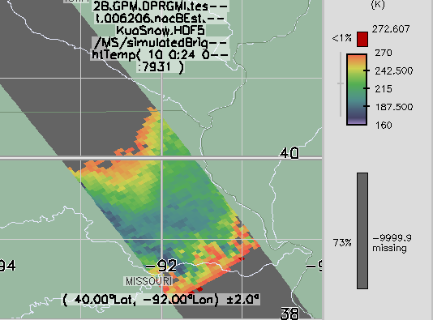
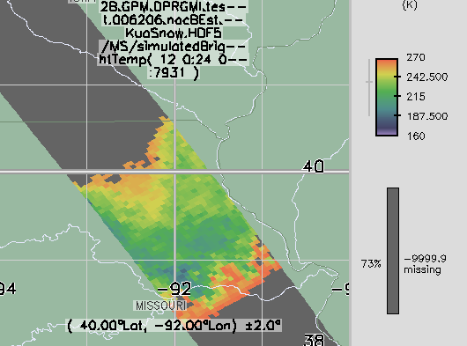
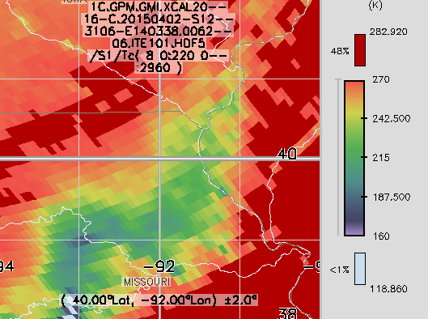
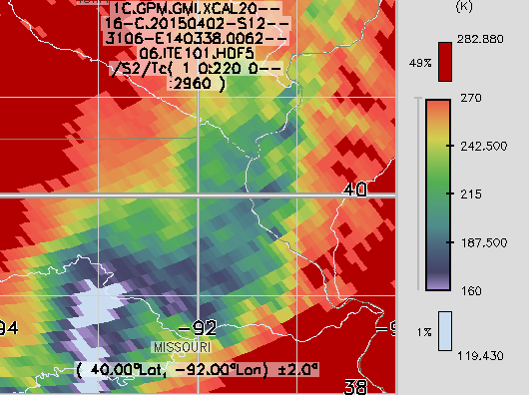
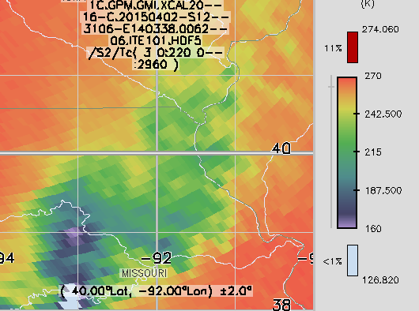
Scattering Table Tests (#6206)
Mie100
P@5km
Mie100
89 GHz
Mie100
166 GHz
Mie100
183+/-7 GHz
KuoSno
P@5km
KuoSno
89 GHz
KuoSno
166 GHz
KuoSno
183+/-7 GHz
1CGMI
89 GHz
1CGMI
166 GHz
1CGMI
183+/-7 GHz
Courtesy of Bill Olson

Slide 10
Surface Emissivity
V4
V5
Ocean: GMI Tbs used to retrieve 10m wind in precipitation areas
Land: TELSEM climatology + random perturbations used for emissivity
Ocean: GMI Tbs and measured σ₀ used to retrieve 10m wind in precipitation areas
Land: GMI-based climatology+covariance with σ₀ used to jointly adjust emissivity in precipitation areas

Slide 11
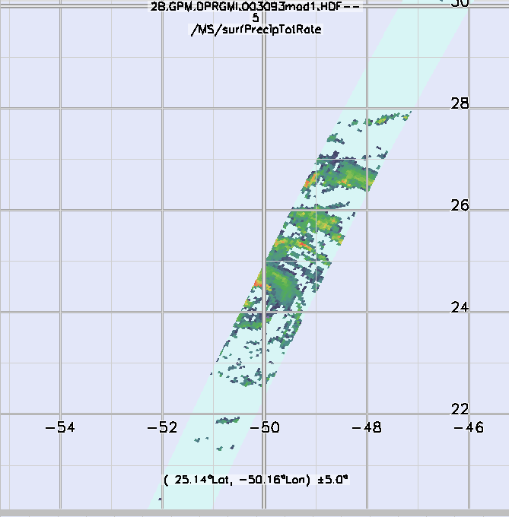
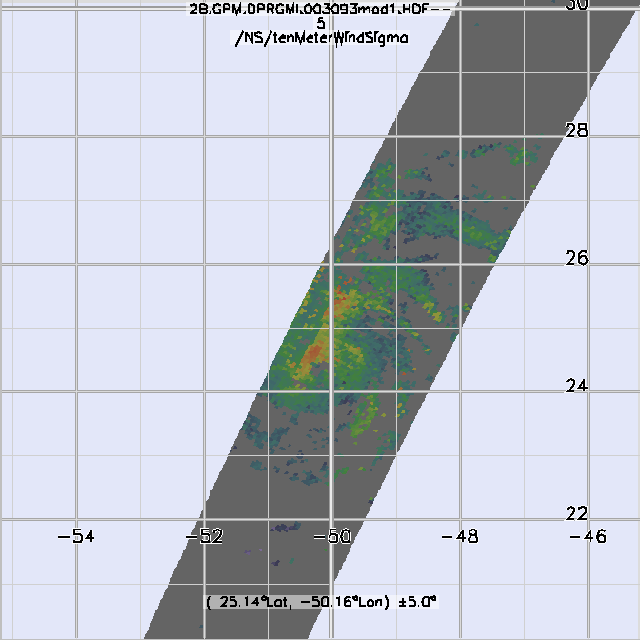
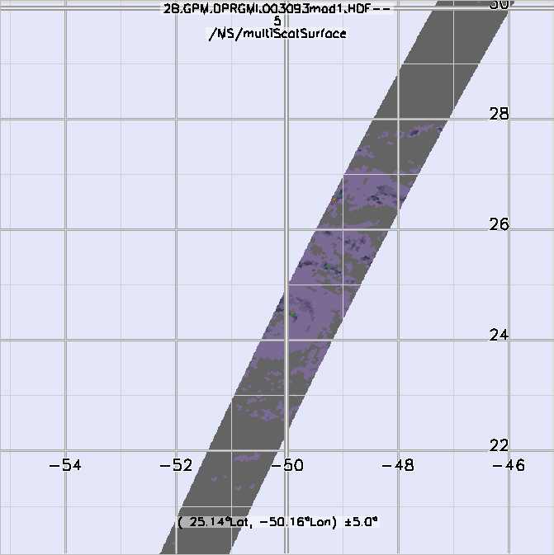
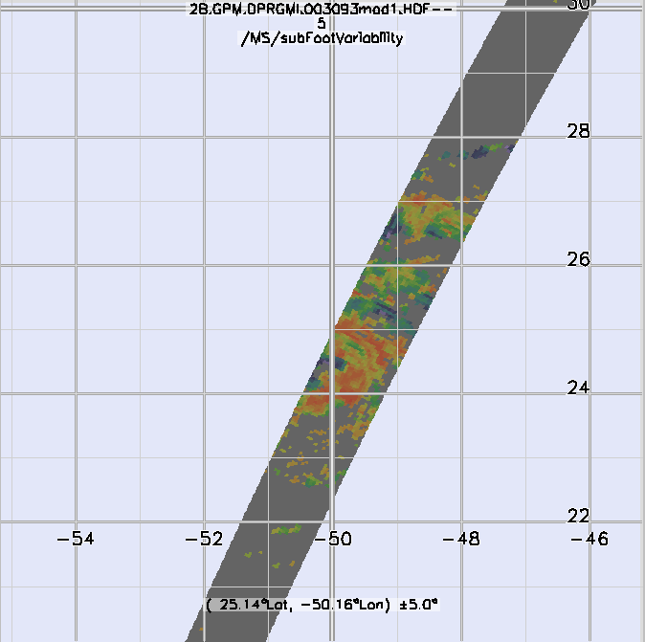
New output fields
multiScatCalc flag
multiScatSurface (MS only)
subFootVariability (MS only)
surfEmissSigma
tenMeterWindSigma

