Slide 1
MHS cross-track retrievals
Western Europe
SE USA
Western Europe: UKMO nimrod surface radar data (15 min/5 km);
Analysis done at 15x15 km resolution
USA: GV-MRMS surface radar (2 min/0.01x0.01 deg);
Analysis done at 15 x 15 km

Slide 2
MHS databases
03
04
05
06
10
11
12
13
MeanRR/bin
H.Vege
Mod.L.Snow
MHS database is derived from the GMI database through the transfer-modelling of the Tbs.
The databases use the same surface categories as the GMI, but has three (equal) scan positions.
Channel weightings are derived/ extrapolated from the GMI channel weightings.
BUT: database is not necessary ‘consistent’
Mod.H.Vege
L.Snow
Mod.Vege
St.Water
Mod.L.Vege
Coastal
tcwv
T2m

Slide 3
01
02
03
04
05
06
07
pos#1
pos#2
pos#3
08
09
10
11
12
13
14
01
02
03
04
05
06
07
08
09
10
11
12
13
14
01
02
03
04
05
06
07
08
09
10
11
12
13
14

Slide 4
01
02
03
04
05
06
07
pos#1
pos#2
pos#3
08
09
10
11
12
13
14
01
02
03
04
05
06
07
08
09
10
11
12
13
14
01
02
03
04
05
06
07
08
09
10
11
12
13
14

Slide 5
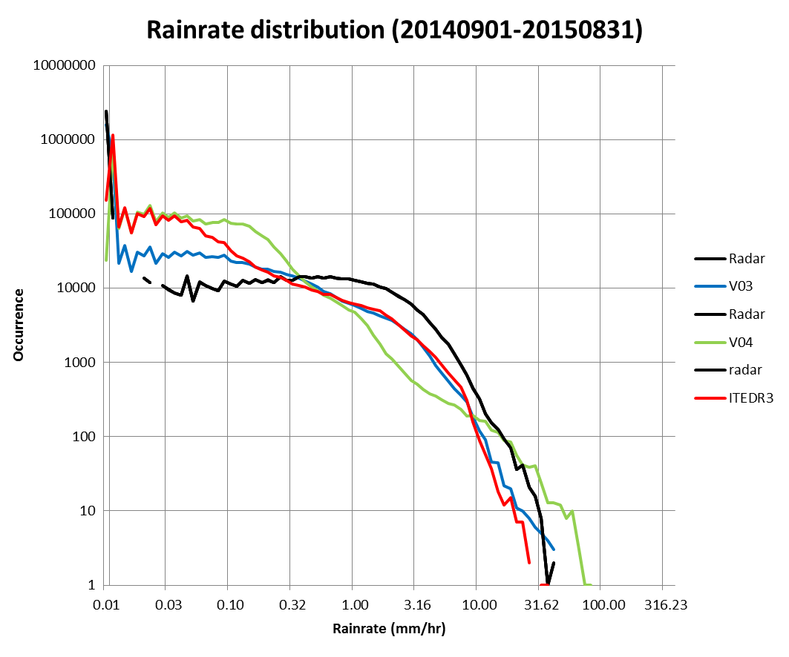
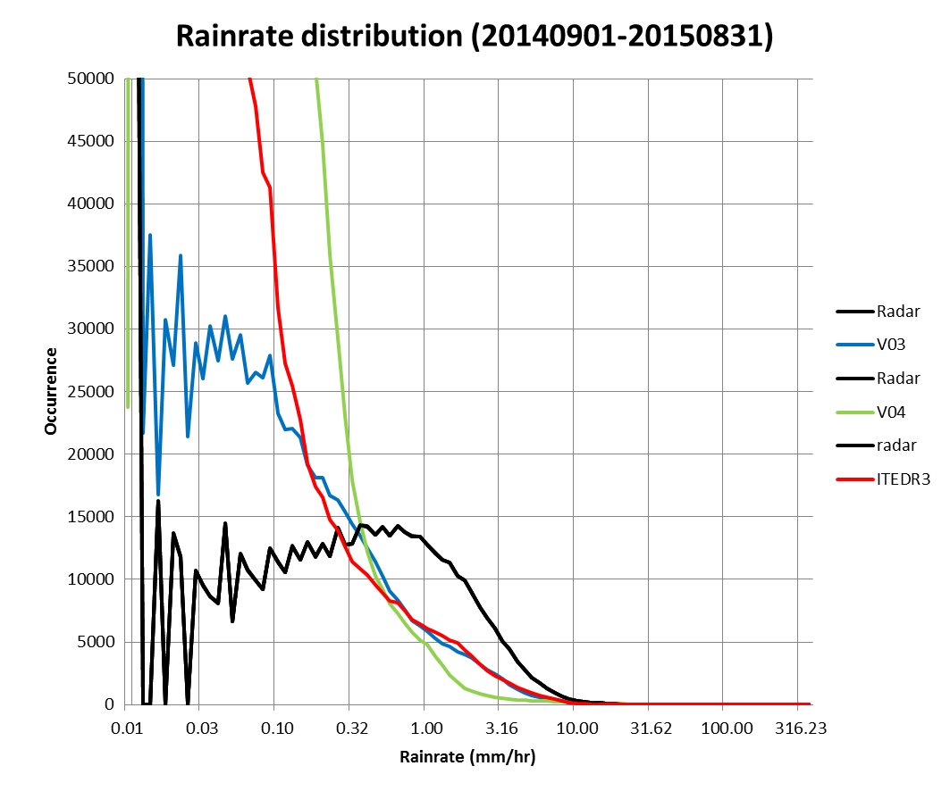
Western Europe
Occurrence by rain rate: log/log scale left, linear/log scale right
‘ITEDR3’ generally similar to V03, and better than V04, although all underestimate precipitation above about 0.5 mm/hr

Slide 6
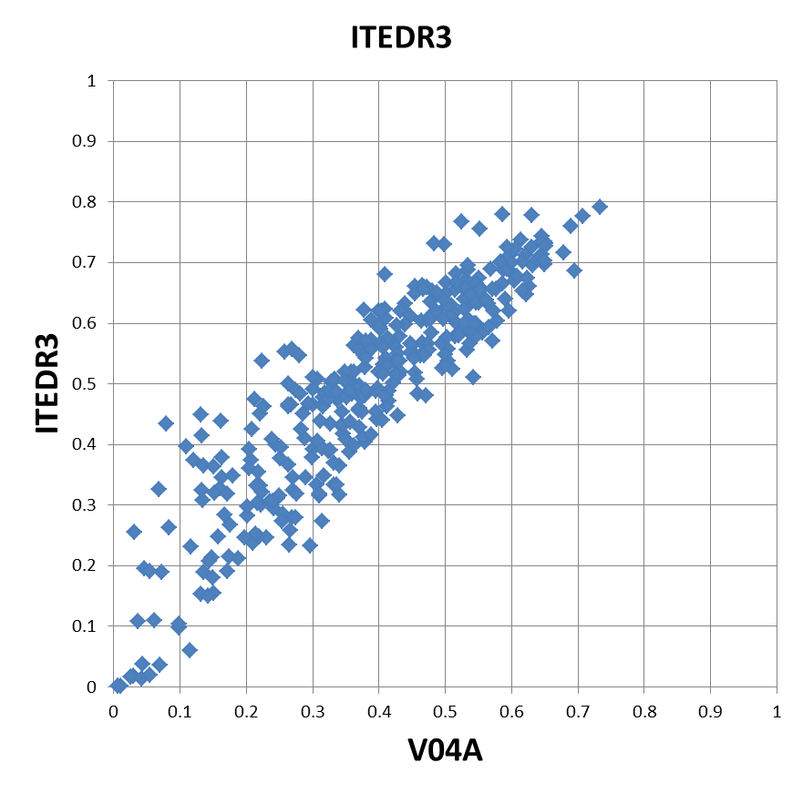
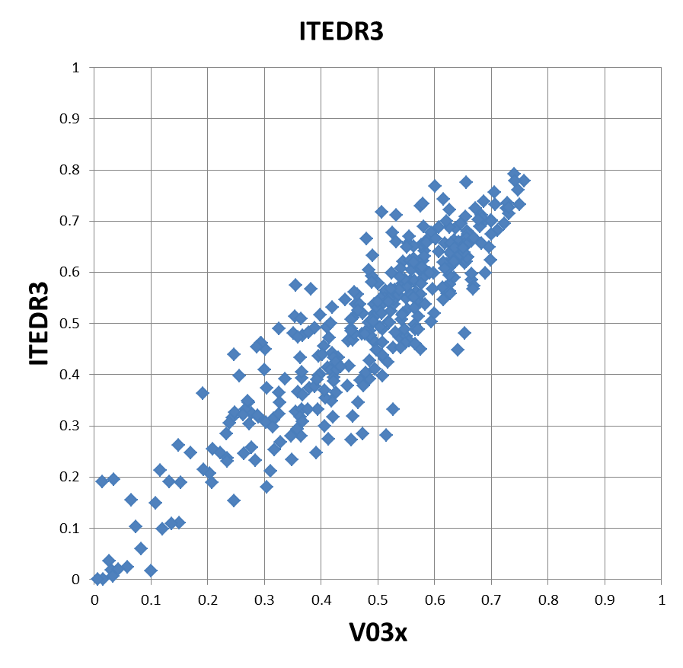
MHS: V03/V04/V05 Correlations (EU)
V05 (aka ITEDR3) has much better correlations than V04
V05 (aka ITEDR3) has generally similar correlations to V03

Slide 7
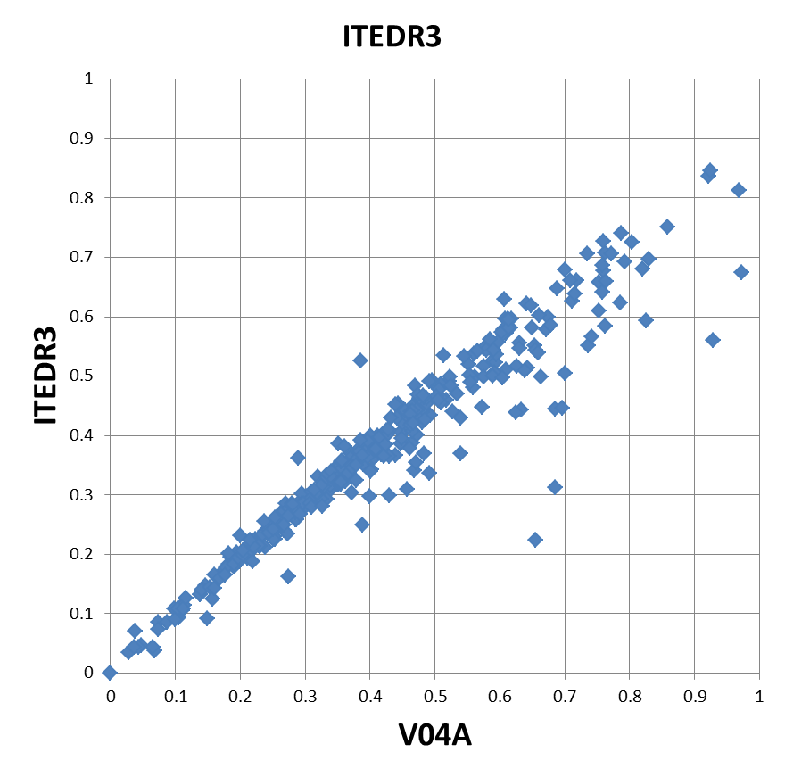
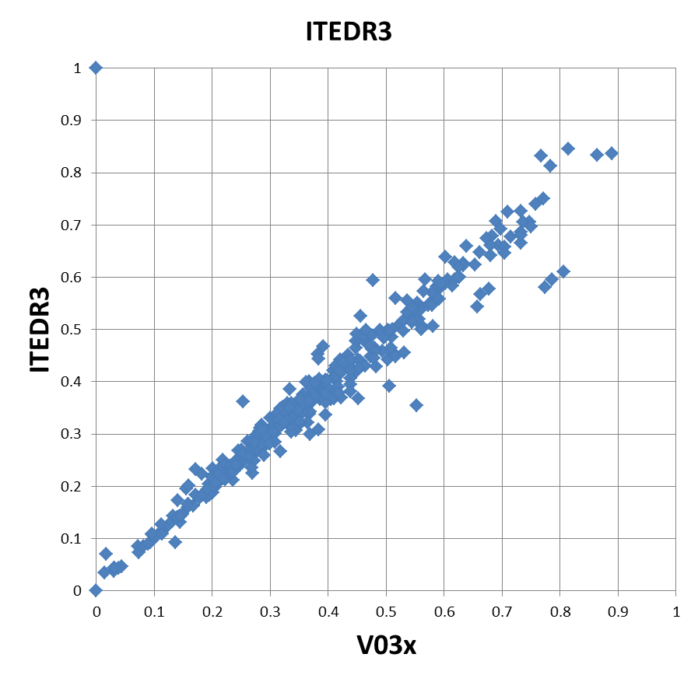
MHS: V03/V04/V05 RMSE (EU)
V05 (aka ITEDR3) has generally lower RMSE than V04
V05 (aka ITEDR3) has generally similar RMSE to V03

Slide 8
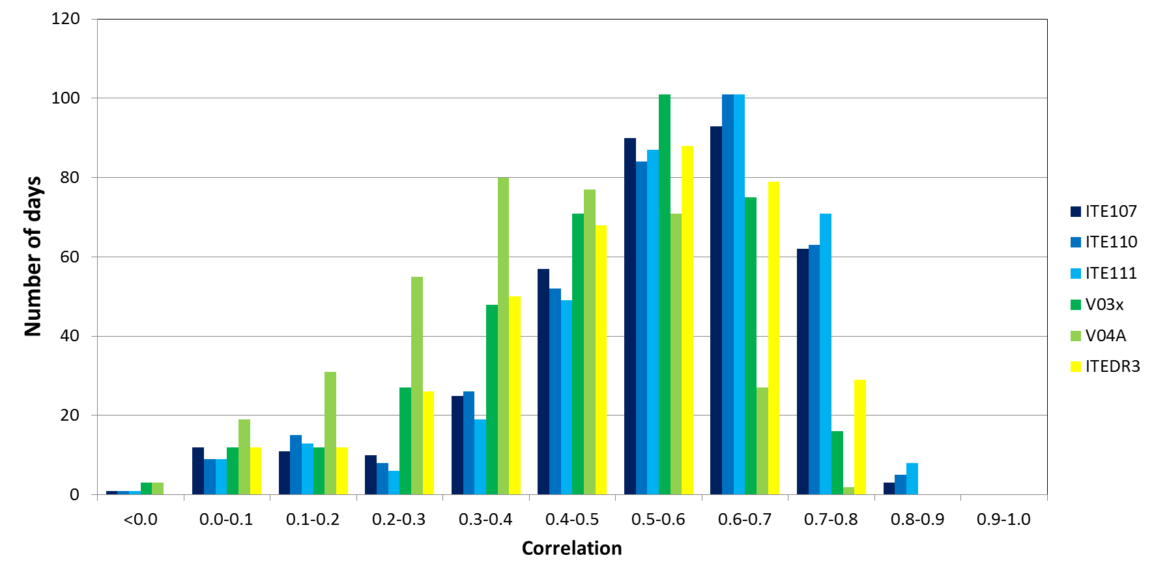
Daily Instantaneous Correlations (EU)
ITE107/110/111 are GMI, others are NOAA18 MHS

Slide 9
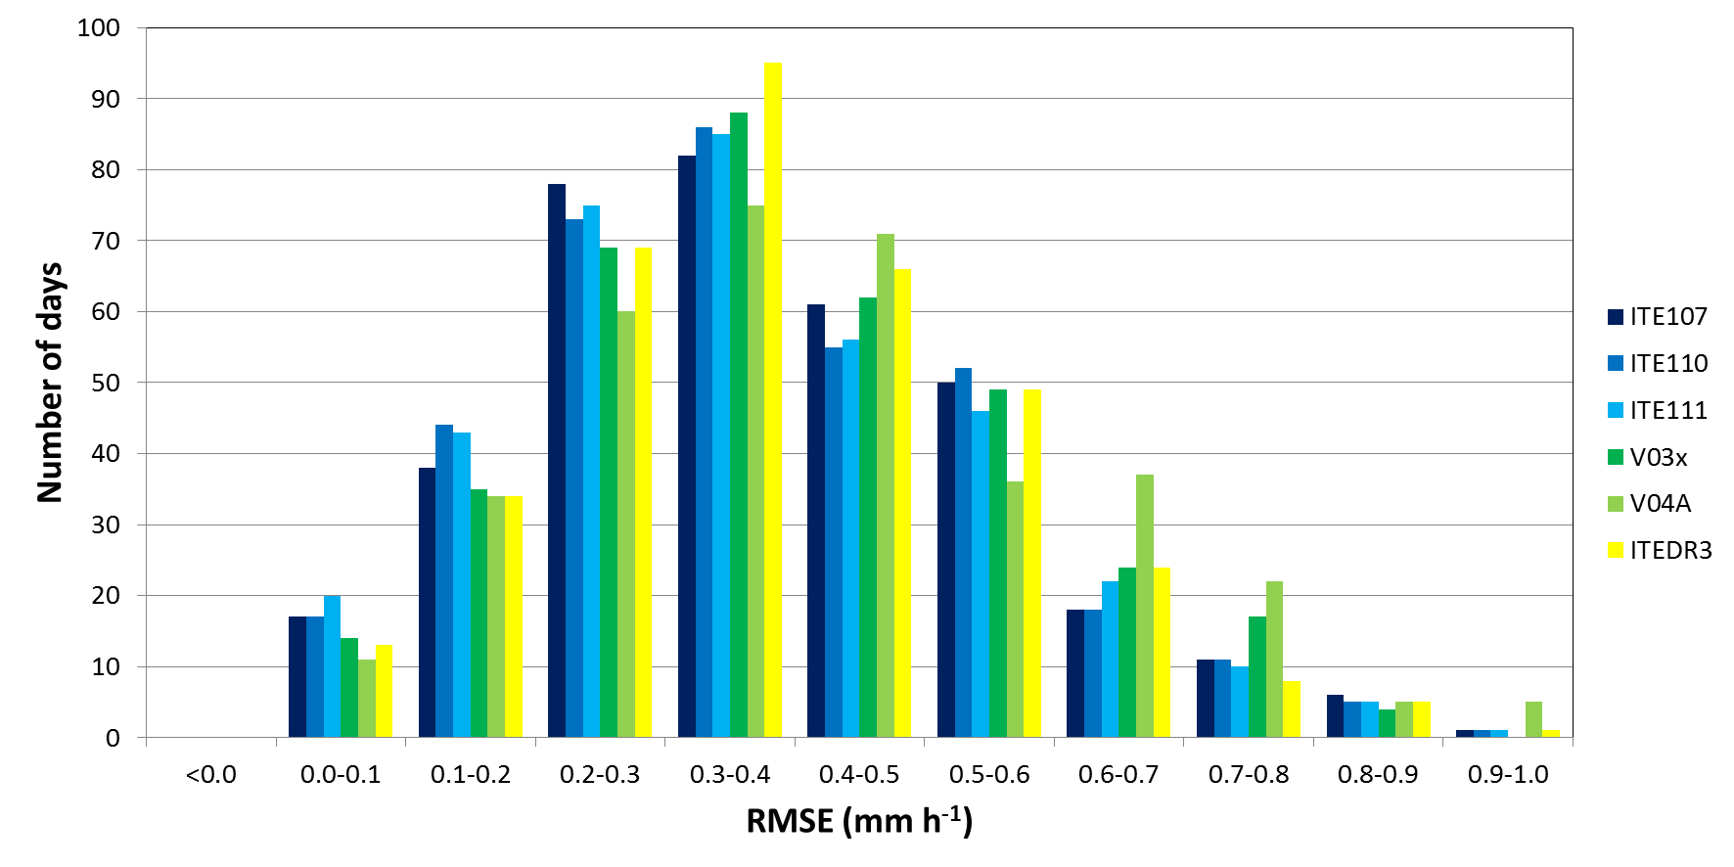
Daily instantaneous RMSEs (EU)
ITE107/110/111 are GMI, others are NOAA18 MHS

Slide 10
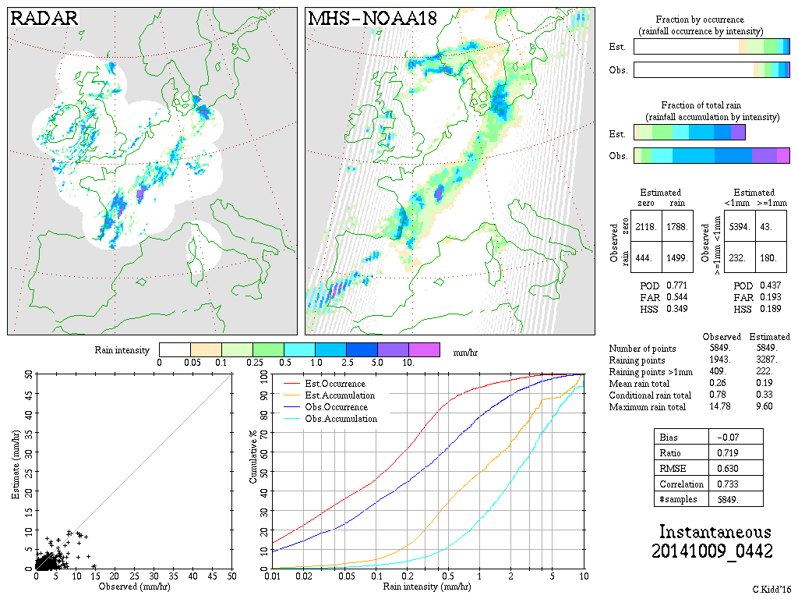
NOAA18-MHS V03B

Slide 11
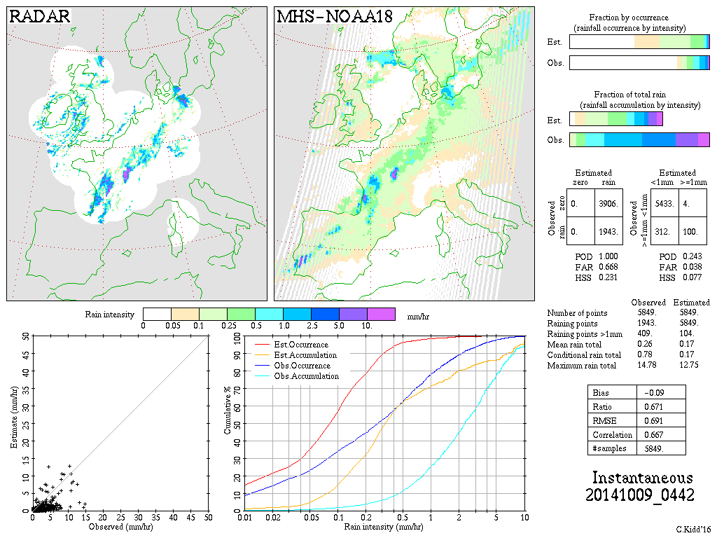
NOAA18-MHS V04A

Slide 12
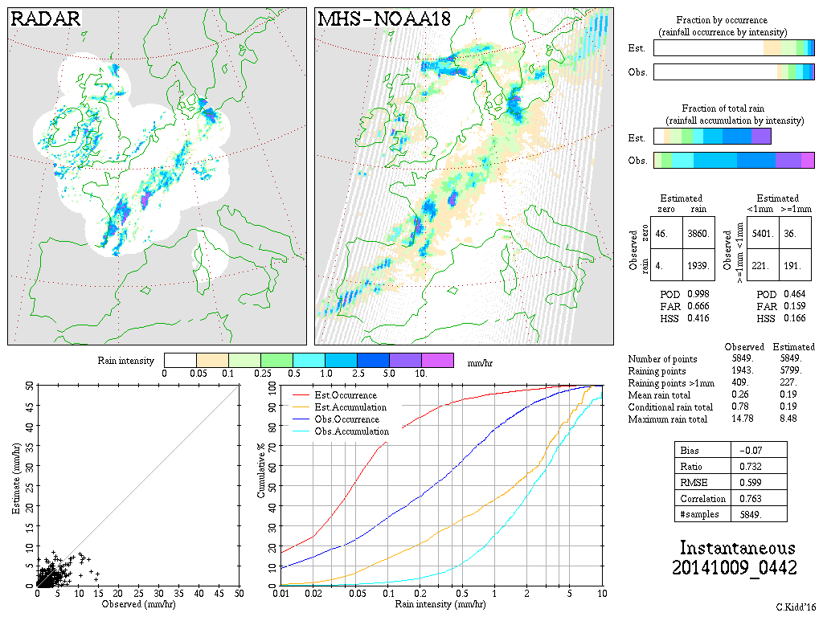
NOAA18-MHS ITEDR3

Slide 13
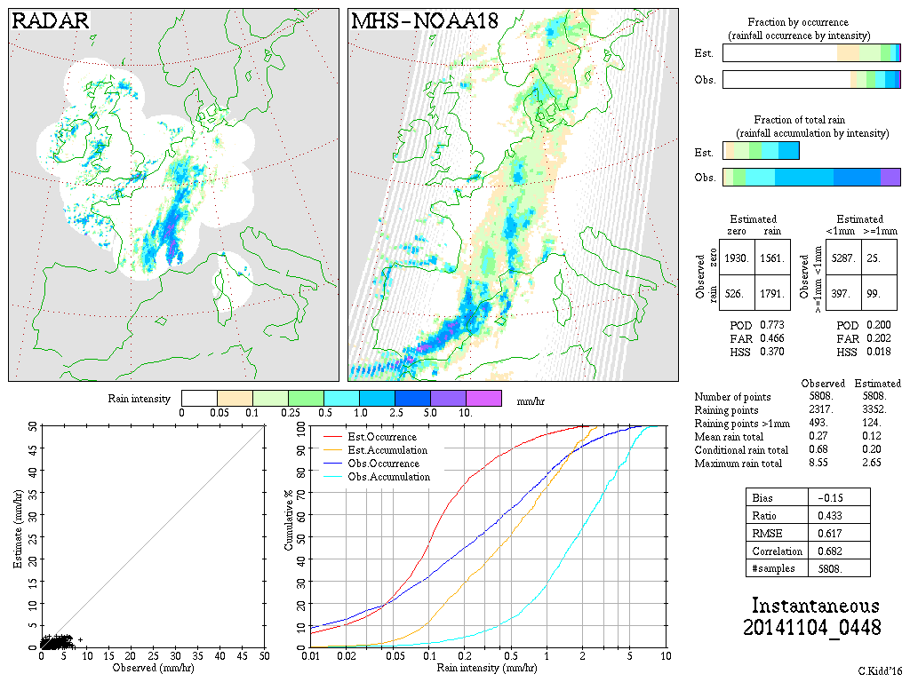
NOAA18-MHS V03B

Slide 14
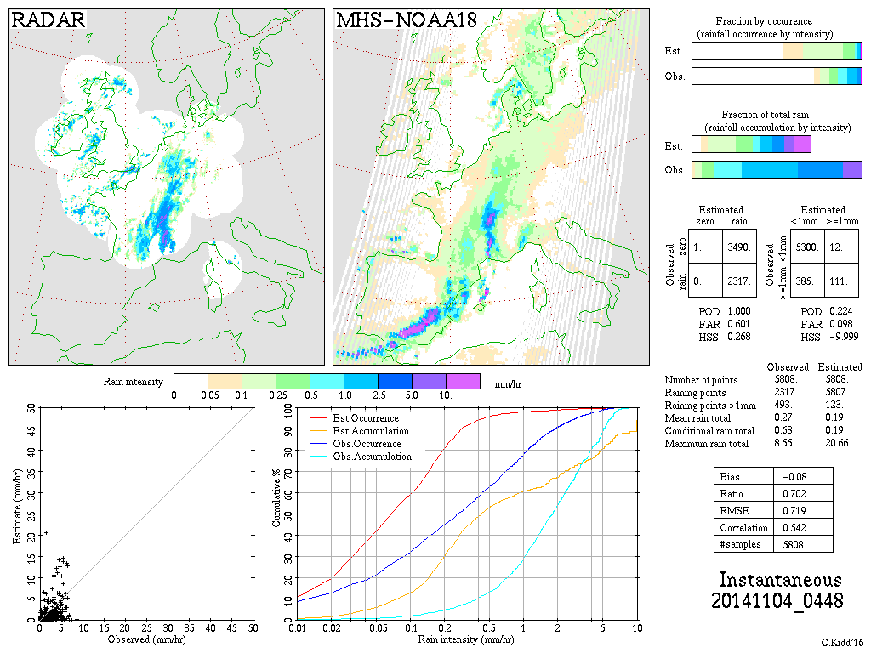
NOAA18-MHS V04A

Slide 15
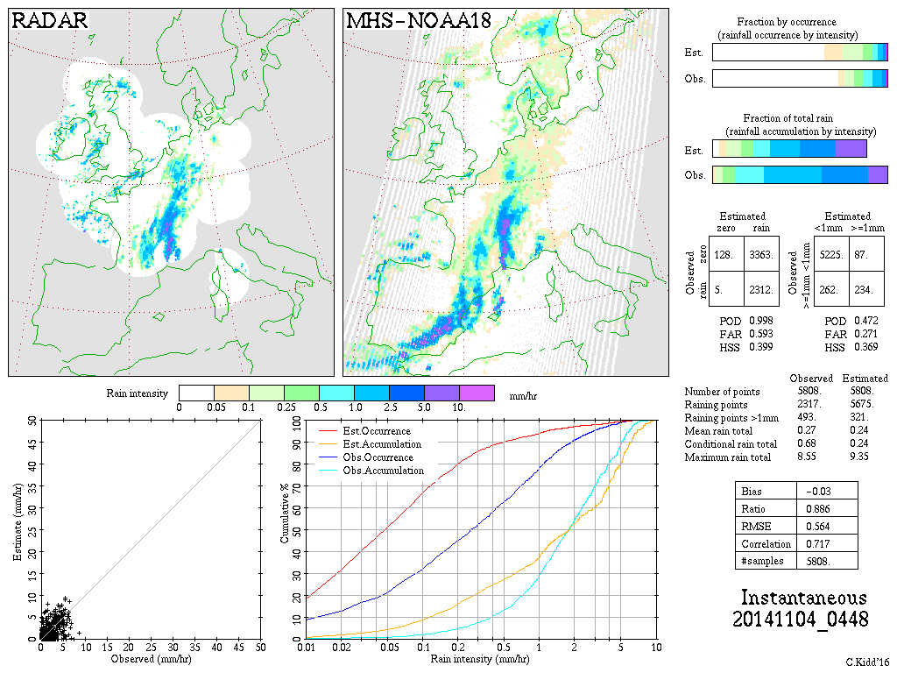
NOAA18-MHS ITEDR3

Slide 16
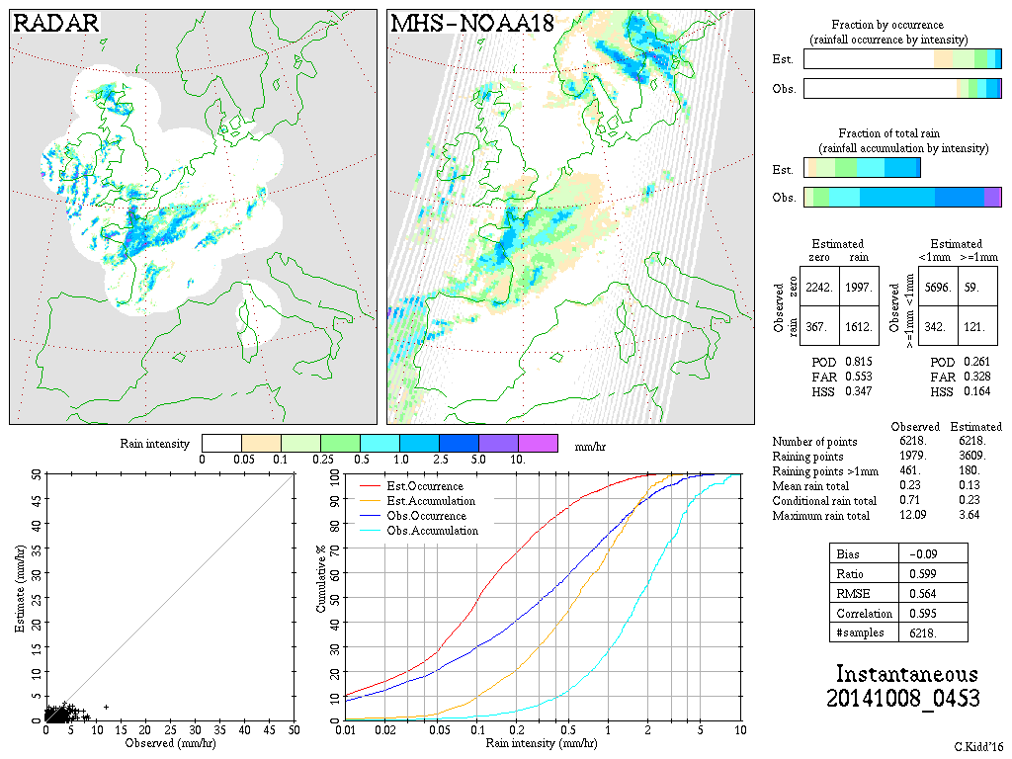
NOAA18-MHS V03B

Slide 17
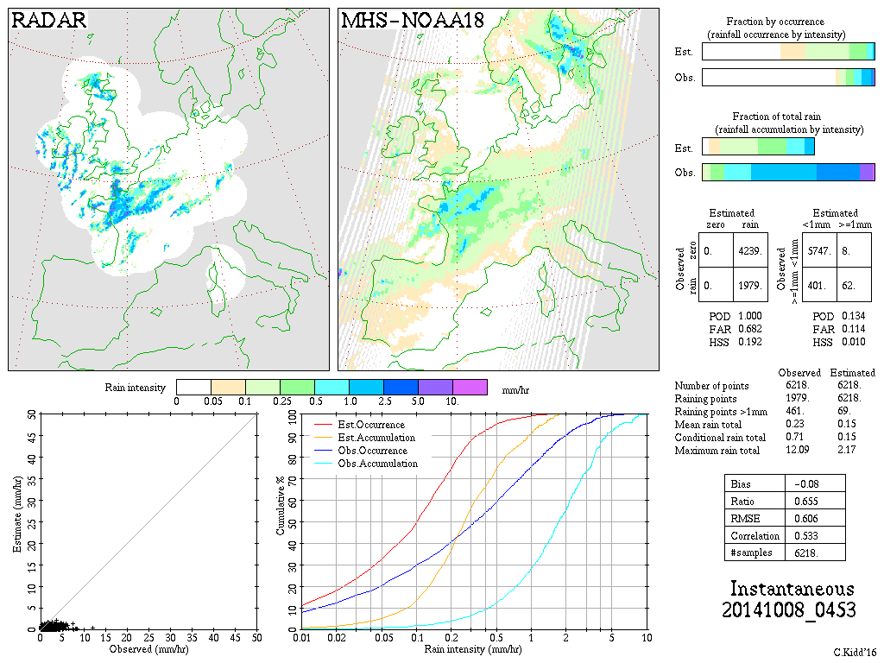
NOAA18-MHS V04A

Slide 18
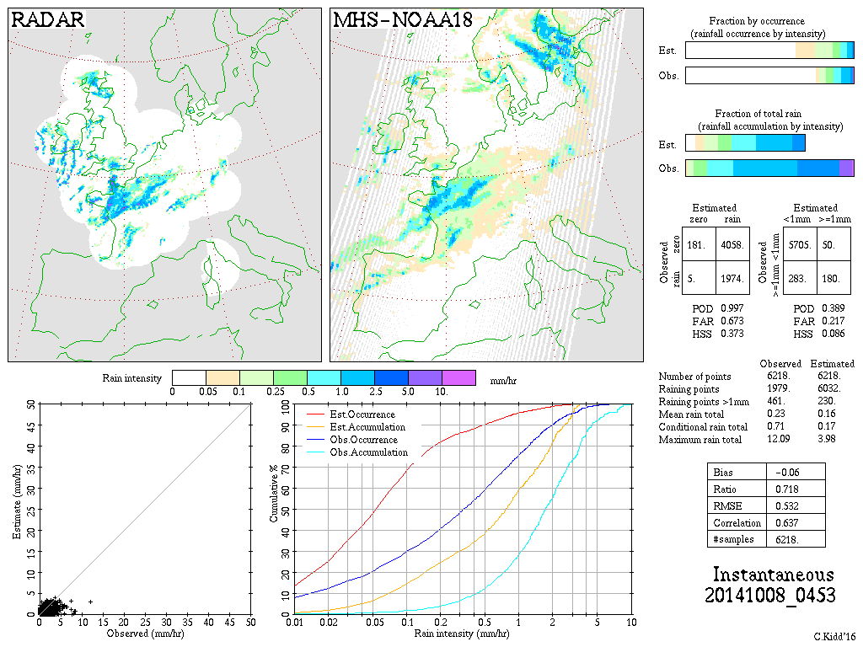
NOAA18-MHS ITEDR3

Slide 19
MHS (V05) ITE114
Performance of MHS V05 is essentially the same as that of V03; V05:
has 3 equally-spaced scan position divisions (note – not equal-spaced EIA)
has databases that are derived from the GMI and ‘corrected’ for scan angle, resolution and frequency
has 14 surface types
(V03 had a single MMF model-generated database for all scan positions and all surface types)

