Slide 1
The Precipitation Retrieval and Profiling Scheme (PRPS)
Chris Kidd UMD-ESSIC/NASA-GSFC
Kidd, C. 2017: last updated 2018: GPROF CNES/ISRO Megha-Tropiques SAPHIR radiometer Precipitation Retrieval and Profiling Scheme, Level 2A precipitation product. NASA/GSFC, Greenbelt, MD, USA. doi=10.5067/GPM/SAPHIR/MT1/PRPS/2A/05

Slide 2
Rationale
Sounders now provide the majority of passive microwave sensors with better resolution, particularly at nadir and often at nadir too;
PRPS is designed to best utilise satellite observations, with no reliance upon dynamic ancillary data;
But challenges due to cross-track nature of the sensors, leading to variable Earth Incidence Angle, resulting in variable resolution, variable atmospheric path length and variable atmospheric profile weightings.
However – concentrate upon the main issues first, starting with the SAPHIR instrument.

Slide 3
GPM Constellation
resolutions > imagers

Slide 4
Sondeur Atmosphérique du Profil d'Humidité Intertropicale par Radiométrie (SAPHIR)
on Megha-Tropiques - low inclination ;
X-track sensor, 182 scan positions, 1700 km swath;
6 channels around 183.31 GHz;
10 km sampling (fovs from c.7x7 km).
Revisit
Limited surface
Hi-res

Slide 5
SAPHIR characteristics

Slide 6
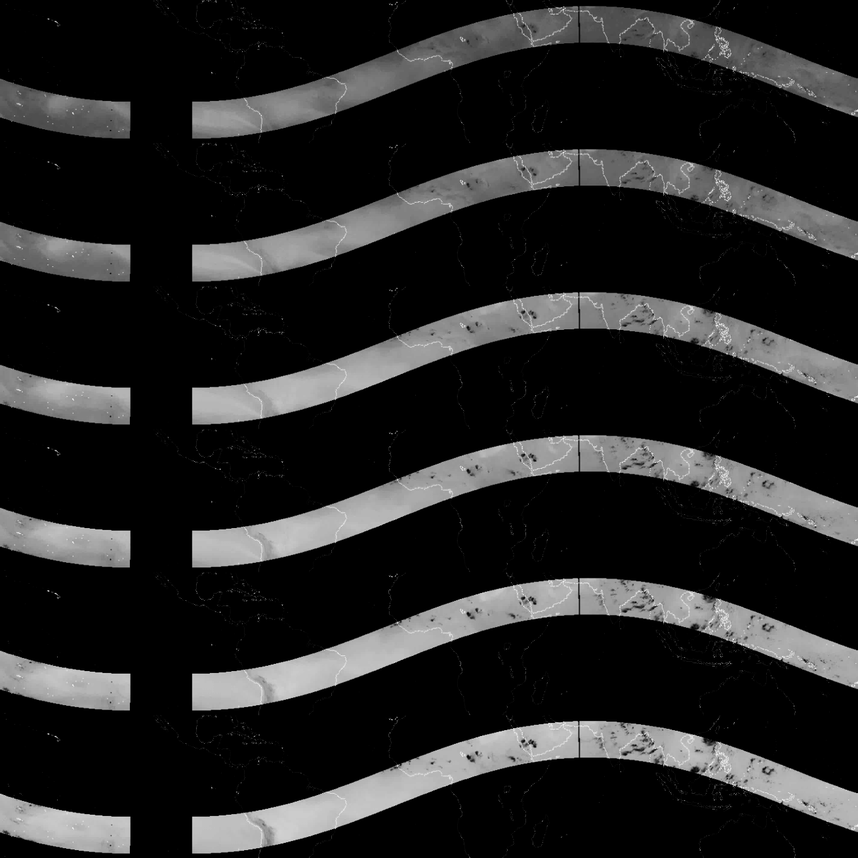
183.31±0.2
183.31±1.1
183.31±2.8
183.31±4.2
183.31±6.8
183.31±11.

Slide 7
Retrieval basics
Database:
Matchups of SAPHIR/DPR observations;
database organised by the two Tcs channels with greatest variation – channels 1 and 6;
independent of any dynamic ancillary data (no surface type (except land/sea), no TPW and no T2m);
database access via a lookup table (computationally efficient!);
Retrieval resolution set to a nominal 5.4x5.4 km (DPR)
Additional information used:
Land/sea (due to significant differences in meteorology);
Altitude – since sounder channels are height-dependent.

Slide 8
Matched information
An initial comprehensive database is generated for each matched overpass (GPM vs SAPHIR < 300 seconds).
Included for each of the matched fovs:
sensor Tbs (GMI/MHS or GMI/SAPHIR)
GPROF retrievals (or each sensor - missing)
GPROF-determined surface type, TPW, T2m
DPR near & estimated surface rain intensities
all filenames, scan lines, scan position, lat/lons
2014-2017 | #cases | non-int | GMI-int
GMI-SAPHIR | 2439 | 1209168 | 10365732
GMI-MHS | 13990 | 2489379 | 22727663

Slide 9
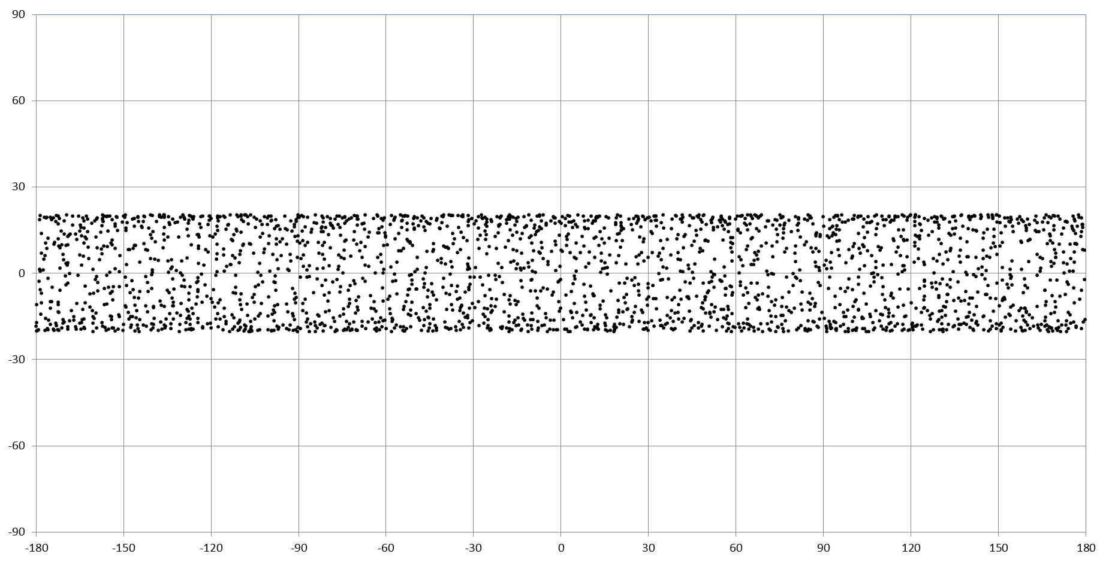
GPM:SAPHIR matchups 2014-2017
Latitude
Longitude
Distribution of SAPHIR-GPM overpass matchups < 300s
(2014-2017)

Slide 10
‘Fat’ database – one per case
Source filenames
ex1C.NOAA19.MHS.XCAL2016-V.20170428-S190725-E204925.042368.V05A.dat
ex1C.GPM.GMI.XCAL2016-C.20170428-S190846-E204121.017987.V05A.dat
ex2A.NOAA19.MHS.GPROF2017v1.20170428-S190725-E204925.042368.V05A.dat
ex2A.GPM.GMI.GPROF2017v1.20170428-S190846-E204121.017987.V05A.dat
exNSMSHS.GPM.DPR.V7-20170308.20170428-S190846-E204121.017987.V05A.dat
6.277 103.559 5.000
17 4 28 20 18 36 19.365 98.006 1602 85 283.32 281.98 242.26 257.39 267.37 17 4 28 20 11 34 19.338 98.001 2010 105 279.49 276.72 281.50 278.65 283.62 281.03 279.34 284.81 284.81 17 4 28 20 11 42 19.358 98.000 2014 105 280.04 279.55 258.12 269.88 17 4 28 20 18 36 19.365 98.006 1602 85 0.00 3. 195. 35. 17 4 28 20 11 34 19.338 98.001 2010 105 0.00 3. 195. 35. 17 4 28 20 12 43 19.367 97.969 5481 27 0.00
17 4 28 20 18 38 19.210 97.975 1603 85 282.94 281.27 242.45 256.00 267.21 17 4 28 20 11 36 19.210 98.000 2011 104 278.67 276.92 280.75 279.88 283.64 281.90 280.54 284.73 284.60 17 4 28 20 11 44 19.232 98.005 2015 104 277.71 279.22 257.63 268.50 17 4 28 20 18 38 19.210 97.975 1603 85 0.00 3. 195. 36. 17 4 28 20 11 36 19.210 98.000 2011 104 0.00 3. 195. 36. 17 4 28 20 12 45 19.223 97.982 5484 28 0.00
17 4 28 20 18 38 19.128 98.691 1603 83 278.30 273.71 232.75 251.53 261.06 17 4 28 20 11 42 19.129 98.695 2014 115 275.34 273.81 278.14 276.09 279.08 275.83 275.70 276.00 274.28 17 4 28 20 11 49 19.146 98.680 2018 116 266.95 263.50 251.62 258.89 17 4 28 20 18 38 19.128 98.691 1603 83 0.18 3. 194. 34. 17 4 28 20 11 42 19.129 98.695 2014 115 0.34 3. 194. 34. 17 4 28 20 12 51 19.132 98.702 5493 15 0.00
17 4 28 20 18 41 19.098 97.554 1604 86 285.79 283.77 246.93 262.02 271.43 17 4 28 20 11 36 19.073 97.583 2011 96 280.40 276.89 282.26 280.79 284.65 282.90 281.58 285.94 285.63 17 4 28 20 11 44 19.099 97.588 2015 95 280.77 281.76 265.15 273.76 17 4 28 20 18 41 19.098 97.554 1604 86 0.00 3. 195. 35. 17 4 28 20 11 36 19.073 97.583 2011 96 0.00 3. 195. 35. 17 4 28 20 12 44 19.074 97.577 5483 37 0.00
17 4 28 20 18 44 18.989 97.110 1605 87 285.29 285.36 249.60 264.70 274.22 17 4 28 20 11 36 18.965 97.100 2011 87 281.15 279.03 281.88 282.17 282.67 282.05 281.02 284.39 283.45 17 4 28 20 11 44 19.001 97.111 2015 85 283.28 283.54 268.15 275.94 17 4 28 20 18 44 18.989 97.110 1605 87 0.00 3. 195. 30. 17 4 28 20 11 36 18.965 97.100 2011 87 0.00 3. 195. 30. 17 4 28 20 12 42 18.978 97.074 5480 47 0.00
17 4 28 20 18 44 18.944 97.523 1605 86 285.62 283.63 246.83 261.06 270.90 17 4 28 20 11 38 18.937 97.527 2012 94 279.70 276.90 282.62 280.34 284.33 282.38 280.07 286.29 285.83 17 4 28 20 11 46 18.966 97.544 2016 93 282.21 281.82 266.37 274.48 17 4 28 20 18 44 18.944 97.523 1605 86 0.00 3. 195. 35. 17 4 28 20 11 38 18.937 97.527 2012 94 0.00 3. 195. 35. 17 4 28 20 12 45 18.950 97.527 5485 39 0.00
17 4 28 20 18 44 18.818 98.627 1605 83 278.79 274.97 233.65 252.25 262.17 17 4 28 20 11 46 18.814 98.599 2016 111 275.65 274.38 278.14 276.05 279.01 276.98 275.14 277.89 277.11 17 4 28 20 11 53 18.840 98.607 2020 112 269.49 269.33 252.96 262.40 17 4 28 20 18 44 18.818 98.627 1605 83 0.13 3. 194. 35. 17 4 28 20 11 46 18.814 98.599 2016 111 0.29 3. 194. 35. 17 4 28 20 12 55 18.843 98.623 5498 19 0.07
17 4 28 20 18 49 18.549 98.217 1607 84 280.91 279.68 234.76 254.70 264.99 17 4 28 20 11 47 18.538 98.246 2017 103 277.33 274.20 278.78 275.36 280.16 277.46 276.36 280.47 280.24 17 4 28 20 11 55 18.562 98.256 2021 103 279.57 278.46 257.84 269.29 17 4 28 20 18 49 18.549 98.217 1607 84 0.00 3. 195. 37. 17 4 28 20 11 47 18.538 98.246 2017 103 0.00 3. 195. 37. 17 4 28 20 12 56 18.550 98.236 5500 29 0.00
17 4 28 20 18 52 18.436 97.819 1608 85 284.97 284.56 243.58 259.60 270.91 17 4 28 20 11 47 18.407 97.829 2017 95 280.45 277.45 281.32 280.24 283.57 281.00 280.46 285.39 285.15 17 4 28 20 11 55 18.434 97.839 2021 94 282.33 281.32 263.98 273.15 17 4 28 20 18 52 18.436 97.819 1608 85 0.00 3. 196. 37. 17 4 28 20 11 47 18.407 97.829 2017 95 0.00 3. 196. 37. 17 4 28 20 12 55 18.401 97.831 5499 38 0.00
17 4 28 20 19 2 17.694 98.732 1612 82 279.75 272.46 235.53 249.29 259.65 17 4 28 20 12 2 17.704 98.740 2025 105 275.82 271.05 278.98 274.75 280.79 279.87 276.88 281.93 281.44 17 4 28 20 12 10 17.723 98.738 2029 105 273.35 273.04 249.77 261.00 17 4 28 20 19 2 17.694 98.732 1612 82 0.17 3. 195. 37. 17 4 28 20 12 2 17.704 98.740 2025 105 0.00 3. 195. 37. 17 4 28 20 13 11 17.694 98.722 5522 27 0.00
17 4 28 20 19 10 17.119 99.530 1615 79 267.33 250.34 229.86 248.51 248.11 17 4 28 20 12 16 17.139 99.523 2032 114 272.52 262.93 278.15 270.50 280.70 277.67 273.14 261.74 256.66 17 4 28 20 12 23 17.157 99.514 2036 115 236.43 228.53 247.36 243.45 17 4 28 20 19 10 17.119 99.530 1615 79 1.07 4. 197. 48. 17 4 28 20 12 16 17.139 99.523 2032 114 1.62 4. 197. 48. 17 4 28 20 13 25 17.149 99.529 5541 16 0.31
17 4 28 20 19 13 16.999 99.212 1616 80 271.28 255.77 232.94 249.91 253.43 17 4 28 20 12 16 17.002 99.230 2032 108 279.34 271.84 282.60 278.41 283.68 283.23 279.75 274.44 272.94 17 4 28 20 12 23 17.014 99.211 2036 108 256.38 250.58 250.54 254.55 17 4 28 20 19 13 16.999 99.212 1616 80 0.86 3. 196. 45. 17 4 28 20 12 16 17.002 99.230 2032 108 0.77 12. 196. 45. 17 4 28 20 13 25 16.980 99.192 5541 24 0.05
17 4 28 20 19 16 16.844 99.180 1617 80 272.08 256.92 236.38 250.59 254.78 17 4 28 20 12 17 16.851 99.178 2033 106 276.31 267.51 279.68 273.41 282.16 279.94 276.31 267.20 263.97 17 4 28 20 12 25 16.868 99.171 2037 106 249.89 243.53 249.95 253.49 17 4 28 20 19 16 16.844 99.180 1617 80 0.85 3. 196. 45. 17 4 28 20 12 17 16.851 99.178 2033 106 1.52 3. 196. 45. 17 4 28 20 13 26 16.857 99.144 5543 26 0.23
17 4 28 20 19 16 16.741 100.000 1617 77 259.32 236.18 239.12 247.40 244.59 17 4 28 20 12 25 16.722 99.998 2037 119 254.33 228.34 266.56 253.04 275.54 271.53 264.09 265.99 262.56 17 4 28 20 12 32 16.752 100.001 2041 121 246.00 236.64 248.25 248.08 17 4 28 20 19 16 16.741 100.000 1617 77 1.96 5. 197. 58. 17 4 28 20 12 25 16.722 99.998 2037 119 0.93 5. 197. 58. 17 4 28 20 13 34 16.746 100.019 5554 10 0.67
17 4 28 20 19 26 16.153 99.604 1621 78 280.90 275.78 229.05 251.70 261.24 17 4 28 20 12 31 16.127 99.612 2040 108 259.98 233.97 267.86 251.53 277.41 271.99 259.75 282.25 279.62 17 4 28 20 12 38 16.139 99.595 2044 108 269.62 267.19 250.01 258.85 17 4 28 20 19 26 16.153 99.604 1621 78 0.00 5. 197. 56. 17 4 28 20 12 31 16.127 99.612 2040 108 0.00 5. 197. 56. 17 4 28 20 13 39 16.141 99.609 5562 23 0.00
17 4 28 20 19 24 16.180 100.630 1620 74 268.12 251.21 238.08 244.93 244.50 17 4 28 20 12 38 16.157 100.644 2044 126 262.29 242.09 273.52 263.91 277.20 268.84 263.16 255.30 250.30 17 4 28 20 12 46 16.170 100.607 2048 128 232.17 226.55 243.89 240.33 17 4 28 20 19 24 16.180 100.630 1620 74 1.31 4. 198. 56. 17 4 28 20 12 38 16.157 100.644 2044 126 2.31 4. 198. 56. 17 4 28 20 13 46 16.164 100.646 5572 3 1.15
17 4 28 20 19 29 16.105 98.719 1622 81 280.35 275.88 238.23 252.07 262.14 17 4 28 20 12 27 16.081 98.697 2038 92 276.28 273.54 280.23 277.64 279.90 278.75 277.96 280.51 280.64 17 4 28 20 12 34 16.113 98.725 2042 91 273.74 272.79 251.98 262.40 17 4 28 20 19 29 16.105 98.719 1622 81 0.16 3. 196. 40. 17 4 28 20 12 27 16.081 98.697 2038 92 0.00 3. 196. 42. 17 4 28 20 13 34 16.094 98.702 5554 41 0.00
17 4 28 20 19 29 16.068 99.015 1622 80 278.69 275.08 236.39 251.08 261.71 17 4 28 20 12 29 16.038 99.006 2039 97 277.43 274.58 278.23 277.16 279.15 276.41 275.78 276.88 275.94 17 4 28 20 12 36 16.060 99.006 2043 96 271.42 269.30 250.38 262.14 17 4 28 20 19 29 16.068 99.015 1622 80 0.16 3. 194. 37. 17 4 28 20 12 29 16.038 99.006 2039 97 0.43 3. 194. 37. 17 4 28 20 13 37 16.036 98.990 5558 36 0.04
17 4 28 20 19 29 15.964 99.832 1622 77 281.14 278.13 237.68 252.05 262.04 17 4 28 20 12 34 15.974 99.855 2042 111 258.78 233.23 266.08 244.49 276.20 270.52 254.75 282.17 278.17 17 4 28 20 12 42 15.978 99.820 2046 111 271.46 272.83 251.63 261.59 17 4 28 20 19 29 15.964 99.832 1622 77 0.18 4. 197. 56. 17 4 28 20 12 34 15.974 99.855 2042 111 0.00 4. 197. 56. 17 4 28 20 13 44 15.958 99.841 5568 20 0.00
17 4 28 20 19 32 15.877 99.266 1623 79 280.81 276.15 237.29 252.58 262.31 17 4 28 20 12 32 15.867 99.257 2041 100 276.84 274.17 281.00 280.75 282.38 282.38 280.25 281.92 281.04 17 4 28 20 12 40 15.896 99.285 2045 100 272.45 272.37 250.36 261.42 17 4 28 20 19 32 15.877 99.266 1623 79 0.00 3. 194. 42. 17 4 28 20 12 32 15.867 99.257 2041 100 0.00 3. 194. 42. 17 4 28 20 13 41 15.873 99.267 5564 32 0.00
17 4 28 20 19 29 15.839 100.790 1622 73 273.32 264.13 235.69 252.11 259.71 17 4 28 20 12 44 15.828 100.785 2047 126 268.21 251.01 276.41 270.09 281.16 278.62 275.10 275.01 273.55 17 4 28 20 12 51 15.841 100.748 2051 128 265.34 264.04 248.91 257.48 17 4 28 20 19 29 15.839 100.790 1622 73 0.90 5. 198. 53. 17 4 28 20 12 44 15.828 100.785 2047 126 0.64 5. 198. 53. 17 4 28 20 13 52 15.835 100.786 5580 3 0.68
17 4 28 20 19 34 15.722 99.233 1624 79 281.67 278.21 237.44 253.21 262.82 17 4 28 20 12 34 15.741 99.254 2042 99 277.85 275.53 280.01 279.08 282.01 280.82 280.33 280.35 280.25 17 4 28 20 12 42 15.758 99.241 2046 98 272.24 270.51 249.80 261.80 17 4 28 20 19 34 15.722 99.233 1624 79 0.00 3. 193. 38. 17 4 28 20 12 34 15.741 99.254 2042 99 0.00 3. 194. 41. 17 4 28 20 13 42 15.750 99.219 5566 34 0.00
17 4 28 20 19 45 15.101 99.100 1628 79 283.70 280.77 238.87 252.87 264.49 17 4 28 20 12 44 15.098 99.128 2047 92 279.30 274.65 281.26 280.33 282.65 281.68 281.41 283.68 283.81 17 4 28 20 12 51 15.120 99.109 2051 90 275.60 277.43 251.32 264.01 17 4 28 20 19 45 15.101 99.100 1628 79 0.00 3. 194. 37. 17 4 28 20 12 44 15.098 99.128 2047 92 0.00 3. 194. 37. 17 4 28 20 13 51 15.092 99.087 5578 42 0.00
17 4 28 20 19 42 15.092 100.392 1627 74 284.30 276.93 239.91 252.01 259.94 17 4 28 20 12 51 15.059 100.424 2051 114 267.29 247.11 277.33 264.76 282.81 280.74 271.28 286.69 285.30 17 4 28 20 12 59 15.076 100.415 2055 115 273.81 272.80 250.72 261.04 17 4 28 20 19 42 15.092 100.392 1627 74 0.00 12. 198. 56. 17 4 28 20 12 51 15.059 100.424 2051 114 0.00 12. 198. 57. 17 4 28 20 14 0 15.099 100.414 5591 16 0.00
17 4 28 20 19 42 15.032 100.839 1627 72 285.62 283.04 245.78 258.70 268.39 17 4 28 20 12 55 15.023 100.843 2053 121 270.81 255.66 280.08 272.56 284.91 283.18 278.80 287.25 286.14 17 4 28 20 13 2 15.048 100.835 2057 123 277.18 277.06 254.84 266.86 17 4 28 20 19 42 15.032 100.839 1627 72 0.00 5. 198. 57. 17 4 28 20 12 55 15.023 100.843 2053 121 0.00 5. 198. 57. 17 4 28 20 14 3 15.044 100.800 5596 9 0.00
17 4 28 20 19 45 14.906 100.585 1628 73 284.35 279.99 234.58 255.10 264.67 17 4 28 20 12 55 14.889 100.613 2053 116 270.53 251.35 279.10 268.67 283.49 281.12 274.32 285.56 284.09 17 4 28 20 13 2 14.902 100.592 2057 117 269.29 267.93 248.97 257.55 17 4 28 20 19 45 14.906 100.585 1628 73 0.00 12. 199. 57. 17 4 28 20 12 55 14.889 100.613 2053 116 0.00 12. 199. 57. 17 4 28 20 14 4 14.895 100.604 5597 14 0.00
17 4 28 20 19 58 14.070 100.845 1633 71 281.27 278.84 248.45 260.91 267.73 17 4 28 20 13 8 14.071 100.844 2060 114 265.70 242.03 275.92 262.61 283.10 279.63 270.01 287.85 286.12 17 4 28 20 13 16 14.088 100.835 2064 115 279.67 279.13 262.39 271.35 17 4 28 20 19 58 14.070 100.845 1633 71 0.00 12. 199. 56. 17 4 28 20 13 8 14.071 100.844 2060 114 0.00 12. 199. 56. 17 4 28 20 14 17 14.072 100.849 5616 16 0.18
crossing lat/lon (and resolution)
One entry per matched fov
yr mo dy hr mn sc lat lon scanline/pos Tc(1:5)
MHS L1C data
yr mo dy hr mn sc lat lon scanline/pos Tc(1:9) Tc(1:4)
GMI L1C data
…..
Two versions available for SAPHIR (and MHS):
Only coincident fovs across ALL sensors are extracted, and;
GMI footprints interpolated (for test purposes only).

Slide 11
Database & retrieval scheme
“fat”
database
TPW/t2m index
L1CMHS
L1CSAPHIR
‘thin’ database
L2AMHS
(TPW/T2m)
L1CGMI
retrieval
L2AGMI
retrieval
L2ADPR
L1CMHS
Tb/Tb index

Slide 12
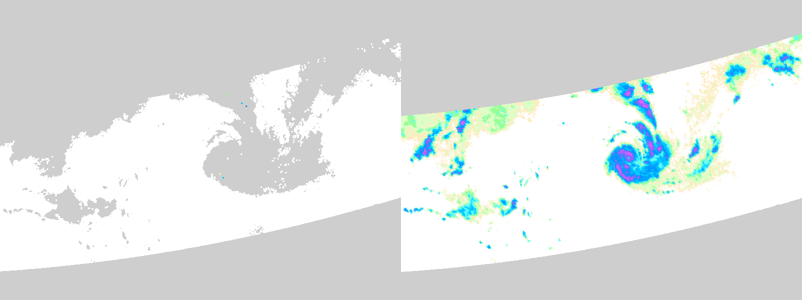
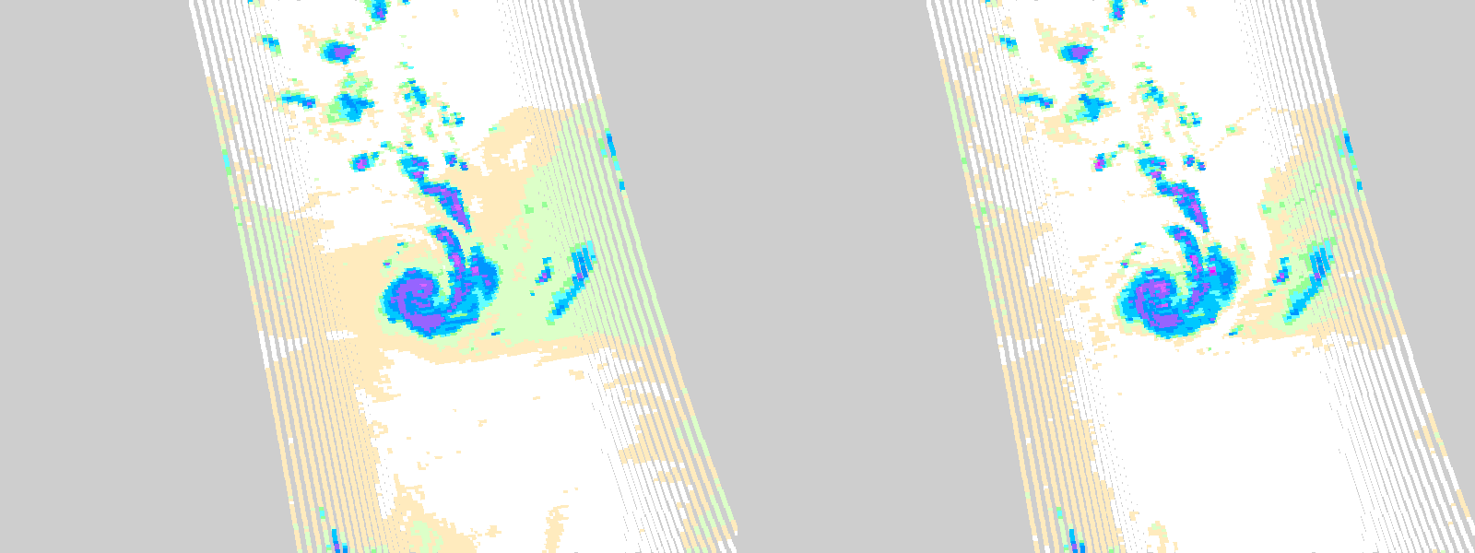
Initial ‘dummy’ test
SAPHIR PRPS V0.0
MHS GPROF V05
H. Maria, 2017-09-19
Basic mean RR per Tb/Tb bin SAPHIR PRPS v0.0 retrieval vs NOAA19 MHS GPROF V05 retrieval.
Individual cases are encouraging: some slight indication of scan-position issues – as shown by light precipitation at edge of swath.

Slide 13
PRPS v01-02 requirements
Five input data sets are required:
i) a priori database of DPR(rainrate)-SAPHIR(Tc radiances);
ii) a priori database index;
iii) a priori topography data;
iv) a priori scan-position correction database, and;
v) Level 1C SAPHIR data.
All database/index information is held in memory – making batch processing extremely fast.
Outputs include:
Precipitation intensity
Quality flag
Error assessment (RMSE of intensities/retrieval)
‘fit’ (RMSE of observation/database Tc vectors)

Slide 14
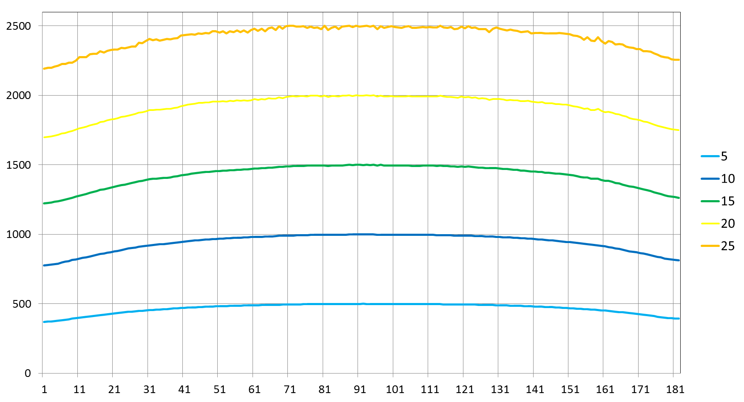
PRPS v01-02 requirements
25
20
15
10
5
0
input
rainrate
(mmh⁻¹)
Corrected rainrate (mmh⁻¹)
SAPHIR scan position
Post-retrieval scan position correction scheme

Slide 15
2017-09 comparisons
SSMIS
SAPHIR -mean
SAPHIR -NN
0.0 0.1 0.2 0.5 1.0 1.5 2.0 3.0 4.0 6.0 8.0 12.0 16.0 24.0 mmd⁻¹

Slide 16
Results

Slide 17
Monthly accumulation

Slide 18
PRPS v2?
MHS channel
combinations
lookup index
surface
database
full profile database
Ch | 1 | 2 | 3 | 4 | 5
1
2
3
4
5
start
Ch | 1 | 2 | 3 | 4 | 5
1
2
3
4
5
c. 20 million entries
end
2D arrays of start/end locations
x10
Provides multi-channel indexing with 10x n² rather than n⁵ entries

Slide 19
Future
Iron-out the wrinkles:
Increase in precipitation noted along northern/southern edges depending upon season;
Retrievals close to and over high ground;
Subtropical high-pressure regions.
Extension to MHS underway;
Biggest issue is snow/ice where atmospheric water content is small.

Slide 22
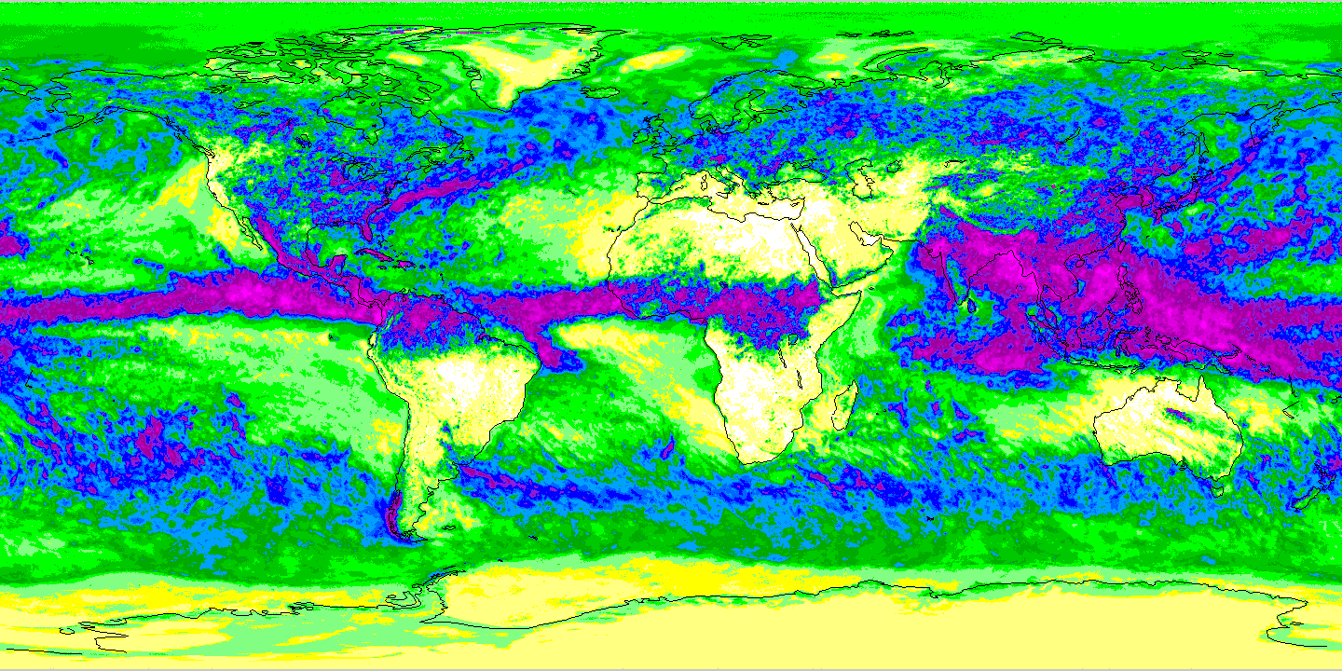
2017-07
0.0 0.1 0.2 0.5 1.0 1.5 2.0 3.0 4.0 6.0 8.0 12.0 16.0 24.0 mmd⁻¹

Slide 23
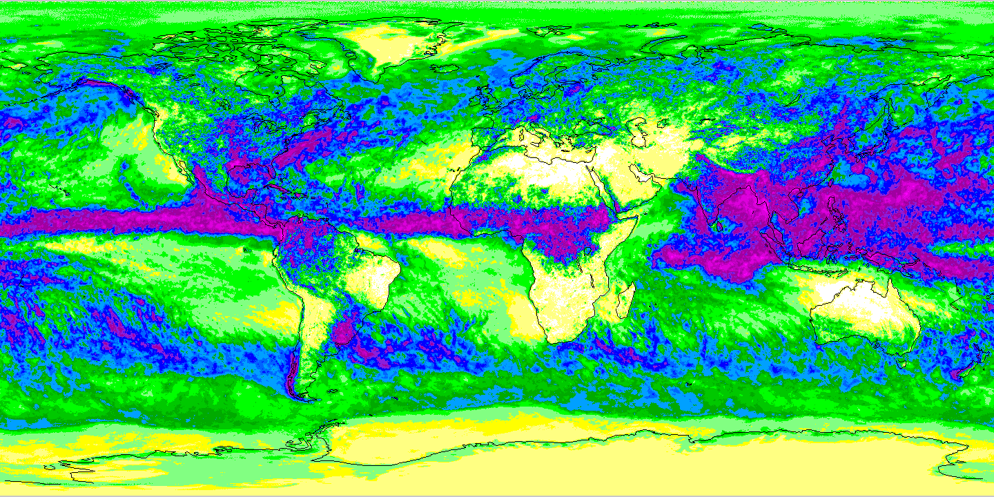
2017-08
0.0 0.1 0.2 0.5 1.0 1.5 2.0 3.0 4.0 6.0 8.0 12.0 16.0 24.0 mmd⁻¹

Slide 24
2017-09
0.0 0.1 0.2 0.5 1.0 1.5 2.0 3.0 4.0 6.0 8.0 12.0 16.0 24.0 mmd⁻¹

Slide 25
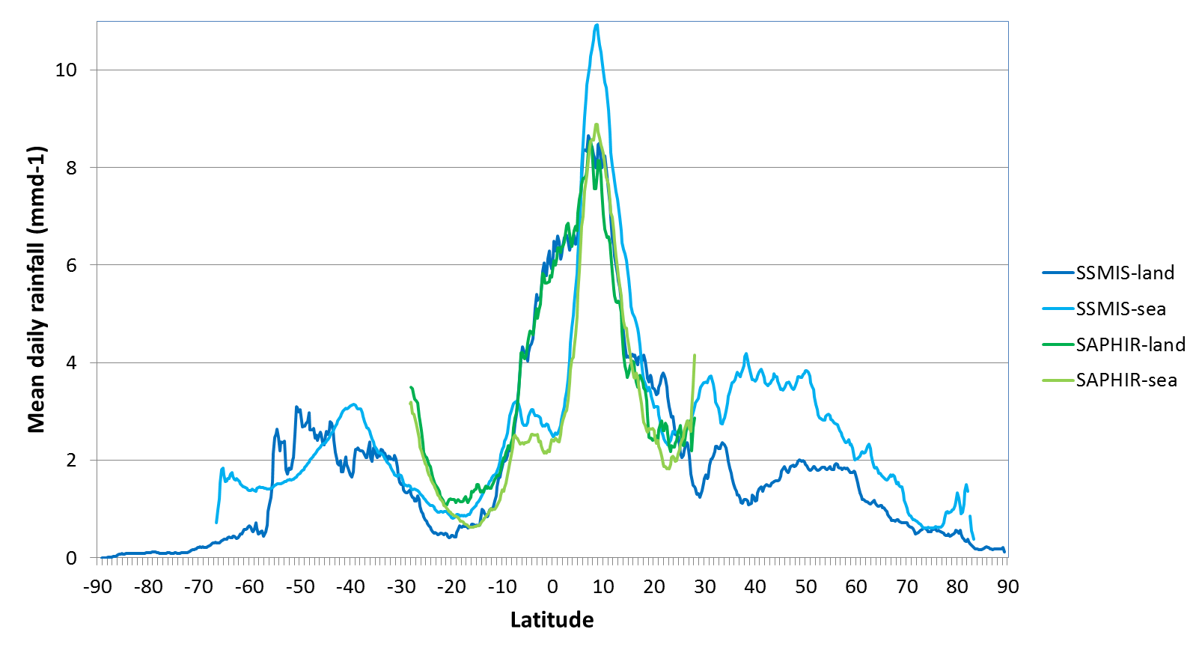
Latitudinal profiles
Over land between 10°N and 10°S SAPHIR and SSMIS are near identical

Slide 26
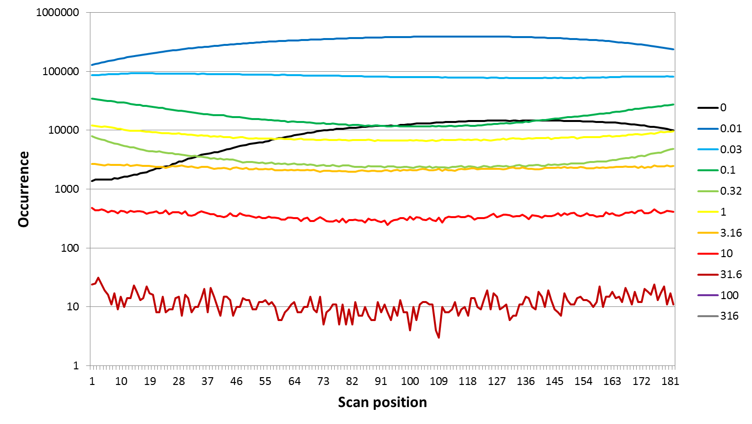
SAPHIR scan position biases
mmh⁻¹
Note that the biases are not symmetrical around nadir (and that nadir is not at the centre of swath.

Slide 27
Initial assessment
Using even a very basic mean rain rate per database bin a reasonable retrieval is possible;
Over the land the maximum values of the SAPHIR products are similar to those of the SSMIS;
Over ocean the SSMIS generates more precipitation than SAPHIR (note that SAPHIR does not discriminate between land and ocean);
SAPHIR retrievals have issues in regions of little or no rain (probably due to mean rain rate per bin);
Next stage – run the retrievals with weighted values per database bin….

