Slide 1
Deconvolving the snow cover and snowfall passive microwave signals: A data-driven learning using GPM data
Zeinab Takbiri¹, Ardeshir Ebtehaj¹, Efi Foufoula-Georgiou^{1,2}
¹University of Minnesota; ²University of California Irvine
Email: takbi001@umn.edu
Land Surface Working Group, February 28th 2018

Slide 2
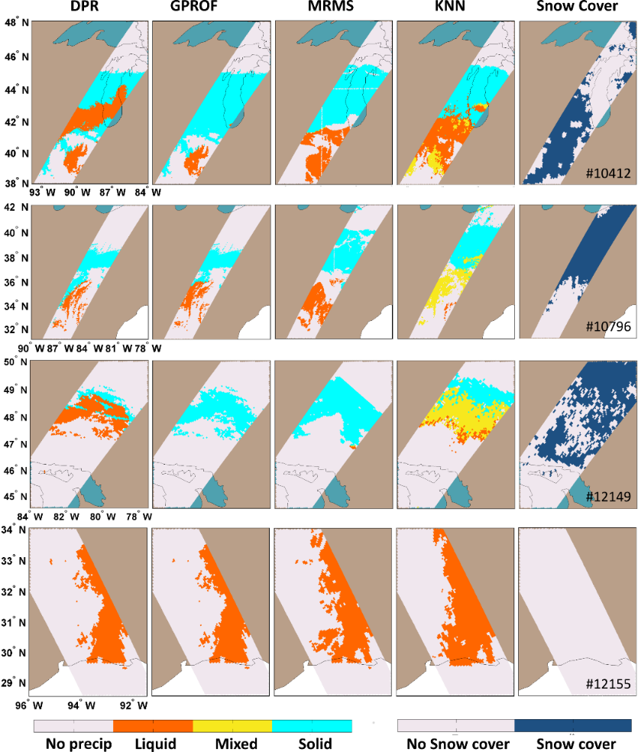
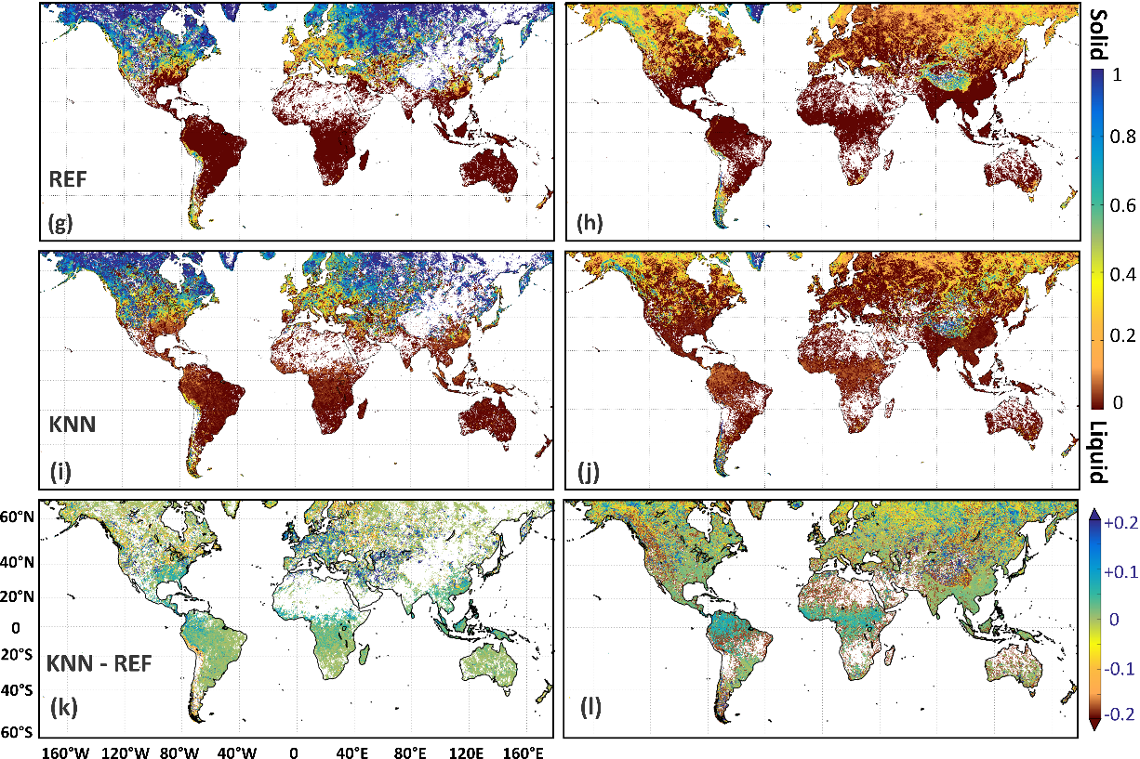



Snowfall estimation: A nested K-nearest algorithm and an observed irregularity
Winter
Summer
Seasonal precipitation phase probabilities by, REF (merged GPM active and passive products), and the presented KNN approach. The phase of REF (g & h), KNN (i & j), and their phase differences (k & l)
Irregularity
Zeinab Takbiri, Ardeshir Ebtehaj, Efi Foufoula-georgiou, Pierre-emmanuel Kirstetter , and F. Joseph Turk, “A Prognostic Retrieval Approach for Microwave Precipitation Phase Detection over Snow Cover” (under review AMS)

Slide 3
Database
Passive and active microwave observations from GPM to have the overlapped brightness temperatures and snowfall intensities.
Snow water equivalent (SWE) from MERRA-2.
Snow cover presence or absence from AutoSnow.
Total cloud liquid water path (LWP), vapor water path (VWP), 2-meter, and skin temperature (T_{s}) from both MERRA-2 and ECMWF.

Slide 4
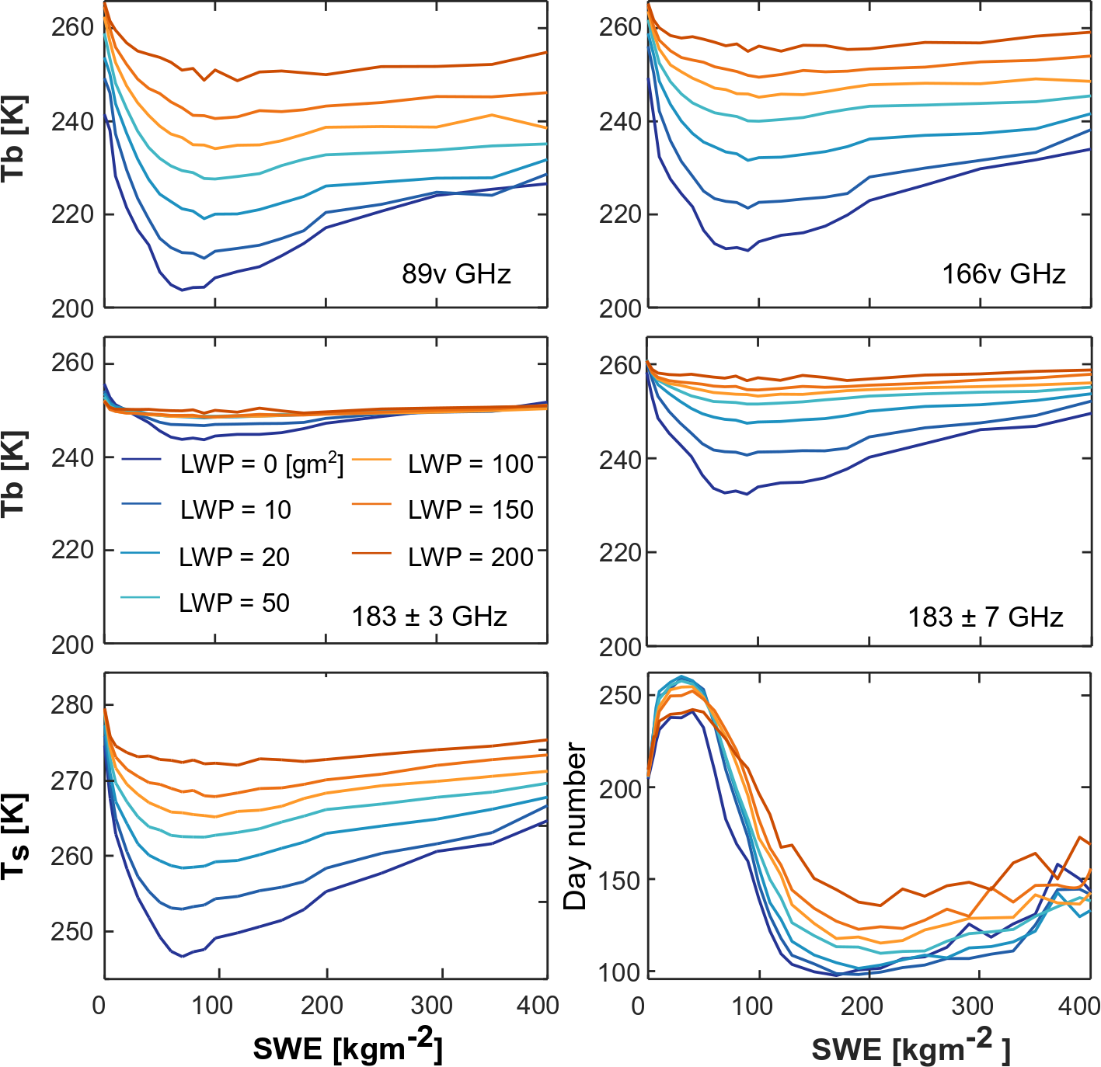
Tb variations over snow-covered surfaces
The bowl shape of Tbs as SWE increases matches with the previous studies on SWE analysis such as Rosenreid and Grody (2000).
However, the pattern of increase and decrease in Tbs with the increase in LWP emission and SWE scattering also follow the pattern of skin temperature variations.

Slide 5
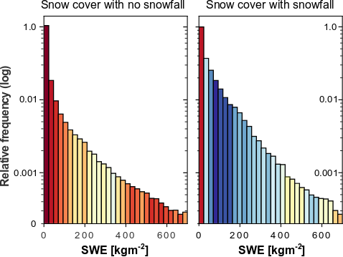
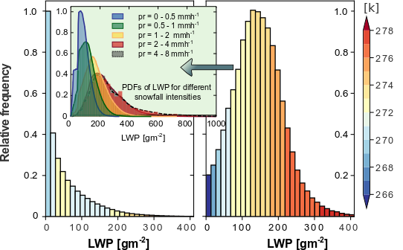
The Skin temperature variations with the increase of SWE and LWP
The LWP and skin temperature snow cover with and without snowfall is very different.
Thus, it is almost impossible to find enough data binned over both SWE and LWP for a small enough skin temperature interval to avoid its effects on brightness temperatures.

Slide 6
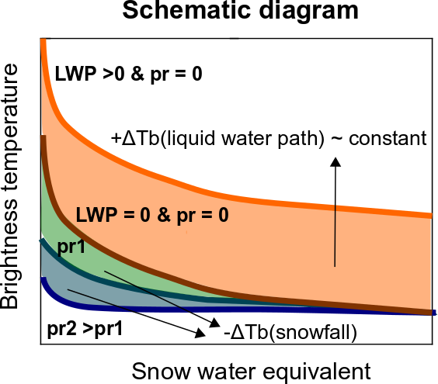

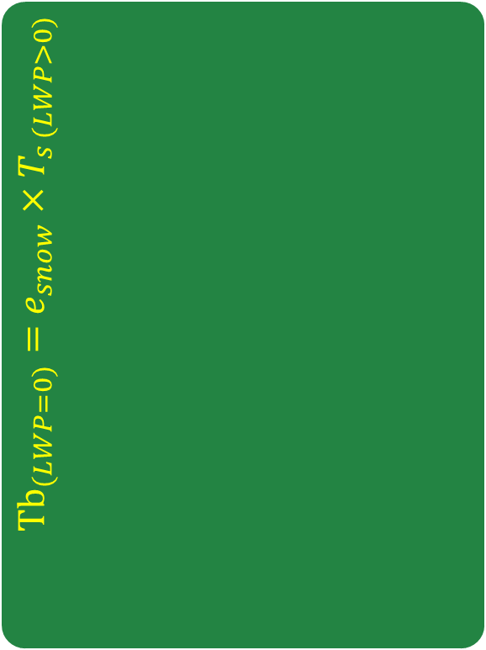
Our approach: Deconvolution
Analyzing the $∆$Tb variations over the snow-covered surfaces (with no precipitation) with increase of SWE and LWP as a parameter
Analyzing the variations of Tbs with SWE for different snowfall intensities compared to those Tbs with no precipitation over the snow cover.
Calculating the variations of clear-sky emissivity of snow cover with increase of SWE
Snowfall scattering on top of snow cover
Remove the Skin temperature effects
$${Tb}_{(LWP=0)}=e_{snow}×T_{s (LWP>0)}$$

Slide 7
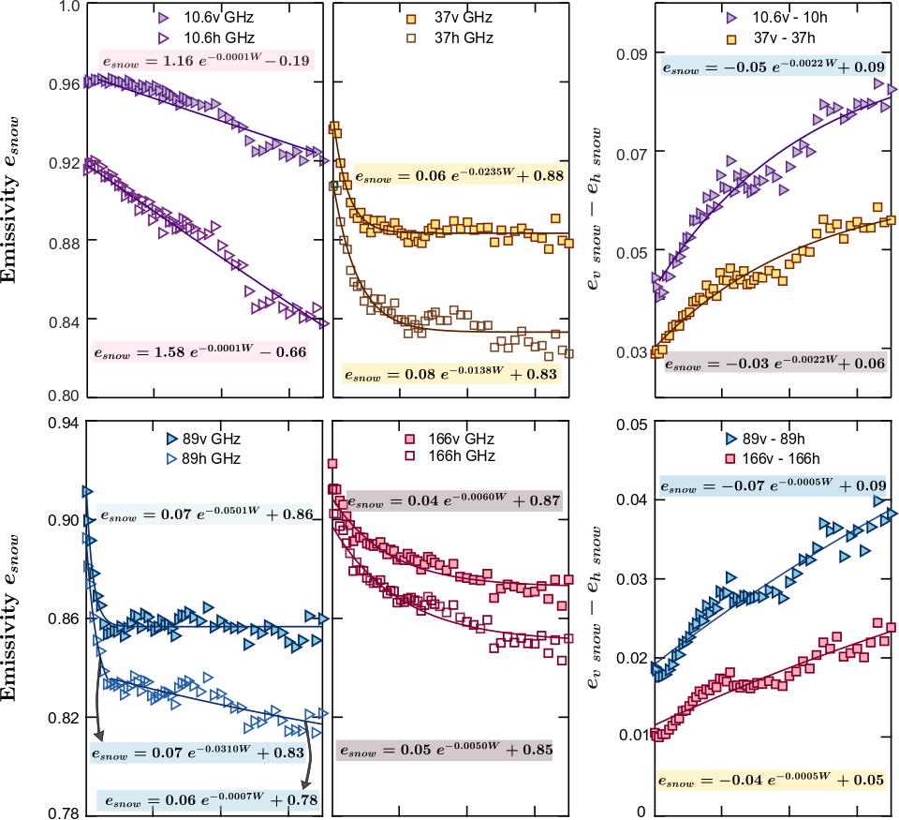
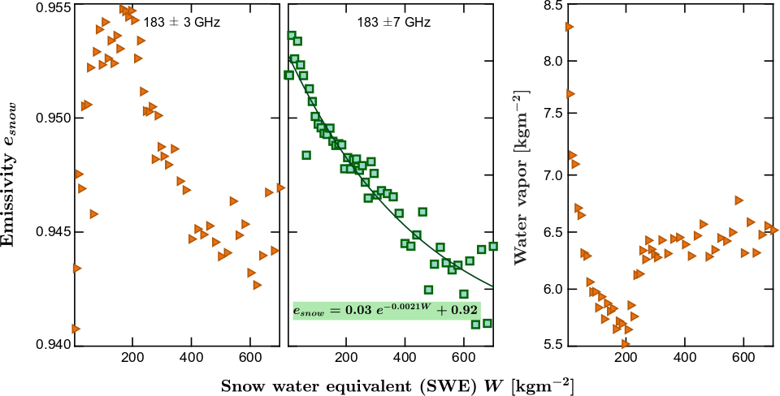
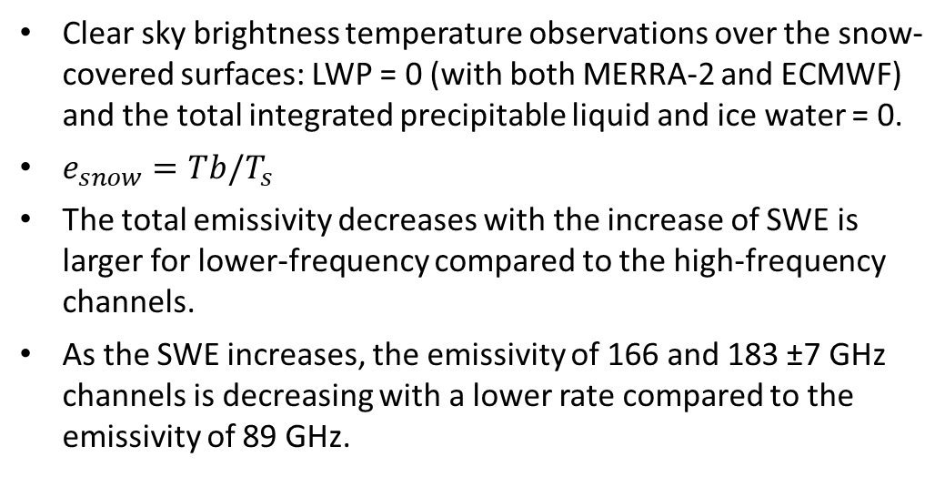
Clear-sky emissivity: to remove the skin temperature effects
Clear sky brightness temperature observations over the snow-covered surfaces: LWP = 0 (with both MERRA-2 and ECMWF) and the total integrated precipitable liquid and ice water = 0.
$e_{snow}=Tb/T_{s}$
The total emissivity decreases with the increase of SWE is larger for lower-frequency compared to the high-frequency channels.
As the SWE increases, the emissivity of 166 and 183 ±7 GHz channels is decreasing with a lower rate compared to the emissivity of 89 GHz.

Slide 8
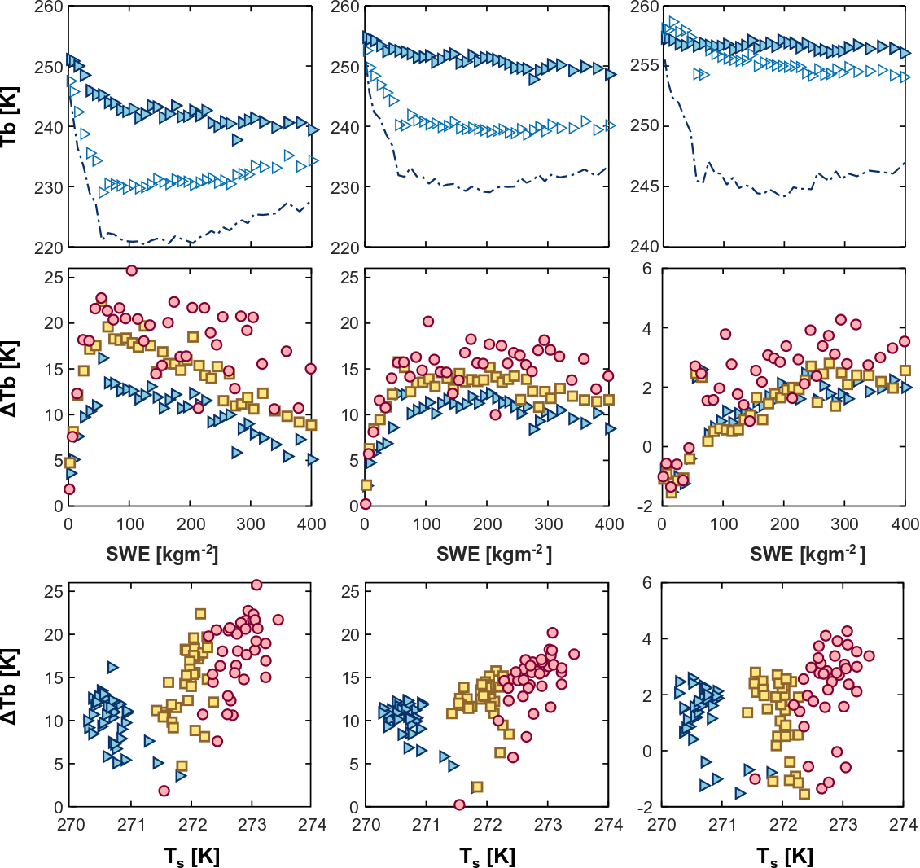
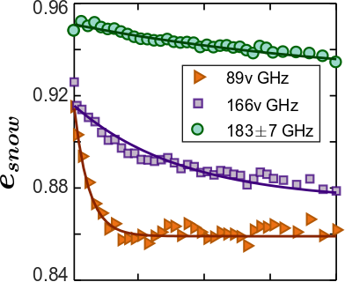
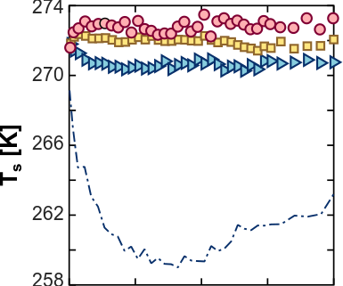
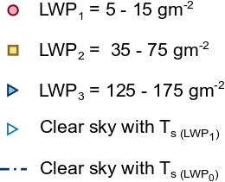
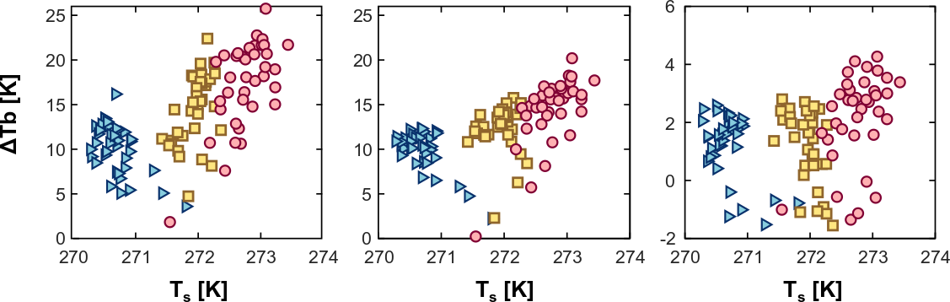
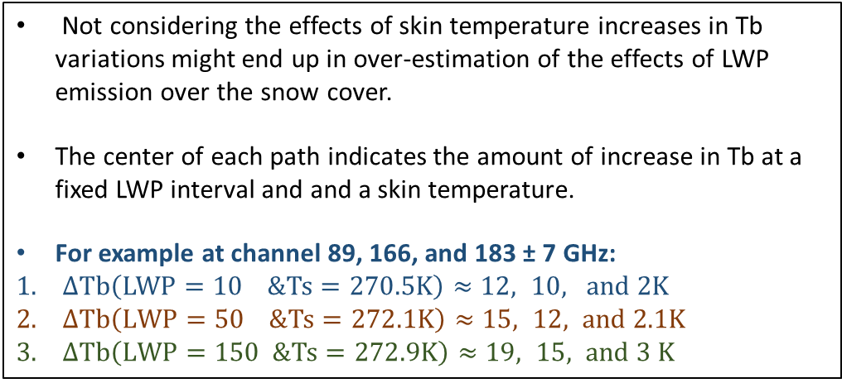

The combined effects of LWP and SWE when there is no precipitation in the sky
Emissivity (clear-sky)
$$×$$
Skin temperature
Not considering the effects of skin temperature increases in Tb variations might end up in over-estimation of the effects of LWP emission over the snow cover.
The center of each path indicates the amount of increase in Tb at a fixed LWP interval and and a skin temperature.
For example at channel 89, 166, and 183 ± 7 GHz:
$∆Tb\left(LWP=10 \&Ts=270.5K\right)≈12, 10, and 2K$
$∆Tb\left(LWP=50 \&Ts=272.1K\right)≈15, 12, and 2.1K$
$∆Tb\left(LWP=150 \&Ts=272.9K\right)≈19, 15, and 3 K$

Slide 9
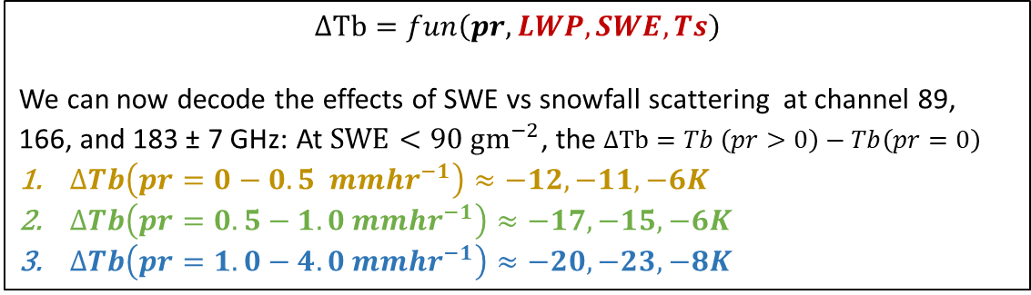
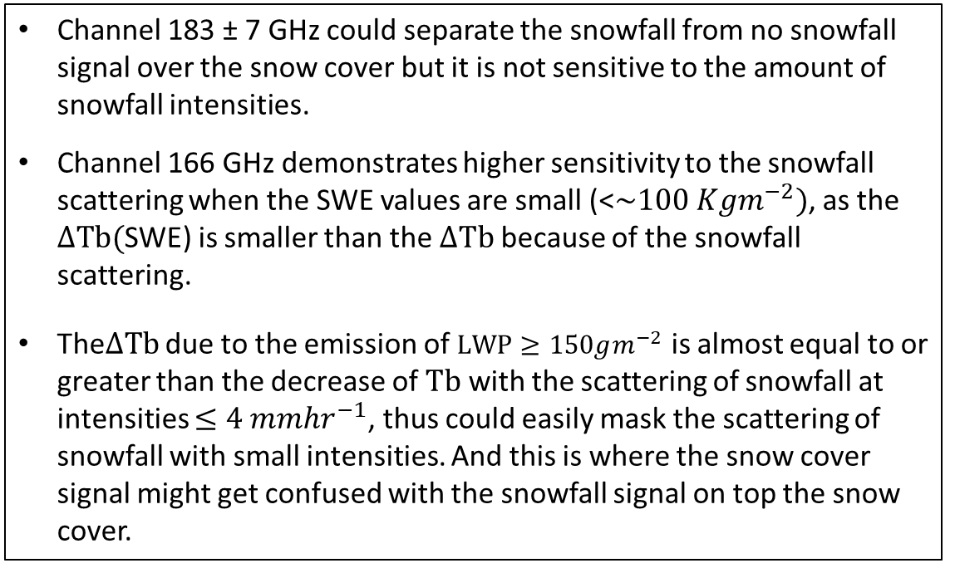
The snowfall scattering at different intensities over the snow cover
$$∆Tb=fun\left(pr, LWP, SWE,Ts\right)$$
We can now decode the effects of SWE vs snowfall scattering at channel 89, 166, and 183 ± 7 GHz: At $SWE<90 gm^{−2}$, the $∆Tb=Tb \left(pr>0\right)−Tb\left(pr=0\right)$
$∆Tb\left(pr=0−0.5 mm{hr}^{−1}\right)≈−12,−11, −6K$
$∆Tb\left(pr=0.5−1.0 mm{hr}^{−1}\right)≈−17, −15, −6K$
$∆Tb\left(pr=1.0−4.0 m{mhr}^{−1}\right)≈−20, −23, −8K$
Channel 183 ± 7 GHz could separate the snowfall from no snowfall signal over the snow cover but it is not sensitive to the amount of snowfall intensities.
Channel 166 GHz demonstrates higher sensitivity to the snowfall scattering when the SWE values are small (<$\sim 100 Kgm^{−2})$, as the $∆Tb($SWE) is smaller than the $∆Tb$ because of the snowfall scattering.
The$∆Tb$ due to the emission of $LWP≥150gm^{−2}$ is almost equal to or greater than the decrease of $Tb$ with the scattering of snowfall at intensities $≤4 mmhr^{−1}$, thus could easily mask the scattering of snowfall with small intensities. And this is where the snow cover signal might get confused with the snowfall signal on top the snow cover.

