Slide 1
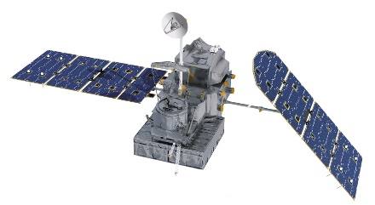


Using XPOL Observations from Complex Terrain Field Experiments to Characterize Passive Microwave Retrieval Uncertainty
Yagmur Derin¹, Emmanouil Anagnostou¹, Marios Anagnostou^{2,3,4}, John Kalogiros³
¹University of Connecticut, Department of Civil and Environmental Engineering, Storrs-Mansfield, CT, USA (manos@uconn.edu)
²Dept. of Water Resources and Env. Engineering, School of Civil Engineering, National Technical University of Athens, Athens, Greece
³National Observatory of Athens, Institute of Environmental Research & Sustainable Development, Athens, Greece
⁴ DUTH, School of Engineering, Department of Environmental Engineering, Xanthi, Greece
August 22nd 2018
PMM Land Surface Working Group

Slide 2
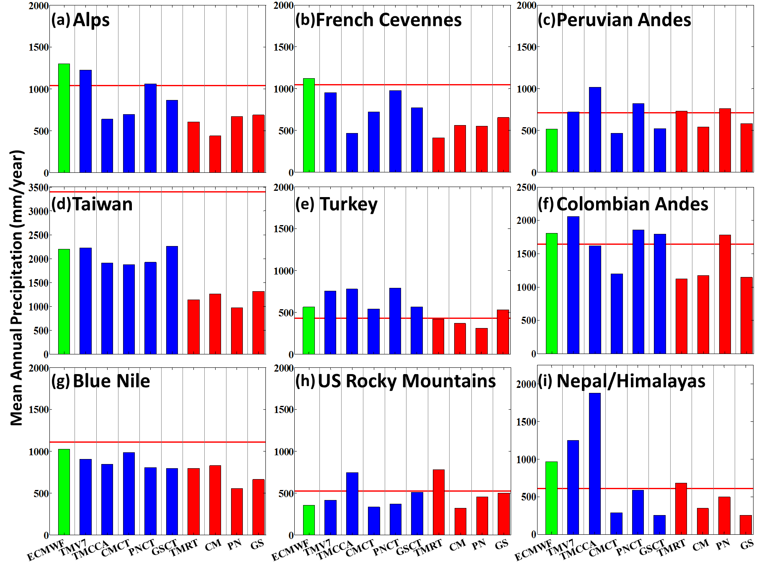
Multi-regional Satellite Precipitation Products Evaluation over Complex Terrain
Rain Gauge corrected SBR
Satellite only SBR
Derin, Y., E. N. Anagnostou, A. Berne, M. Borga, B. Boudevillain, W. Buytaert, C-H. Chang, G. Delrieu, Y. Hong, Y. C. Hsu, W. Lavado-Casimiro, B. Manz, S. Moges, E. I. Nikolopoulos, D. Sahlu, F. Salerno, J-P. Rodrigues-Sanchez, H. J. Vergera, and K. K. Yilmaz, 2016: Multi-regional satellite precipitation products evaluation over complex terrain. J. Hydrometeor., 17, 1817-1836.

Slide 3
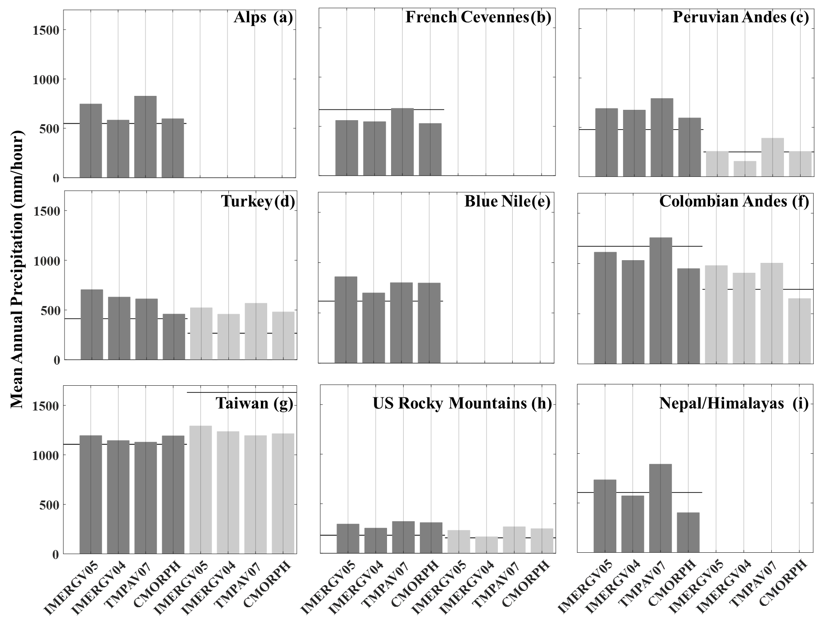
Multi-regional Satellite Precipitation Products Evaluation over Complex Terrain
Legend
Rain Gauges
Lower elevation rain gauges corresponding SBR values
Higher elevation rain gauges corresponding SBR values
Derin, Y., E. N. Anagnostou, A. Berne, M. Borga, B. Boudevillain, W. Buytaert, C-H. Chang, G. Delrieu, Y. Hong, Y. C. Hsu, W. Lavado-Casimiro, B. Manz, S. Moges, E. I. Nikolopoulos, D. Sahlu, F. Salerno, J-P. Rodrigues-Sanchez, H. J. Vergera, and K. K. Yilmaz: Multi-regional Evaluation of Satellite Precipitation Product IMERG over Complex Terrains. Under Preparation.

Slide 4
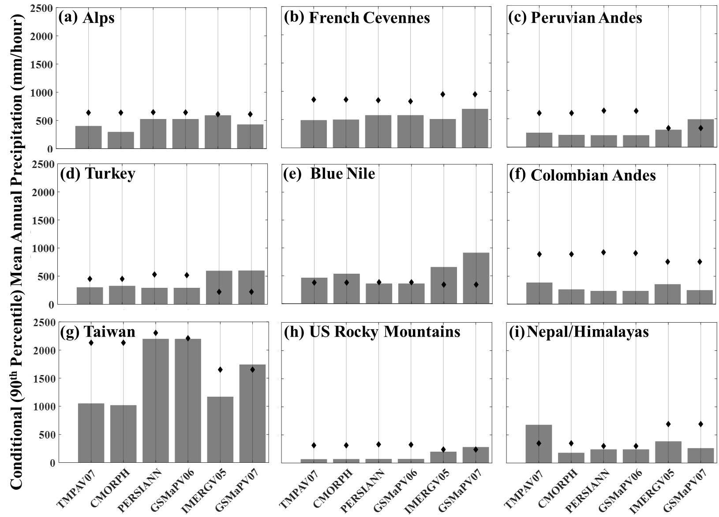
Multi-regional Satellite Precipitation Products Evaluation over Complex Terrain
Y. Derin, E. Nikolopoulos and Anagnostou., M. N., 2018: Retrieving Extreme Precipitation with Multiple Satellite-based Precipitation Products, Extreme Hydroclimatic Events and Multivariate Hazards in a Changing Climate, Elsevier

Slide 5
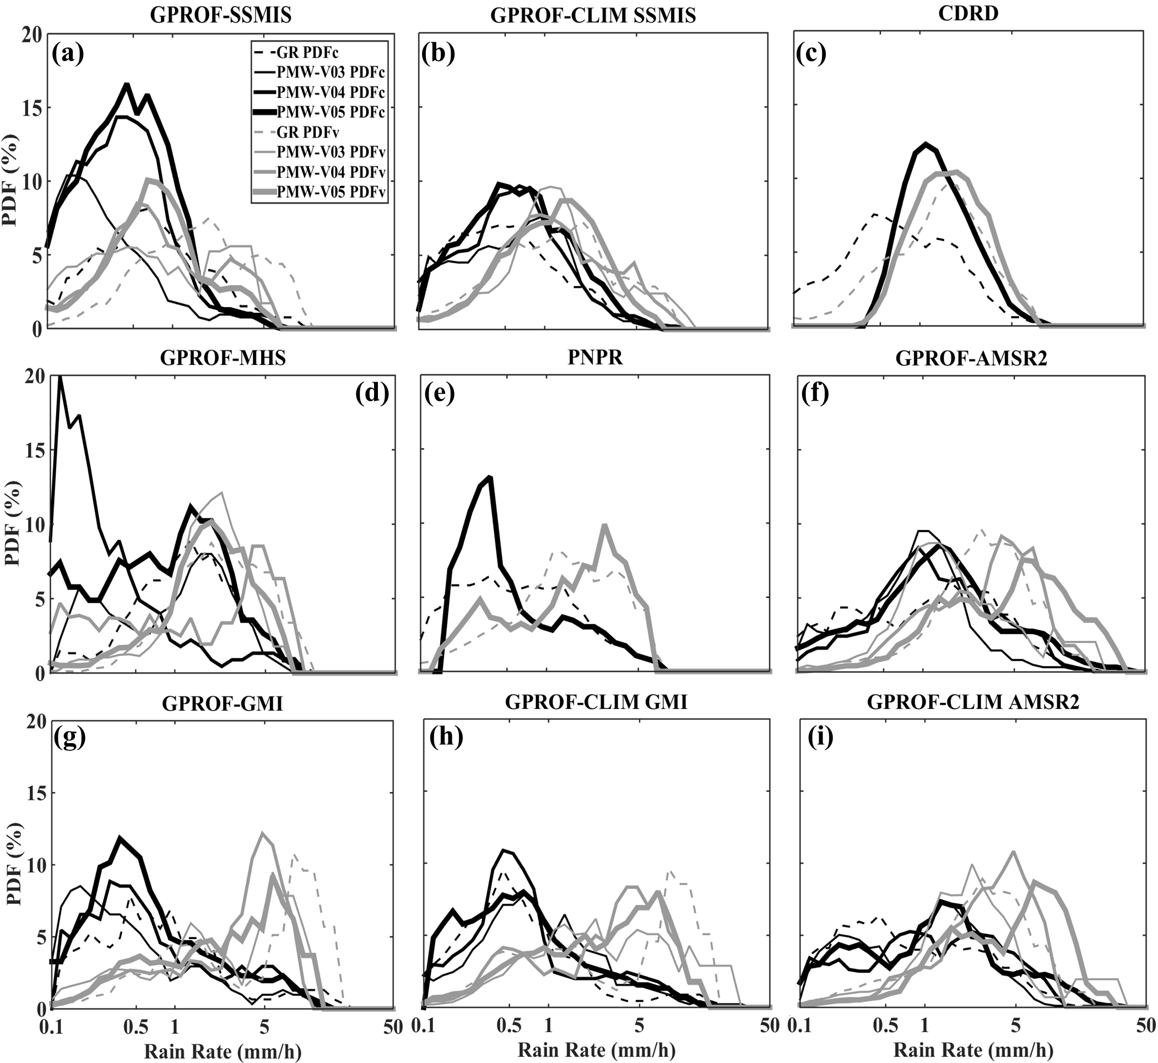
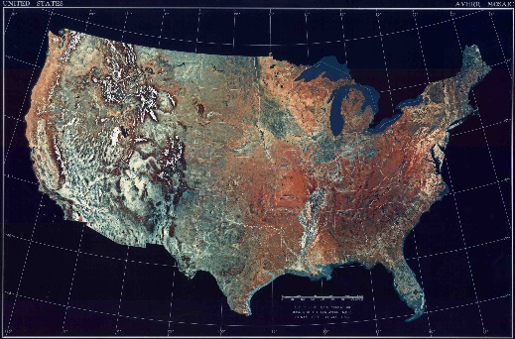
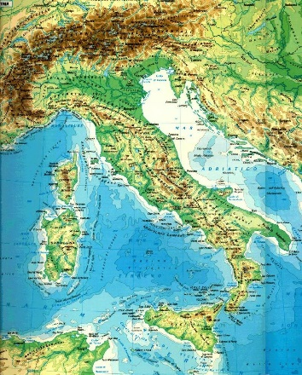
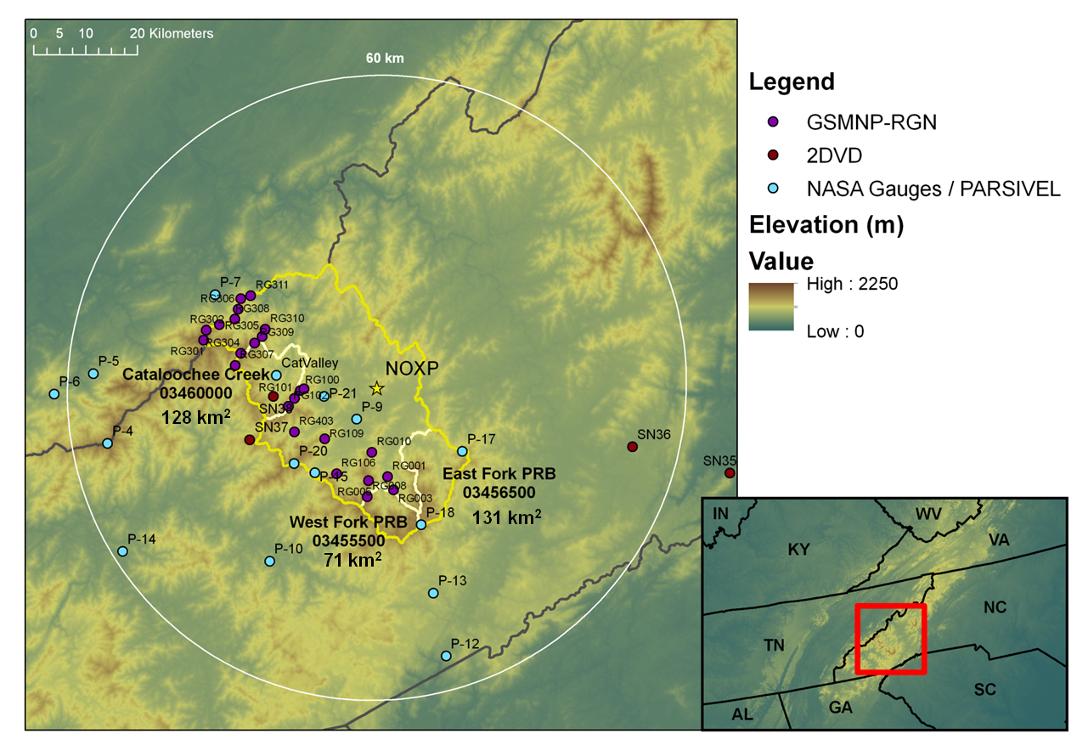
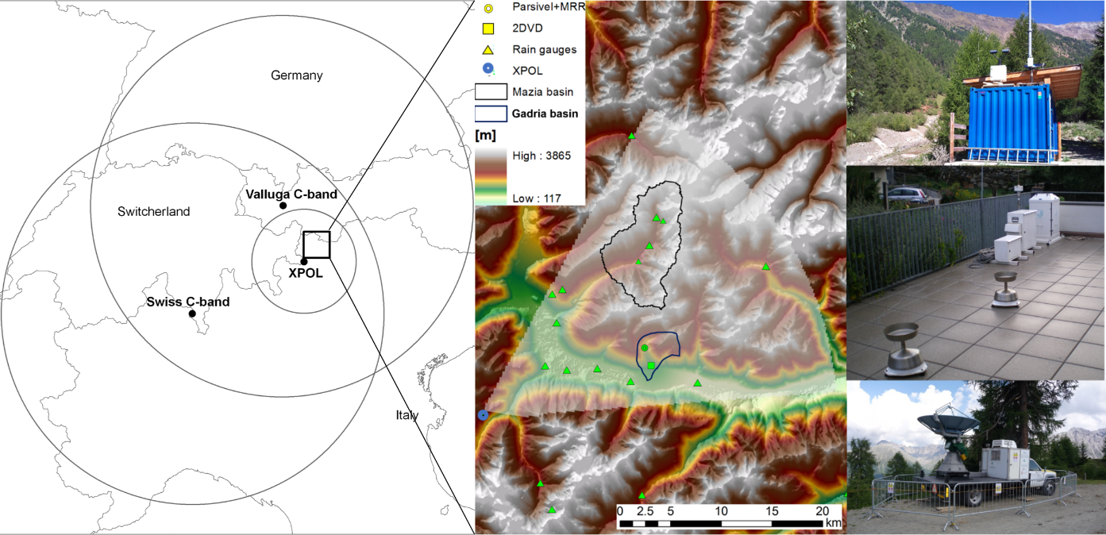
Passive Microwave Rainfall Error Analysis Using High-Resolution X-Band Dual-Polarization Radar Observations in Complex Terrain
North Carolina
May 1- June 15 2014
North Italy
August 1 – Oct 15 2014
21 Days
34 Days
Main Results;
The magnitude-dependent systematic error, going from overestimation or weak underestimation of light precipitation to mainly underestimation of heavier precipitation, shows weak covariation with the ground reference.
GPROF V5 algorithm depicted significant improvement over its previous versions (V3 and V4). In general, the GPROF-CLIM algorithm and GPROF V5 showed the best performance in terms of correlation and systematic error for both regions
Derin, Y., Anagnostou E., Anagnostou M. N., Kalogiros J., Casella D., Marra A. C., Panegrossi G., and Sano P., 2018: Passive Microwave Rainfall Error Analysis Using High-Resolution X-Band Dual-Polarization Radar Observations in Complex Terrain. IEEE Transactions on Geoscience and Remote Sensing, 56:5, 2565-2586; 10.1109/TGRS.2017.2763622

Slide 6
Passive Microwave Rainfall Error Analysis Using High-Resolution X-Band Dual-Polarization Radar Observations in Complex Terrain
Derin, Y., Anagnostou E., Anagnostou M. N., Kalogiros J., Casella D., Marra A. C., Panegrossi G., and Sano P., 2018: Passive Microwave Rainfall Error Analysis Using High-Resolution X-Band Dual-Polarization Radar Observations in Complex Terrain. IEEE Transactions on Geoscience and Remote Sensing, 56:5, 2565-2586; 10.1109/TGRS.2017.2763622

Slide 7
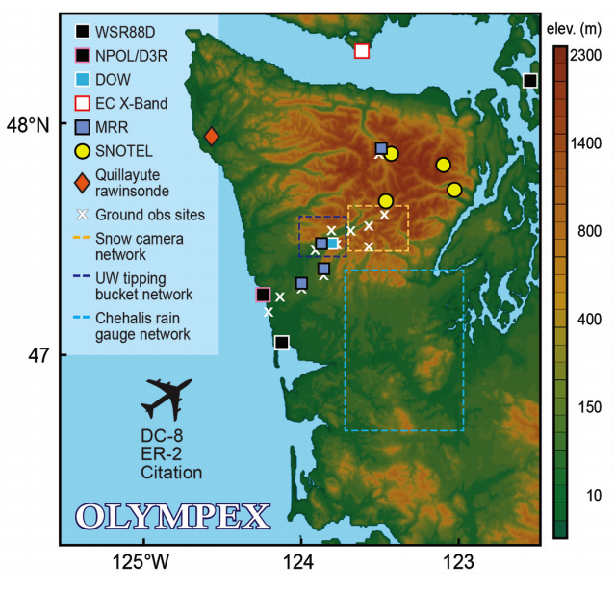
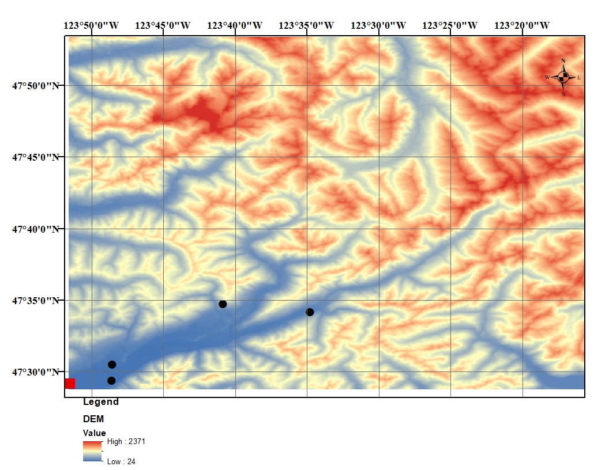
Analysis of X-Band Dual Polarization Radar Observations in OLYMPEX
Quantify precipitation and microphysical parameters from the OLYMPEX Doppler on Wheels (DOW) dual-polarization X-band radar.
Evaluate accuracy of these estimates against in-situ measurements from disdrometers, rain gauges and MRR.
Use the OLYMPEX experiment to demonstrate the value of locally deployed radar as a gap fill to operational radar networks in complex terrain (i.e. NEXRAD).
DOW
In-situ stations

Slide 8
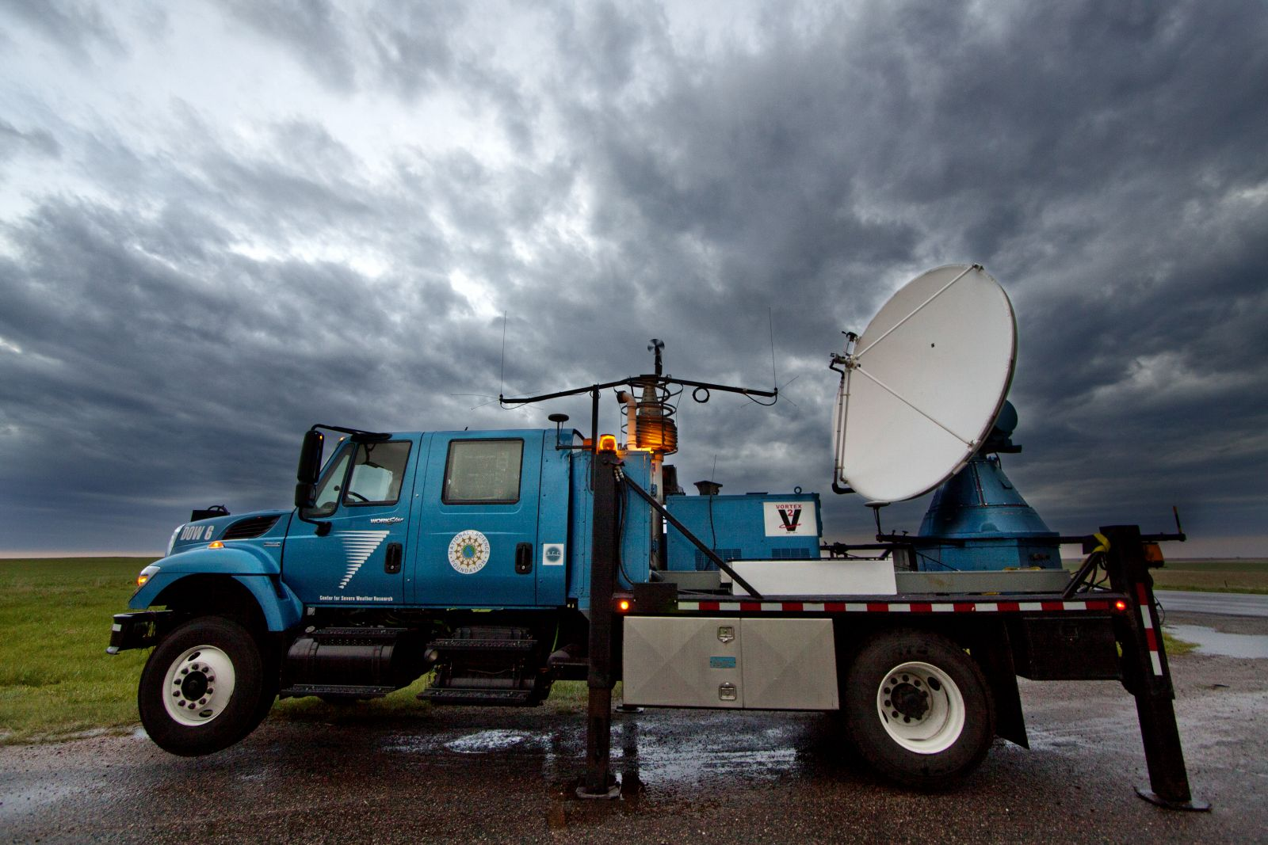
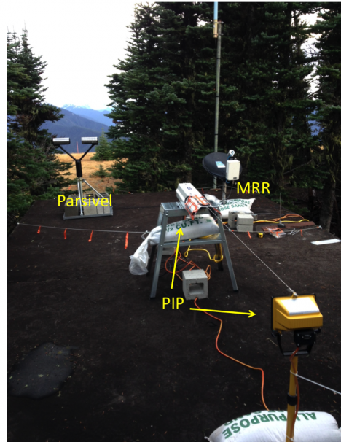
Datasets
DOW sector volumes contain scans at 6 elevations – app ~ 2.8, 3.0, 5.0, 7.0, 9.0 and 11.0 degrees
DOW properties
Range | 59.96 km
Gate Length | 75 m
Pulse Length | 500 ns
Beam Width | 0.93 deg
Beam Indexing | 0.25 deg
Lowest elevation angles
Highest elevation angles
Site IDs | Instruments | Range from DOW (km) | Elev (m)
DOW | DOW | - | 72
APU07, NASA0036 | Parsivel, Gauges | 4.65 | 65
APU08, NASA0029 | Parsivel, Gauges, MRR | 5.34 | 87
APU09, STDALN01 | Parsivel, Gauges | 15 | 116
APU11, STDALN02 | Parsivel, Gauges | 23 | 181
Close in-situ stations
Far in-situ stations

Slide 9
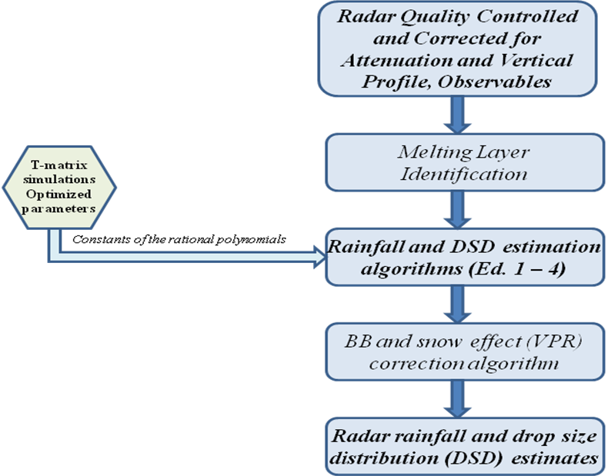
SCOPE-ME ALGORITHM
Precipitation Algorithm
Quality control (ρ_{HV}, V_{r}, σ_{Vr}, signal above noise level):
  real-time ground clutter detection and suppression
  beam blockage correction
  rain signal areas detection (ρ_{HV}>0.8)
  differential phase filtering (phase continuity, 1- 3 km linear filter for K_{DP})
Attenuation correction: KDP-based iterative differential phase algorithm along each ray
Bright-band detection and correction for VPR: ρ_{HV} based PPI areal method or RHI profile method
Rain rate and microphysical parameters estimation (SCOPE-ME)
Anagnostou, M. N., John Kalogiros, Frank S. Marzano, Emmanouil N. Anagnostou, Mario Montopoli, and Errico Picciotti, 2013: Performance evaluation of a new dual-polarization microphysical algorithm based on long-term X-band radar and disdrometer observations, J. Hydrometeor. 14, 560 – 576.
Kalogiros, J., M. N. Anagnostou, E. N. Anagnostou, M. Montopoli, E. Picciotti, and F. S. Marzano, 2014: Evaluation of a new Polarimetric Algorithm for Rain-Path Attenuation Correction of X-Band Radar Observations Against Disdrometer Data, IEEE Geoscience and Remote Sensing Letters, 52, 1369 – 1380.
Notes:
SCOP algorithm uses optimal parameterizations of specific horizontal and differential attenuation and backscattering phase shift in an iterative scheme.

Slide 10
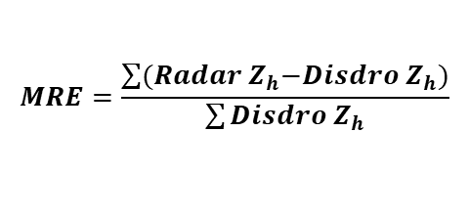
Reflectivity Comparison at Lowest Elevation Angle
Measured Z_{h}
Corrected Z_{h}
Height of the beam = 304, 340 m
$$MRE=\frac{\sum{{(Radar Z}_{h}−Disdro Z_{h})}}{\sum{Disdro Z_{h}}}$$
Closest Disdrometers
Height of the beam = 875, 2380 m
Farthest Disdrometers

Slide 11
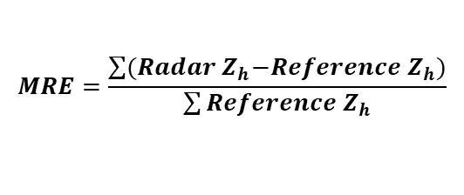
Reflectivity Comparison at Highest Elevation Angle
Measured Z_{h}
Corrected Z_{h}
$$MRE=\frac{\sum{{(Radar Z}_{h}−Reference Z_{h})}}{\sum{Reference Z_{h}}}$$
Height of the beam = 930, 1060 m
Closest Disdrometers
Height of the beam = 3025, 8330 m
Farthest Disdrometers

Slide 12

Reflectivity Comparison at Lowest & Highest Elevation Angle
Lowest Elevation Angle
Highest Elevation Angle
Radar Z_{hm}
Radar Z_{h}
$$Bias={Radar Z}_{h}−Disdro{ Z}_{h}$$

Slide 13
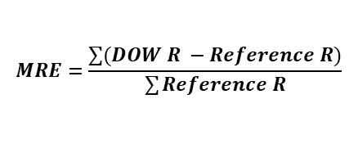
Rainfall Comparison for Lowest Elevation Angle
$$MRE=\frac{\sum{(DOW R −Reference R)}}{\sum{Reference R}}$$
Hourly Rainfall
15 min Rainfall
Closest in-situ stations

Slide 14
Rainfall Comparison for Highest Elevation Angle
$$MRE=\frac{\sum{(DOW R −Reference R)}}{\sum{Reference R}}$$
Hourly Rainfall
15 min Rainfall
Closest in-situ stations

Slide 15
Rainfall Comparison for Lowest & Highest Elevation Angle
Lowest Elevation Angle
Highest Elevation Angle
Closest RGs
Hourly Rainfall
Hourly Rainfall
Farthest RGs
15 min Rainfall
15 min Rainfall

Slide 16
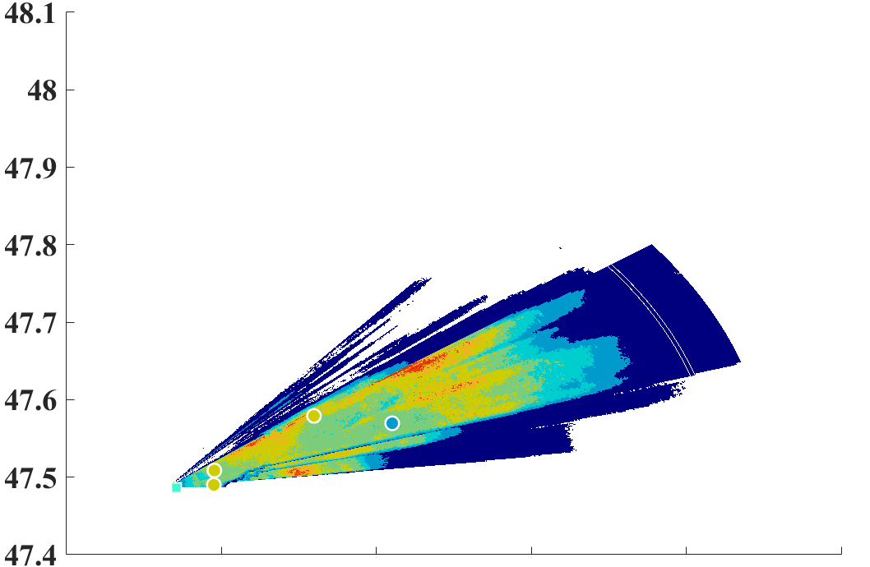
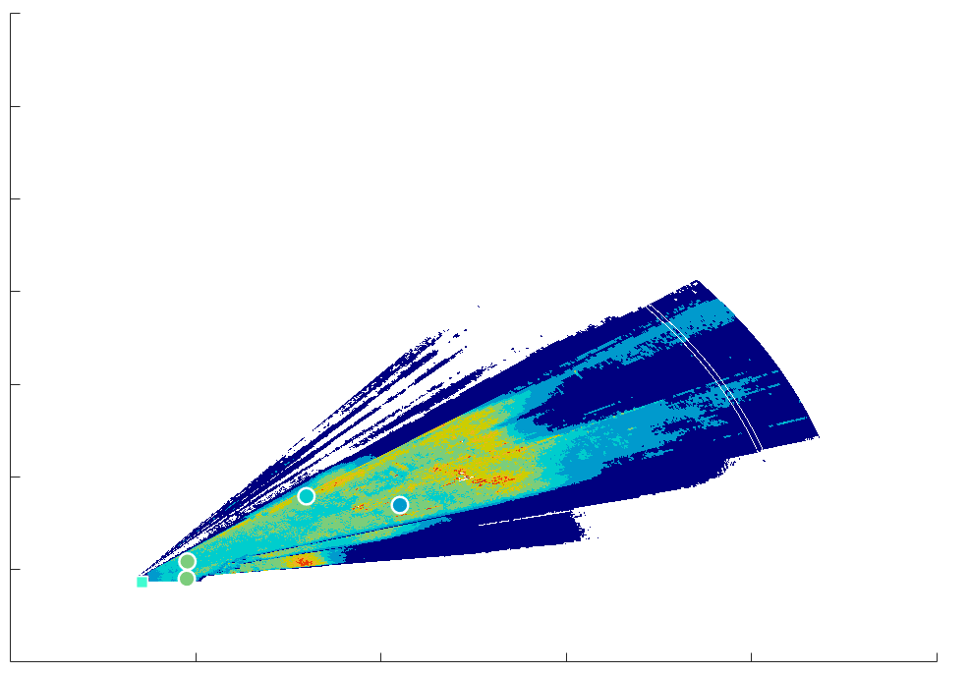
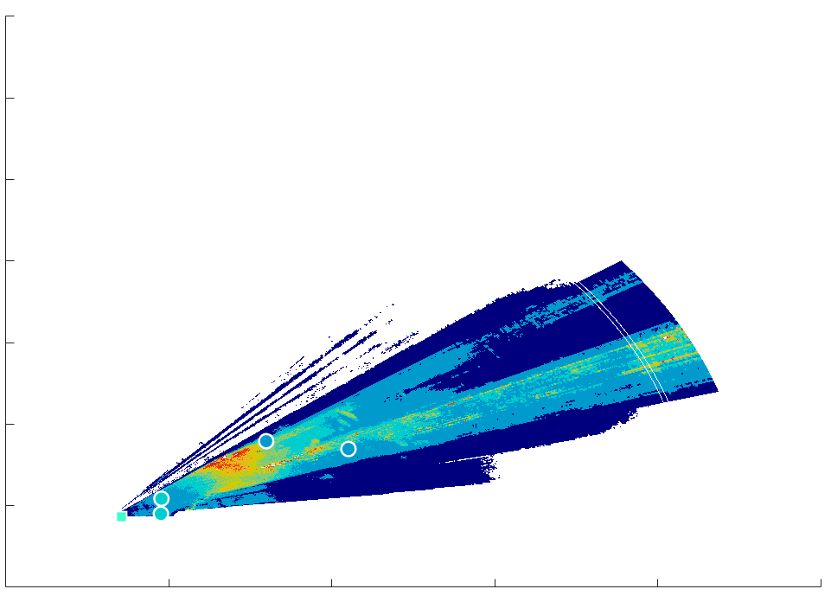



Event-based Accumulated Rainfall
Event: 2015 12 08
Event: 2015 12 09
Event: 2015 12 13
Disdrometer
Rain Gauges

Slide 17
Event-based PDFc (PDF by occurrence of rain rates) and PDFv (PDF by volume of rain rates)
Event: 2015 12 08
Event: 2015 12 09
Event: 2015 12 13

Slide 18
Closing Remarks
Our error analysis over North Carolina and Northeast Italy showed that PMW-based estimates have systematic underestimation particularly of high rain rates. In addition we showed that GPROF algorithm (both versions) applied on GMI has the least conditional bias. Almost all sensors have problem detecting light precipitation rates, however, performance varies across different algorithms.
The XPOL algorithm presented in this study would facilitate more comprehensive investigation of those PMW retrieval error characteristics, because the XPOL estimates were shown to have consistently low bias and random errors across different radar ranges and rainfall magnitudes. In addition, we showed that rainfall estimation error statistics is comparable to random error evaluated by comparing collocated in-situ stations.

Slide 19
Future Work
Apply XPOL estimates to study PMW retrieval uncertainty
Extend the work to additional complex terrain study areas capitalizing on their local XPOL observations.
 |  | Ground Radar | Location |  | Period | Collaborator
Processed |  | X-POL | Northeast Italian Alps |  | 07/2014-09/2014 (21 events) | John Kalogiros, NOA
 |  | NOXP | Appalachian, North Carolina |  | 05/2014-06/2014 (25 events) | NASA, IPHEX
 |  | DOW | Olympic Mountain, Washington |  | 10/2015-02/2016 (39 events) | NASA, OLYMPEX
 |  | NOXP | Rocky Mountains, Colorado |  | 09/04/2014-10/13/2014 (35 events) 07/31/2015-09/30/2015 (53 events) 03/01/2017-04/21/2017 (32 events) | Pierre Kirstetter, OU
To be processed |  | X-POL | Swiss Alps |  | 02/2014 03/2014-06/2014 06/2014-05/2015 11/2016-current | Alexis Berne, EPFL
 |  | NOXP | Andes, Peru |  | 01/18/2018-04/02/2018 (45 events) | Boonleng Cheong, OU
 |  | X-POL | French Cevennes & Alps |  | 09/2012-10/2012 09/2013-current | Guy Delrieu Univ. of Grenoble
 |  | X-POL | Korea |  | 01/14/2018-03/12/2018 | Alexis Berne, EPFL ICE-POP
 |  | X-POL | Arizona |  | 2018 summer (to be deployed) | Jonathan Gourley, OU
 |  | X-POL | Sierras de Córdoba Mountain range, Argentina |  | 2018 (to be deployed) | Joseph C. Hardin, Pacific Northwest National Laboratory

