Slide 1
TRMM PR Products in the GPM Era.
Boring Stuff
L1 Changes
L2 Retrieval Changes
Histograms
GPM DPR

Slide 2
Data, Filenames and Format
TRMM data has been reprocessed from 1997-2015.
  GPM-like formats
  HDF5 (TRMM V7 was HDF4).
  Filenames are now in GPM style (Product Version V05).
    Where did my orbit go?
      Orbit numbers are the same but overlap orbits belong to a different day. The beginning time stamp of the orbit product determines the day.
  Guide to HDF4 -> HDF5 changes can be found at:
  https://pps.gsfc.nasa.gov/Documents/TRMM_HDF5_Primer.pdf
  TRMM data is now part of the GPM data tree on FTP
    ftp://pps.gsfc.nasa.gov/gpmdata/<YYYY>/<MM>/<DD>/......
  STORM web ordering is also supported for latest TRMM data
    Geo/parameter subsets, etc.

Slide 3
PR Products/Fields in HDF5
PR

Slide 4
L1 and L2 Algorithm Changes
Level-1: 1BPR (powers)
  Calibration change.
  Sigma0 for PR is consistent with DPR Ku.
  New beam mismatch algorithm for post-boost data.
  New S/C attitude tracking with gyro/PR roll estimates.
Level-2: 2APR (retrievals)
  Similar to GPM Ku algorithm. GPM SLV module, not 2A25.
    DSD temporal database by month, default R-Dm relation.
  New surface database (same as GPM).
  Surface bin/clutter thickness could change.

Slide 5
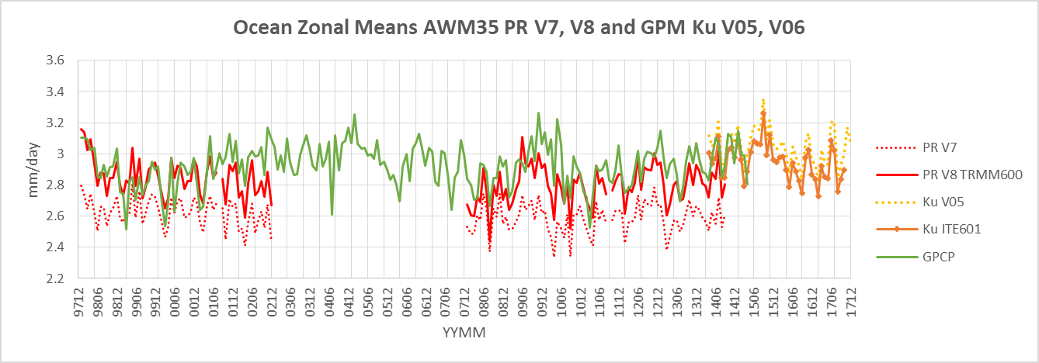
Changes relative to V7: Ocean
PR: (V8-V7)/V7 9% increase over V7
PR is Estimated Surface Precip.

Slide 6
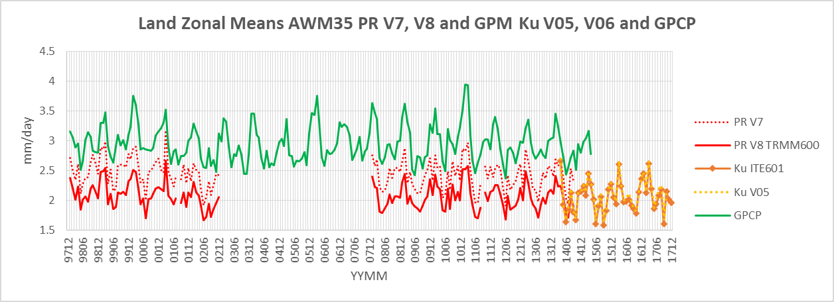
Changes Relative to V7: Land
PR: (V8-V7)/V7 15% decrease from V7
PR is Estimated Surface Precip

Slide 7
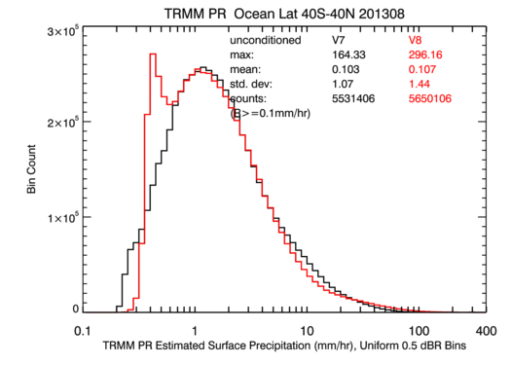
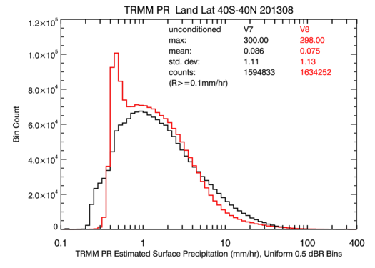
Histograms of Est. Surf. Precip.
Ocean
For GPM Ku precipitation there has been very little change between V05 and V06
Land
PDF of rain rates over ocean shows small changes except for second peak at ~0.4 mm/hr.
Over land, rain decreases above 5-6 mm/hr, increases below, and also shows sharp peak at 0.4 mm/hr.

Slide 8
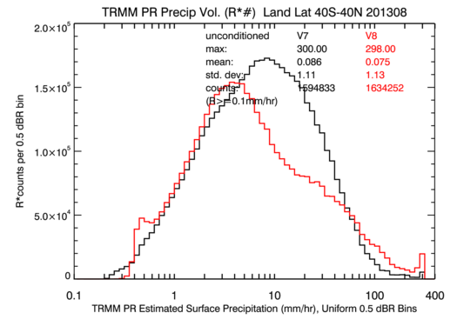
R Volume: Land.
Large changes to volume R>10mm/hr

Slide 9
GPM DPR Reprocessing
GPM DPR reprocessing set for Oct. 2018 (V06).
TRMM and GPM Combined algorithm reprocessing at same time.
  Combined algorithm in testing now.
IMERG later.
DPR Ka-HS scan change: May 21, 2018 (V05B products).
  Ka-HS ifovs now scan in the outer area beyond Ka-MS.
  Full 49 ray dual-frequency data; Ku/Ka.
  Ka-HS is now set to missing while DPR team changes algorithm.
  Full scan dual-frequency retrievals ~ end of 2019.

Slide 10
Backup

Slide 11
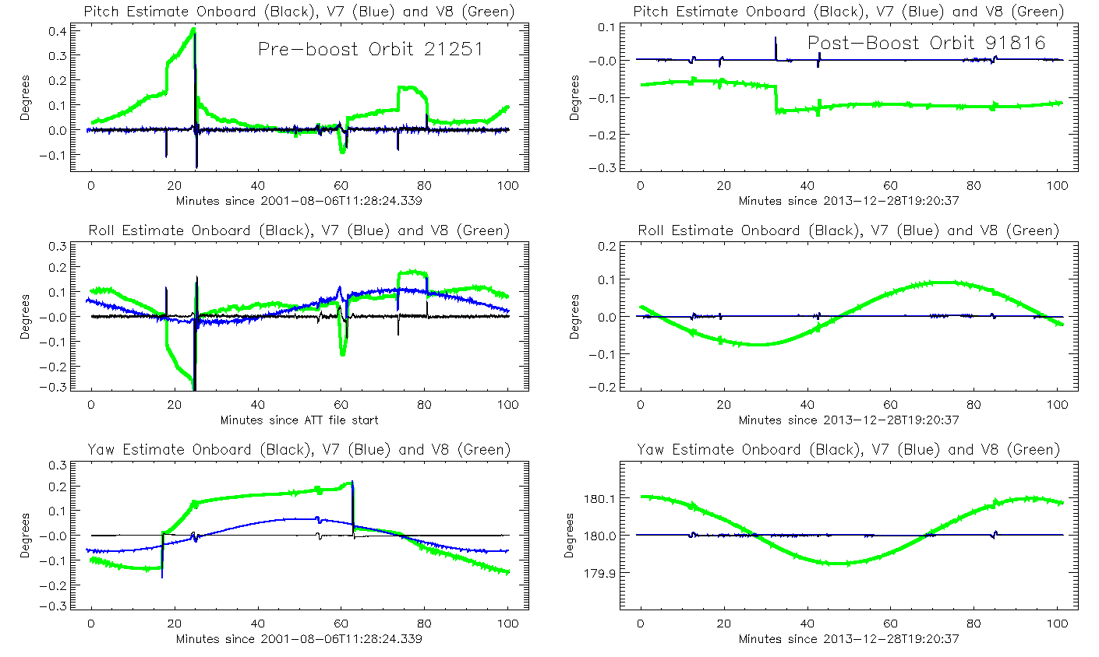
Geolocation: Spacecraft
Attitude/Ephemeris Improvements
S. Bilanow
New definitive ground attitude, replacing onboard estimates. Excursions now tracked using 3-axis gyro and PR science data. Typical pointing knowledge errors reduced from tenths to hundredths of a degree.
Preboost. Transient Pitch and Roll excursions up to ~0.2º, and Yaw changes twice each orbit are now included in attitude solution.
Postboost. Pitch drift and jumps up to ~0.2º, Roll and Yaw orbit-period deviations up to ~0.2º degrees are now tracked.
Roll errors in V7 were corrected from boost to 2009 with PR roll estimates. New solutions include entire post-boost time period.
Green – New solutions.
Blue – V7.
Black - Onboard reported.
Improved ephemeris in GPM format. Fixed occasional error up to 0.5 km.
Geolocation computational improvements with GPM-era software.

Slide 12
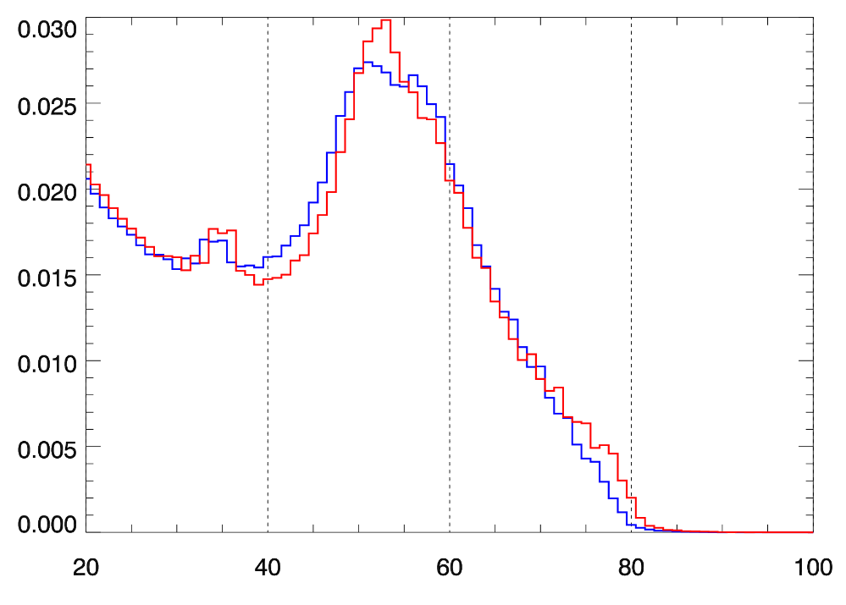
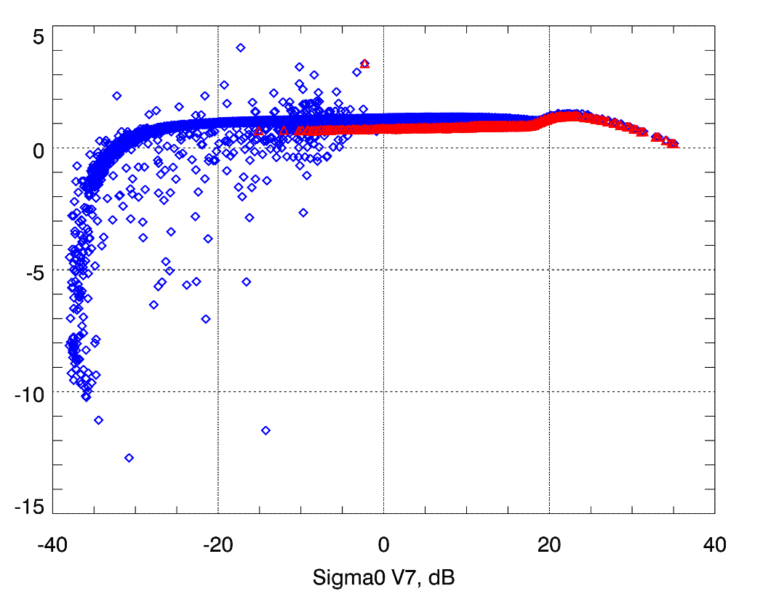
Zm/Sigma0
Distributions of Version 7 and Version 8 Zm
V8 is interpolated to DPR-like 125m resolution
Oct. 1999, 10 Orbits
Sigma0 Difference (Version 8 - Version 7)
Orbit of IFOVS, Oct. 3, 1999
Non-linear changes resulted in need for new Sigma0 temporal reference files.
Encapulates changes in calibration, pointing and surface location.
V7
V8
Relative Percent Occurance
Sigma0 V8 – V7, dB
All Angles
Nadir Only
Zm, dBZ

Slide 13
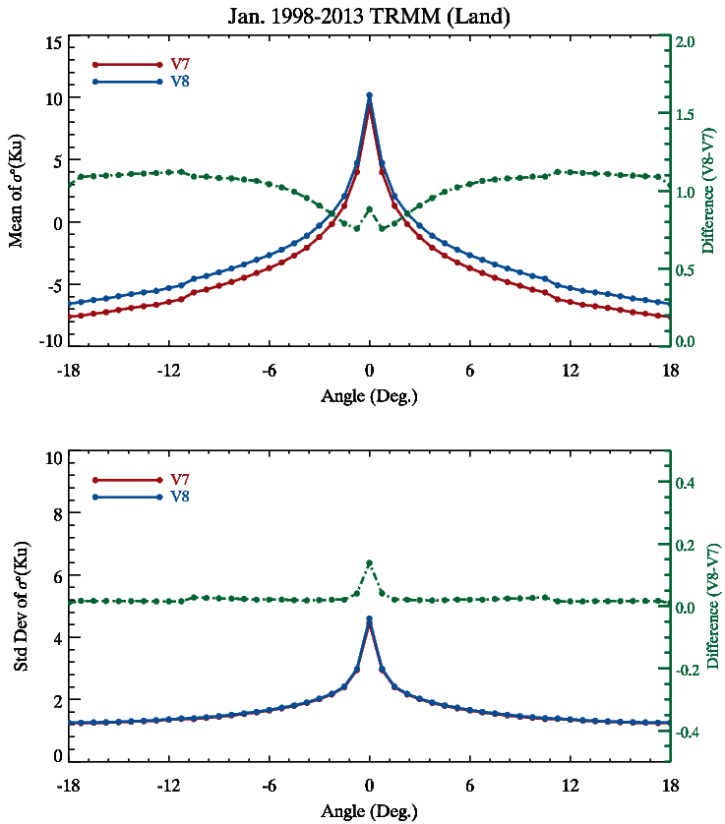
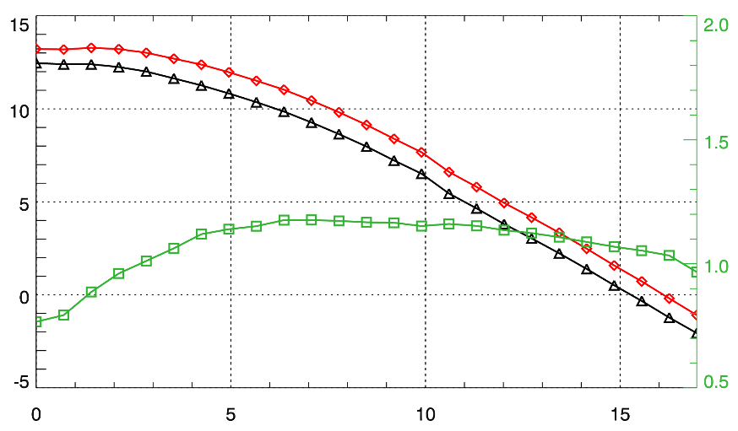
Sigma0 Temporal Reference
Land
Version 7 – 12 years
Version 8 – 17 years
V8 Sigma0 larger across all angles over Ocean.
~ 1dB.
Bob Meneghini/Hyokyung
Mean Sigma0 Ocean, January
V7
V8
Sigma0, dB
Difference (V8 – V7)
V8 - V7
Angle from Nadir

