Slide 1



Overcoming the pixel: a nonlocal formulation of GPM passive MW precipitation retrieval
Clément Guilloteau, Efi Foufoula-Georgiou

Slide 2

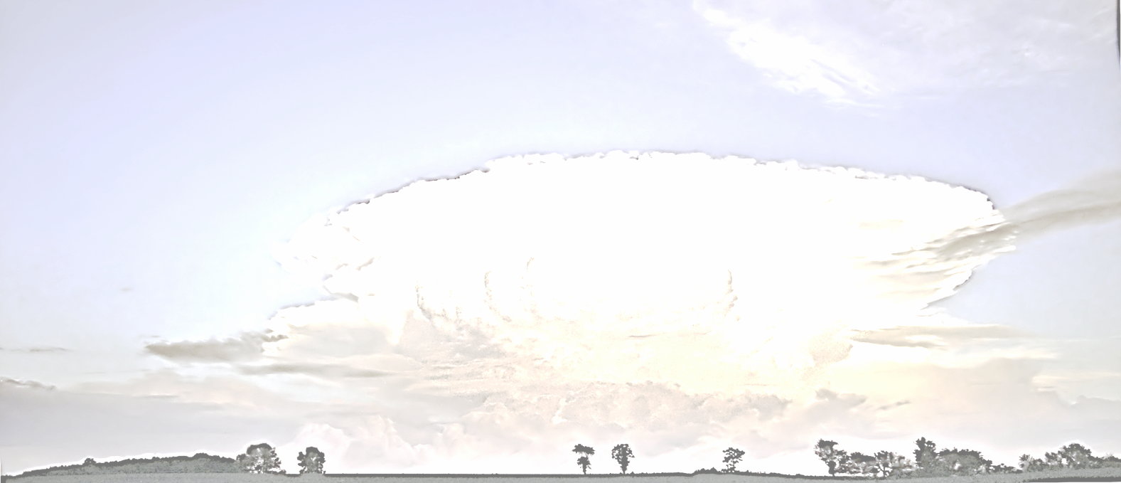
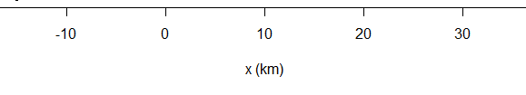
An underdetermined inversion problem
1
The direct problem:
TB = f(R_{C},E_{S})
Resolved by radiative transfer models.
The inverse problem:
R_{C} = g(TB,E_{S})
Observed TBs
Hydrometeors
profile
Surface emissivity
Radiative
transfer
?
Surface emission
x (km)

Slide 3
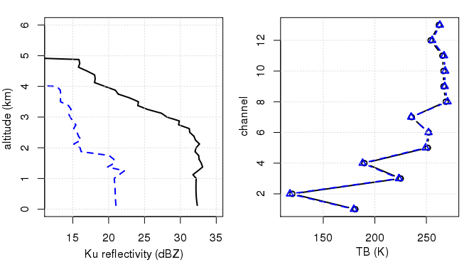

An underdetermined inversion problem
2
The direct problem:
TB = f(R_{C},E_{S})
Resolved by radiative transfer models.
The inverse problem:
R_{C} = g(TB,E_{S})
DPR Ku reflectivity GMI spectral signature
Hydrometeors
profile
Surface emissivity
profile A
profile A
profile B
profile B
?
Different hydrometeor
profiles
Same spectral signature
Underdetermined

Slide 4
Retrieval from an a-priori database
3
Principle:
Look for the solution among a set of previously observed atmospheric profiles: the a-priori database.
e.g.: GPM DPR profiles associated to observed (or simulated) TBs.
Select the appropriate profile based on the radiometric distance to the observation, i.e. a vectorial distance in a N-dimensional space, N = number of channels, (N = 13 for GMI).
The retrieval becomes an interpolation problem in the N-dimensional radiometric space.

Slide 5
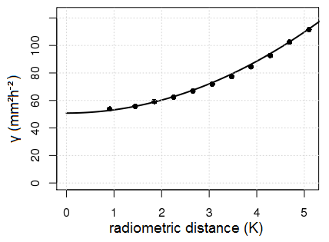
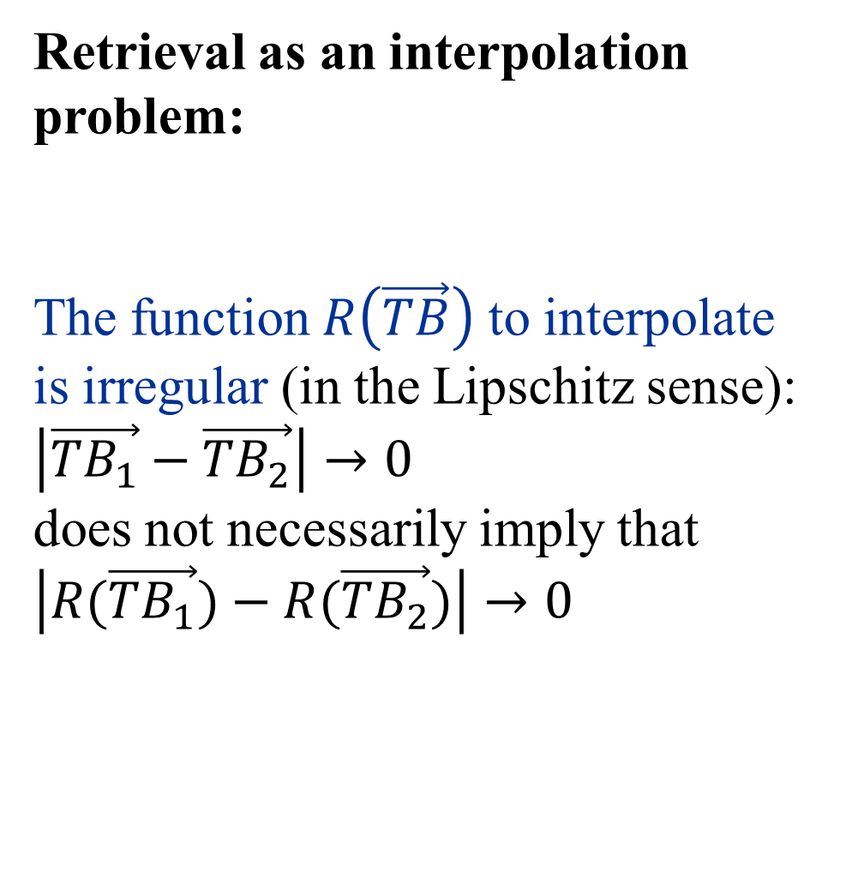
Retrieval from an a-priori database
4
Retrieval as an interpolation problem:
The function $R\left(\vec{TB}\right)$ to interpolate is irregular (in the Lipschitz sense): $\left|\vec{{TB}_{1}}−\vec{{TB}_{2}}\right|→0$
does not necessarily imply that $\left|R(\vec{{TB}_{1}})−R(\vec{{TB}_{2}})\right|→0$
variogram of R(TB) in the 13-D GMI TB space
nugget effect

Slide 6

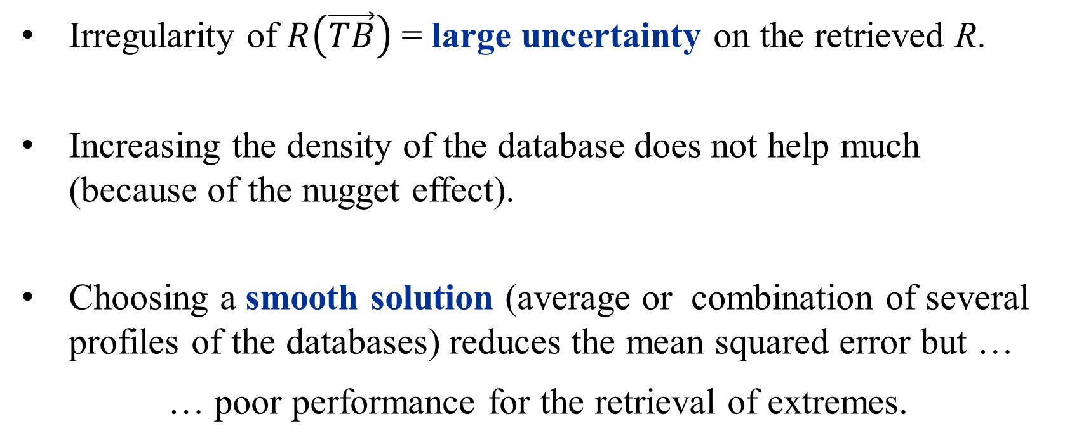
Retrieval from an a-priori database
5
Irregularity of $R\left(\vec{TB}\right)$ = large uncertainty on the retrieved R.
Increasing the density of the database does not help much (because of the nugget effect).
Choosing a smooth solution (average or combination of several profiles of the databases) reduces the mean squared error but …
… poor performance for the retrieval of extremes.

Slide 7
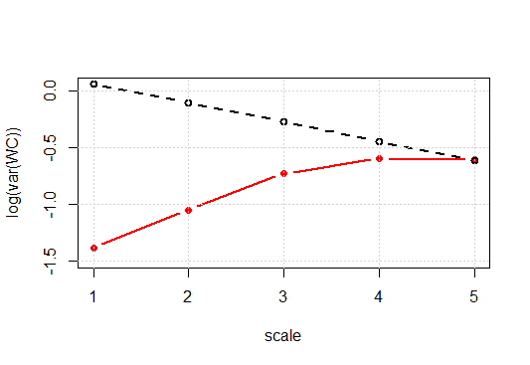
Retrieval from an a-priori database
6
smooth relations in the TB space = spatially smooth retrieved precipitation fields
Irregularity of $R\left(\vec{TB}\right)$ = large uncertainty on the retrieved R.
Increasing the density of the database does not help much (because of the nugget effect).
Choosing a smooth solution (average or combination of several profiles of the databases) reduces the mean squared error but …
… poor performance for the retrieval of extremes.
GPROF and KUPR wavelet spectra over oceans
GPM radar instantaneous precip.
GPM passive MW instant. precip. (GMI-GPROF)
5km 10km 20km 40km 80km
Guilloteau et al, JHM, 2017
New information needed to reduce the uncertainty.

Slide 8
Adding new information
7
Supplementary information …
… can be obtained from ancillary datasets, e.g. surface type, environment parameters from reanalyses (CAPE, TPW, 2-m-temperature …).
… can be extracted from the spatial variations of the TBs in the neighborhood around the “pixel” of interest.
New paradigm:
Current algorithms invert one “pixel” at a time and all “pixels” independently, ignoring the spatial structure of precipitation across adjacent “pixels”.
The “nonlocal” approach aims at overcoming the pixel-wise relations between TBs and precipitation.

Slide 9
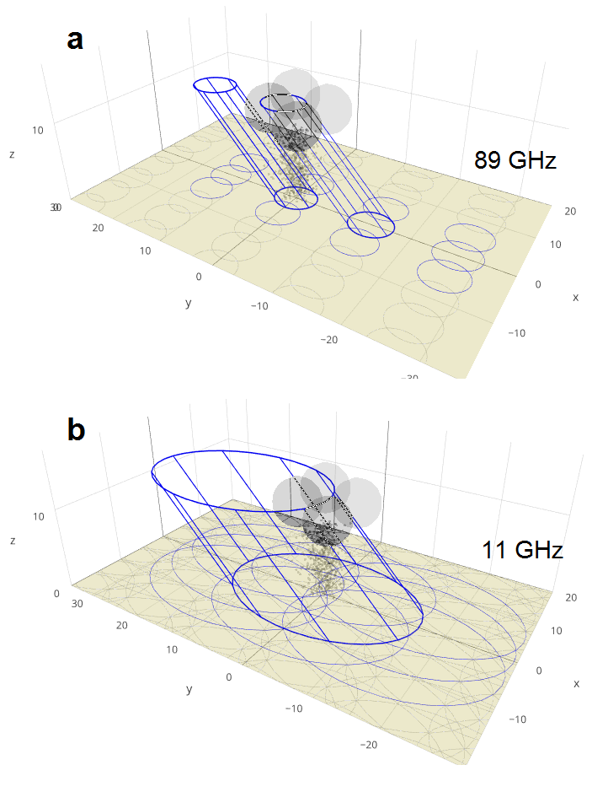
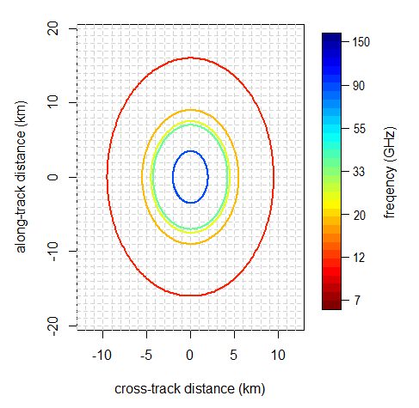
Why?: “nonlocal” information in observed TBs
8
Observation geometry
GMI footprints at various frequencies
What is the retrieval field of view? What defines the “pixel” and the retrieval “resolution”?

Slide 10
Why?: “nonlocal” information in observed TBs
9
Observation geometry
Low Frequencies (<40 GHz): Significant overlapping of the fields of view.
High Frequencies: 53° Earth incident angle => a vertical atmospheric column always interpolated by at least two different fields of view.
Different channels responding to different altitude levels => multi-spectral signature characterizing a vertical atmospheric column split across several pixels.

Slide 11
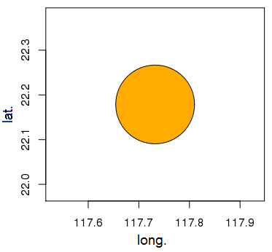
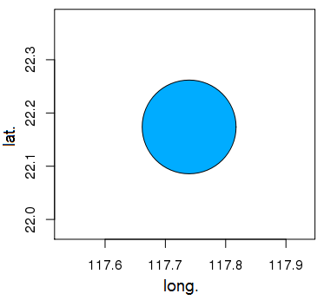
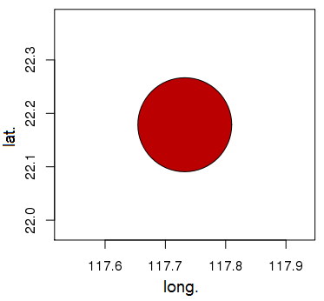

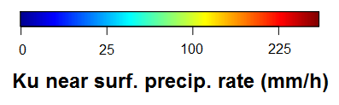
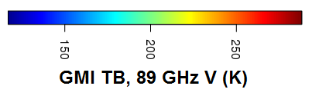
Why?: “nonlocal” information in observed TBs
10
Illustrative case study:
DPR
GMI GPROF
GMI 89 GHz V TB
149 mm/h
24 mm/h
278 K
NO ICE ?

Slide 12
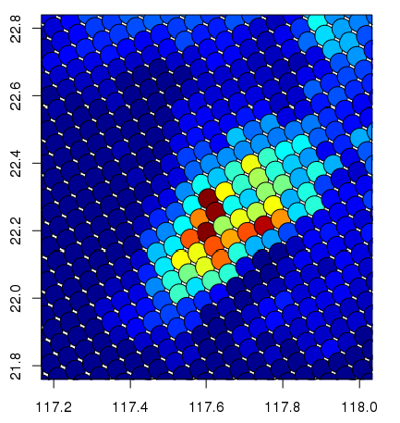
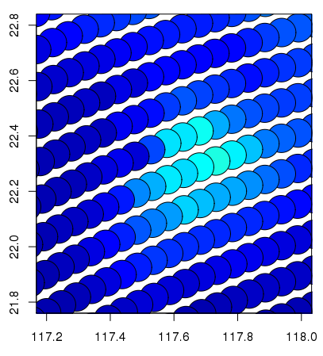
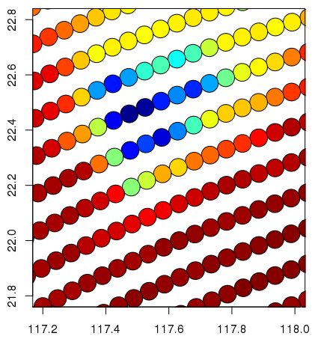
Why?: “nonlocal” information in observed TBs
11
Illustrative case study:
DPR
GMI GPROF
GMI 89 GHz V TB

Slide 13
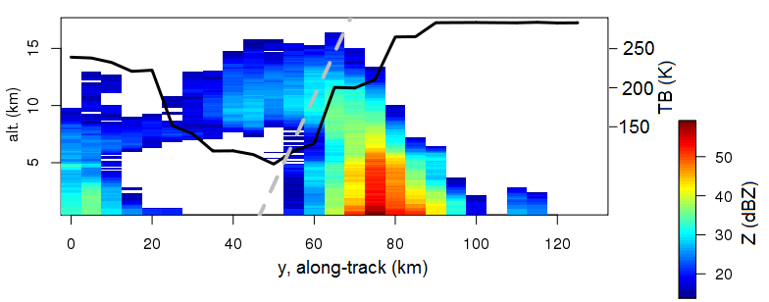
Why?: “nonlocal” information in observed TBs
12
Three-dimensional structure of the system:
TB 89 V

Slide 14
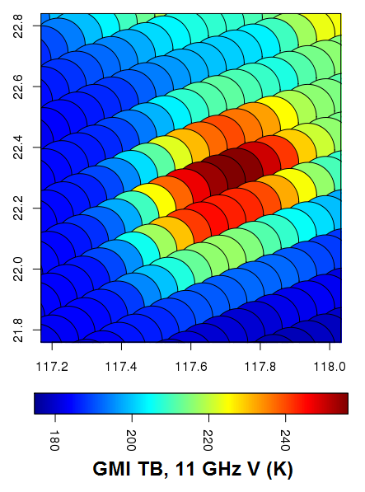
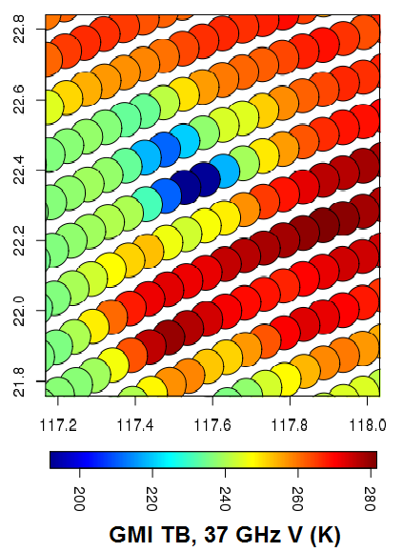
Why?: “nonlocal” information in observed TBs
13
GMI 89 GHz V TB
GMI 11 GHz V TB
GMI 37 GHz V TB

Slide 15
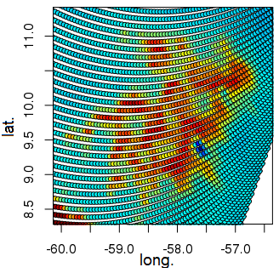
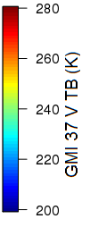
Why?: “nonlocal” information in observed TBs
14
37 GHz TB sensitive to both liquid emission and ice scattering. => Non-monotonic response to precipitation intensity.
Area with low / medium TBs embedded inside an area of high TBs = geometric signature of a convective cell.
Specific TB patterns are the signatures of specific atmospheric features.
Scale dependence in the covariations of TBs and precipitation.

Slide 16
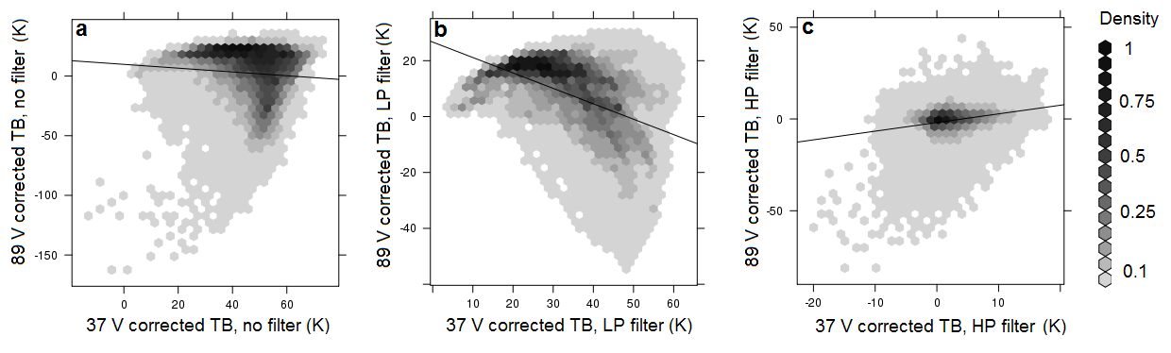
Why?: “nonlocal” information in observed TBs
15
relations between TBs 37V and 89V as a function of the scale
37 GHz TB sensitive to both liquid emission and ice scattering. => Non-monotonic response to precipitation intensity.
coarse scales > 100km
fine scales < 40 km
all scales
Area with low / medium TBs embedded inside an area of high TBs = geometric signature of a convective cell.
Specific TB patterns are the signatures of specific atmospheric features.
Scale dependence in the covariations of TBs and precipitation.
over ocean, TBs corrected from the influence of surface temperature

Slide 17
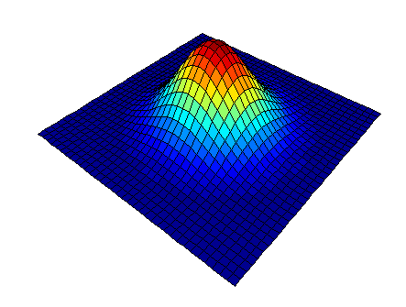
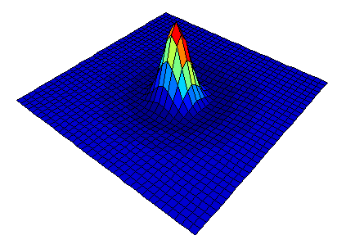
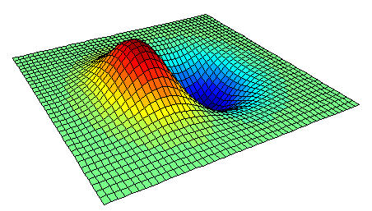
How?: extracting the nonlocal information
16
The spatial variability of the TBs around can be analyzed through convolution filters.
Pattern extraction (with or without directionality parameter)
Multiscale decomposition of the TB fields (orthogonal filters / wavelets)
Gaussian
Differences of Gaussians

Slide 18
How?: utilizing the nonlocal information
17
The nonlocal parameters derived from the spatial variations of the TBs can be used in various ways:
By performing a pre-selection of the atmospheric profiles of the a-priori database before the retrieval, i.e. a first classification step.
By including them in the observation vector to augment it and compute the radiometric distances in a higher-dimensional space to perform the retrieval.

Slide 19
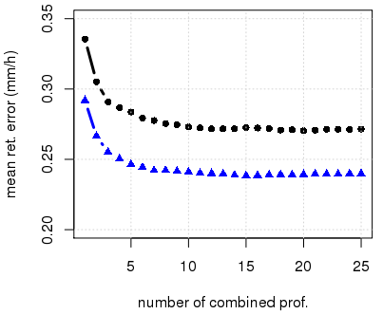
Preliminary results
18
Retrieval from GMI over land with a 700 000 - profile a-priori database:
13 “pixel” TBs
+ 2m temp. + surf. type
13 “pixel” TBs
+ 2m temp. + surf. type
+ 3 nonlocal param. (at 37 and 89 GHz)

Slide 20
Conclusions
Current algorithms perform pixel-wise retrievals associating the precipitation rate in a “pixel” only to the TBs observed inside the pixel.
But the pixel exists within a context. TB fields have a spatial organization reflecting the spatial organization of precipitation. ⇒ There is information outside of the pixel.
+ With the scanning geometry of GMI and other similar instruments the pixel is ill-defined.
Information from outside the pixel can be extracted (e.g. using convolution filters) to better constrain the inversion and reduce the retrieval uncertainty.

