Slide 1
An Active-Passive Microwave Land Surface Classification from GPM
Joe Munchak*, Ludovic Brucker, Sarah Ringerud, Yalei You,
and Catherine Prigent
*s.j.munchak@nasa.gov

Slide 2
Outline
Introduction/Motivation
Emissivity Retrieval
Precipitation Screening and Cloud Clearing
Database Construction
Data Availability
Land Surface Classification

Slide 3
Introduction/Motivation
Existing microwave emissivity atlases (e.g., TELSEM) are useful, but lack the full range of GMI frequencies
Backscatter at DPR frequencies and incidence angles used in temporal reference component of SRT, but not linked to microwave emissivity
Superior calibration, resolution, and matched active-passive data from GPM provide uniquely valuable dataset for model developers
In order to provide a dataset relevant to these application areas, we have developed a 5-year database of GPM emissivity and backscatter data

Slide 4
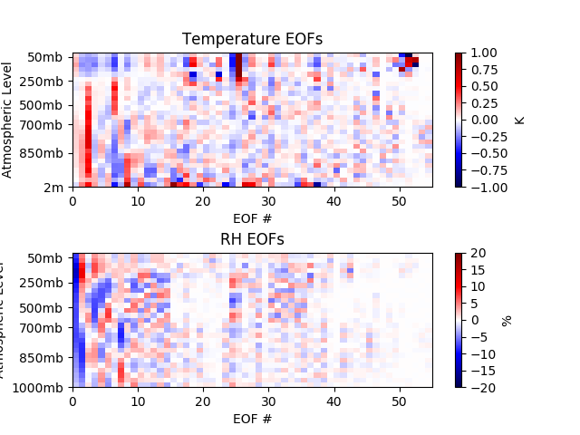
Emissivity Retrieval
Optimal estimation at each GMI pixel
Use MERRA2 for T_{skin} and first-guess atmosphere (temperature and water vapor profile)
Retrieve emissivity vector and EOF representation of MERRA2 error
No assumed covariance between emissivity at different channels (except 18V-23V-36V and 166-183) – we want to use output to discover these relationships

Slide 5
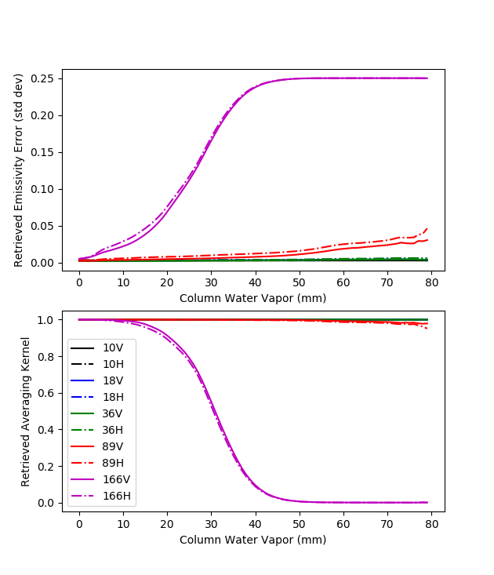
Information Content
As column water vapor increases, GMI Tb becomes less sensitive to surface emissivity, therefore it becomes difficult to retrieve and can be influenced by errors in water vapor profile.
Effect is not significant below 89 GHz, and even there only for very high column water vapor (> 50 mm). At 166 GHz the impact is much larger. Retrievals not reliable above 10-20mm column water vapor.
Clouds and precipitation also impact retrievals significantly and must be screened, as these are not accounted for in the forward model.

Slide 6
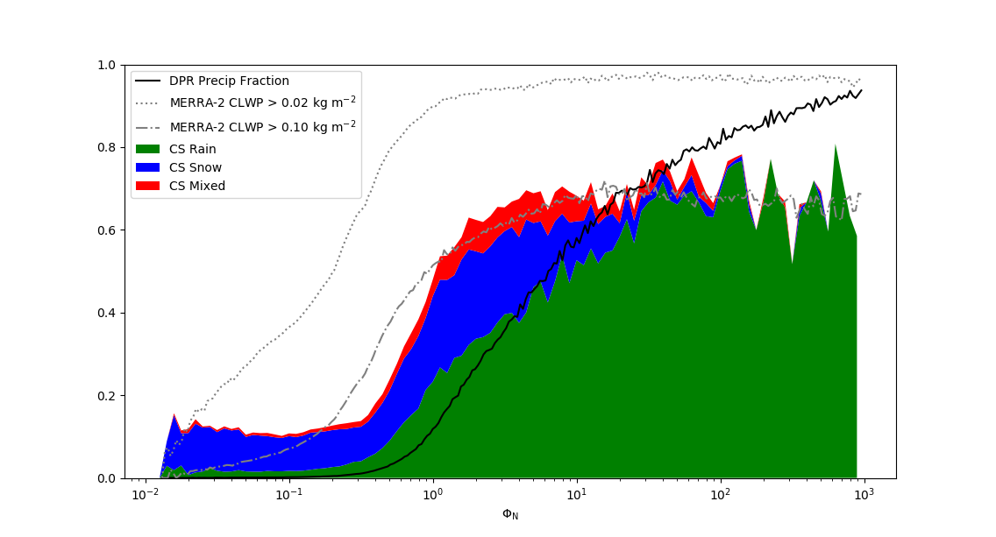
Precipitation Screening by Normalized Cost Function
Light Precipitation detectable by GMI but not DPR

Slide 7
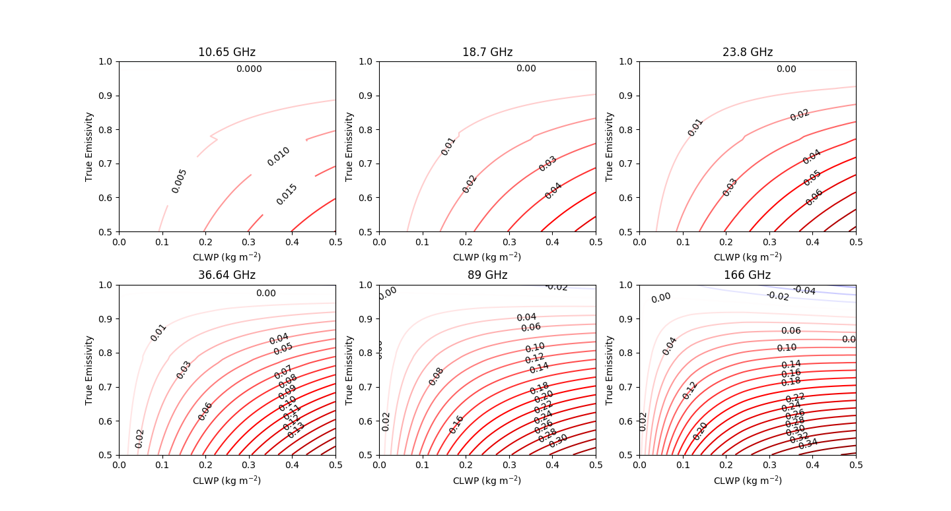
Influence of Liquid Clouds on Retrieved Emissivity
Contours are retrieved emissivity error (retrieved minus true). Error can be significant, yet difficult to retrieve cloud unless emissivity is already strongly constrained. Solution: Use ancillary data (MERRA2) to screen clouds.

Slide 8
Database construction and availability
Retrieval run for full GMI swath at GMI resolution (GMI.*.HDF5 files)
Contains retrieved emissivities, column water vapor, GMI observed and simulated Tbs, retrieval cost function, MERRA2 fields (Tskin, cloud LWP, column water vapor)
Match to DPR resolution (nearest neighbor) (GPM.*.HDF5 files)
All the data in the GMI files, plus several fields copied from DPR files (incl. GANAL Tskin, precip flags, snow flags, sigma_zero, PIA from gas attenuation)
Files for March 2014 – February 2019 available at ftp://meso-a.gsfc.nasa.gov/pub/munchak/gpm/emis/
Switching to ftps in near future
Anticipated to be part of GPM combined algorithm V7

Slide 9
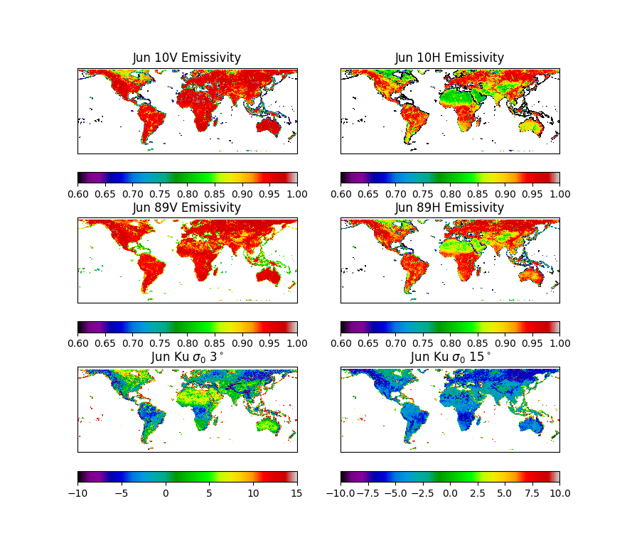
Gridded Database Construction
0.25°-resolution grids of the following statistics compiled:
Mean emissivity (n=11)
Mean sigma_zero (n=25+13)
Emissivity covariance matrix (n=66)
Sigma_zero covariances (n=51)
Emissivity-sigma_zero covariances (n=418)
Separate grids for each month
Separate grids for snow/sea ice

Slide 10
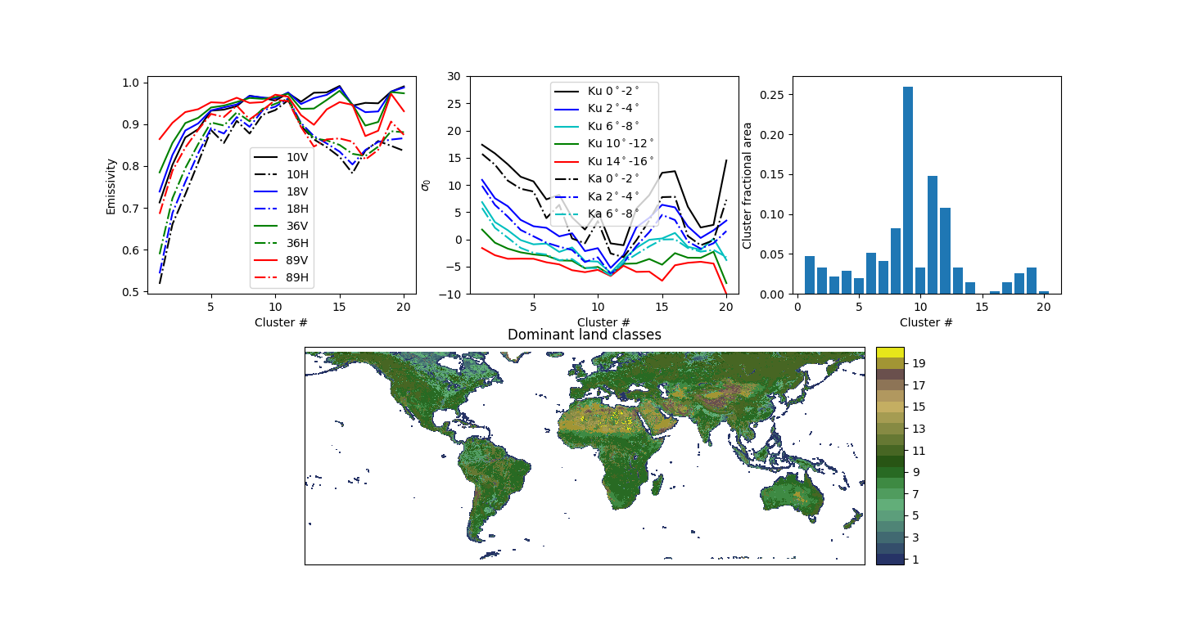
Kohonen Self-Organizing Map Clustering Method: Snow-free land

Slide 11
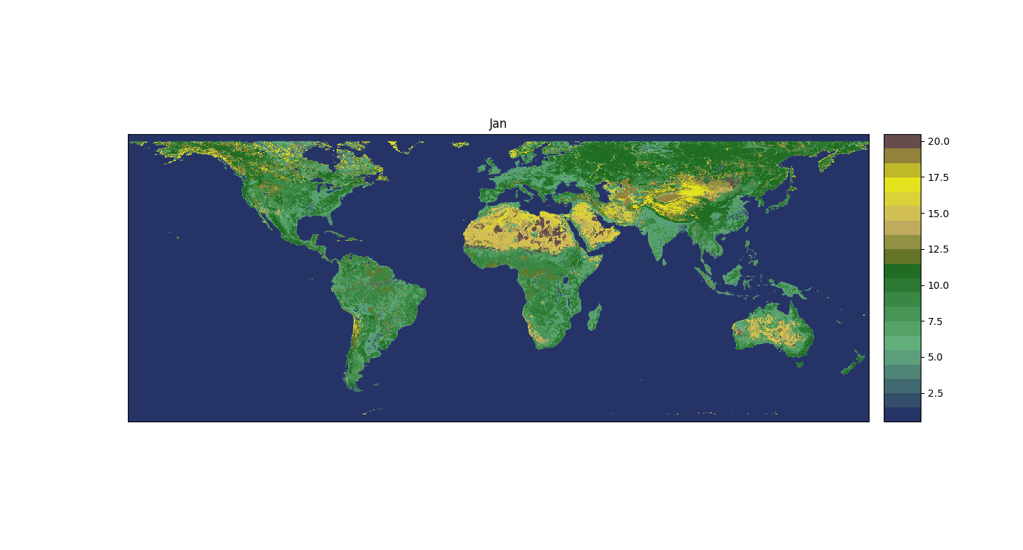

Slide 12
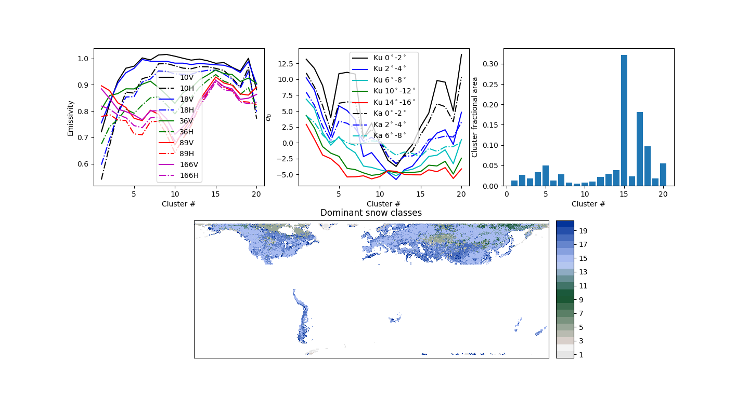
Kohonen Self-Organizing Map Clustering Method: Snow-covered land

Slide 13
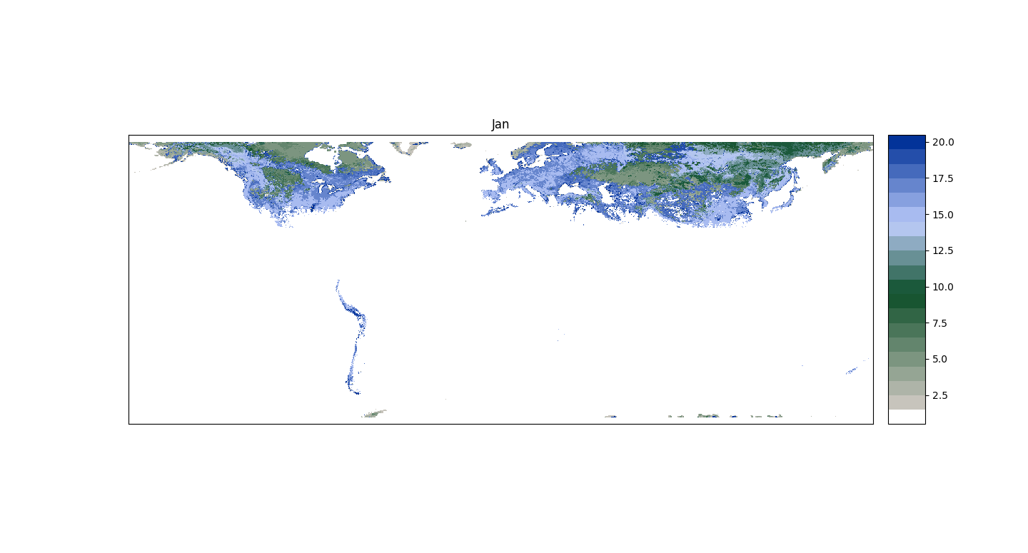

Slide 14
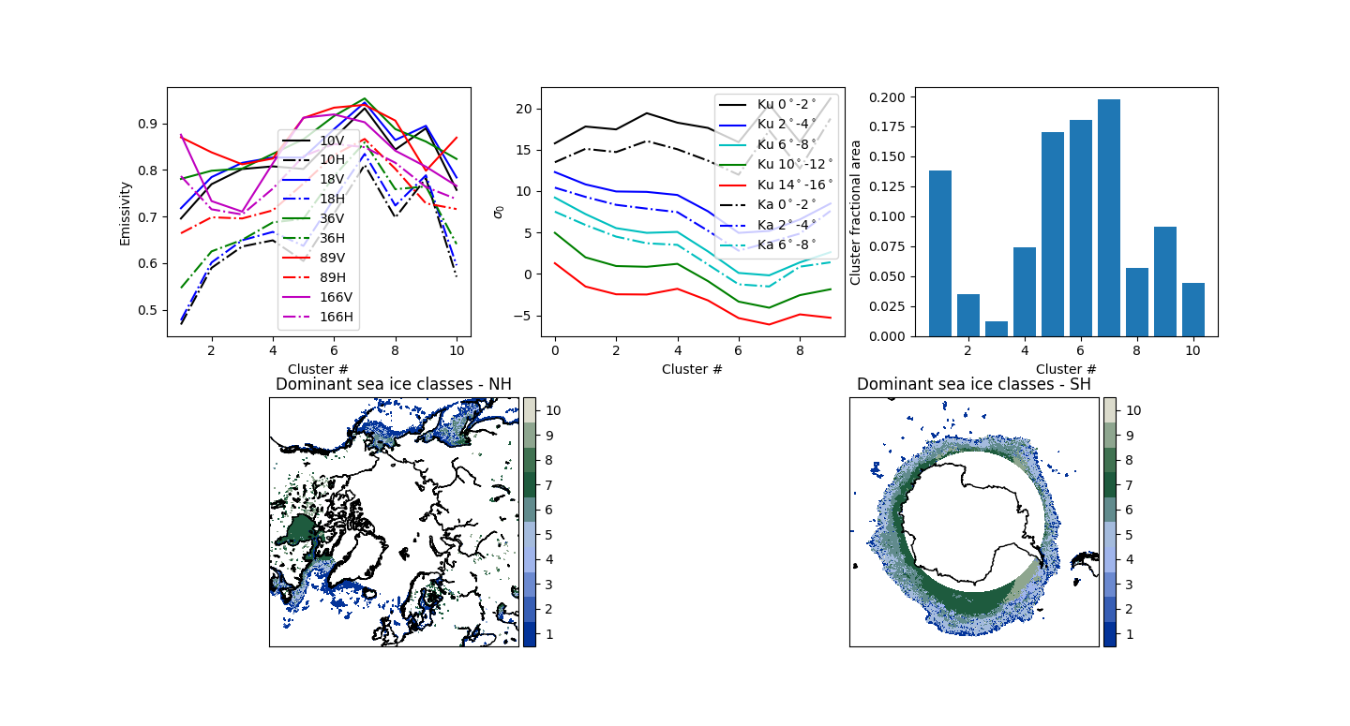
Kohonen Self-Organizing Map Clustering Method: Sea ice

Slide 15
