Slide 1
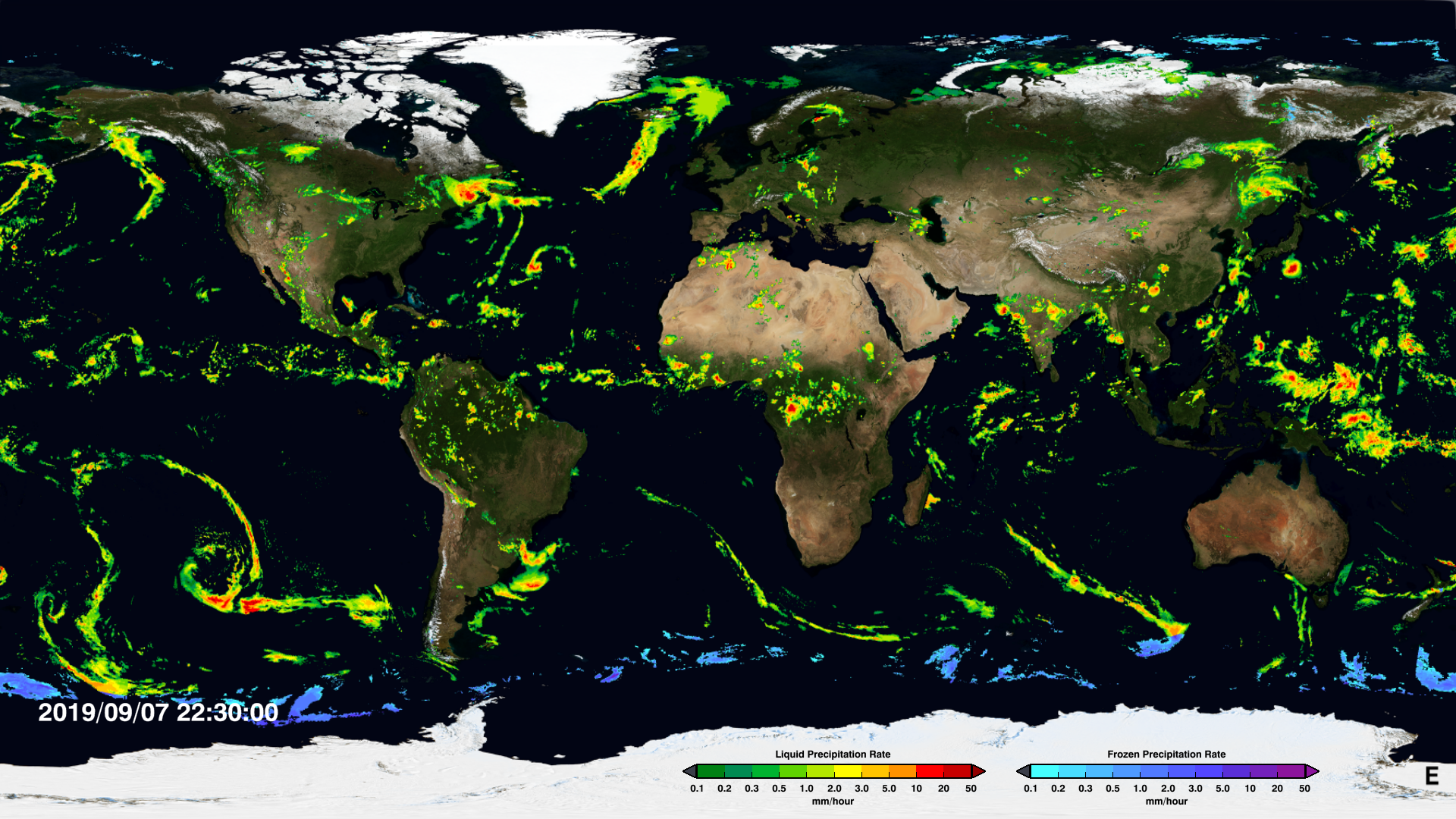
IMERG Precipitation Rate Distribution
pmm.nasa.gov
Mani Rajagopal, Prof. Ed Zipser
University of Utah
11th Sep 2019

Slide 2
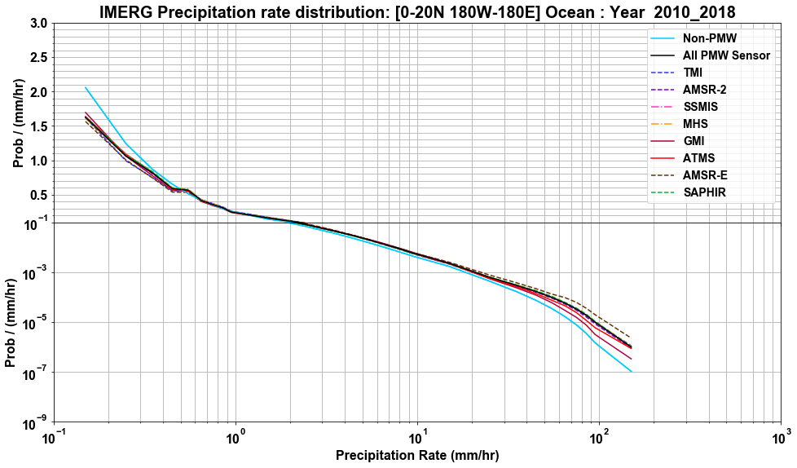
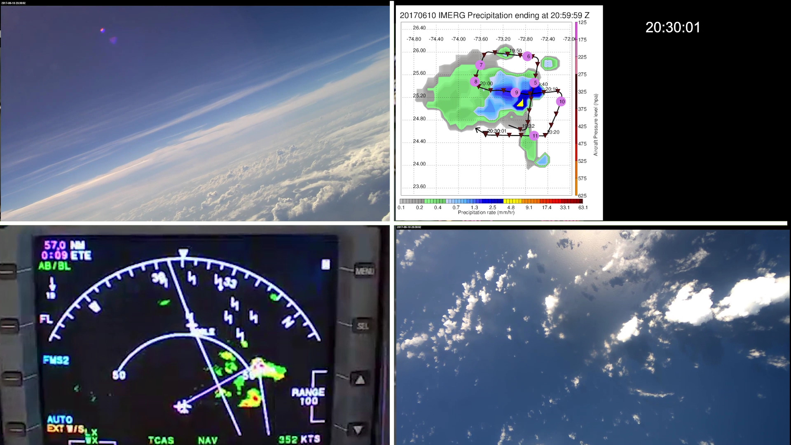
Motivation
Study upscale growth of MCS over tropical ocean using Integrated Multi-satellitE Retrievals for GPM (IMERG)
Use IMERG, a multi-satellite precipitation product with high temporal resolution, to define precipitation features (IPF) and track their evolution.
Convective Processes Experiment (CPEX) cases showed that IMERG had areas of light precipitation when there are no PMW overpass.
Use precipitation rate distribution, to determine an optimum minimum precipitation rate threshold, for defining an IPF boundary

Slide 3
Methodology
Following region and period is being used to create IPF database to study the upscale growth of MCS over tropical oceans
Region: 0 – 20 N and 180 W – 180 E.
Period: 2010 to 2018
IMERG has a variable - precipitation source sensor at every grid.
Compute precipitation rate distribution
Group precipitation rate into unequal size bins (0.1, 1.0, 10, 100)
Standardize: Divide frequency at each bin by bin width
Normalize: Divide frequency at each bin by total frequency
Precipitation rate distribution: Land Vs Ocean
Using Land-Ocean mask

Slide 4
OCEAN: 2010 – 2018 (TRMM + GPM )
OCEAN
No significant differences between different PMW sensors.
Except near the tail, particularly GMI? (Discussed in the next slides).
There is kink for all the PMW sensor precipitation around 0.5 mm/hr.

Slide 5
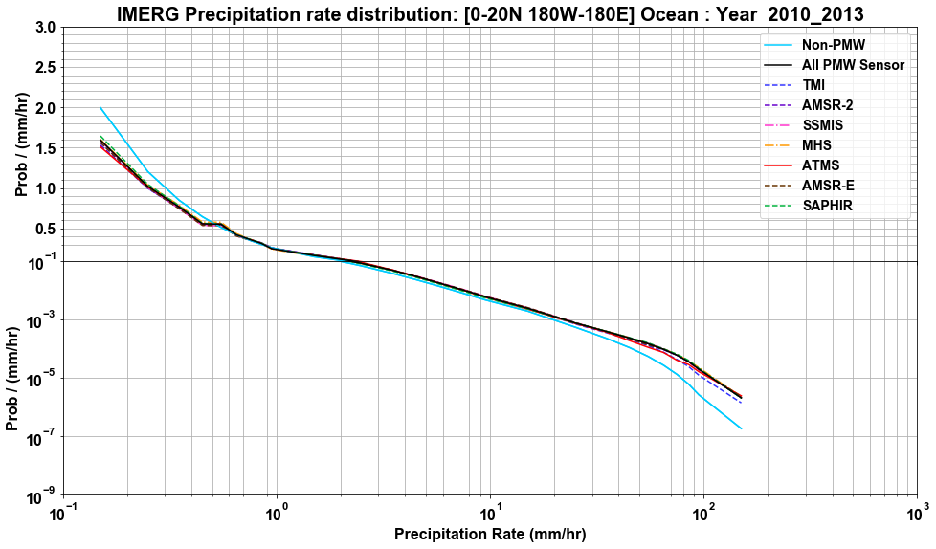
Extras!!!
OCEAN: 2010 – 2013 (TRMM)
OCEAN - TRMM
There are no significant differences between PMW sensors at the tail, when grouped as TRMM and GPM era (next slide).
But this shows the differences in precipitation rate distribution between two eras (Switch forward and back between this and next slide)

Slide 6
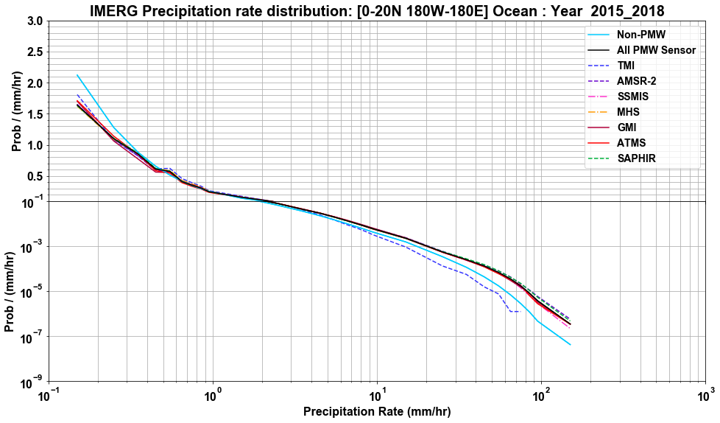
OCEAN: 2015 – 2018 (GPM )
OCEAN - GPM
TMI: During its final months has large difference compared to other sensors.

Slide 7
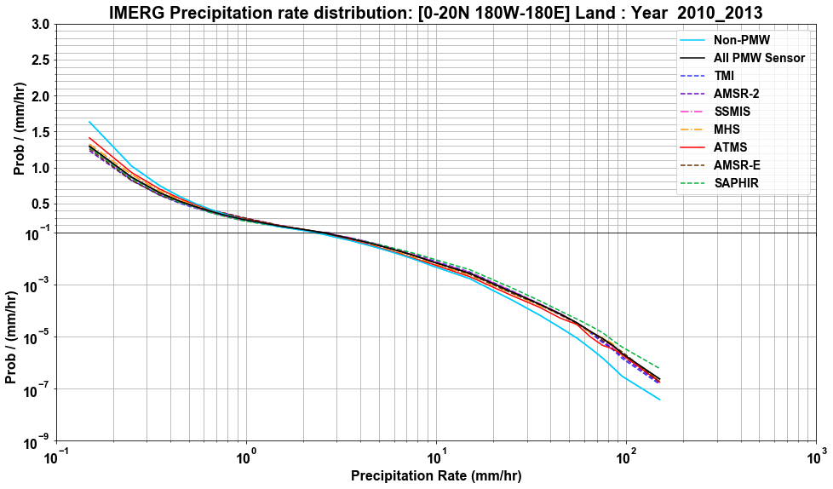
Extras!!!
LAND: 2010 – 2013 (TRMM )
LAND - TRMM
Small difference between sensors near both ends. But more pronounced during GPM era (next slide)
No kink around 0.5 mm/hr

Slide 8
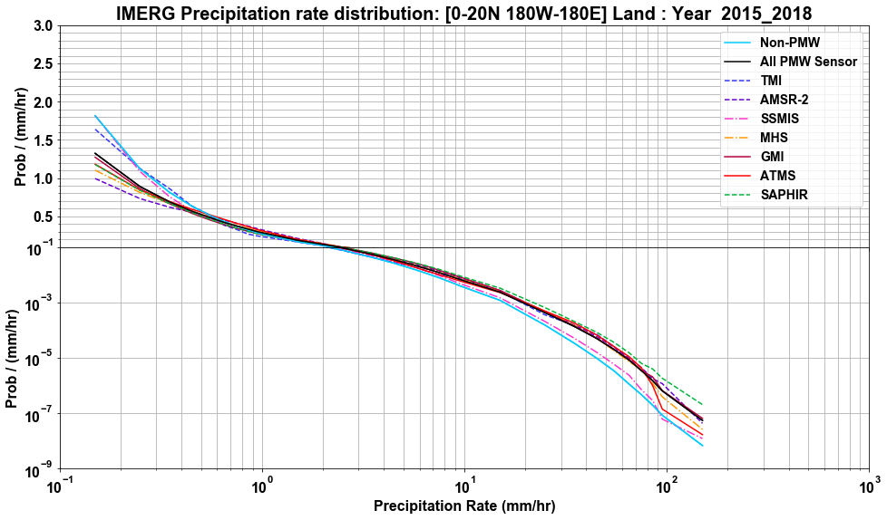
Extras!!!
LAND: 2015 – 2018 (GPM )
LAND - GPM
Significant difference between PMW sensors during GPM era.

Slide 9
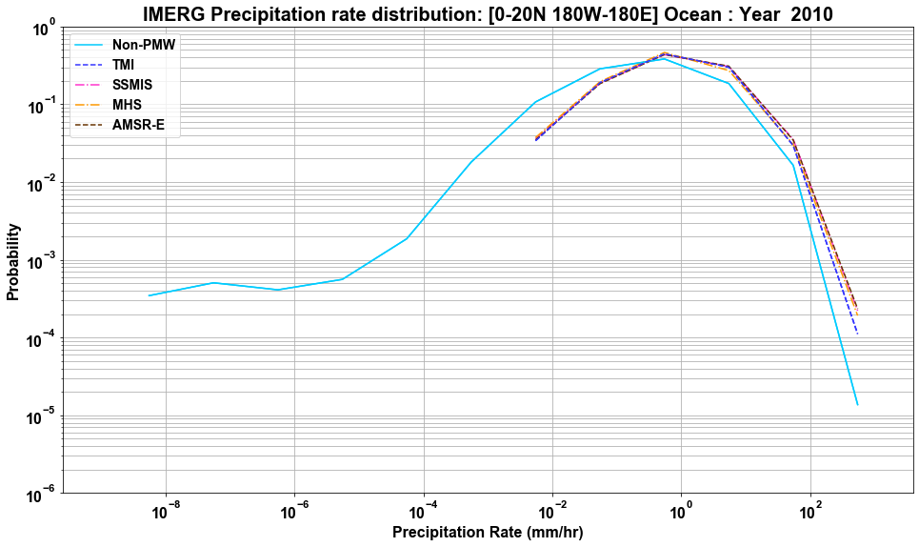
Spectrum of precipitation rates : 2010
Ocean - TRMM
Non-PMW distribution appears to be shifted to the left i.e. towards lower values. This is as expected due to the interpolation of PMW precipitation with lower weights.

Slide 10
Summary
Difference in distribution between TRMM and GPM periods.
No significant differences between PMW sensors over ocean.
Differences may be small compared to spatial and temporal variability of precipitation.
Looking at precipitation rates from different sensor over same location and time may bring out the differences.
There are differences between PMW sensors over land during GPM period.
TMI has differences/bias during its final months (Year: 2015)

Slide 11
Thank you! & Questions?

Slide 12
Extras – Slides!

Slide 13
OCEAN: 2010 – 2018 (TRMM + GPM )
OCEAN
For precipitation rates < 0.5 mm/hr, non-PMW has higher probability/more area with light precipitation compared to PMW. These regions with light precipitation, may not have actual precipitation. Hence a minimum precipitation threshold 0.5 mm/hr is used to define IPF boundary.

Slide 14
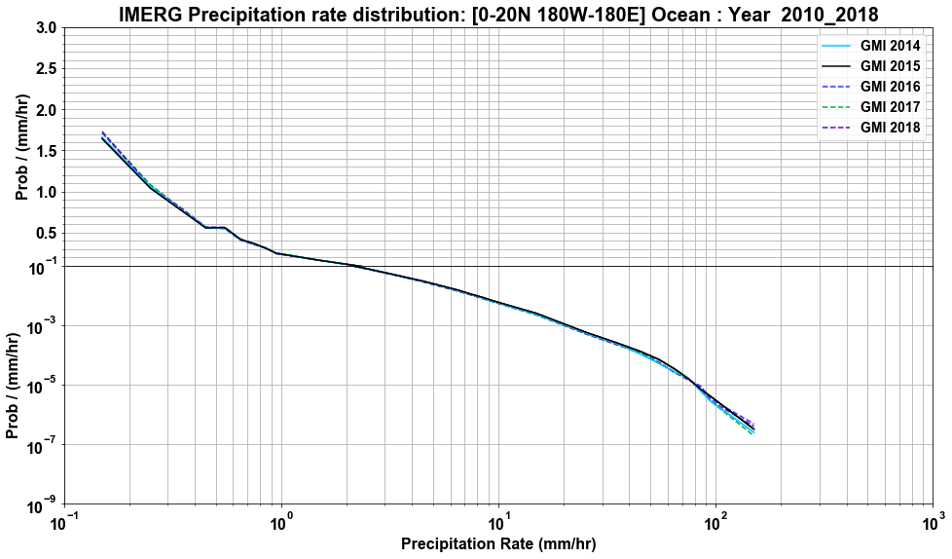
Extras!!!

Slide 15
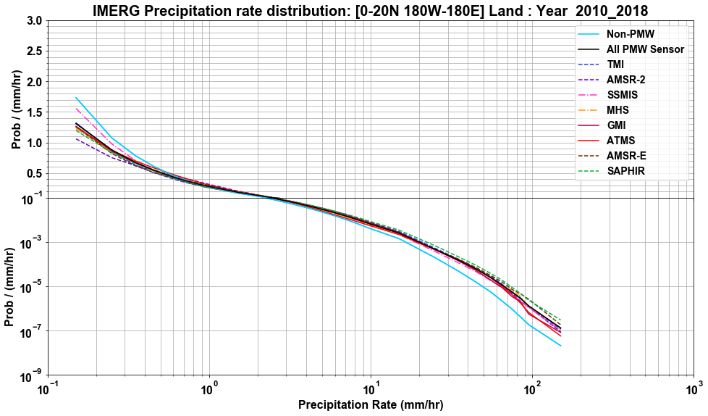
LAND

Slide 16
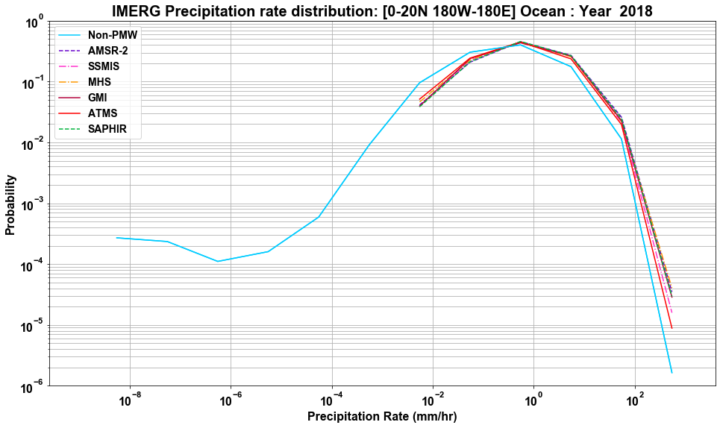
Ocean - GPM

Slide 17
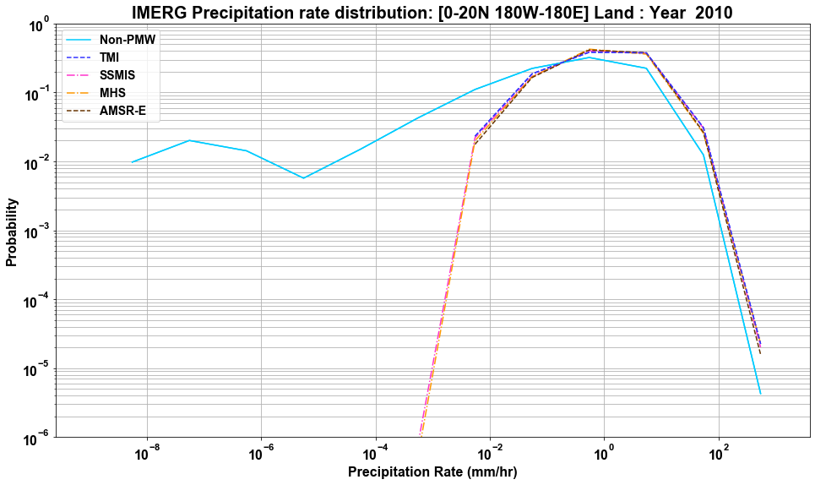
LAND - TRMM

Slide 18
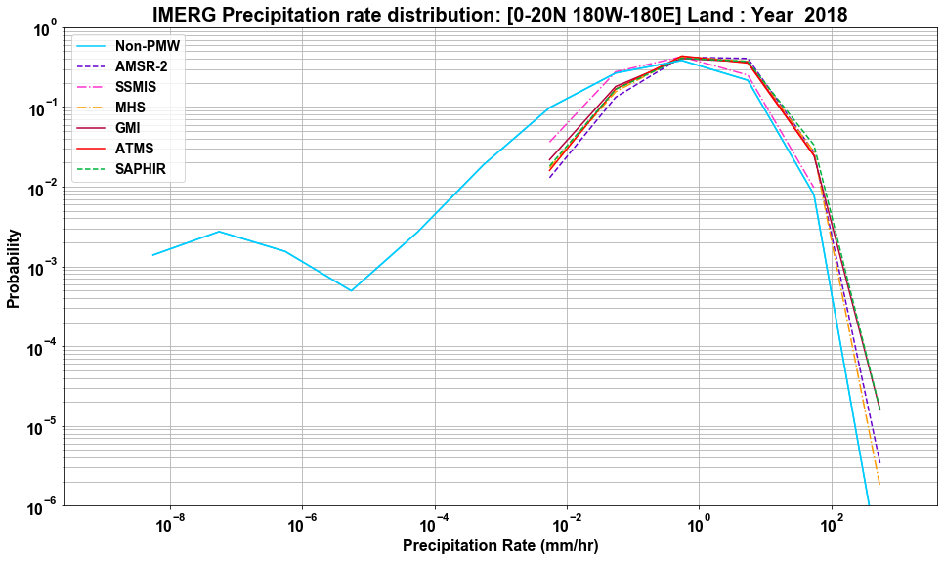
LAND - GPM

Slide 19
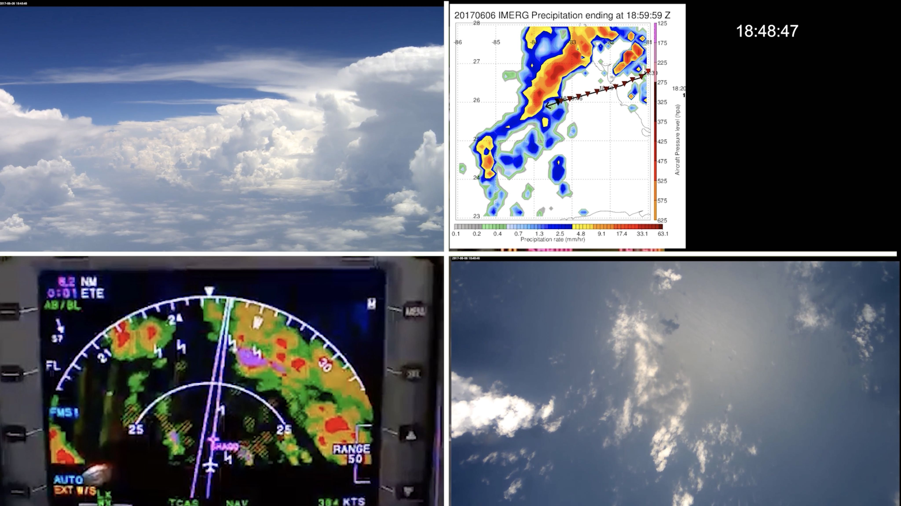
CPEX Mission – June 06th 2017
Forward Camera
Nadir Camera
PMW overpass ~ 18:53 Z. IMERG Precipitation qualitatively matches observed cloud field in camera and pilot radar.

Slide 20
CPEX Mission – June 10th 2017
Forward Camera
Nadir Camera
Next PMW overpass ~ 23:30 Z (nearly 2 hours and 30 mins away). IMERG has light precipitation over a large area to the west. Aircraft camera and pilot radar shows no deeps clouds or precipitation.
Forward Camera

Slide 21
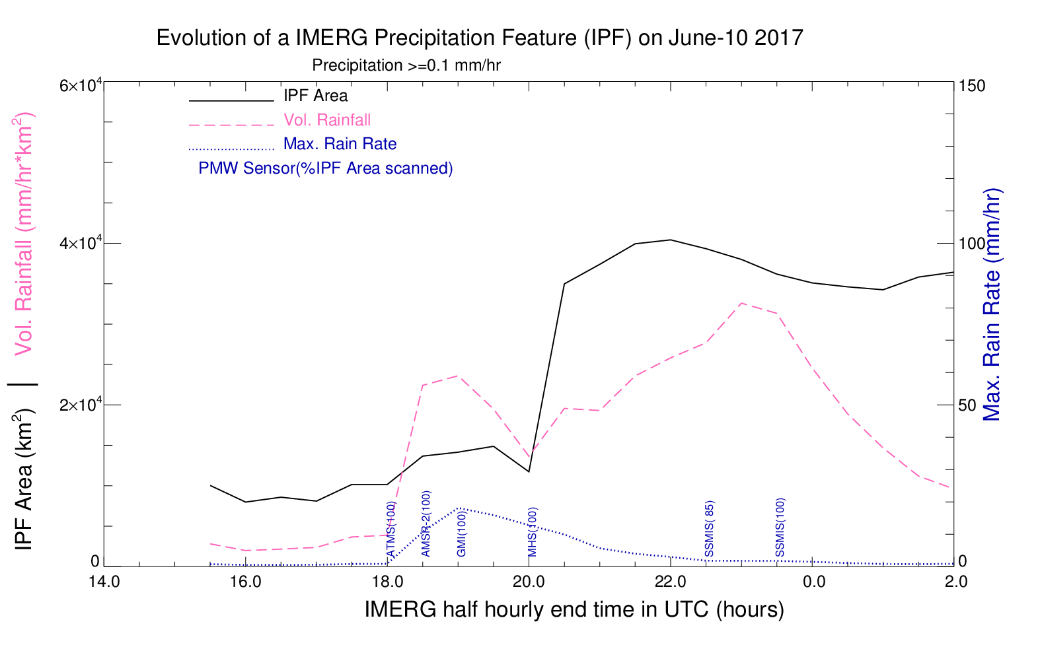
CPEX Mission – June 10th 2017
IPF Area grew rapidly around 2030 Z, which was not observed in the aircraft data. Volumetric rain rate shows that it grew upscale over a period of ~ 3 hours.

