Slide 1
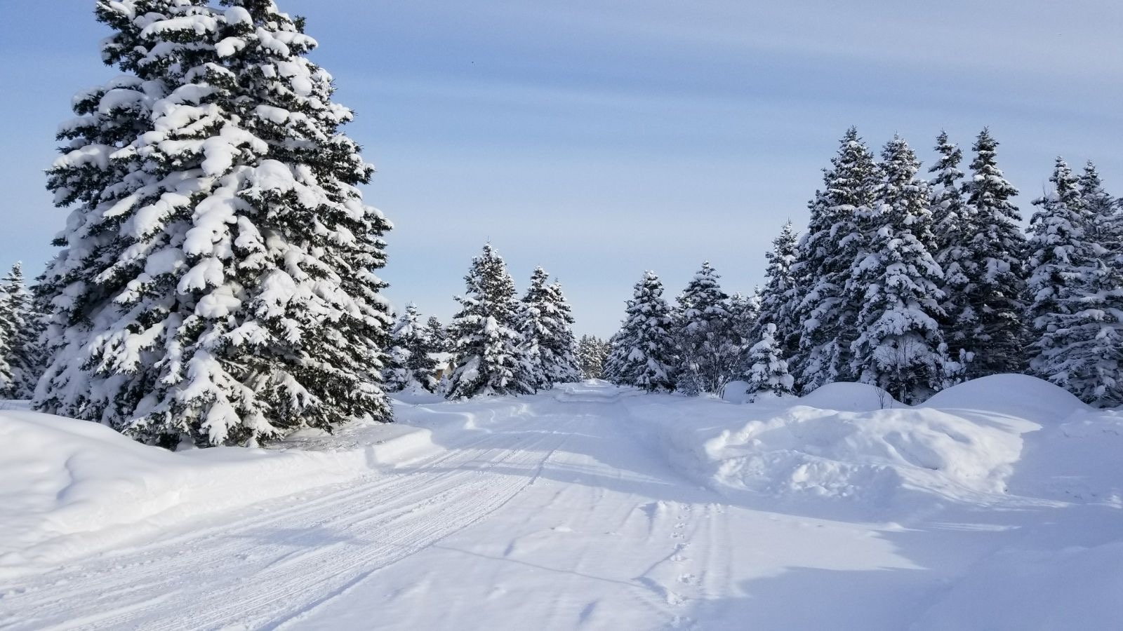
Shallow convective snow from a GPM Microwave Imager perspective: Snowfall Quantitative Precipitation Estimation Strengths and Weaknesses
Lisa Milani
NASA-GSFC / University of Maryland
Mark S. Kulie (NOAA)
Daniele Casella (ISAC-CNR)
Pierre E. Kirstetter (Univ. of Oklahoma)
Giulia Panegrossi (ISAC-CNR)
Veljko Petkovic (Colorado State Univ.)
Sarah E. Ringerud (NASA-GSFC)
Jean-François Rysman (Lab. Met. Dynam.)
Paolo Sanò (ISAC-CNR)
Gail Skofronick-Jackson (NASA-HQ)
Nai-You Wang (UMD)
Yalei You (UMD)

Slide 2
Lake-Effect Snow
What is it?
Cold-air outbreaks that interact with unfrozen or partially frozen bodies of water
Focus on the Great Lakes Region
Why is it important?
Great Lakes cold-season high regional hydrological and societal impacts
Globally regions with high frequency of convective snow
NOAA SciJinks
NOAA Photo Library
Convective Snowfall Occurrence Fraction (CloudSat) (Kulie et al. 2016)

Slide 3
GPM PROFiling algorithm (GPROF)
Bayesian algorithm: searches an a-priori database of potential precipitation profiles and retrieves a weighted average of these entries based upon an uncertainty-weighted proximity of the observed Tb to the simulated Tb corresponding to each precipitation profile
The a-priori database is constructed by pairing observed precipitation estimates with the GMI brightness temperature observations
DPR Ku over land and coast
CMB over ocean
MRMS over snow covered surfaces
Phase classification based on 2 m wet bulb temperature (T2m) (Sims and Liu, 2014)
credit: Chris Kummerow

Slide 4
Multi-Radar/Multi-Sensor system (MRMS)
Resolution 0.01°/2 min
Precipitation Phase:
Surface Temperature < 2°C
Wet bulb temperature < 0°C
Fixed Z-S relationship Z = 75 S²
No gauge correction for snow
Snow rates filtered out when radar beam > 2.5 Km AGL
Reflectivity threshold 5 dBZ for snow (~0.2 mm h⁻¹)
(Zhang et al. 2016)

Slide 5
Lake-Effect Snow
Scientific Questions:
Does GMI consistently display unique multi-frequency signatures for Great Lakes lake-effect snow events?
Does GPROF effectively retrieve snowfall for lake-effect snow?

Slide 6
CASE 1
CASE 2
MRMS precipitation product
20 Nov 2014 18.22
MRMS precipitation product
09 Jan 2015 12.28
GMI High Frequencies Brightness Temperatures

Slide 7
CASE 1
CASE 2
MRMS precipitation product
20 Nov 2014 18.22
MRMS precipitation product
09 Jan 2015 12.28

Slide 9
Lake-Effect Snow
Scientific Questions:
Does GMI consistently display unique multi-frequency signatures for Great Lakes lake-effect snow events?
Does GPROF effectively retrieve snowfall for lake-effect snow?

Slide 10
CASE 1
CASE 2
MRMS precipitation product
20 Nov 2014 18.22
09 Jan 2015 12.28
GPROF SurfPrecip product

Slide 11
Filters
1
GPROF SurfPrecip original
MRMS
Quality Flag (QF)
2 : "Use pixel with extreme care over snow covered surface."
The pixel is set to 2 if the probability of precipitation is of poor quality or indeterminate.
Use these pixels for climatological averaging of precipitation, but not for individual storm scale daily cases.
2
Rate threshold: SR>0.08
GPROF SurfPrecip SR-threshold-filtered
Quality Flag (QF)
GPROF SurfPrecip QF-filtered

Slide 12
CASE 1
CASE 2
20 Nov 2014 18.22
MRMS precipitation product
09 Jan 2015 12.28
GPROF SurfPrecip QFF
GPROF SurfPrecip TPR
GPROF SurfPrecip QFF
GPROF SurfPrecip TPR
TPR=0.08 mmh⁻¹
TPR=0.011 mmh⁻¹

Slide 14
What’s failing in TBs → GPROF SR ???
A-priori database representativeness (mainly for low TPW/T2m)
Channel Weighting (still based on a pre launch calculation)

Slide 15
CASE 1
CASE 2
20 Nov 2014 18.22
09 Jan 2015 12.28
Surface type
T2m
TPW

Slide 16
2D distribution of profiles
MIN snow
LOW snow
Number of profiles within
a T2m-TPW bin
MOD snow
MAX snow
coast

Slide 17
Distribution of snowing profiles in the a-priori databases
All snowing profiles
Snowing profiles with
T2m < 273K
TPW < 5mm

Slide 18
Coast
DPR a-priori database
MRMS a-priori database
Notes:
Since low T2m and TPW are not super represented on the DPR database, we will try to run GPROF using only MRMS database over all surfaces (included in this case coast that seems to be better represented)

Slide 19
Coast
DPR a-priori database
MRMS a-priori database

Slide 20
CASE 1
CASE 2
20 Nov 2014 18.22
09 Jan 2015 12.28
MRMS precipitation product
GPROF SurfPrecip product
GPROF SurfPrecip product
Forcing the use of MRMS
a-priori database over all surfaces

Slide 21
What’s failing in TBs → GPROF SR ???
A-priori database representativeness (mainly for low TPW/T2m)
Channel Weighting (still based on a pre launch calculation)

Slide 22
Modified channel sensitivity
 | 89 V GHz | 89 H GHz | 166 V GHz | 166 H GHz | 183 ± 3 GHz | 183 ± 7 GHz
snowcover | + 50% | +75 % | + 50 % | - 100 % | + 50 % | + 75 %
coast | 0 % | + 50 % | + 87.5 % | + 87.5 % | + 87.5 % | + 75 %
*Just test percentages

Slide 23
Original GPROF
With TPR
CASE 1
CASE 2
Modified
Channel
sensitivity
MRMS
Notes:
Not filtering precipitation, even the worse case shows a pattern

Slide 24
Summary
GMI “sees” intense lake-effect snow signatures
GPROF a-priori database representativeness
Snow classes populated but low T2m and TPW are not well represented mainly for
“higher” (>2 mmh⁻¹) snowrates
Coast for low T2m and TPW is not represented
Channel Weighting
Need to increase the sensitivity of high frequency channels

