Slide 1
Applications of Dynamic Land Surface Information for Passive Microwave Precipitation Retrieval
Sarah Ringerud^{1,2}, Christa Peters-Lidard², Joe Munchak², Yalei You¹
1: University of Maryland – ESSIC
2: NASA GSFC

Slide 2
Bayesian (GPROF-type) vs. 1DVAR (MiRS-type)
NASA Goddard Profiling Algorithm (GPROF)
  Probability of R given Tb
  Database constructed from Combined Retrievals
  Model TPW, 2m T, surface type (Ocean + Ice + Coast + Land (10))
  Retrieves precipitation – requires ancillary geophysical parameters
  Limited to what combined algorithm retrieves (must have active radar signal)
  Nature of Bayesian – lots of light precipitation – do 2 passes
NOAA Microwave Integrated Retrieval System (MiRS)
  1DVAR – physically-based iterative inversion that finds best-fit solution given all Tb
  Two loops: first assumes no hydrometeors (absorption only)
    If no convergence, 2nd loop with multiple scattering
  Retrieves full suite of geophysical parameters (surface: T and ɛ and atmosphere: T, WV, cloud, hydrometeors)
  Can be underconstrained

Slide 3
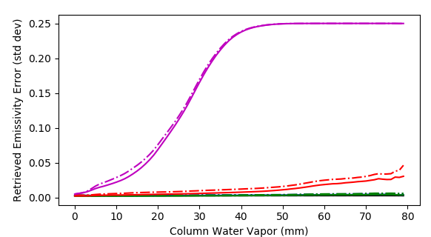

Munchak et al. 2019 Land Surface Emissivity Retrieval
Optimal Estimation Retrieval for GPM GMI (could extend)
  Paper currently in revision
  Anticipated to be part of Combined retrieval product in Version 7
  MERRA-2 first guess, error covariance constructed from radiosonde
  Retrieve emissivity vector, water vapor
  Output includes measure of convergence (Normalized Error)
Information Content
Mean posterior emissivity error (square root of diagonal elements of Sx) Munchak et al. 2020 (In revision)
Notes:
Posterior error – shows sensitivity of observed Tb to emissivity in the Jacobian matrix

Slide 4
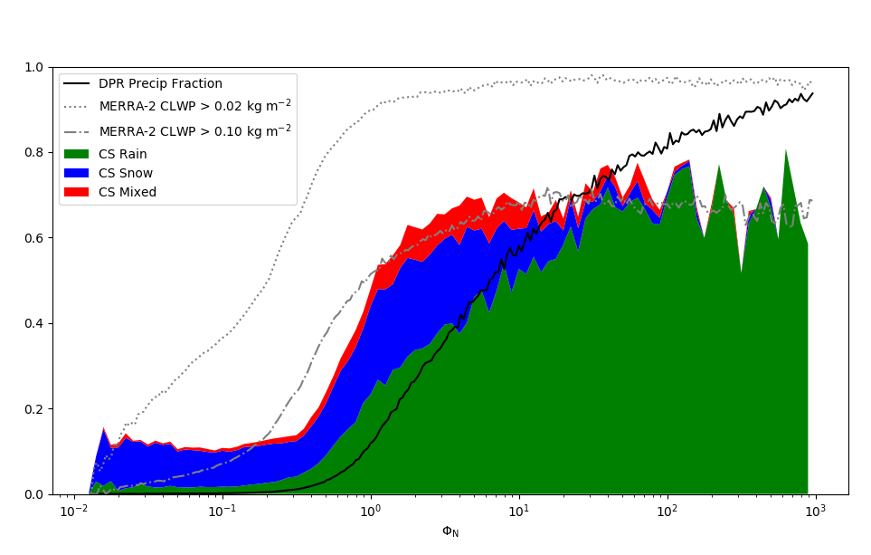
Precipitation Screening by Normalized Cost Function
Munchak et al. 2020 (In Revision)
Notes:
Data were compiled from all CloudSat-GPM matchups between March
2014 and December 2018 over land surfaces.

Slide 5
“Hybrid” Retrieval with Dynamic Surface Constraints
First Pass: OE output from Munchak et al. scheme
  Use retrieved emissivity to determine snow cover
  Precip-free areas use retrieved values
Bayesian Retrieval where Indicated by Normalized Error Parameter
  Test several cutoff values
  Use GPROF database, organized/constrained with retrieved parameters
  Use recent precipitation-free retrieved emissivity climatology at 19 GHz as retrieval constraint (+search below)
  Use retrieved TPW where error parameter shows convergence, interpolate and constrain retrieval in areas (+search above)

Slide 7
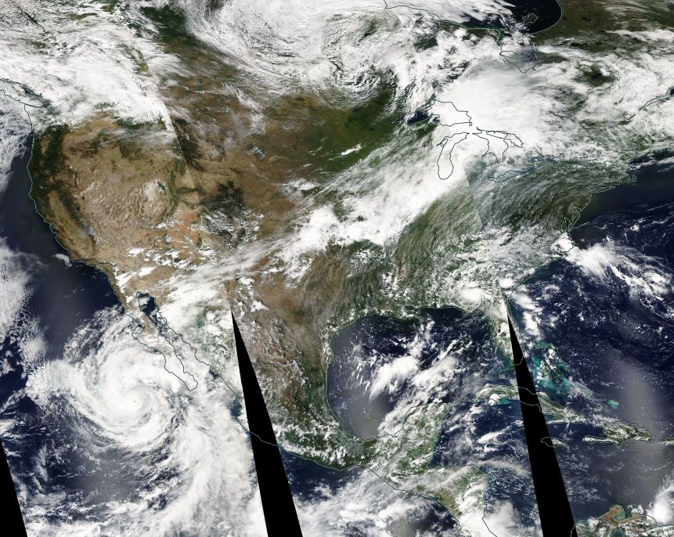
Retrieval Example: September 8, 2015

Slide 9
1 Snow-free surfaces
Notes:
SNOW FREE SURFACES

Slide 10
Conclusions
Munchak emissivity retrieval anticipated to be part of combined algorithm output in V7
Using dynamic observationally-based constraints and OE-based first pass enhances the retrieval
  Use of retrieved TPW and emissivity as constraints makes retrieval more physically consistent and helps with issues at high gradient areas such as frontal boundaries
  Significant decrease in false alarms WRT DPR
  Small decrease in POD - find “sweet spot” to optimize this
Drizzle retrieval potential – add to Combined Retrieval product to filter through to constellation and IMERG
  In the current formulation, Combined retrieval is the “right answer” – need to make any advances HERE
  Get the “where” using the OE retrieval output, just need the “what” – looking at CloudSat and MRR – need to investigate relationships to environmental constraints for implementation of a parameterization for quantifying vertical profiles

