Slide 1
IMERG Hydro-GV with SMAP
Andrew Badger, Christa Peters-Lidard, and Dalia Kirschbaum
NASA/GSFC

Slide 2
Outline
Overview of project/method
IMERG – MRMS comparison
IMERG validation with SMAP
Potential issues
3x3 contingency table
Moving forward

Slide 3
Global
CONUS
Expanding domain
IMERG vs SMAP
IMERG vs SMAP
2
Compare changes in SMAP soil moisture from overpass-to-overpass for presence/absence of precipitation in IMERG
3
After confirming that IMERG vs SMAP and MRMS vs SMAP produce similar skill for CONUS, there is greater confidence that SMAP can be used to validate IMERG on a
global-scale
MRMS vs IMERG
1
Confirm that MRMS and IMERG produce similar patterns for presence/absence of precipitation

Slide 4
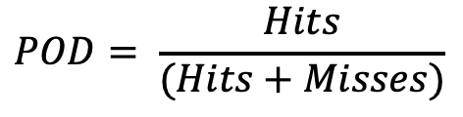
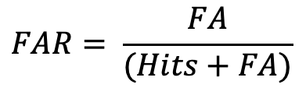
Hydro-GV: Method
Forecast (Precip.) | Observed (SMAP)
 | ∆SM Increase | ∆SM Decrease
Precip. > 0 | Hits | False Alarm (FA)
Precip. = 0 | Misses | Correct Rejection (CR)
Goal: Compare changes in SMAP soil moisture from overpass-to-overpass for presence/absence of precipitation in IMERG and MRMS
SMAP = SPL3SMP_E_002
Precipitation Data:
  IMERG = IMERG_<Early/Late/Final>_V06B
  MRMS
SMAP Overpass and VSM
Precipitation
Hit
Correct
Rejection
Miss
False
Alarm
Probability of Detection:
False Alarm Ratio:
$$POD= \frac{Hits}{(Hits+Misses)}$$
$$FAR= \frac{FA}{(Hits+FA)}$$
Time
Notes:
2016 - 2018
IMERG <Early/Late/Final> V06B
SMAP Level 3 at 9km
Screened out overpass intervals longer than 5 days
Screened out intervals when VSM was at saturation for both overpasses
Schematic shows the four quadrants of contingency table. Hopefully highlight the false alarm, where precipitation can occur but VSM decreases. This could be due to ET from the soil between overpasses, an element of uncertainty to address.

Slide 5
Comparison with MRMS Data
Used half-hour data for 2017 - 2018
Aggregated to daily on the MRMS Grid
  Screened out data with an RQI < 20
Remapped to IMERG grid with a conservative remapping
Compared:
  MRMS with SMAP
  MRMS with IMERG using SMAP overpass intervals
  MRMS with IMERG for daily data

Slide 6
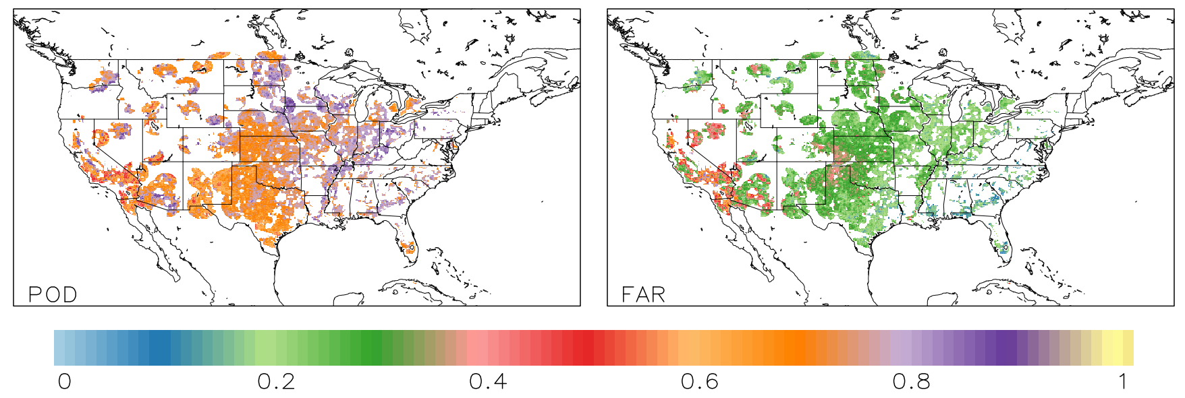
MRMS vs IMERG
 | POD | FAR
IMERG Early vs MRMS (SMAP Overpass intervals) | 0.723 | 0.266
IMERG Early vs MRMS (Daily) | 0.622 | 0.312
Previous IMERG validation with MRMS (Jackson Tan) | 0.667 | 0.466

Slide 7
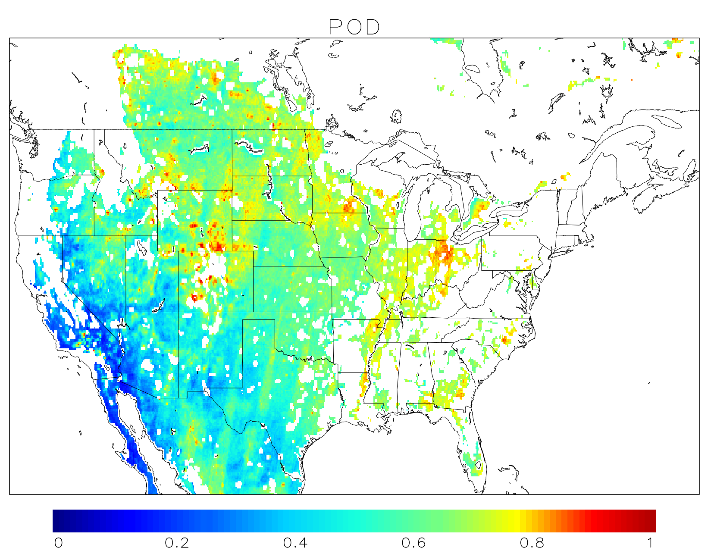
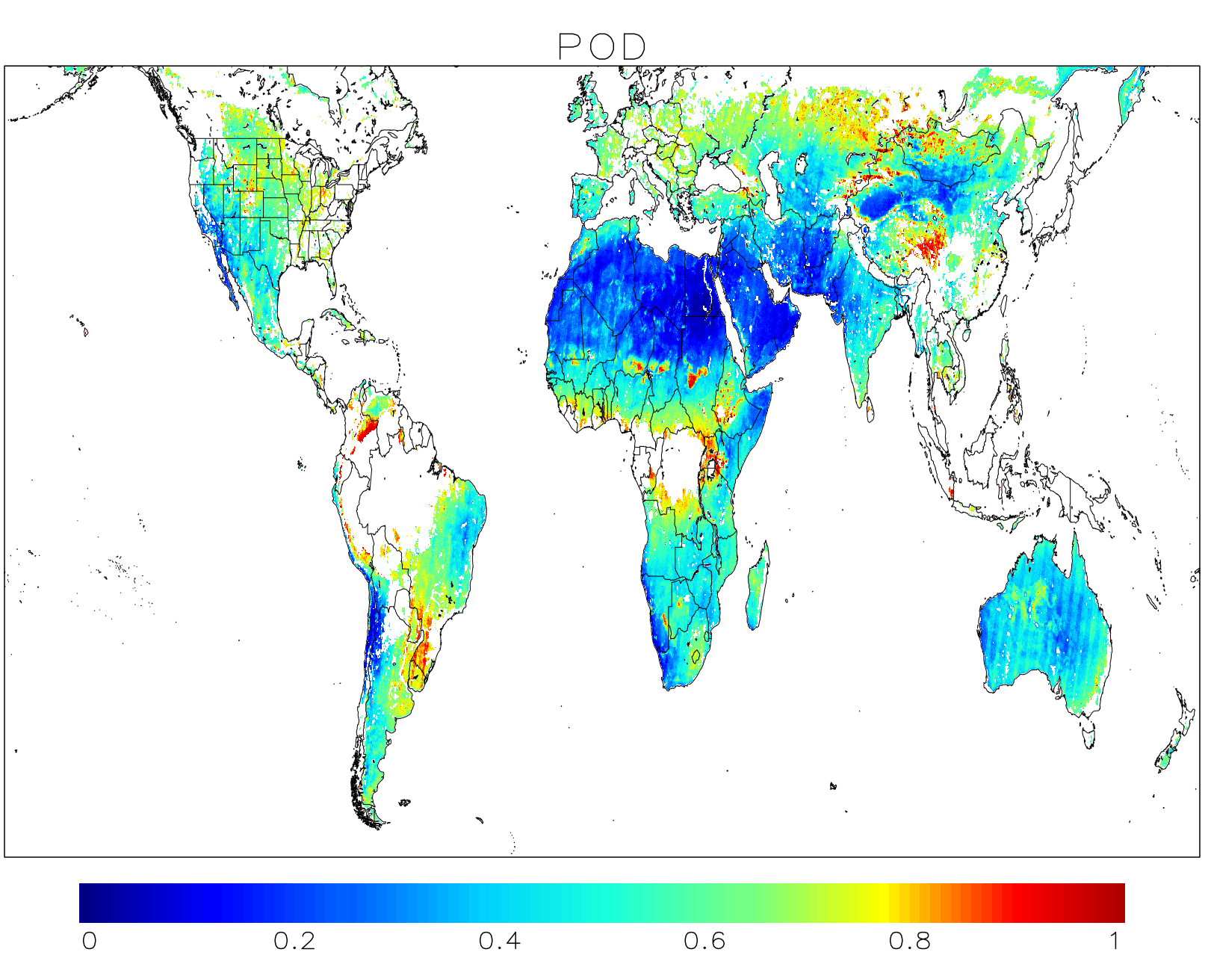
CONUS Mean (IMERG Early): 0.570
CONUS Mean (IMERG Final): 0.566
Previous IMERG Validation
with MRMS
0.667
Global Mean (IMERG Early): 0.487
Global Mean (IMERG Final): 0.487

Slide 8
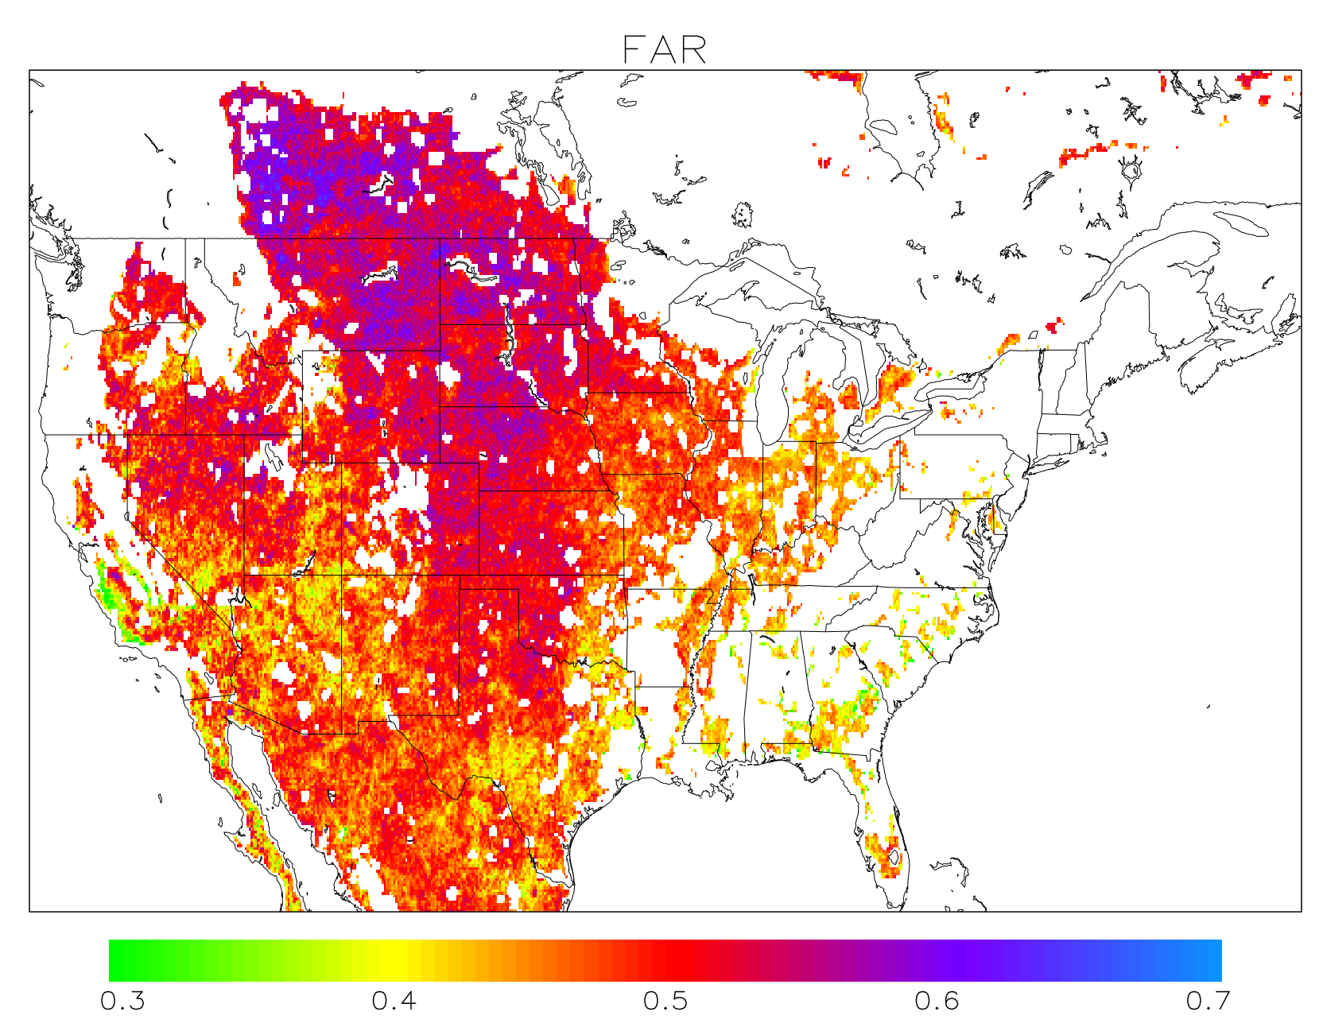
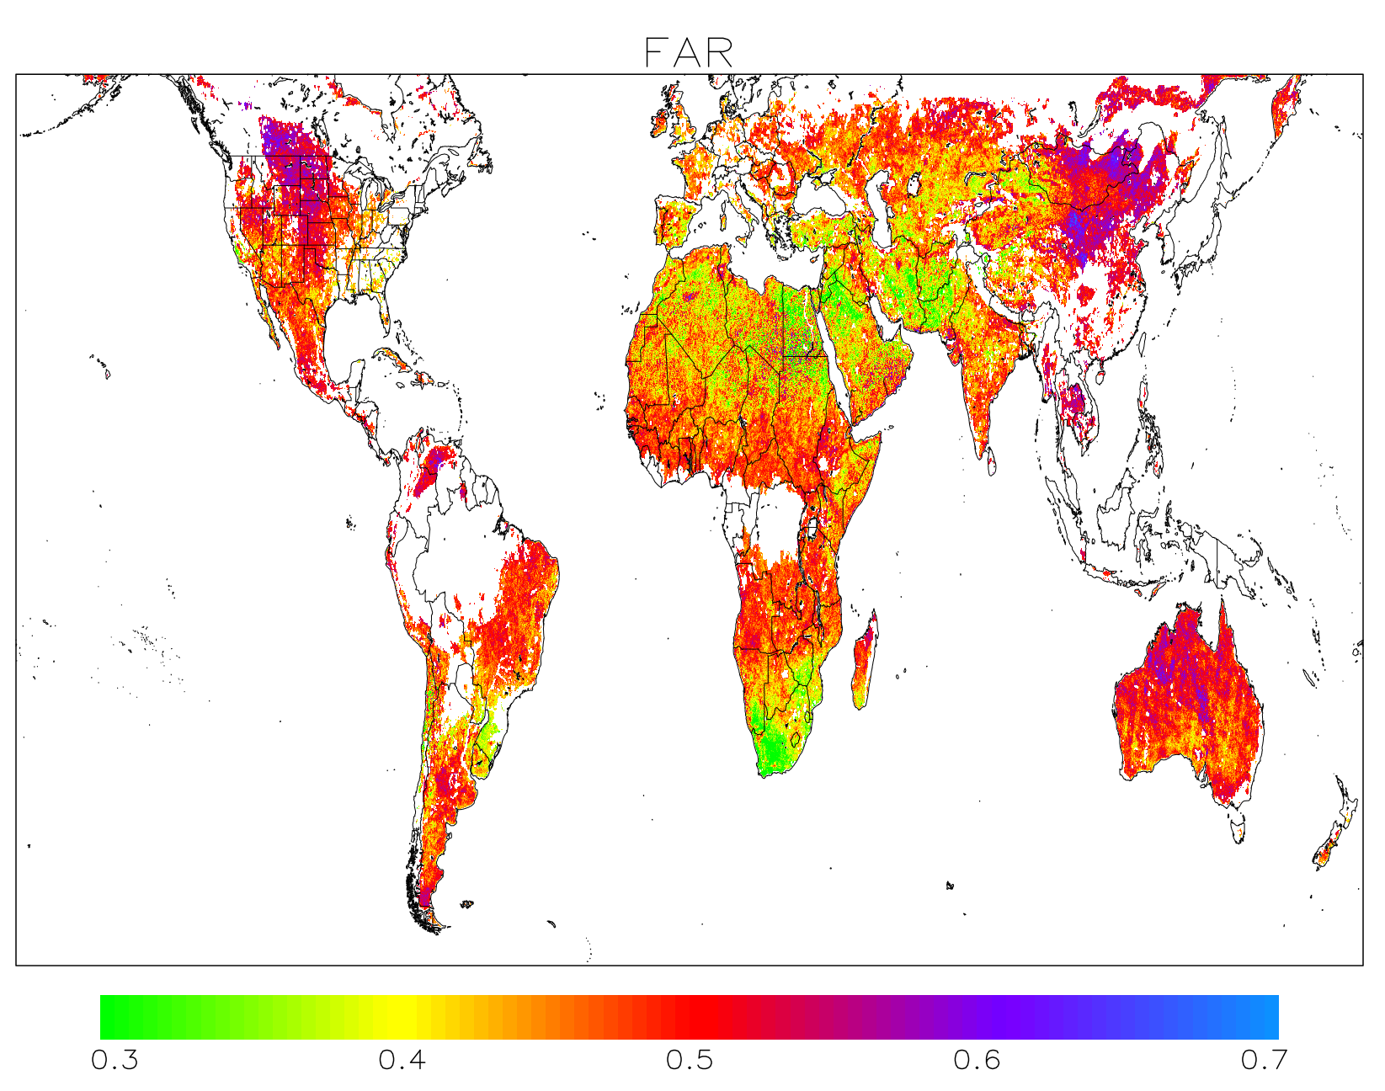
CONUS Mean (IMERG Early): 0.485
CONUS Mean (IMERG Final): 0.485
Previous IMERG Validation
with MRMS
0.466
Global Mean (IMERG Early): 0.463
Global Mean (IMERG Final): 0.462

Slide 9
Two Concerns
POD in desert regions are low
FAR has a substantial amount of noise – potential issues with method

Slide 10
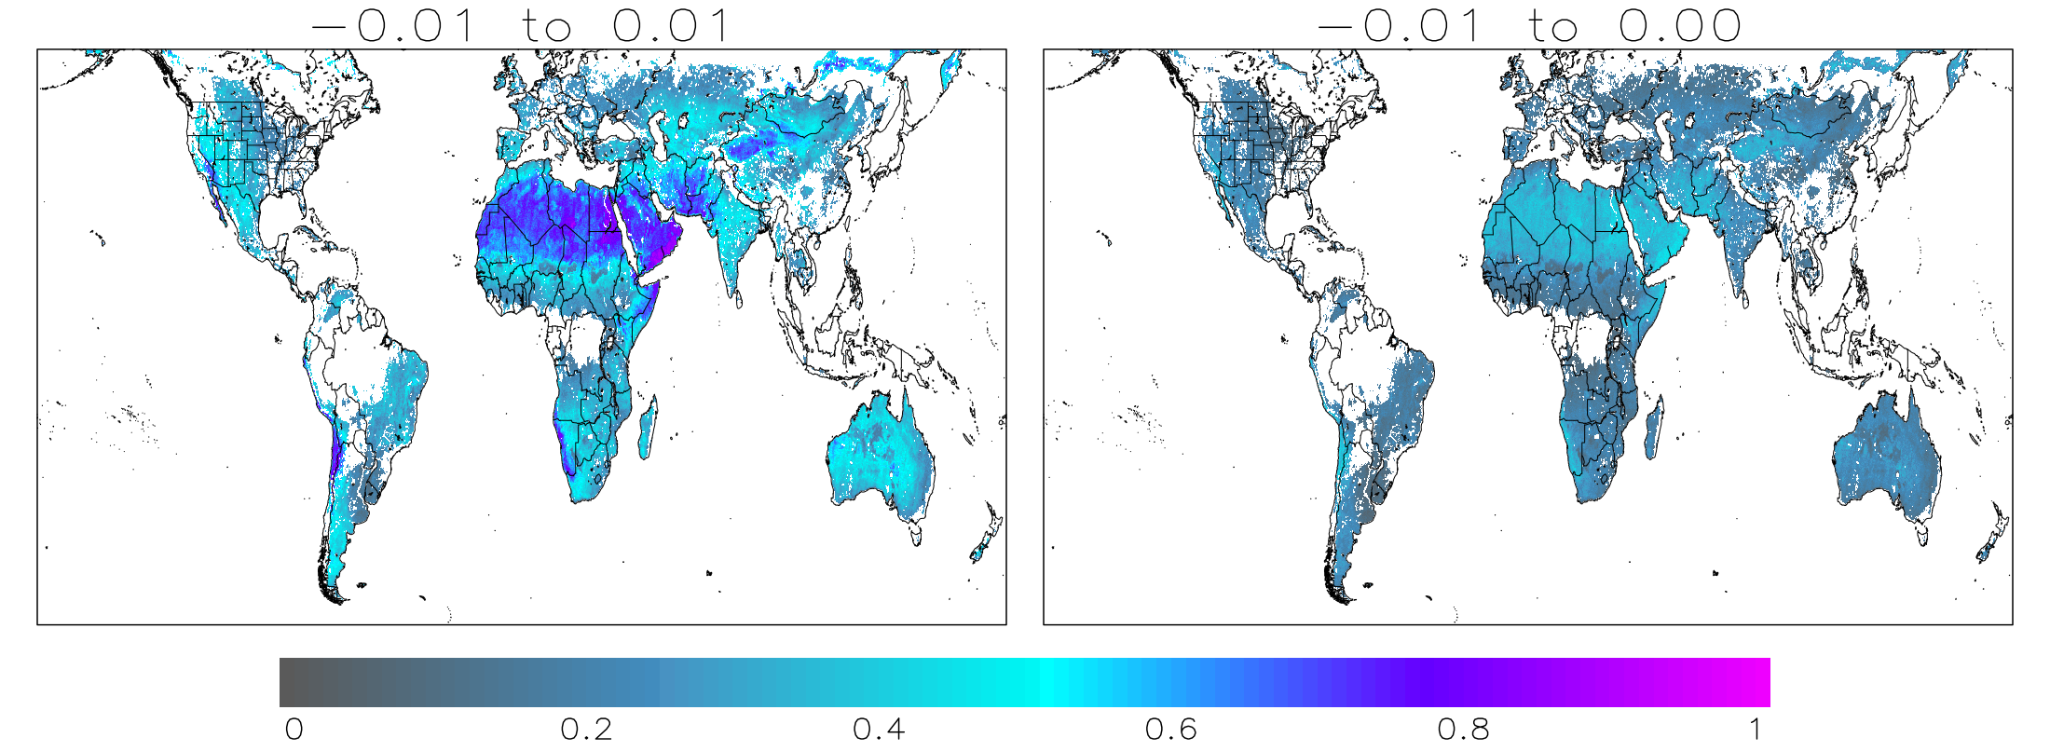
SMAP ”Noise” in Deserts
Deserts show greatest amount of noise at lower threshold intervals as compared to other land areas.
Fair amount of noise in periods without precipitation occurring.
Small amounts of precipitation tend to be categorized as false alarms.

Slide 11
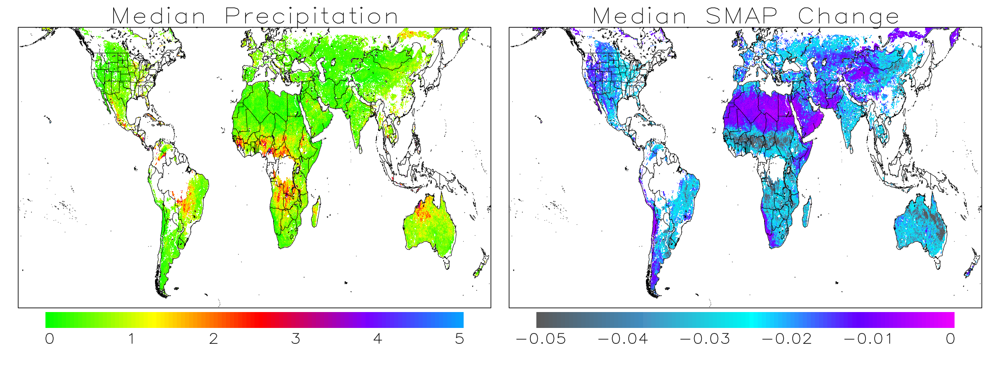
False alarms are dominated by light precipitation
Median precipitation and SMAP change for overpass intervals identifies as false alarms
Light precipitation dominates the signal, 83% of the domain has a median precipitation less than 1mm
Majority of SMAP changes are within the uncertainty criteria of SMAP
Light precipitation can evaporate and before SMAP overpass and show a decrease from previous observation

Slide 12


3x3 Contingency Table
Attempting to isolate signal and noise
 |  | Forecast
 |  | ∆SMAP < -0.01 | -0.01 ≤ ∆SMAP ≥ 0 | ∆SMAP > 0
Observations | IMERG = 0 | a | b | c | d
 | 0 < IMERG ≤ 1 | e | f | g | h
 | IMERG > 1 | i | j | k | l
 |  | m | n | o | p
SIGNAL
SIGNAL
NOISE
SIGNAL
SIGNAL
(Stanski et al., 1989)
a ∼ Correct Rejection
i ∼ Miss
c ∼ False Alarm
k ∼ Hit
Probability of Detection
$$\frac{k}{l}$$
False Alarm Ratio
$$\frac{e+i}{m}$$

Slide 13
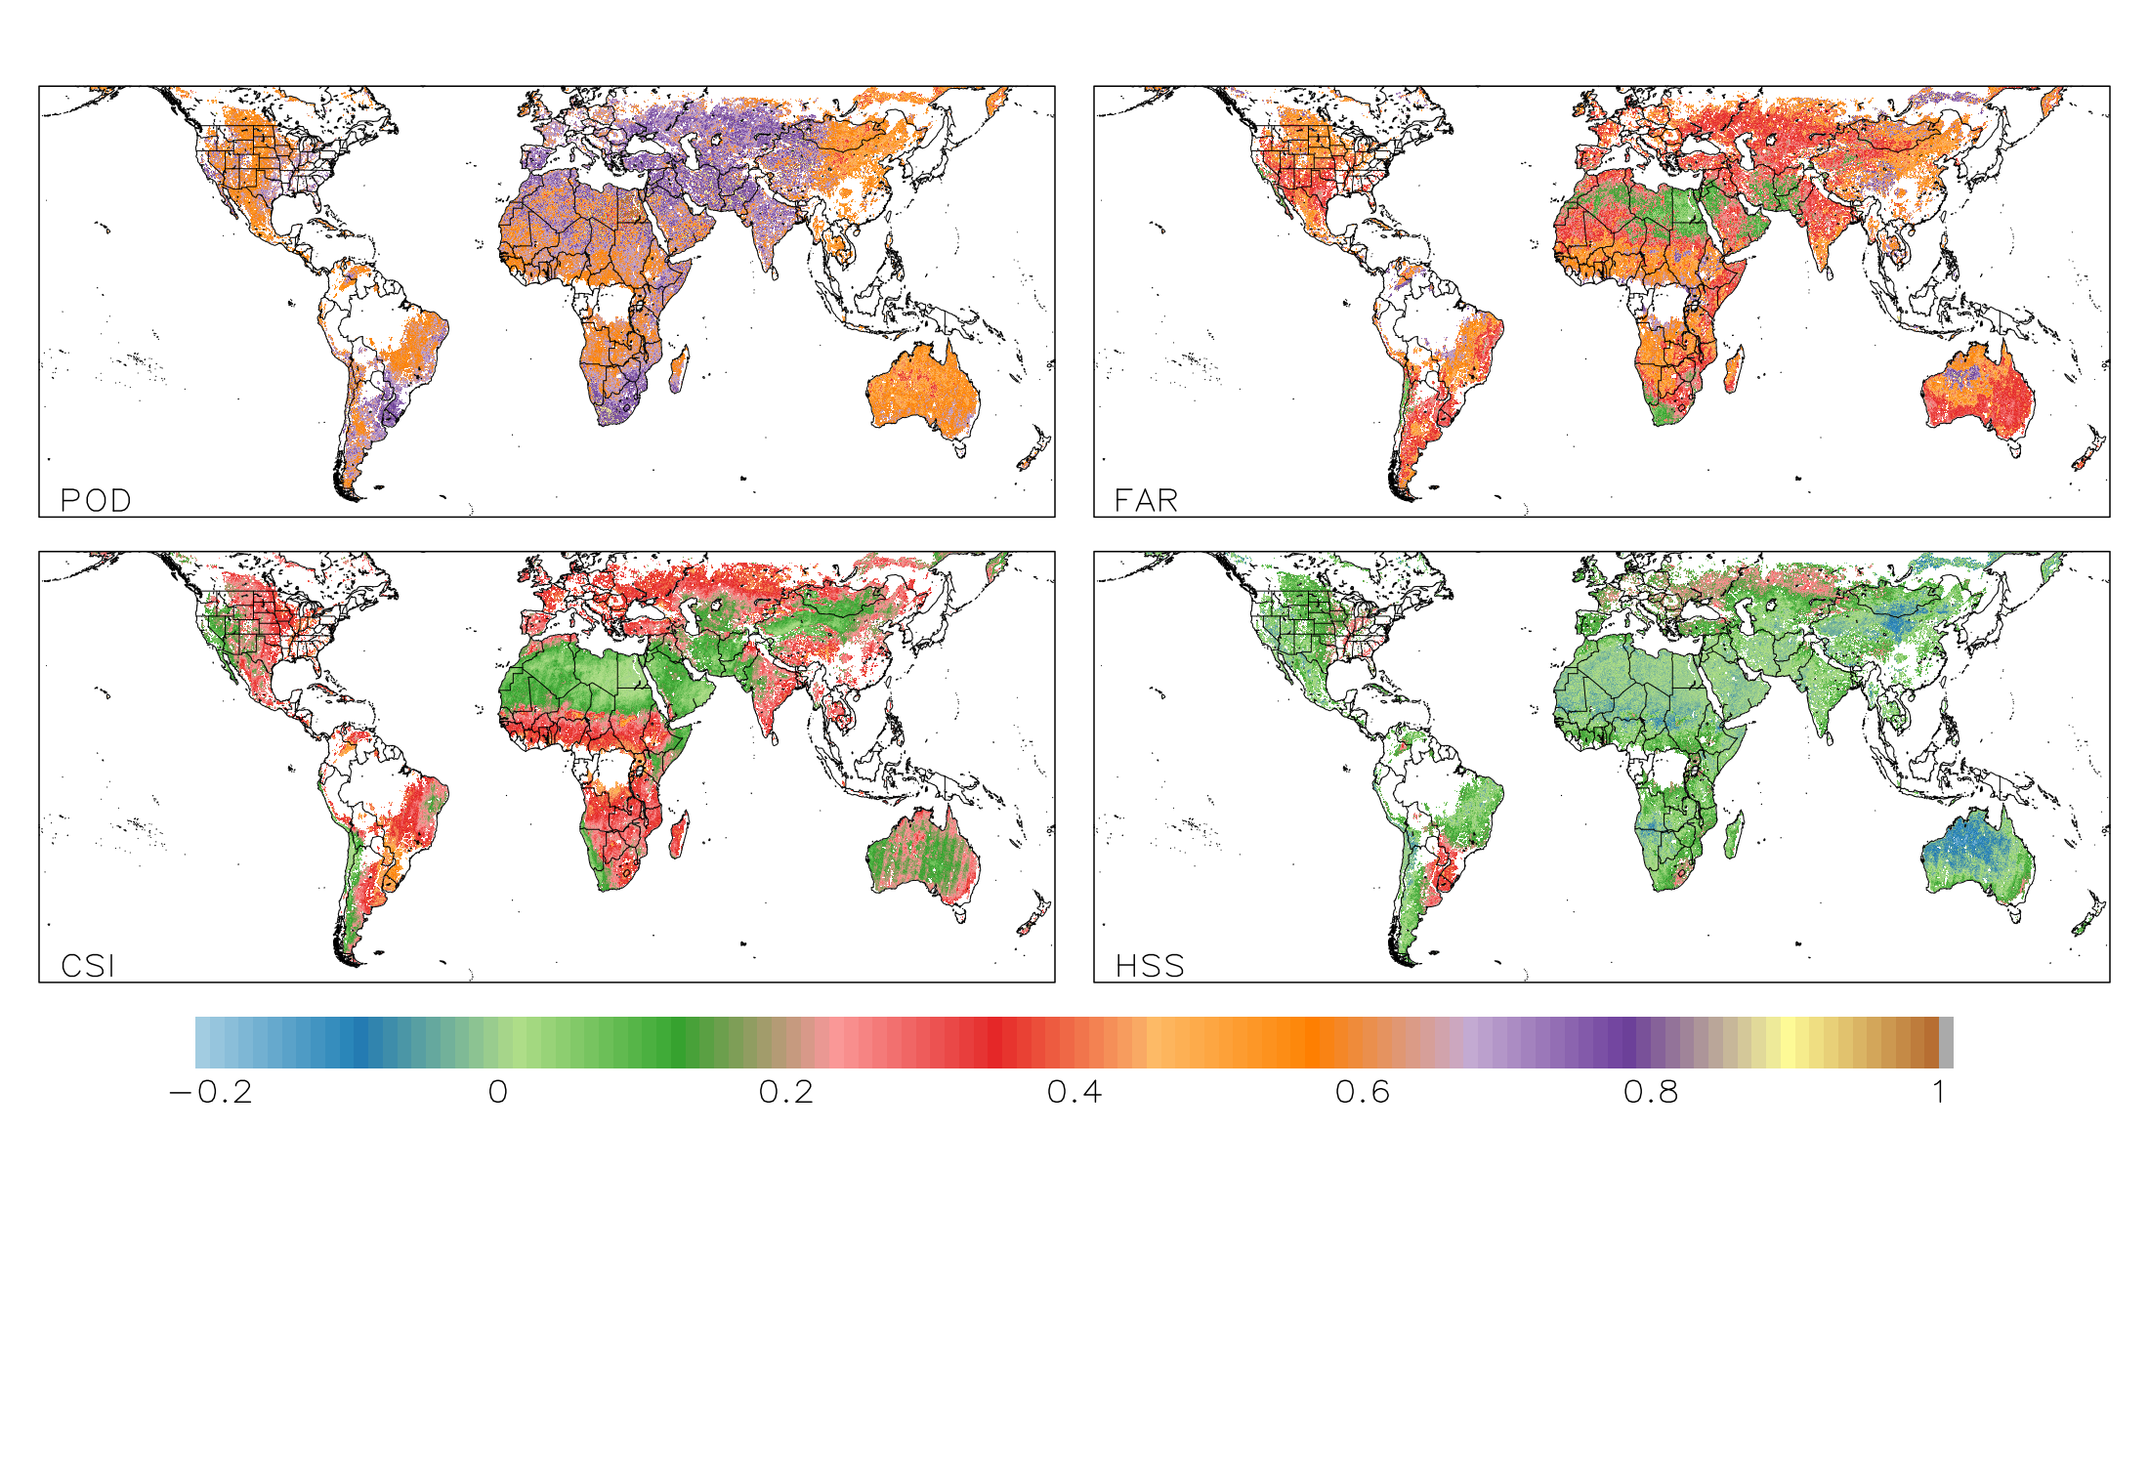
3x3 Contingency Table Results
~60% of overpasses are binned as signal
 |  | Forecast
 |  | ∆SMAP < -0.01 | -0.01 ≤ ∆SMAP ≥ 0 | ∆SMAP > 0
Observations | IMERG = 0 | 18.89% | 18.55% | 23.60% | 61.05%
 | 0 < IMERG ≤ 1 | 7.70% | 3.73% | 8.93% | 20.36%
 | IMERG > 1 | 5.40% | 1.62% | 11.57% | 18.59%
 |  | 31.98% | 23.91% | 44.10%
Global: 0.634
CONUS: 0.612
Global: 0.403
CONUS: 0.418

Slide 14
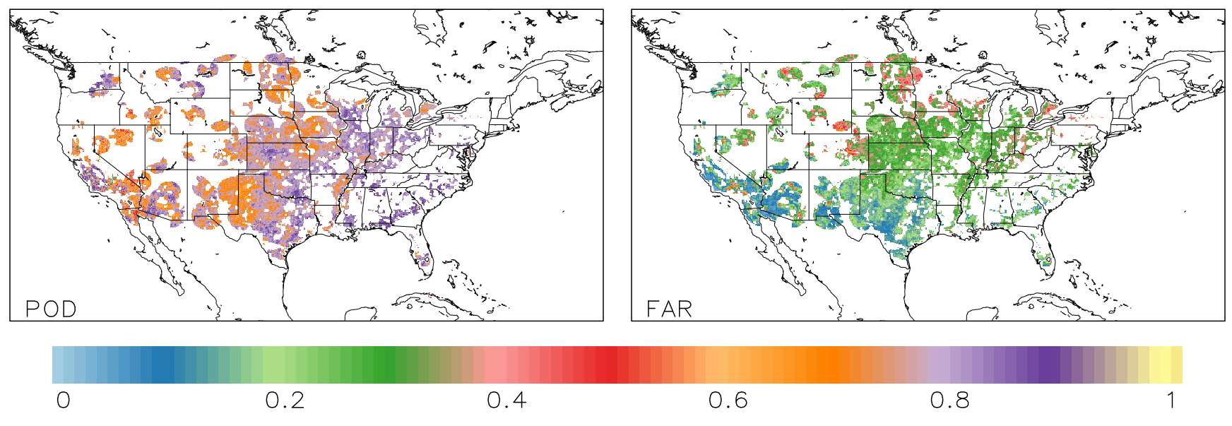
2x2 Contingency Table
IMERG vs MRMS
3x3 Contingency Table

Slide 15
 | POD | FAR
2x2 Contingency Table
IMERG Early vs MRMS (SMAP Overpass intervals) | 0.723 | 0.266
IMERG Early vs MRMS (Daily) | 0.622 | 0.312
Previous IMERG validation with MRMS (Jackson Tan) | 0.667 | 0.466
3x3 Contingency Table
IMERG Early vs MRMS (SMAP Overpass intervals) | 0.763 | 0.242
IMERG Early vs MRMS (Daily) | 0.741 | 0.189
IMERG vs MRMS
3x3 Contingency Table

Slide 16
Conclusions thus far…
  IMERG early, late and final all show similar skill when assessing with SMAP
  IMERG-MRMS skill is comparable to other skill analyses (i.e. Jackson Tan)
  Confidence in using SMAP to validate IMERG at a global-scale
Moving forward…
  Expand data to include 2019
  Investigate potential spatial patterns
    Relationship to soil properties, vegetation, seasonality
  Skill for various precipitation types (e.g. synoptic vs MCS, rain vs mixed-phase)
  Examine subsets of skill
  Expand to LIS analysis to fill gaps in soil mositure between SMAP overpasses
  Potential pathway to validate quantities with SM2Rain methodology

Slide 17
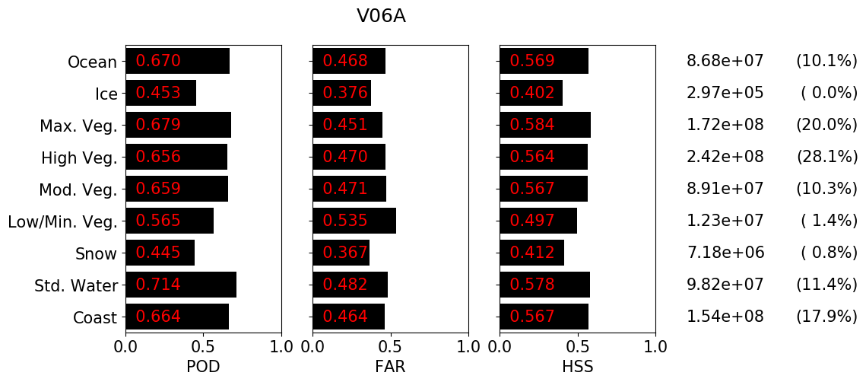
Previous IMERG Validation work

