Slide 1
Improving Orographic Quantitative Precipitation Estimates using Satellite-based Radar Observations and Physical Models
Malarvizhi Arulraj (marulraj@umd.edu)
Postdoctoral Associate, CISESS/UMD
PMM – Land Surface Working Group
June 30, 2020
Malarvizhi Arulraj

Slide 2
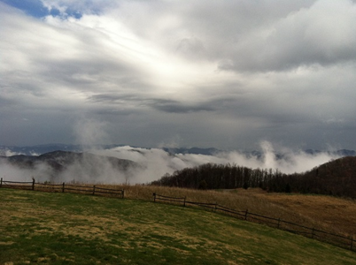
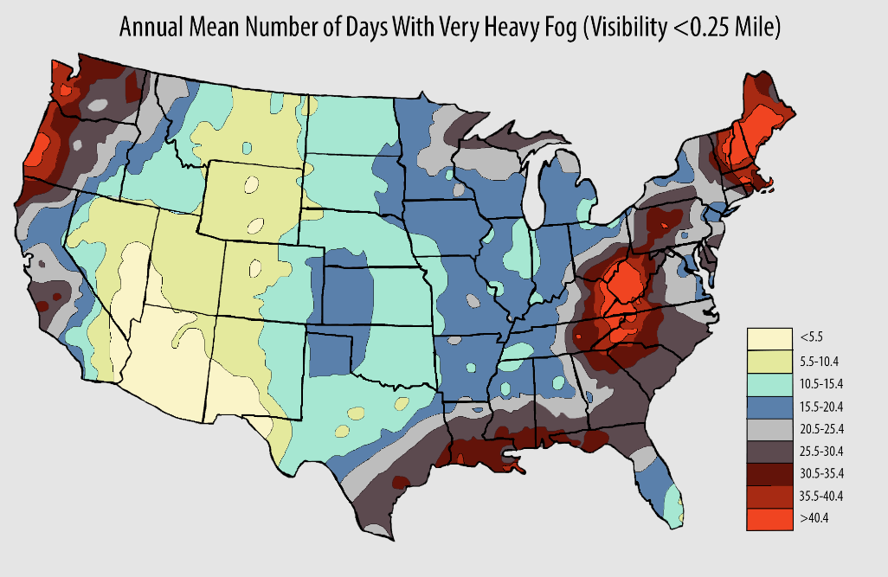
Low-level orographic processes
Appalachians
From: NOAA/NCDC
Spatial Heterogeneity
Layered precipitation
Drop Size Distribution – precipitation regime
Malarvizhi Arulraj

Slide 3
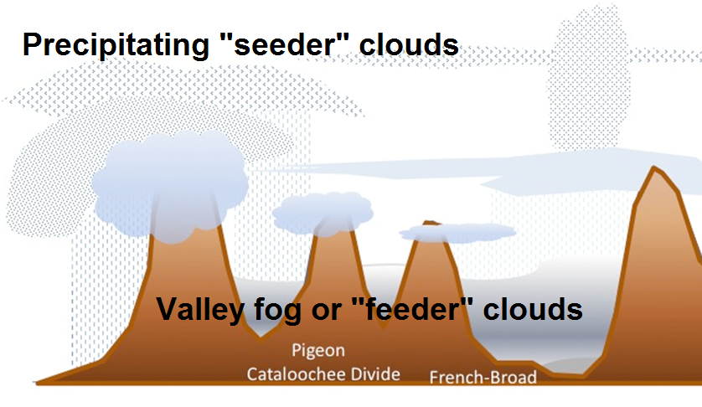
Low-level processes
from Wilson and Barros (2017)
Malarvizhi Arulraj

Slide 4
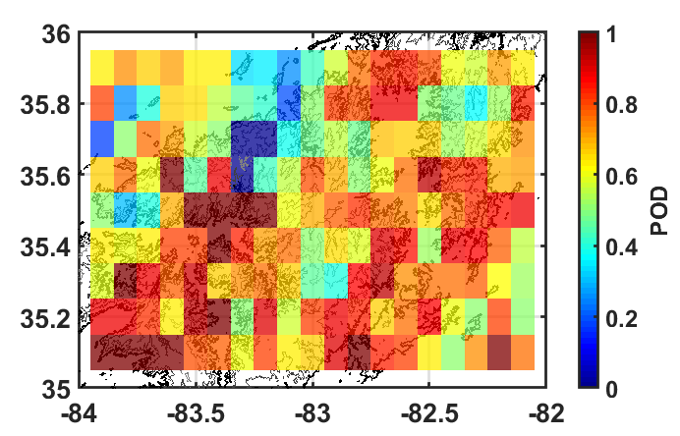
Error Analysis – GPM Ku-PR vs MRMS
 | MRMS ≠ 0 | MRMS = 0
Ku-PR ≠ 0 | YY 1972 (7.0%) | FA 779 (2.8%)
Ku-PR = 0 | MD 917 (3.3%) | NN 24,438 (86.9%)
from Duan and Barros (2017)
Malarvizhi Arulraj

Slide 5
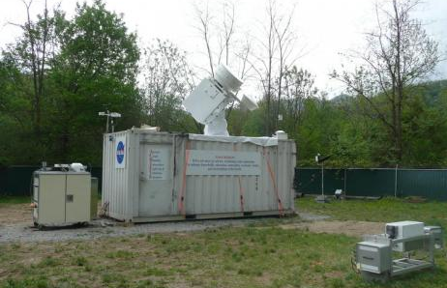
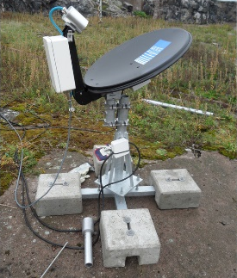
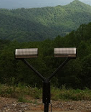
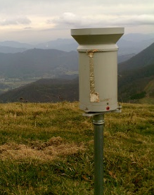

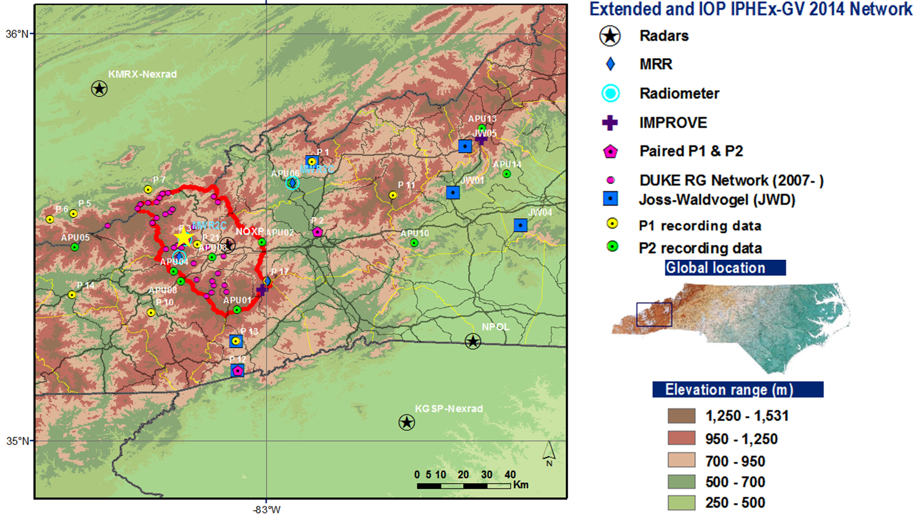
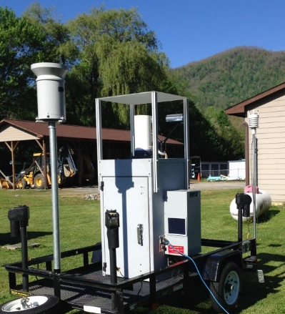
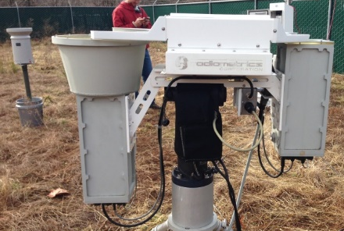
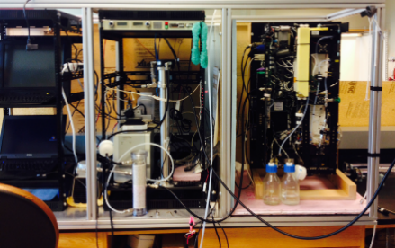

Study Region – Southern Appalachian Mountains
Appalachians
MRR
ACHIEVE (NASA GSFC)
UND Citation
IPHEx
W-band
K-band
P2
RG
Duke H2F
PCASP
2DVD
SMPS/CCN
MWR-3C
(ARM DOE)
Markus Petters (NCSU)
Malarvizhi Arulraj
Notes:
The study region for this research is the Southern Appalachian Mountains – where low-level clouds and fogs play a major role. This region was chosen because of the availability of long-term spatially dense data from collocated instruments since 2007 and also as a part of IPHEx field campaign conducted by NASA in 2014.

Slide 6
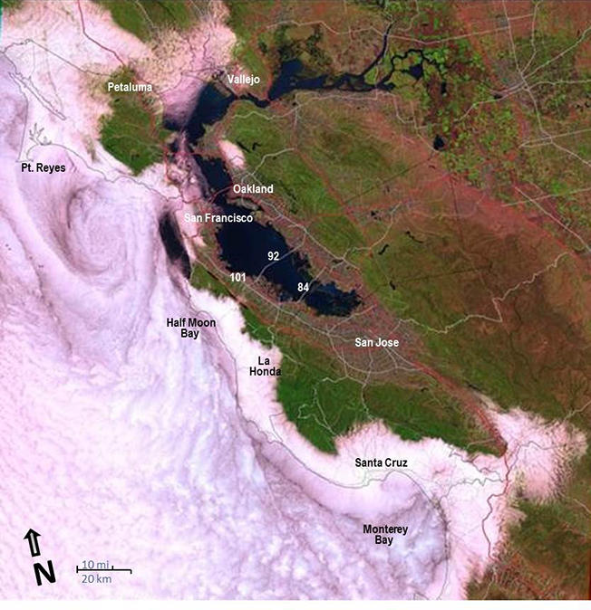
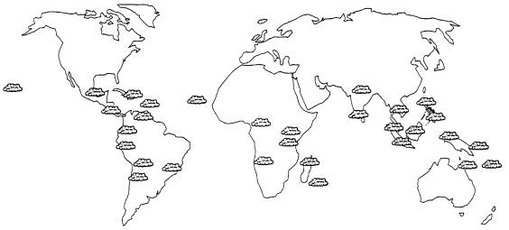
Study Region – Southern Appalachian Mountains
and Coastal Mountains everywhere
Cloud Montane Forests
From Bruijnzeel (2001)
From USGS –The Pacific Coastal Fog Project
Malarvizhi Arulraj
Notes:
Another reason is that the SAM can be categorized as the tropical cloud montane forests and the work done here can be transferable to similar regions.

Slide 7
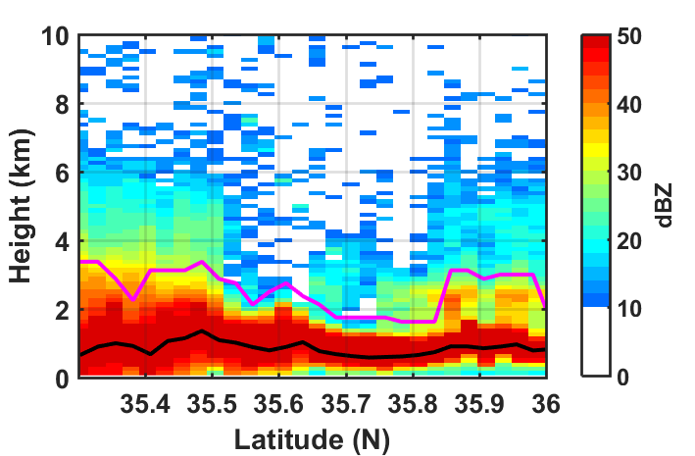
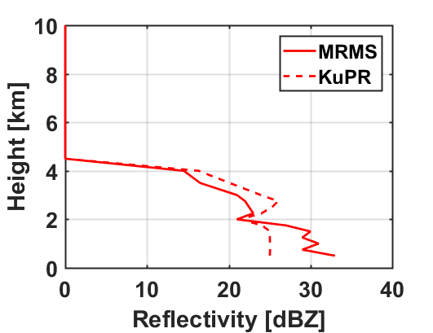
Physical Basis of Errors
Ground-clutter contamination of near-surface reflectivities
Measured reflectivity factor
No Clutter
Height
Malarvizhi Arulraj

Slide 8
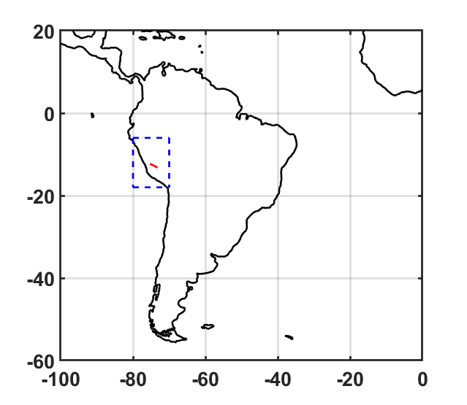
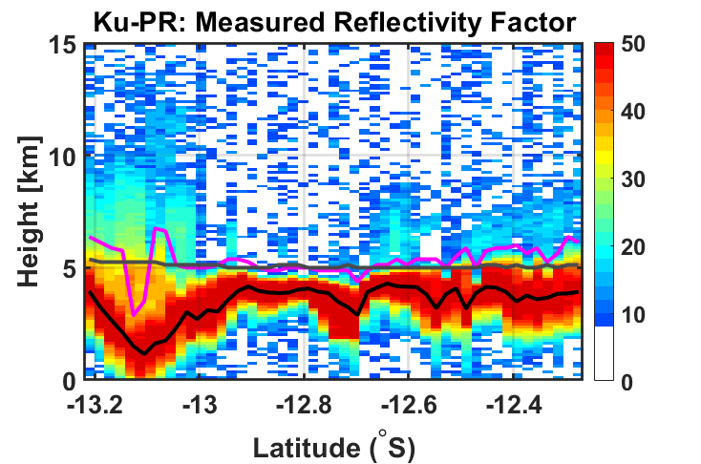
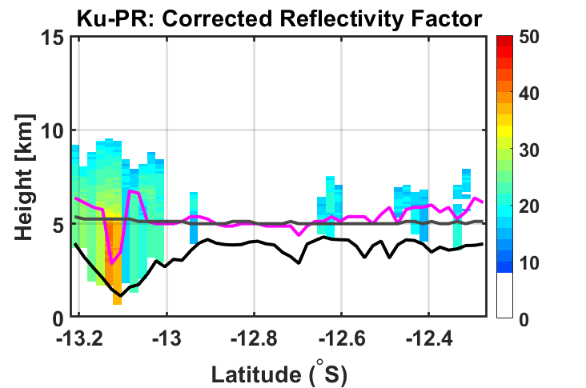
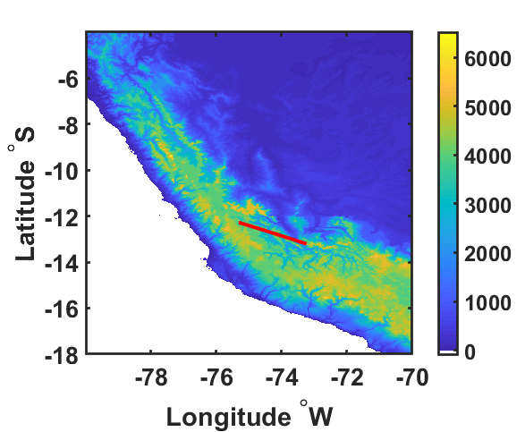
Issues with ground-clutter
Elevation
Minimum no-clutter bin
Zero degree isotherm
Note:
No-clutter bin usually aligns with the DEM. Also, at off-nadir regions, ground-clutter affects higher than 2 km AGL sometimes.
Please see minimum no-clutter bin and DEM for latitude > -13 S in the figure.
However, at slopes (based on the scanning direction of the radar), the no-clutter bin overshoots (purple box).
DEM [m]
Red- line: GPM Ku-PR overpass
December 4, 2015 – Cross track scan
Malarvizhi Arulraj

Slide 9
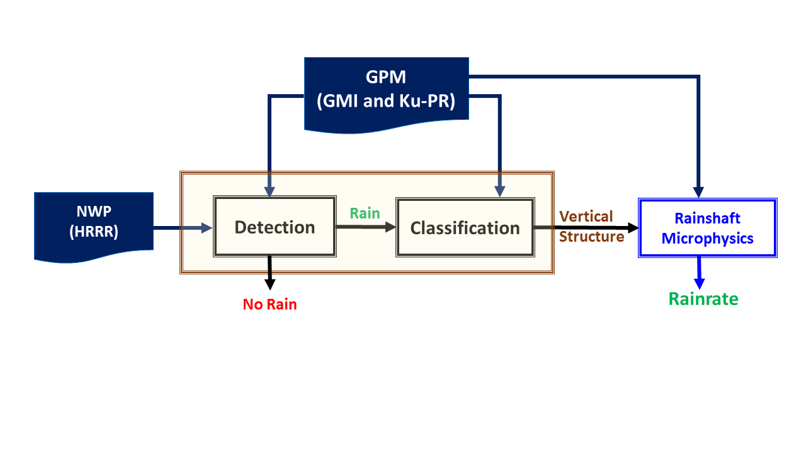
Data-driven method for prediction
Numerical Weather Prediction Models coupled with GPM observations to predict the vertical structure of the precipitation systems?
Malarvizhi Arulraj

Slide 10
Precipitation Detection Algorithm
89 GHz – V & H
RWMR
GPM GMI
Calibrated Brightness Temperature
Channels: 10.65 V/H, 18.70 V/H, 23.8 V, 36.64 V/H, 89 V/H
HRRR
Average and number of non-zero RWMR, SWMR and GRLE within 1.5 km AGL
GPM DPR
Ground-clutter Height
Melting Layer Height
Elevation
Random Forest Classifier
Depth = 20
Number of trees = 500
Output
RAIN
NO-RAIN
Reduction of 77% in False Alarms
Reduction of 82% in Missed Detection
Malarvizhi Arulraj

Slide 11

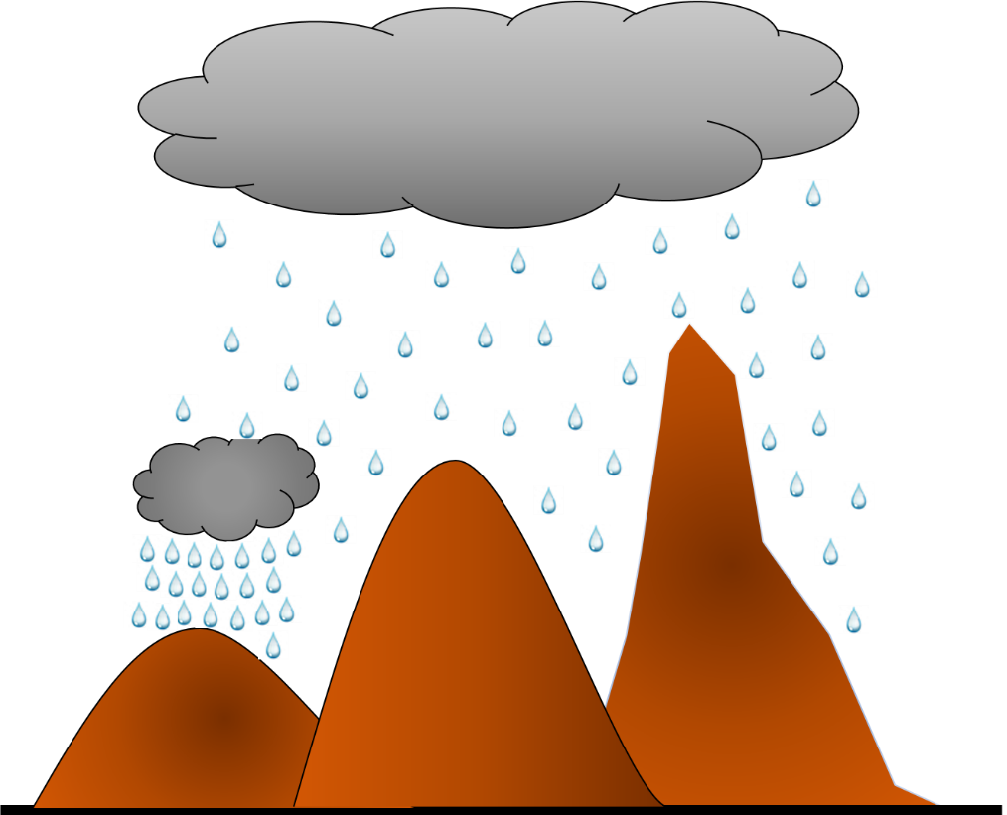
Predict the Vertical Structure
Map the GPM observations to the vertical structure of MRMS
Precipitation type….
Precipitation intensity….
GPM
Specific features to identify similar looking profiles!!
Malarvizhi Arulraj

Slide 12
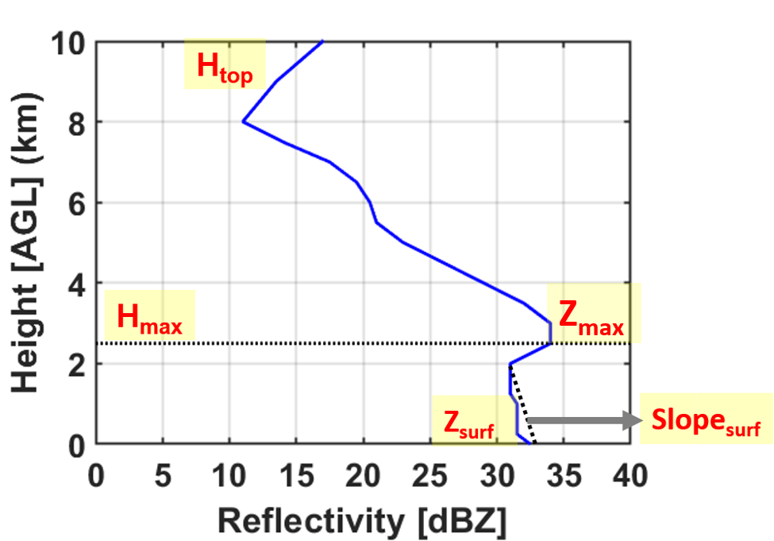
Clustering of MRMS Reflectivity profiles
Malarvizhi Arulraj

Slide 13
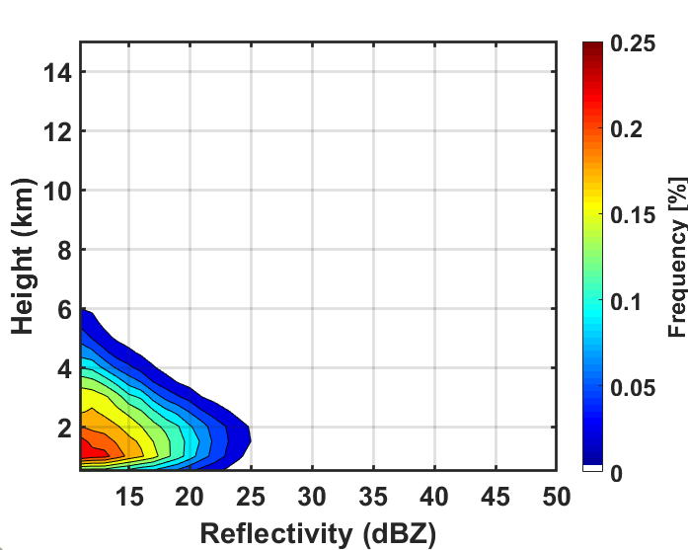
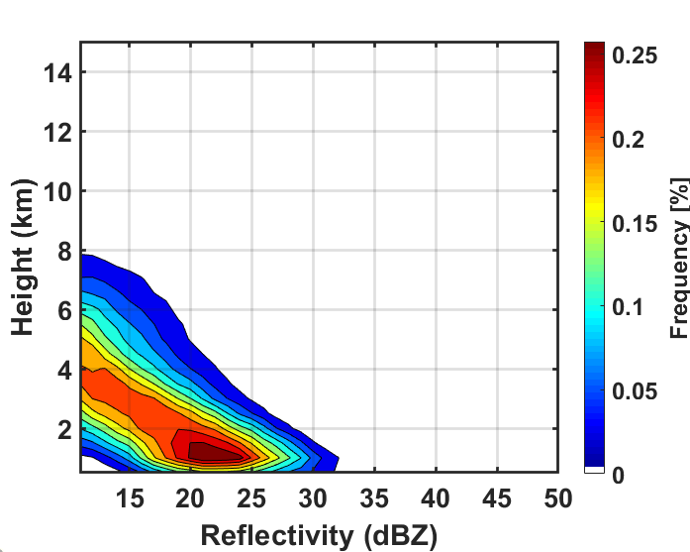
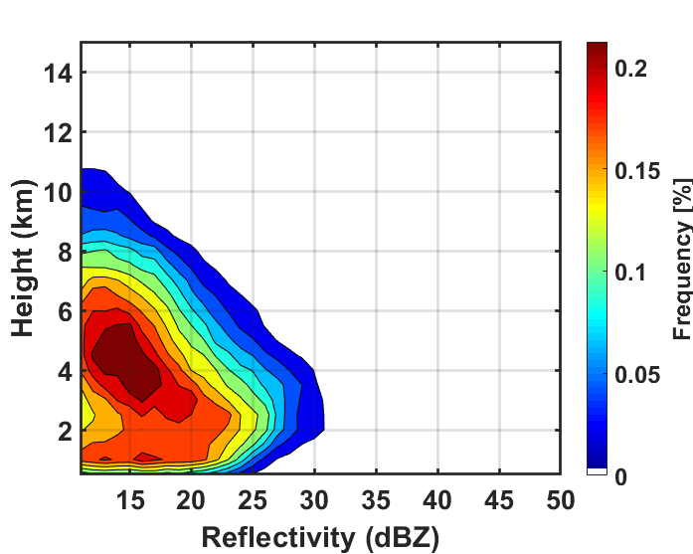
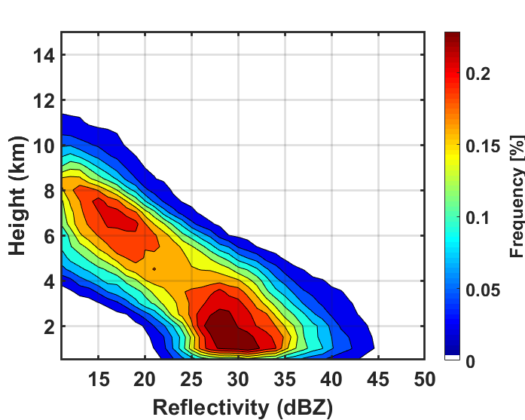
Clustering of MRMS Reflectivity profiles
Cluster-1
Cluster-2
78% MD
26% MD
Surface
enhancement
Shallow
Cluster-3
Cluster-4
16% MD
1% MD
Malarvizhi Arulraj

Slide 14
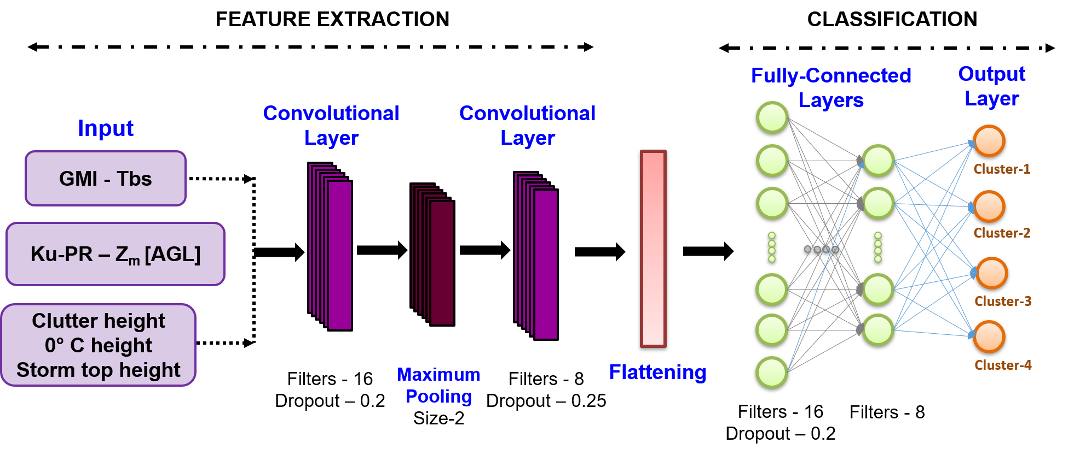
Precipitation Classification
Malarvizhi Arulraj

Slide 15
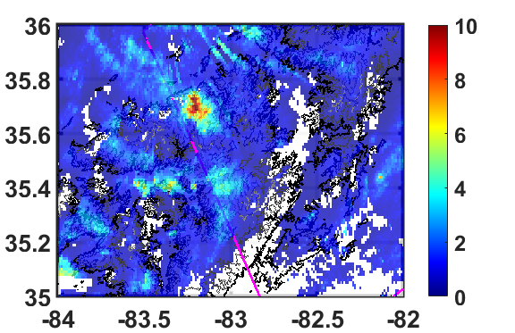
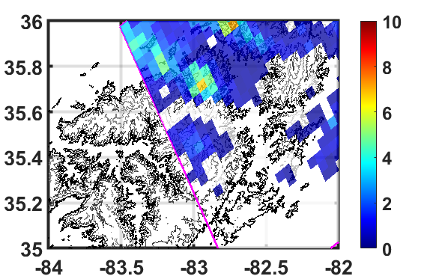
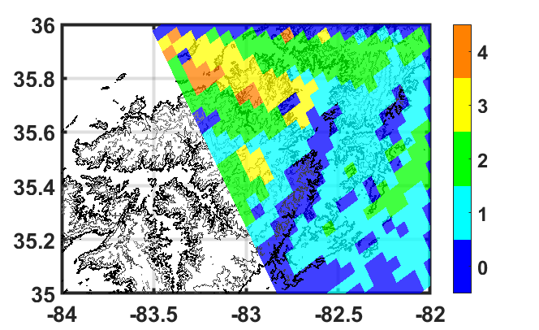
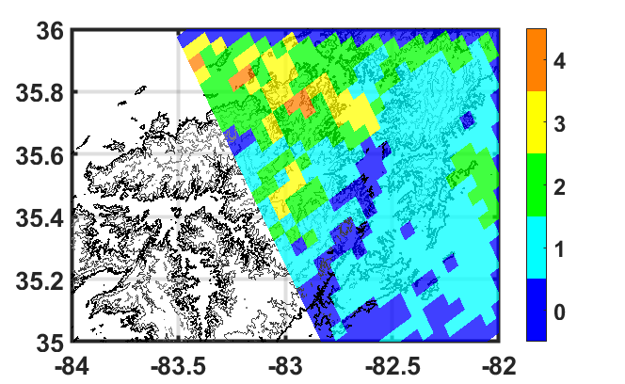
Case study
MRMS Precipitation Rate
GPM Ku-PR Precipitation Rate
UND, MD
Classification label from MRMS
Model predicted Classification label
Malarvizhi Arulraj

Slide 16
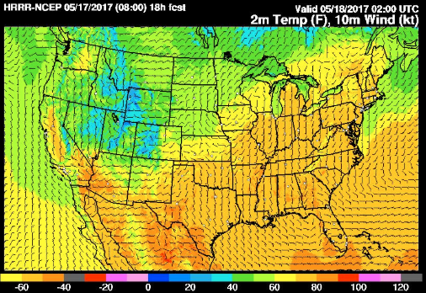
Summary
Findings..
A data-driven framework was developed by integrating HRRR model reanalysis with GPM observations to predict precipitation structure.
GPM-DPR
HRRR
Physically-based modelling framework
Malarvizhi Arulraj

Slide 17
Thank You!
Duke University
Malarvizhi Arulraj

