Slide 1
Recent Developments to NOAA Snowfall Rate Products
Huan Meng¹, Yongzhen Fan², Jun Dong², Yalei You², Cezar Kongoli², Ralph Ferraro¹
¹NOAA/NESDIS/Center for Satellite Applications and Research (STAR)
²University of Maryland/ESSIC/Cooperative Institute for Satellite Earth System Studies (CISESS)
huan.meng@noaa.gov

Slide 2
Outline
Enterprise snowfall rate (SFR) product
Recent algorithm updates
Ocean snowfall detection
Cold extension through machine learning

Slide 3
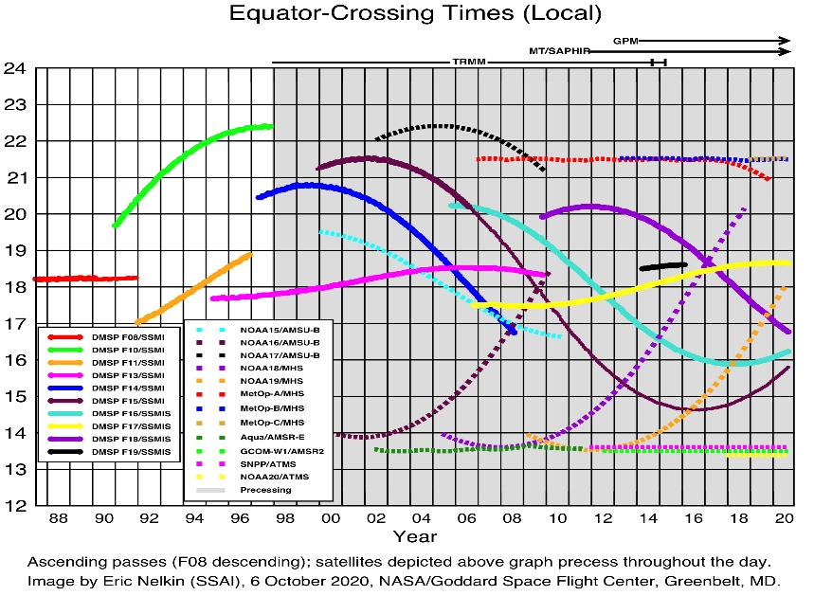
Overview
NOAA/NESDIS operational snowfall rate (SFR) product
Over global land, liquid equivalent snowfall rate estimate
Near real-time production
UMD/CISESS: http://cics.umd.edu/sfr/
NASA/SPoRT: https://weather.msfc.nasa.gov/cgi-bin/sportPublishData.pl?dataset=snowfallrateconus&product=conus_snowrate
Six operational SFR’s
Satellites: S-NPP, NOAA-20, NOAA-19, Metop-A/-B/-C
Sensors: ATMS, AMSU-A/MHS
Four experimental SFR’s
Satellites: GPM, F16, F17, F18
Sensors: GMI, SSMIS
Enterprise production system
One processing system for all (ten) satellites
Same algorithm framework for all satellites
Individual satellites have different external coefficients
Metop-C
NOAA-20

Slide 4
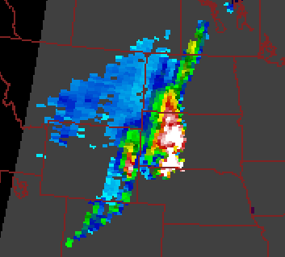
Algorithms
Snowfall Detection (SD)
Logistic regression models
Satellite-based module
NWP model-based module
Optimal combination of the two modules
Screening
Snowfall Rate Estimation
Cloud properties retrieved using a 1DVAR model
Snowfall rate estimation from cloud properties and ice particle fall velocity
Bias correction

Slide 5
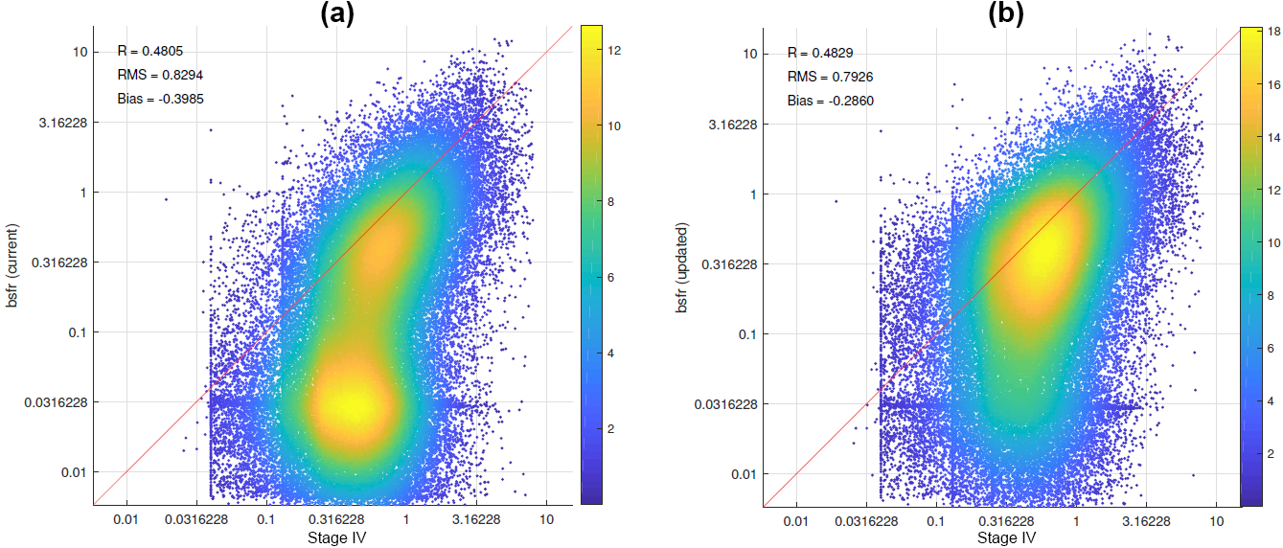
Two-Stream Radiative Transfer Model (RTM) Correction
Modified the two-stream RTM to full stream RTM correction in the 1DVAR
Drastically improved SFR retrievals especially for light to moderate snowfall
Significantly reduced non-convergence rate
Most of the previous retrievals below 0.1 mm/hr did not converge
Non-convergence rate reduced by ~ 50% with the new correction
Density scatter plot of NOAA-20 SFR vs. Stage IV radar-gauge combined precipitation product
SFR from the previous 1DVAR
SFR from the improved 1DVAR

Slide 6
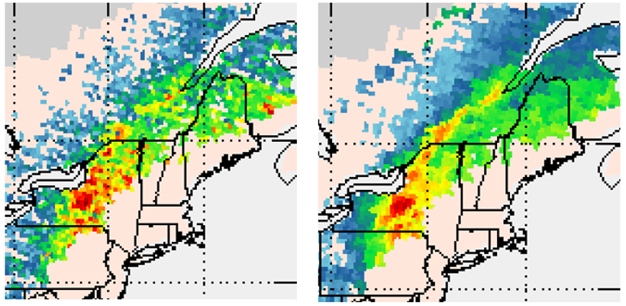
Improved 1DVAR Flexibility
Modified the 1DVAR to allow variable number of channels
Recover retrieval capabilities for sensors with failed channels, e.g., Metop-A MHS (failed 157 GHz channel)
Frequent observations are essential for dynamic processes like snowfall
Metop-A SFR
Before
After

Slide 7
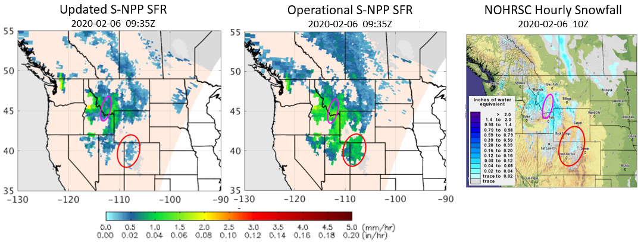
Updated SFR Bias Correction
Bias correction is necessary due to limitation of information content in satellite measurements and uncertainties from various sources
Bias correction
NWS/NCEP Stage IV as ‘truth data’
Previously using histogram matching
New technique: regression between bias and 1DVAR-retrievals, satellite measurements, and NWP predictions
Significant product improvement with the regression bias correction
NOAA-20 SFR
 | R | Bias (mm/hr) | RMSE (mm/hr)
w/o bias correction | 0.45 | -0.34 | 0.80
w/ bias correction | 0.55 | 0.03 | 0.71
NOHRSC: National Operational Hydrologic Remote Sensing Center Snow Analyses

Slide 8
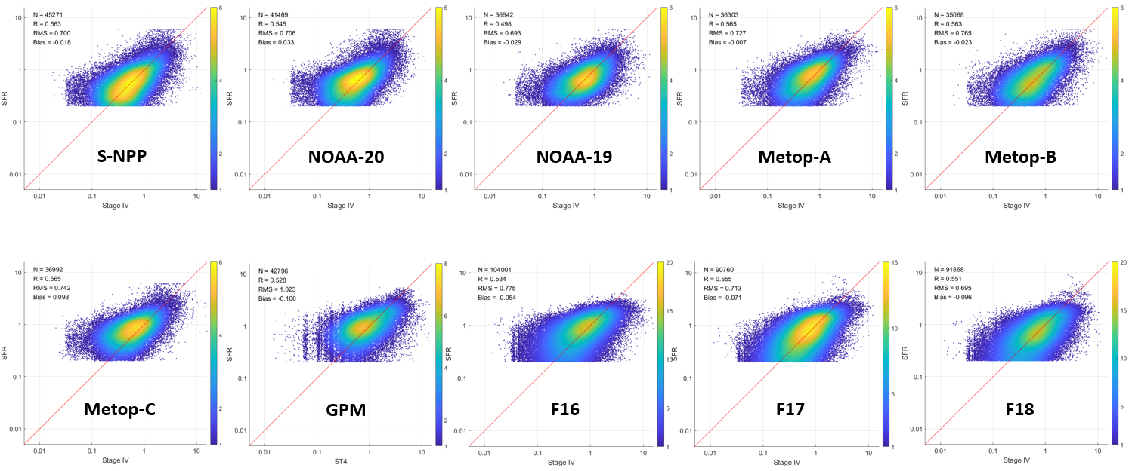
SFR Metrics

Slide 9
SFR Metrics (2)
Satellite | Sensor | R | Bias (mm/hr) | RMSE (mm/hr)
S-NPP | ATMS | 0.56 | -0.02 | 0.70
NOAA-20 | ATMS | 0.55 | 0.03 | 0.71
NOAA-19 | AMSU-A/MHS | 0.50 | -0.03 | 0.69
Metop-A | AMSU-A/MHS | 0.57 | -0.01 | 0.71
Metop-B | AMSU-A/MHS | 0.56 | -0.02 | 0.77
Metop-C | AMSU-A/MHS | 0.57 | 0.09 | 0.74
GPM | GMI | 0.53 | -0.11 | 1.02
F16 | SSMIS | 0.53 | -0.05 | 0.78
F17 | SSMIS | 0.56 | -0.07 | 0.71
F18 | SSMIS | 0.55 | -0.10 | 0.70

Slide 10
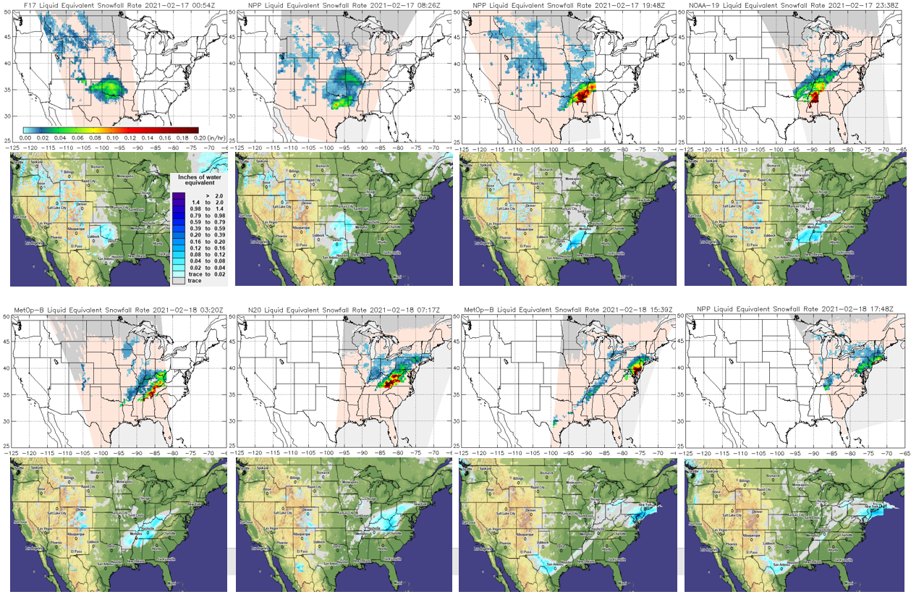
Case Study, Feb 17-18, 2021

Slide 11
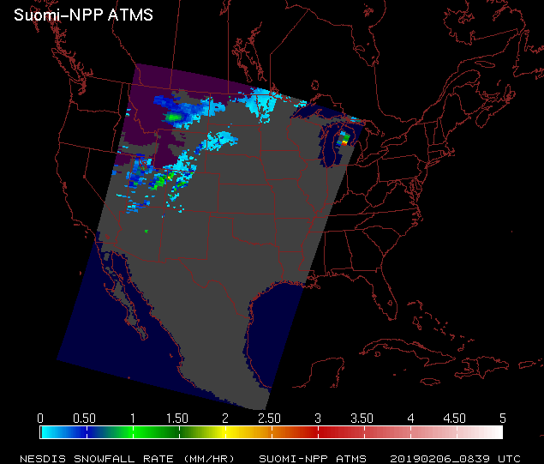
SFR Coverage Issues
Black: Outside overpass
Grey: No snow
Purple: Too cold / no retrieval
Blue: Water / no retrieval

Slide 12
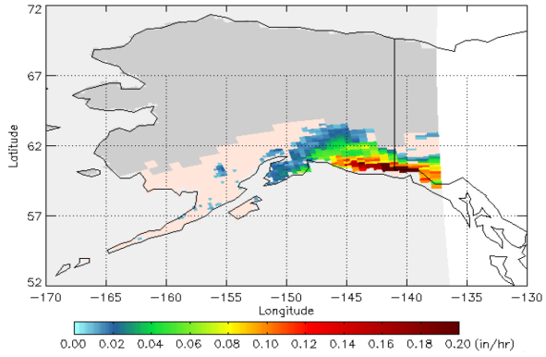
Ocean Extension
Motivation:
The NOAA/NESDIS snowfall rate product is land only. The lack of coverage over ocean adversely impacts product applications in weather forecasting
Objective:
First, develop snowfall detection (SD) algorithms for over ice-free ocean, sea-ice, and coast for the Advanced Technology Microwave Sounder (ATMS) onboard both S-NPP and NOAA-20 satellites, with the ultimate goal of developing snowfall rate algorithms for the three surfaces
Truth data:
Snowfall rate from CloudSat Cloud Profiling Radar (CPR) (2C-SNOW-PROFILE)
SFR
Method:
Global model: One logistic regression model for each surface type
10-degree regional models: A logistic regression model for each grid box with at least 5000 snowfall data points

Slide 13
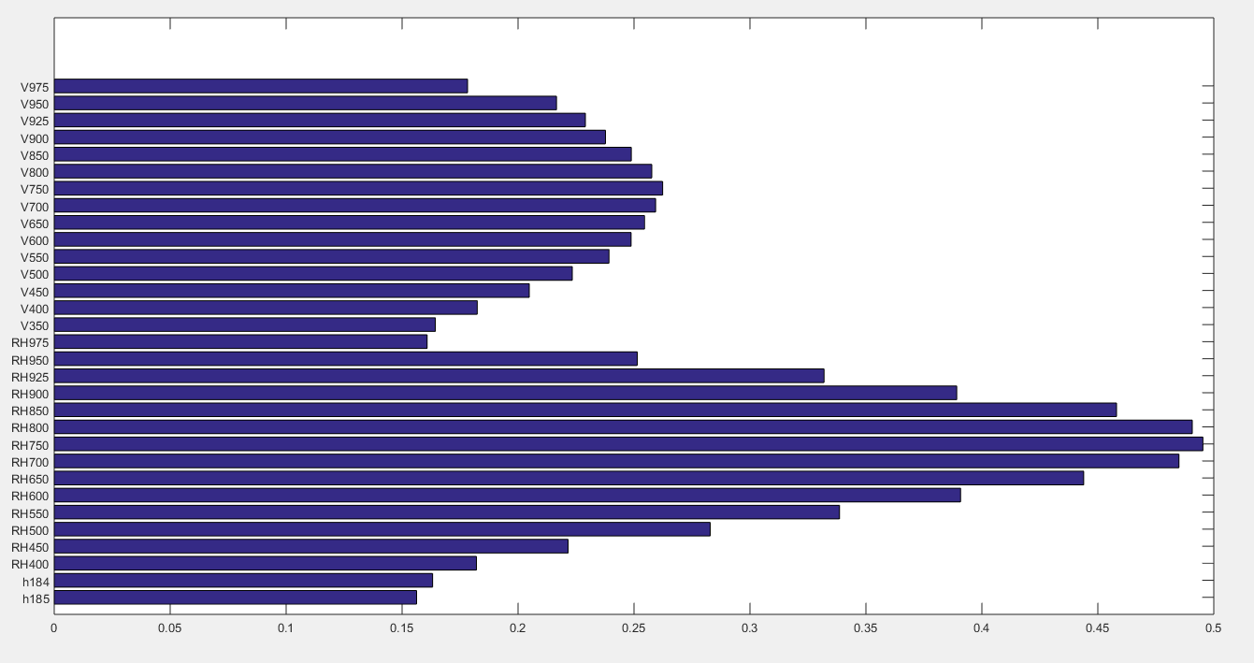
Model Predictors
Predictor selection process:
Step 1: Calculate SD Heidke Skill Score (HSS) for each variable
Step 2: Only select variables with HSS > 0.15
Step 3: Add selected variables to SD models step-wise based on physical understanding; remove redundant variables
Final SD models have 14-16 predictors for each surface type
ATMS brightness temperatures (TBs)
GFS relative humidity profile
GFS TPW and cloud water
Candidate variables
22 TBs
19 Temp
19 RH
19 VV
19 Hgt
19 cloud mixing ratio
single-layer gfs variables
H183±1.8,1
RH profile
Vertical velocity profile
HSS
Notes:
Physical reason

Slide 14
Predictor and Model Performance
Performance Statistics
(TBs + GFS predictors, Global model)
Conclusions:
Combining TBs and GFS predictors produces satisfactory SD models with HSS from 0.55 – 0.59, and POD from 0.69 – 0.74 over all surface types.
Over ice-free ocean, the algorithm primarily depends on TBs for snowfall detection (e.g., the HSS only decreases from 0.59 to 0.57 without GFS predictors).
However, the GFS predictors are critically important for snowfall detection over sea-ice and coastal regions (e.g. HSS over sea-ice and coast reduce to 0.34 and 0.32, respectively, without the GFS predictors).
 | POD | FAR | HSS
Ice-free Ocean | 0.69 | 0.15 | 0.59
Sea-Ice | 0.74 | 0.15 | 0.55
Coast | 0.74 | 0.15 | 0.56
Performance Statistics
(TBs Only, Global model)
 | POD | FAR | HSS
Ice-free Ocean | 0.66 | 0.15 | 0.57
Sea-Ice | 0.54 | 0.15 | 0.34
Coast | 0.53 | 0.15 | 0.32

Slide 15
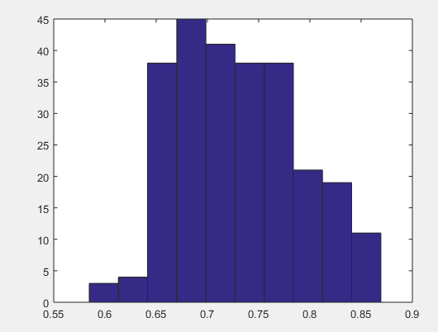
Model Selection
Global model
 | POD | FAR | HSS
Ice-free Ocean | 0.69 | 0.15 | 0.59
Sea-Ice | 0.74 | 0.15 | 0.55
Regional models
 | Average POD | FAR | Average HSS
Ice-free Ocean | 0.73 | 0.15 | 0.58
Sea-Ice | 0.75 | 0.15 | 0.56
Histogram of POD from the Regional Models over ice-free ocean
Conclusion:
Although the averaged statistics from the regional models are comparable to those from the global model, the statistics from individual regional models can be much better (e.g., POD > 0.8) over certain regions
The final SD algorithm is an optimal combination of the two models depending on their performance in specific regions

Slide 16
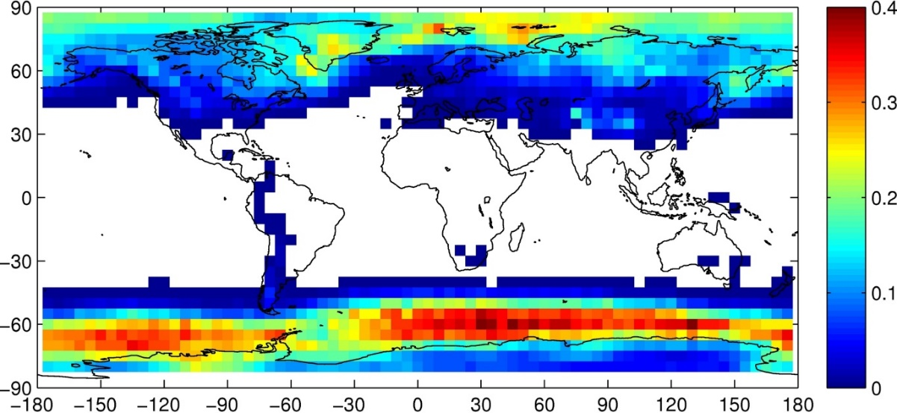
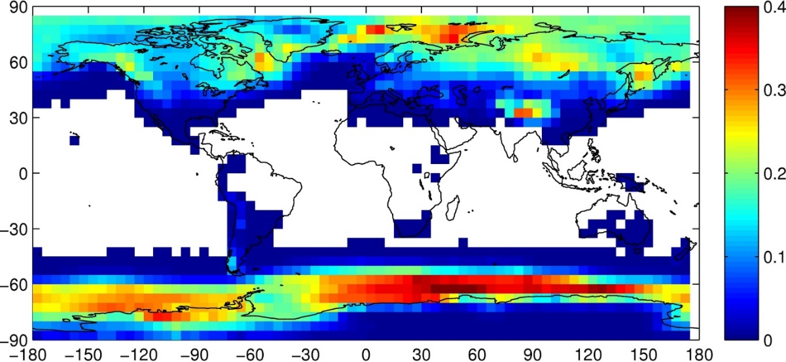
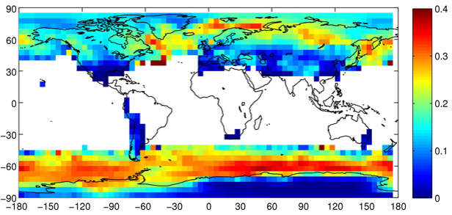
Global Model Climatology
CloudSat CPR snowfall frequency 2006-2016
Snowfall frequency: the number of snowing pixels divided by the number of all pixels in each 5-degree box
The S-NPP snowfall frequency pattern matches well with CPR over ocean, especially over the Southern Ocean; the pattern of NOAA-20 matches less with CPR (1-year data) and requires further model tuning
The higher snowfall frequency from ATMS is likely due to the larger ATMS FOV compared with CPR FOV
S-NPP ATMS snowfall frequency 2012-2016
NOAA-20 ATMS snowfall frequency 2019
Notes:
Global model or regional model?

Slide 17
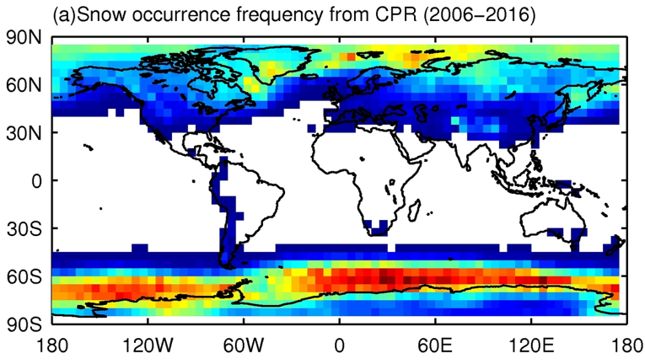
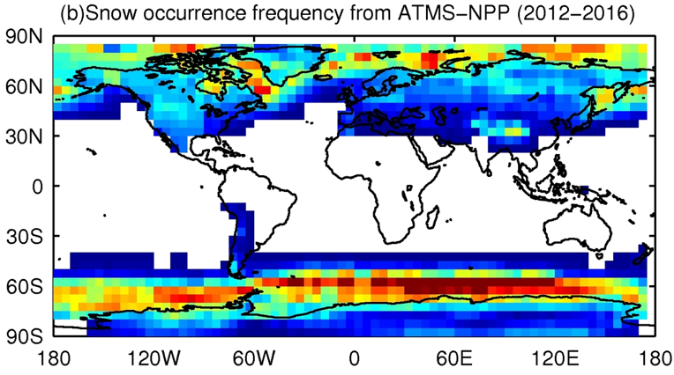
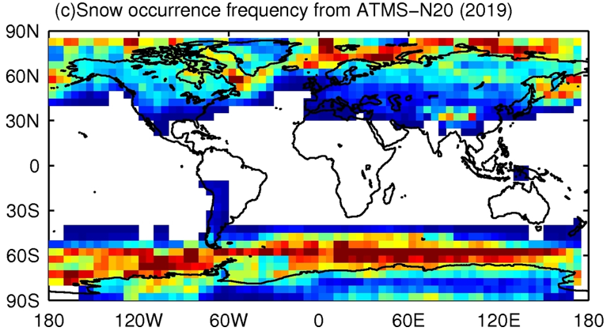
Regional (10-deg Box) Model Climatology
ATMS snowfall frequency is less smooth from the regional models than from the global models
Overall snowfall frequency patterns are similar between S-NPP ATMS and CPR; NOAA-20 is less so (1-year data) and requires further model tuning

Slide 18
Case study over Alaska region: 2013-11-19
Snow probability: regional model
Snow probability: global model
Black line: CPR swath Purple cross: snowing pixel
Regional model generally detects more snowfall with larger snowfall probability than the global model
Snow/no-snow (1/0): regional model
Snow/no-snow(1/0): global model
Notes:
Why the quotation marks? Do the regional models also have more false alarms (even though FAR is the same for both the regional models and the global model)?
What are the thresholds for both?

Slide 19
SD Cold Extension
Current SD Algorithm
A logistic regression (LR) model trained from collocated satellite and ground observations
Performance degradation below ~ -6 ⁰C/21 ⁰F
Non-applicable below ~ -15 ⁰C/7 ⁰F
Major obstacles to applications in cold areas where traditional observations are often lacking, e.g. Alaska, mountainous regions
SD using Machine Learning (ML)
Extend SD to colder regions
Improve SD overall performance
SFR

Slide 20
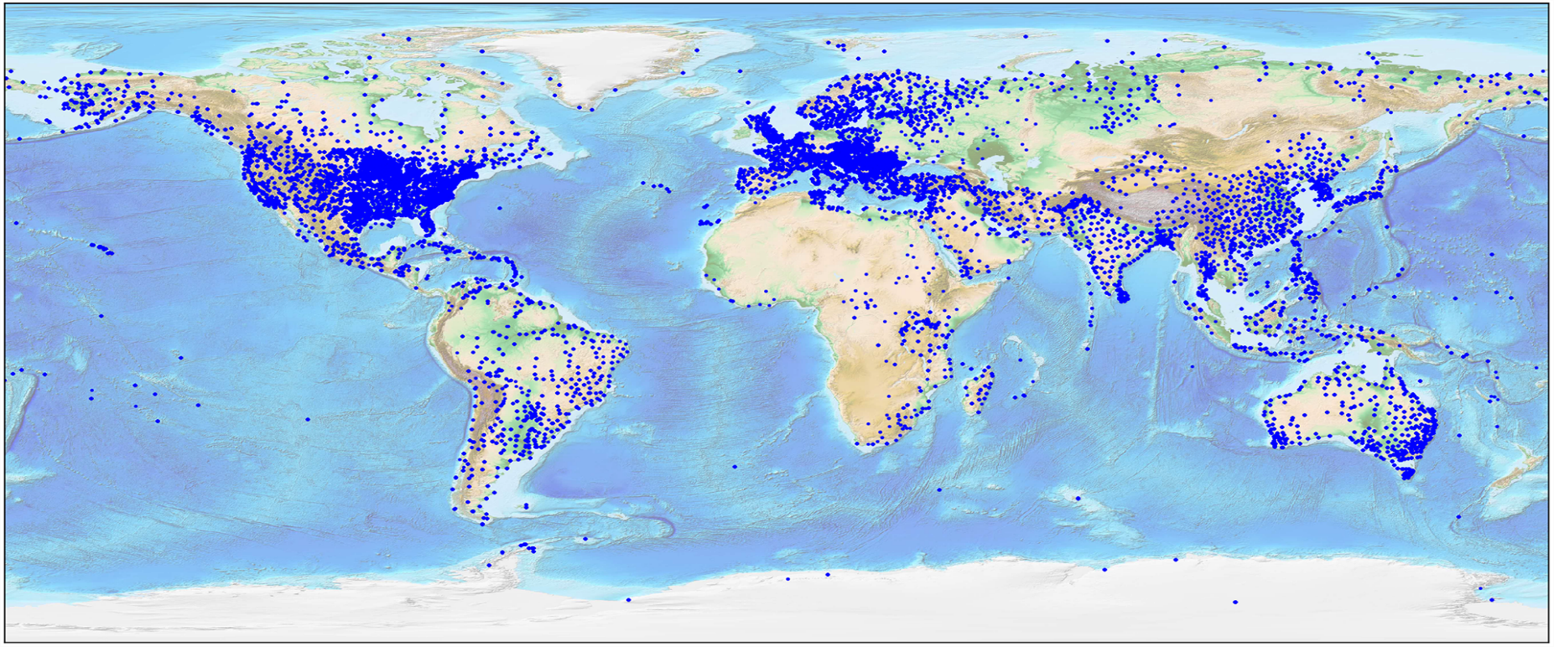
Training Data
Built global training dataset with collocated data:
Truth data: NOAA Integrated Surface Database (ISD) ground observations
S-NPP ATMS satellite measurements
GFS analyses
A total of 1.3 million data records after quality control

Slide 21
Preliminary Deep Neural Network (DNN) SD
Feature analysis identified 50 most important features for detecting snowfall
Divided the dataset into training (80%) and testing (20%) groups
Data was categorized into warm and cold regimes; applied random sampling and oversampling to ensure equal number of samples in each regime
Trained a preliminary DNN model with 50 x 25 neurons

Slide 22
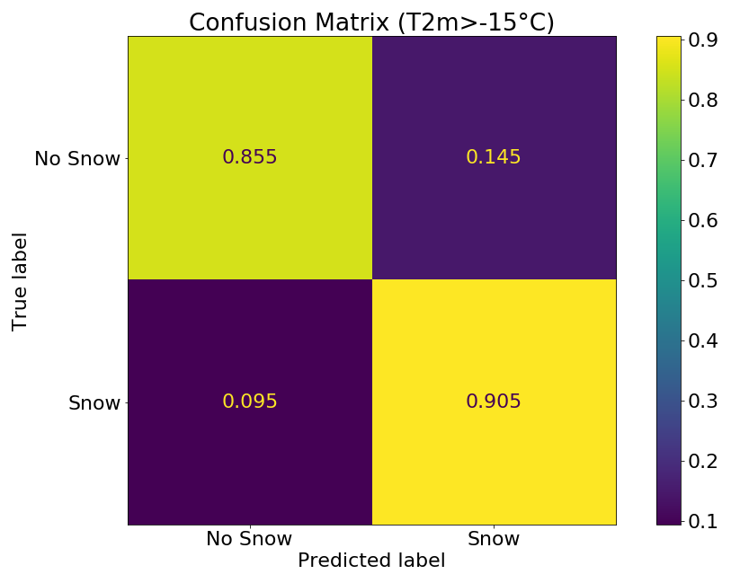
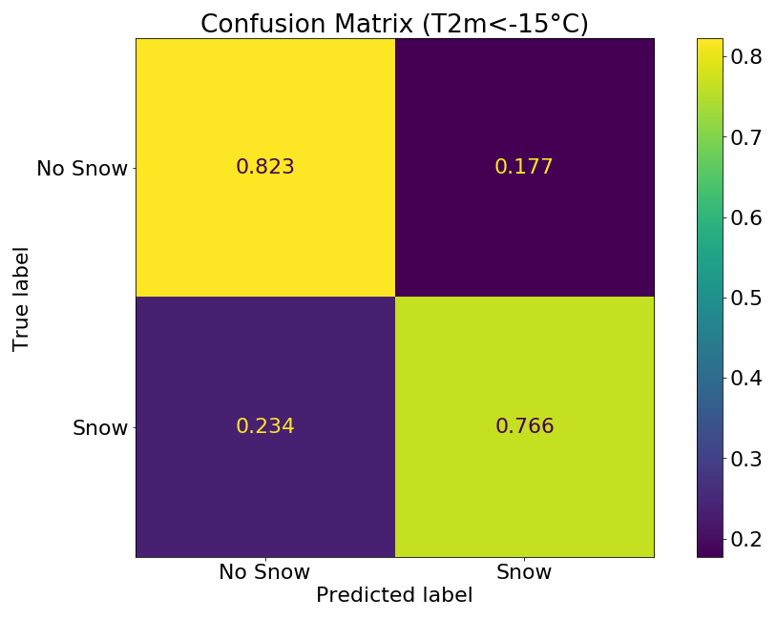
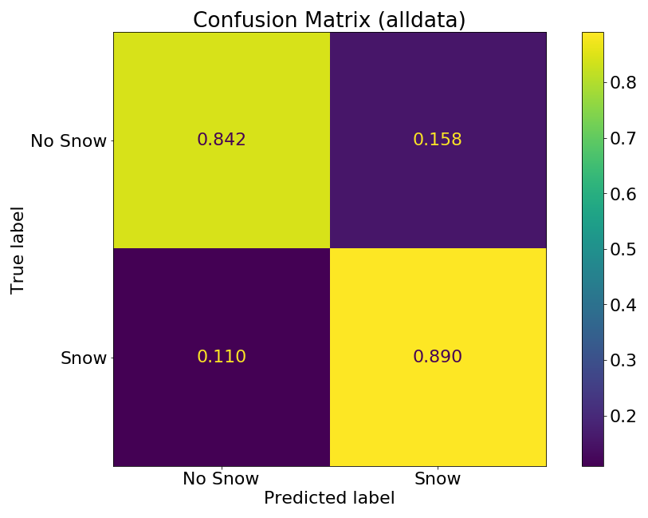
DNN SD Testing Result
Improved performance compared to LR algorithm under warm conditions (T2m > -15 ⁰C).
Applicable to cold conditions (T2m < -15 ⁰C) with good performance
 | T2m>-15⁰C |  | T2m<-15⁰C |  | All Data
 | DNN | LR | DNN | LR | DNN | LR
Probability of Detection | 90.5% | 80.9% | 76.6% | N/A | 89.0% | N/A
False Alarm Rate | 14.5% | 31.4% | 17.7% | N/A | 15.8% | N/A
Heidke Skill Score | 0.754 | 0.496 | 0.535 | N/A | 0.735 | N/A

Slide 23
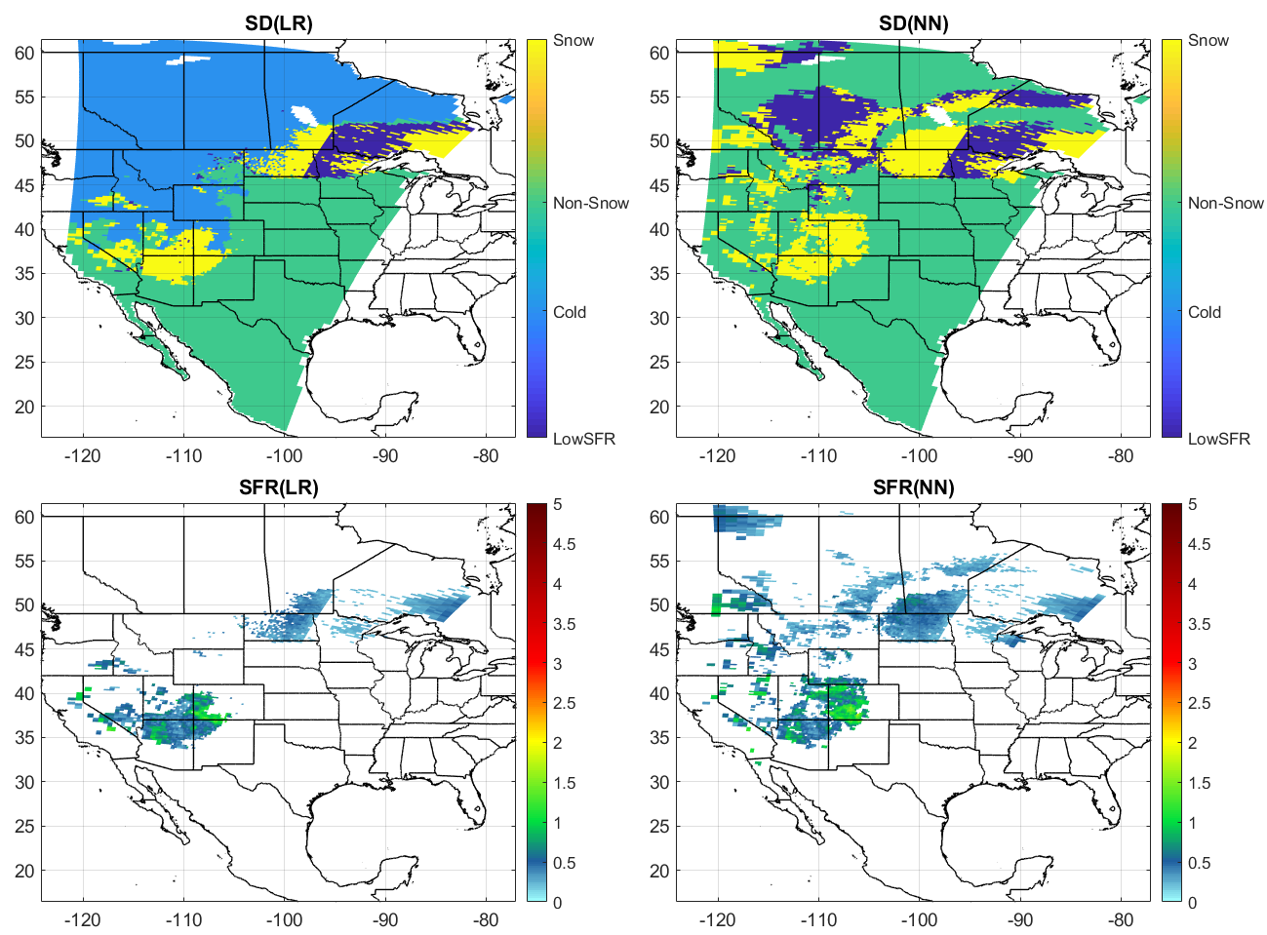
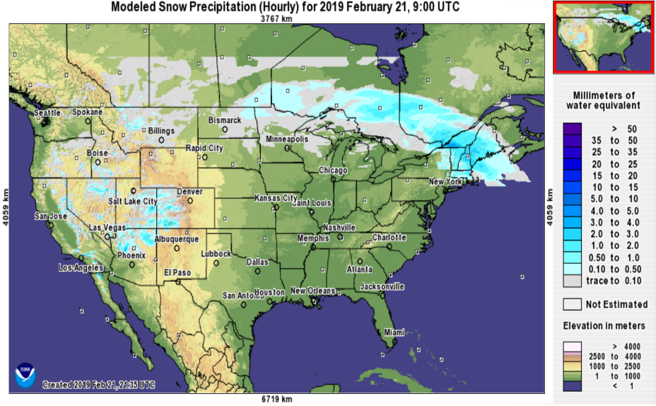
Case Study, February 22, 2019 08:39 UTC
Detected snow in regions where T2m < -15 ⁰C
Similar snowfall pattern as the NOHRSC snow analyses

Slide 24
Summary
Several important updates have been made to the NOAA/NESDIS snowfall rate product recently that significantly improved product quality
A set of ocean extension (over ice-free ocean, sea ice, coast) snowfall detection algorithms has been developed for ATMS. The focus of the ongoing research is to develop ocean snowfall rate algorithms for ATMS
A preliminary S-NPP ATMS deep neural network algorithm has been developed that can detect snowfall in cold regions with good agreement with ground observations
24

