Slide 1
Improving Cross-track Scanning Radiometers’ Precipitation Retrieval over Ocean by Morphing
Yalei You¹, Christa Peters-Lidard², S. Joseph Munchak²,
Jackson Tan^{2,3}, Scott Braun², Sarah Ringerud^{1,2}, William Blackwell⁴,
John Xun Yang¹, Eric Nelkin^{2,5}, and Jun Dong¹
¹CISESS/ESSIC/UMD, ²GSFC/NASA, ³Universities Space Research Association
⁴Lincoln Laboratory/MIT, ⁵Science Systems and Applications
You et al., 2021, JHM, https://doi.org/10.1175/JHM-D-21-0038.1

Slide 2
We proposed to add a time dimension into the retrieval process by linking multiple satellites together
By doing so, we can
Improve the precipitation retrieval over snow-covered land regions by ΔTB (You et al., 2017, JHM; Turk et al., 2021, JHM)
Use the emissivity temporal variation (Δe) for rainfall retrieval enhancements (You et al., 2018, JGR; 2021, JHM)
Capture the liquid raindrop signature over desert regions (You et al., 2020 GRL)
Morph precipitation rates from Conical scanning radiometers to cross-track scanning sensors (You et al., 2021, JHM)

Slide 3
Cross-track Scanning Radiometers (Sounder) :
FOV varies along the scan line, MHS, ATMS, AMSUA/B, SAPHIR
Conical Scanning Radiometers (Imager):
FOV remains constant along the scan line, AMSRE, AMSR2, TMI, GMI, SSMIS
This study uses 10 radiometers:
5 Cross track: MHSs onboard NOAA18, NOAA19, MetOpA, MetOpB, and ATMS onboard NPP
5 Conical: SSMIS onboard F16, F17, and F18, AMSR2, and GMI

Slide 4
Hurricane Celia to highlight the potential benefits of our method
IMERG

Slide 5
Hurricane Celia to highlight the potential benefits of our method
GPROF
IMERG

Slide 6
Hurricane Celia to highlight the potential benefits of our method
GPROF
IMERG
Our method

Slide 7
Hurricane Celia to highlight the potential benefits of our method
1st row: AMSR2, MHS, GMI
2nd row: IMERG final-run in the corresponding half-hour
3rd row: AMSR2, Morphed-MHS, GMI
Innovation:
Improve MHS precipitation rates at the MHS observation time by morphing
In contrast, MHS precipitation rates remain unchanged in IMERG

Slide 8
Objective: Improving cross-track scanning radiometers’ retrievals by morphing conical scanning radiometers’ retrieval
Motivation: Conical > Cross-track over ocean
Innovation:
Improve cross-track scanning radiometers’ retrieval
In contrast, precipitation rates from cross-track radiometers remain unchanged in Level3 datasets (IMERG, CMORPH, and GSMaP).
Motion vector derived from precipitation rate directly, instead of IR TB or MERRA2 TPW
Methodology:
Morphing
Average (equal weight)
Take GMI as the reference (i.e., GMI and cross-track radiometers observe the same event)
KuPR also used for reference, but not for the motion vector calculation

Slide 9
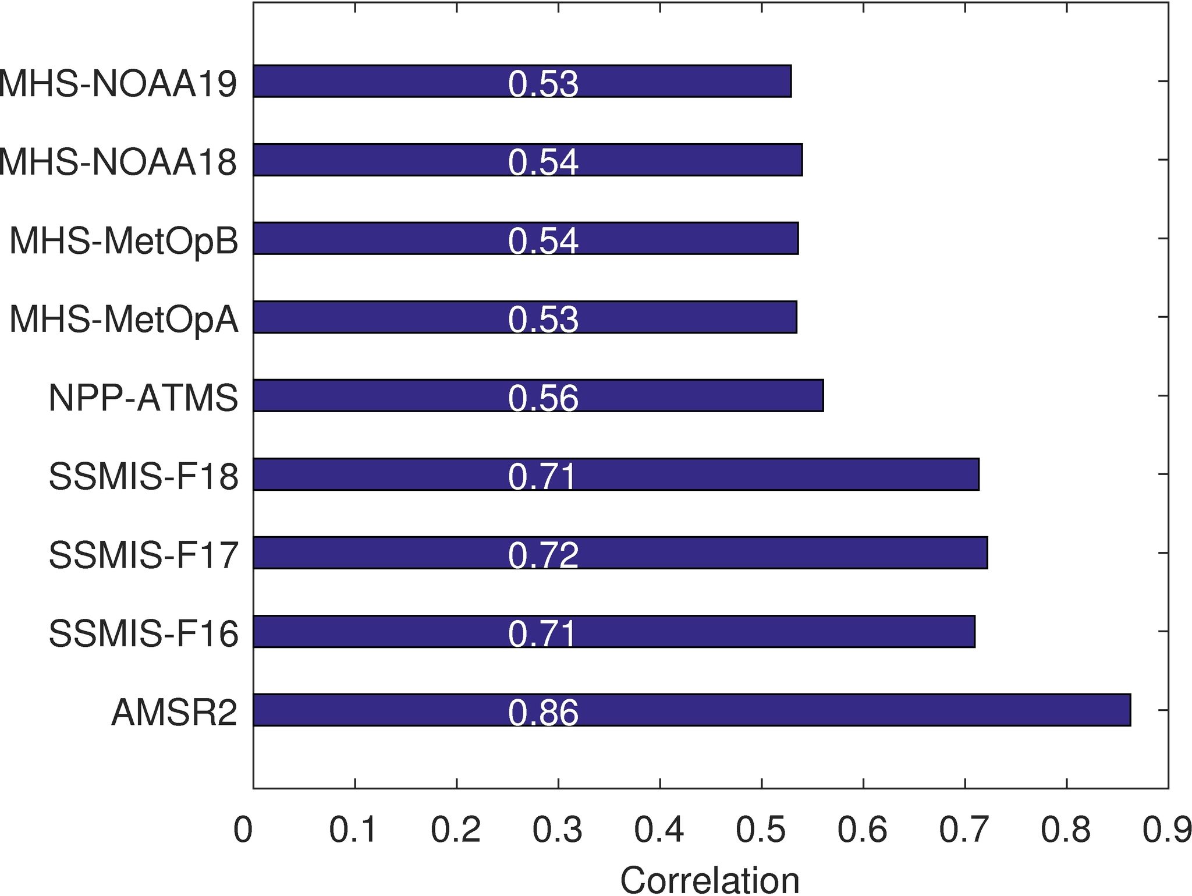
Motivation: Conical > Cross-track over ocean
KuPR as the reference (JHM, You et al. 2020)
GMI as the reference
Coincident observations between KuPR (GMI) and each sensor

Slide 10
Motivation: Conical > Cross-track over ocean
KuPR as the reference (JHM, You et al. 2020)
GMI as the reference
Cross-track
Conical
Coincident observations between KuPR (GMI) and each sensor

Slide 11
Case1: Morphing AMR2 forward to NOAA19-MHS
Because Conical > Cross-track, so we can morph conical’s result to Cross-track’ observation time
NOAA19-MHS and GMI < 5 minutes (take as coincidently)
Morph AMSR2 to NOAA19-MHS
Get the morphed precipitation rates (MHS/2+morphed AMSR2/2)
Compared with GMI

Slide 12
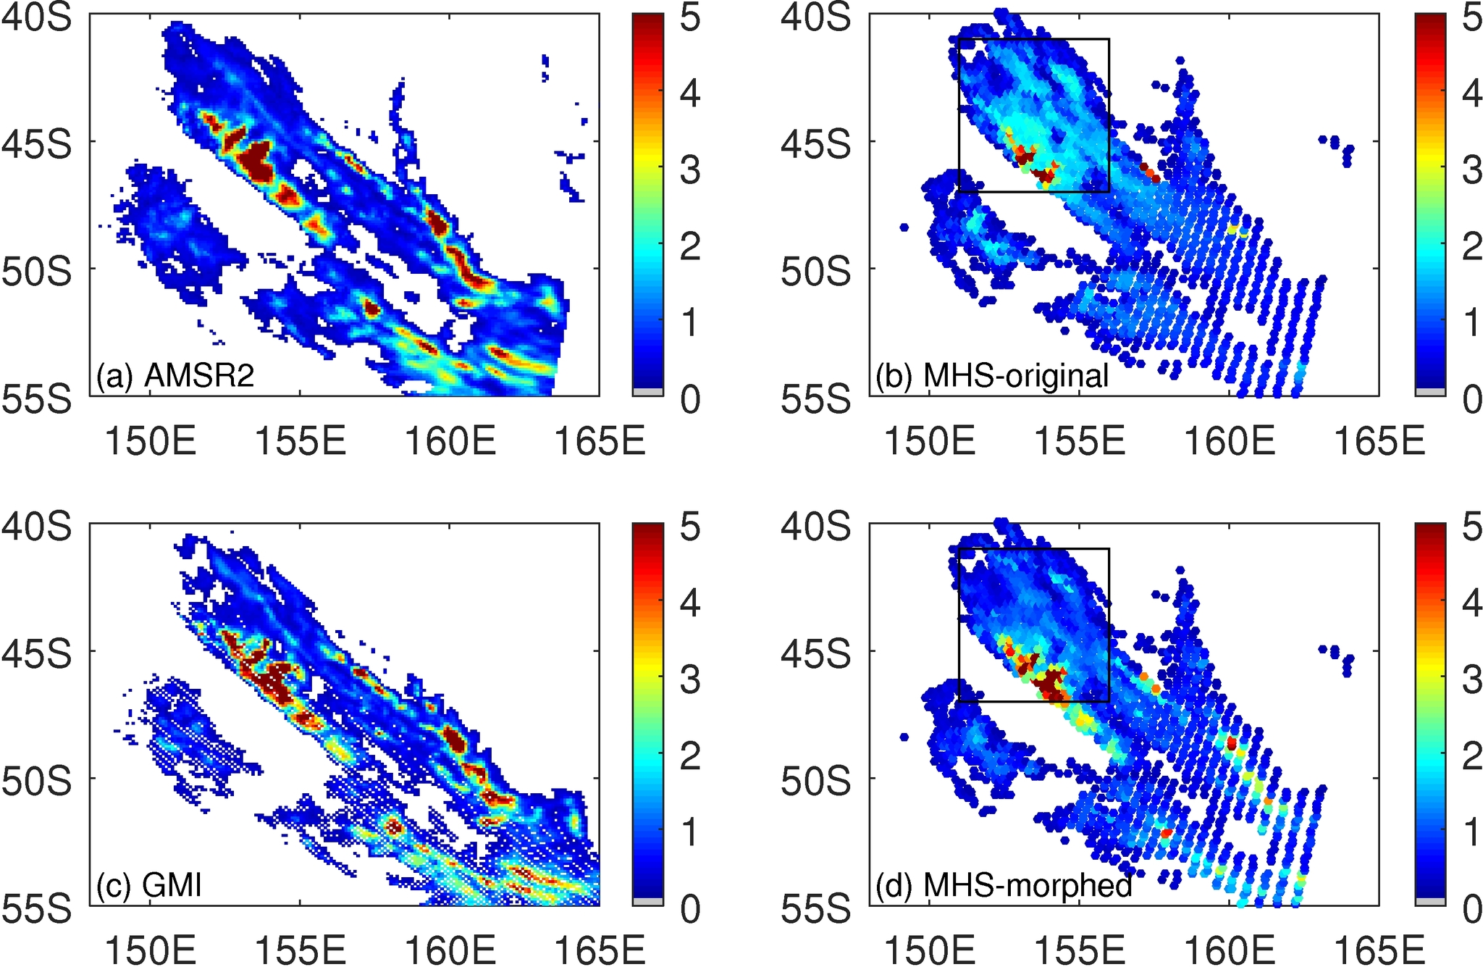
Case1: Morphing AMR2 forward to NOAA19-MHS
Because Conical > Cross-track, so we can morph conical’s result to Cross-track’ observation time
Morphed result (d) agree with much better with GMI (c), especially in the highlighted region indicate by the black box
Heavy rainfall in a larger area
Light rainfall around 1 mm/hr is largely resolved.

Slide 13
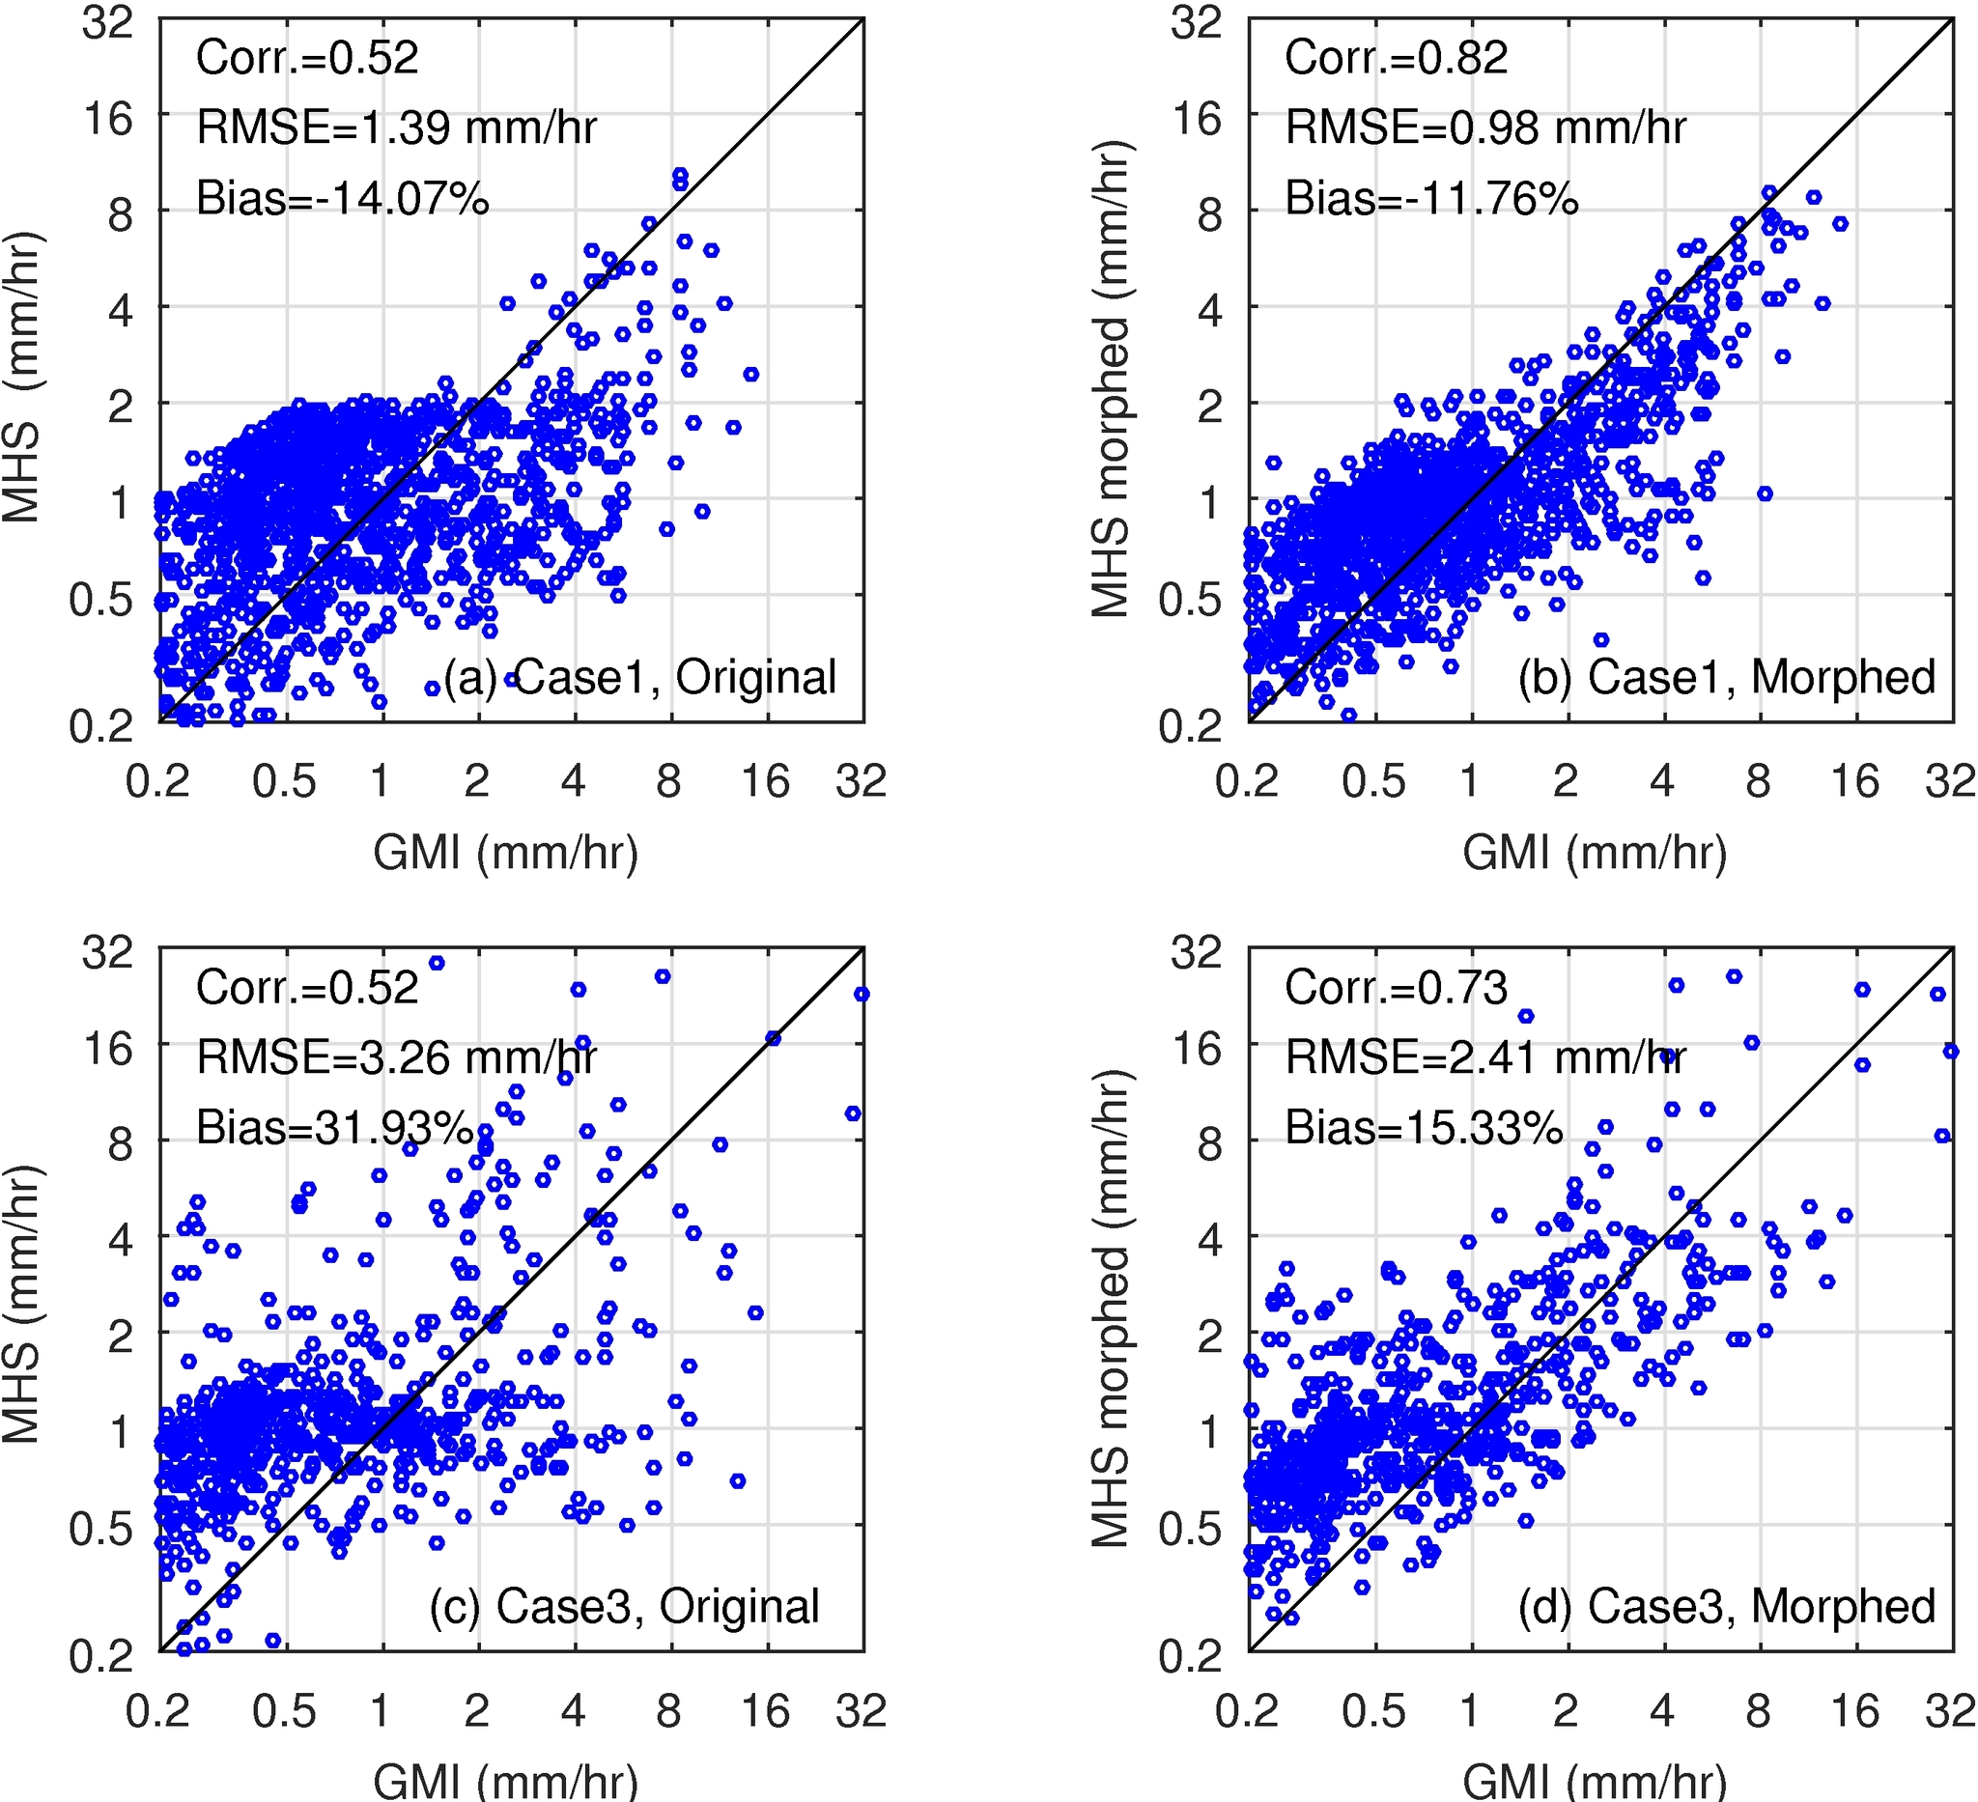
Case1: Morphing AMR2 forward to NOAA19-MHS
Because Conical > Cross-track, so we can morph conical’s result to Cross-track’ observation time

Slide 14
Case2: Morphing F17-SSMIS backward to NOAA19-MHS
Because Conical > Cross-track, so we can morph conical’s result to Cross-track’ observation time

Slide 15
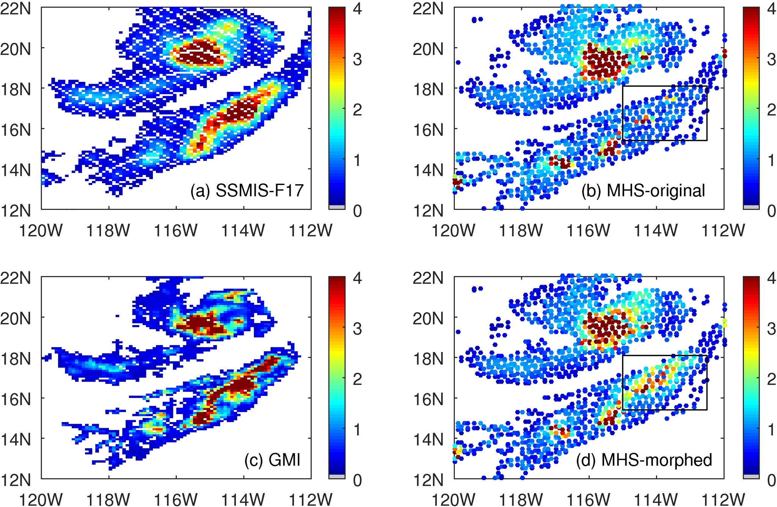
Case2: Morphing F17-SSMIS backward to NOAA19-MHS
Because Conical > Cross-track, so we can morph conical’s result to Cross-track’ observation time

Slide 16
Case2: Morphing F17-SSMIS backward to NOAA19-MHS
Because imagers > sounders, so we can morph conical’s result to sounder observation time

Slide 17
Overall performance for all sounders

Slide 18
Overall performance for all sounders
In order:
NOAA19-MHS (original, morphed)
NOAA18-MHS (original, morphed)
MetOpA-MHS (original, morphed)
MetOpB-MHS (original, morphed)
NPP-ATMS (original, morphed)

Slide 19
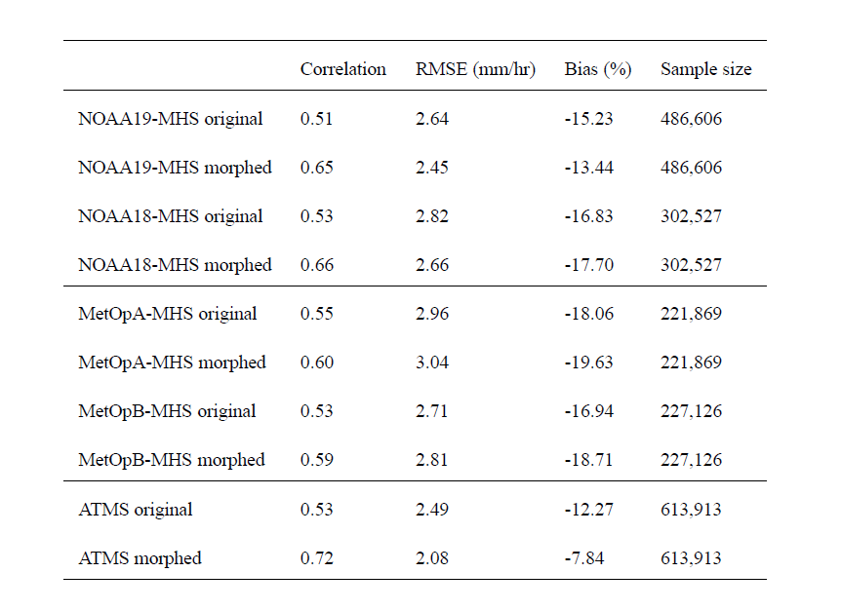
Improvement degree differs:
Degree of the improvement can be grouped into three categories:
ATMS
MHSs from NOAA18 and NOAA19
MHSs from MetOpA and MetOpB

Slide 20
Improvement degree differs:
Why ATMS improves the most:
Almost all the morphed precipitation rates are from AMSR2 (precipitation sources)
Almost all the time differences between ATMS and AMSR2 < 60 minutes (time interval)
We also analyzed three other factors: precipitation type (convective vs. stratiform), precipitation event size (large vs. small), and region (tropics vs. subtropics)

Slide 21
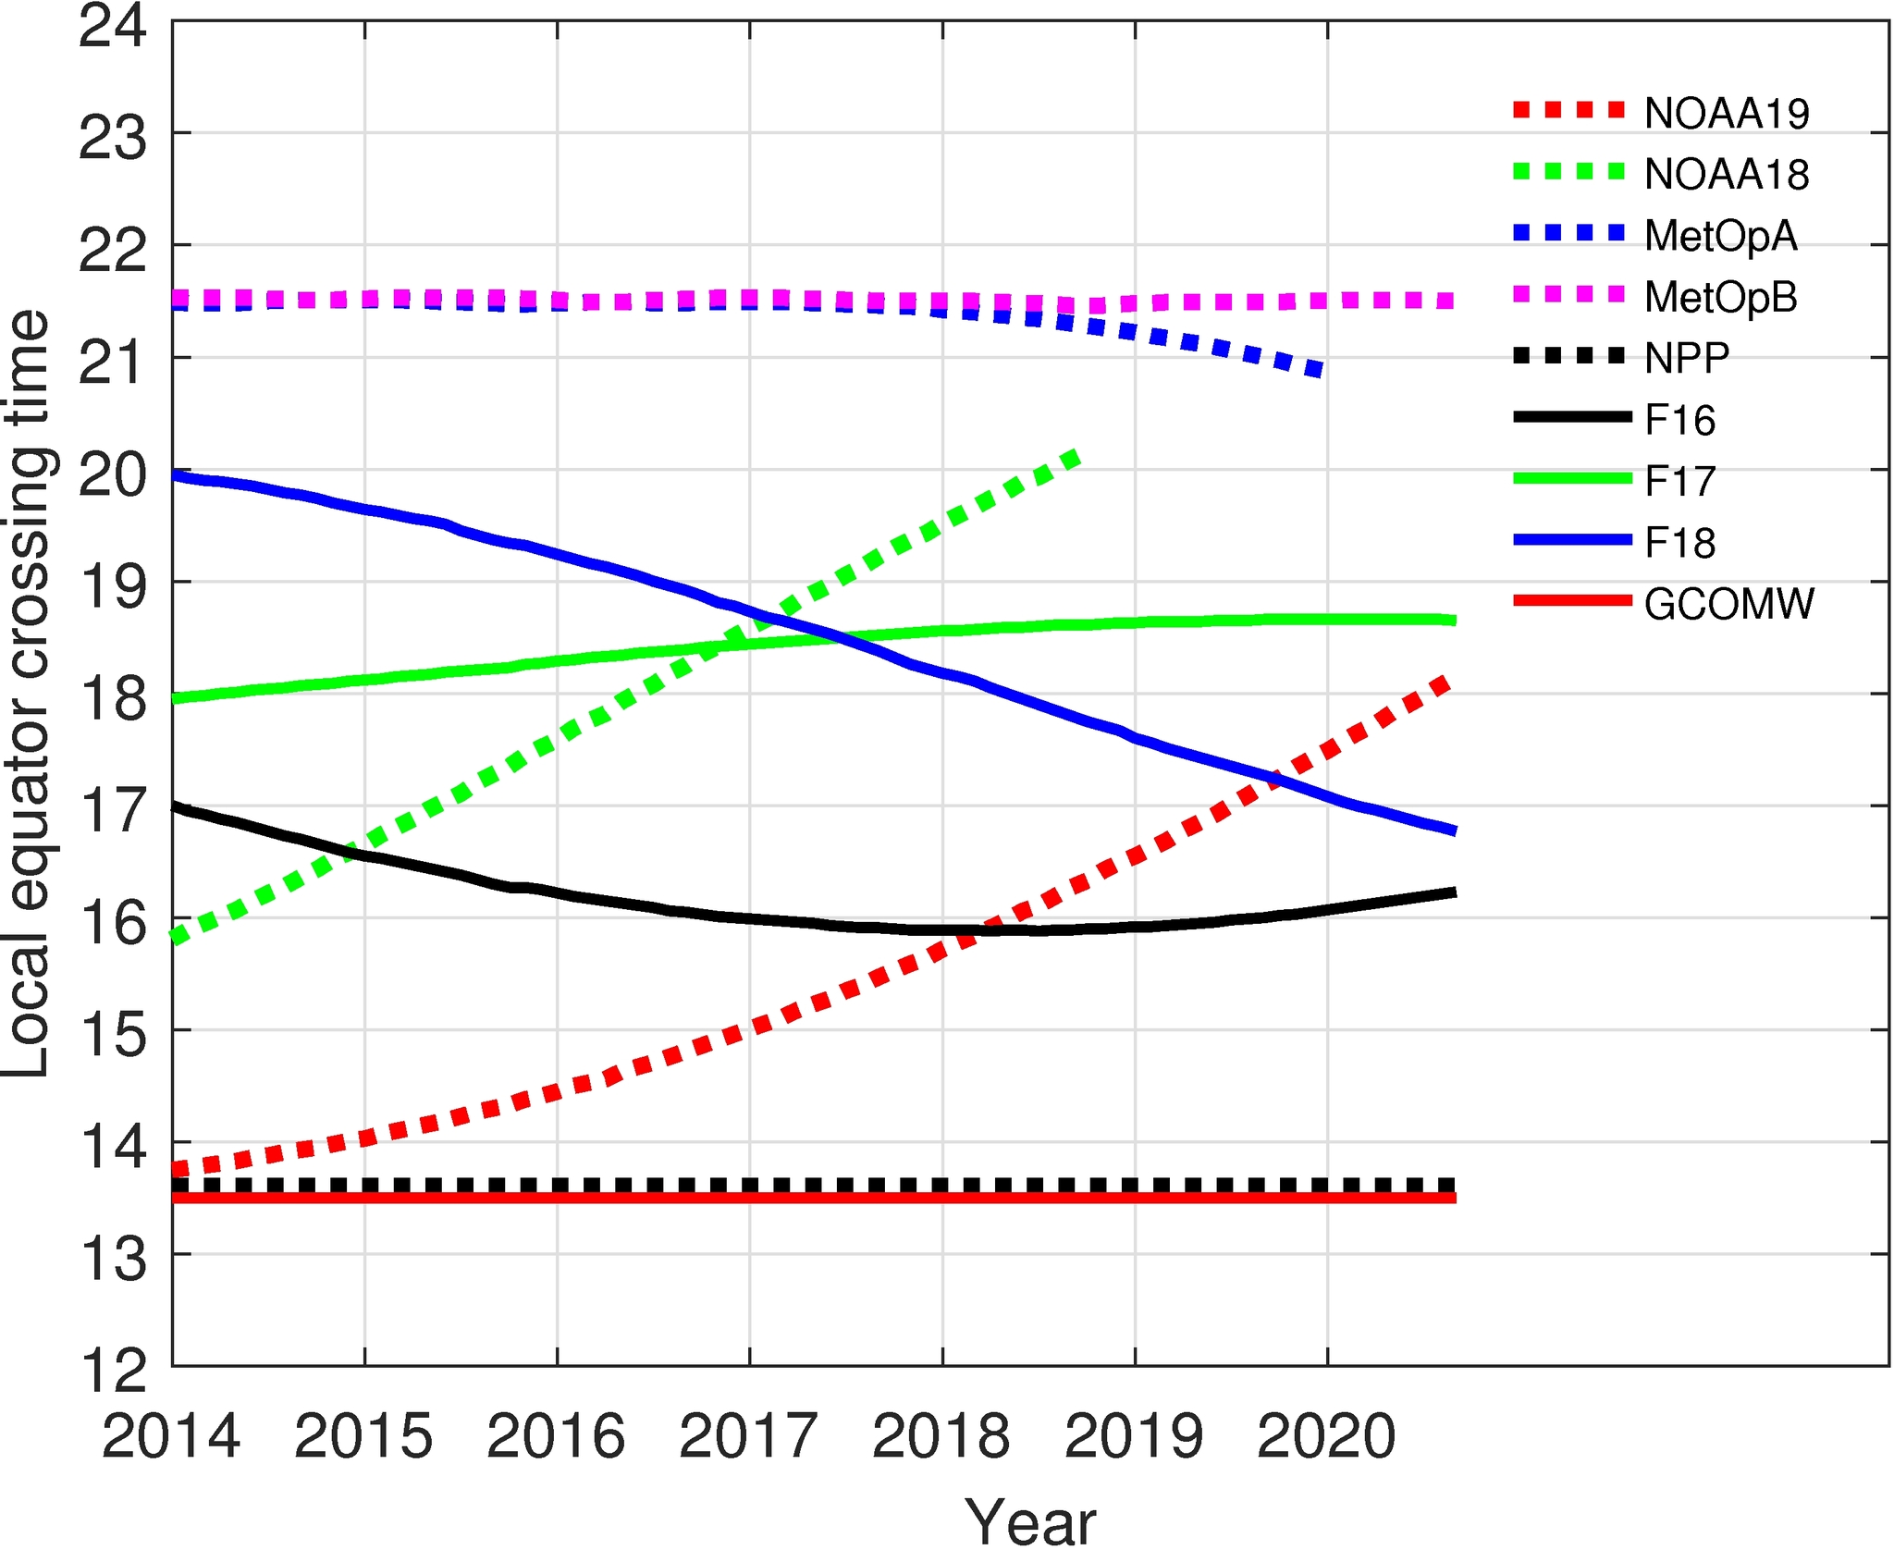
Improvement degree differs:
Whether or not a cross-track scanning sensor can meet a conical scanning sensor depends on their orbital features
ATMS and AMSR2 are close to each other (keep in mind this ECT at nadir).
MetOpA and B do not meet F16 in a +/- 3 hr window

Slide 22
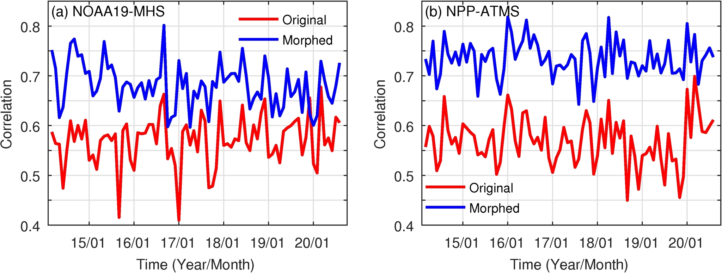
Correlation time series
Correlation increase from 0.57 to 0.68
Correlation increase from 0.57 to 0.74

Slide 23
Hurricane Celia to highlight the potential benefits of our method
1st row: AMSR2, MHS, GMI
2nd row: IMERG final-run in the corresponding half-hour
3rd row: AMSR2, Morphed-MHS, GMI
Innovation:
Improve MHS precipitation rates at the MHS observation time by morphing
In contrast, MHS precipitation rates remain unchanged in IMERG

Slide 24
Conclusions and Discussions:
We can improve the cross-track scanning radiometers’ retrieval by morphing conical scanning radiometers’ retrieval to cross-track scanning radiometers’ time.
The improvement degree depends on
Morphed precipitation sources (e.g., SSMIS vs. AMSR2)
Time interval (1-hr vs. 3-hr)
Precipitation type (convective vs. stratiform)
Precipitation size (large vs. small)
Region (tropics vs. sub-tropics)
Future work includes:
Optimal weights
SAPHIR (both land and ocean)
Morphing KuPR to radiometer’s observation time over both land and ocean
Apply to the TROPICS
Link with IMERG (blended Level2 product)
You et al., 2021, JHM, https://doi.org/10.1175/JHM-D-21-0038.1

Slide 25
Acknowledgments:
Dr. PingPing Xie for the discussions of the morphing concept
NASA grant 80NSSC20K0903 from the Weather and Atmospheric Dynamics program
NASA’s PMM science team via the Internal Scientist Funding Model awarded to Drs. Peters-Lidard and Munchak
All projects are under the management of Dr. Skofronick-Jackson
You et al., 2021, JHM, https://doi.org/10.1175/JHM-D-21-0038.1

Slide 26
Backup slides

Slide 27
Overall performance for all sounders

Slide 28
Improvement degree differs:
Compared with ATMS:
More contributions from SSMISs
Time differences are larger
Compared with ATMS:
More contributions from SSMISs
Time differences are much larger
Why ATMS improves the most:
Almost all the morphed imagers results are from AMSR2
Almost all the time differences between ATMS and AMSR2 < 60 minutes
We also analyzed three other factors: precipitation type (convective vs. stratiform), precipitation event size (large vs. small), and region (tropics vs. subtropics)

Slide 29
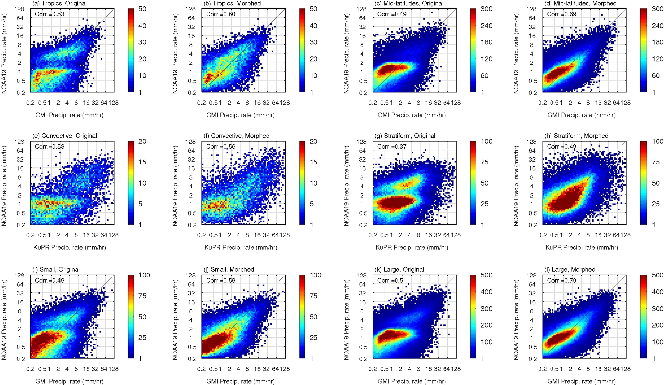
Tropics vs. Sub-tropics
Convective vs. Stratiform
Small vs. Large

Slide 30
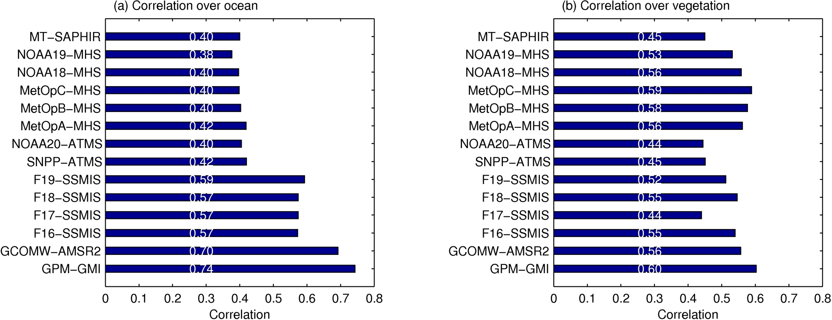
Coincident observations between KuPR (GMI) and each sensor

Slide 31
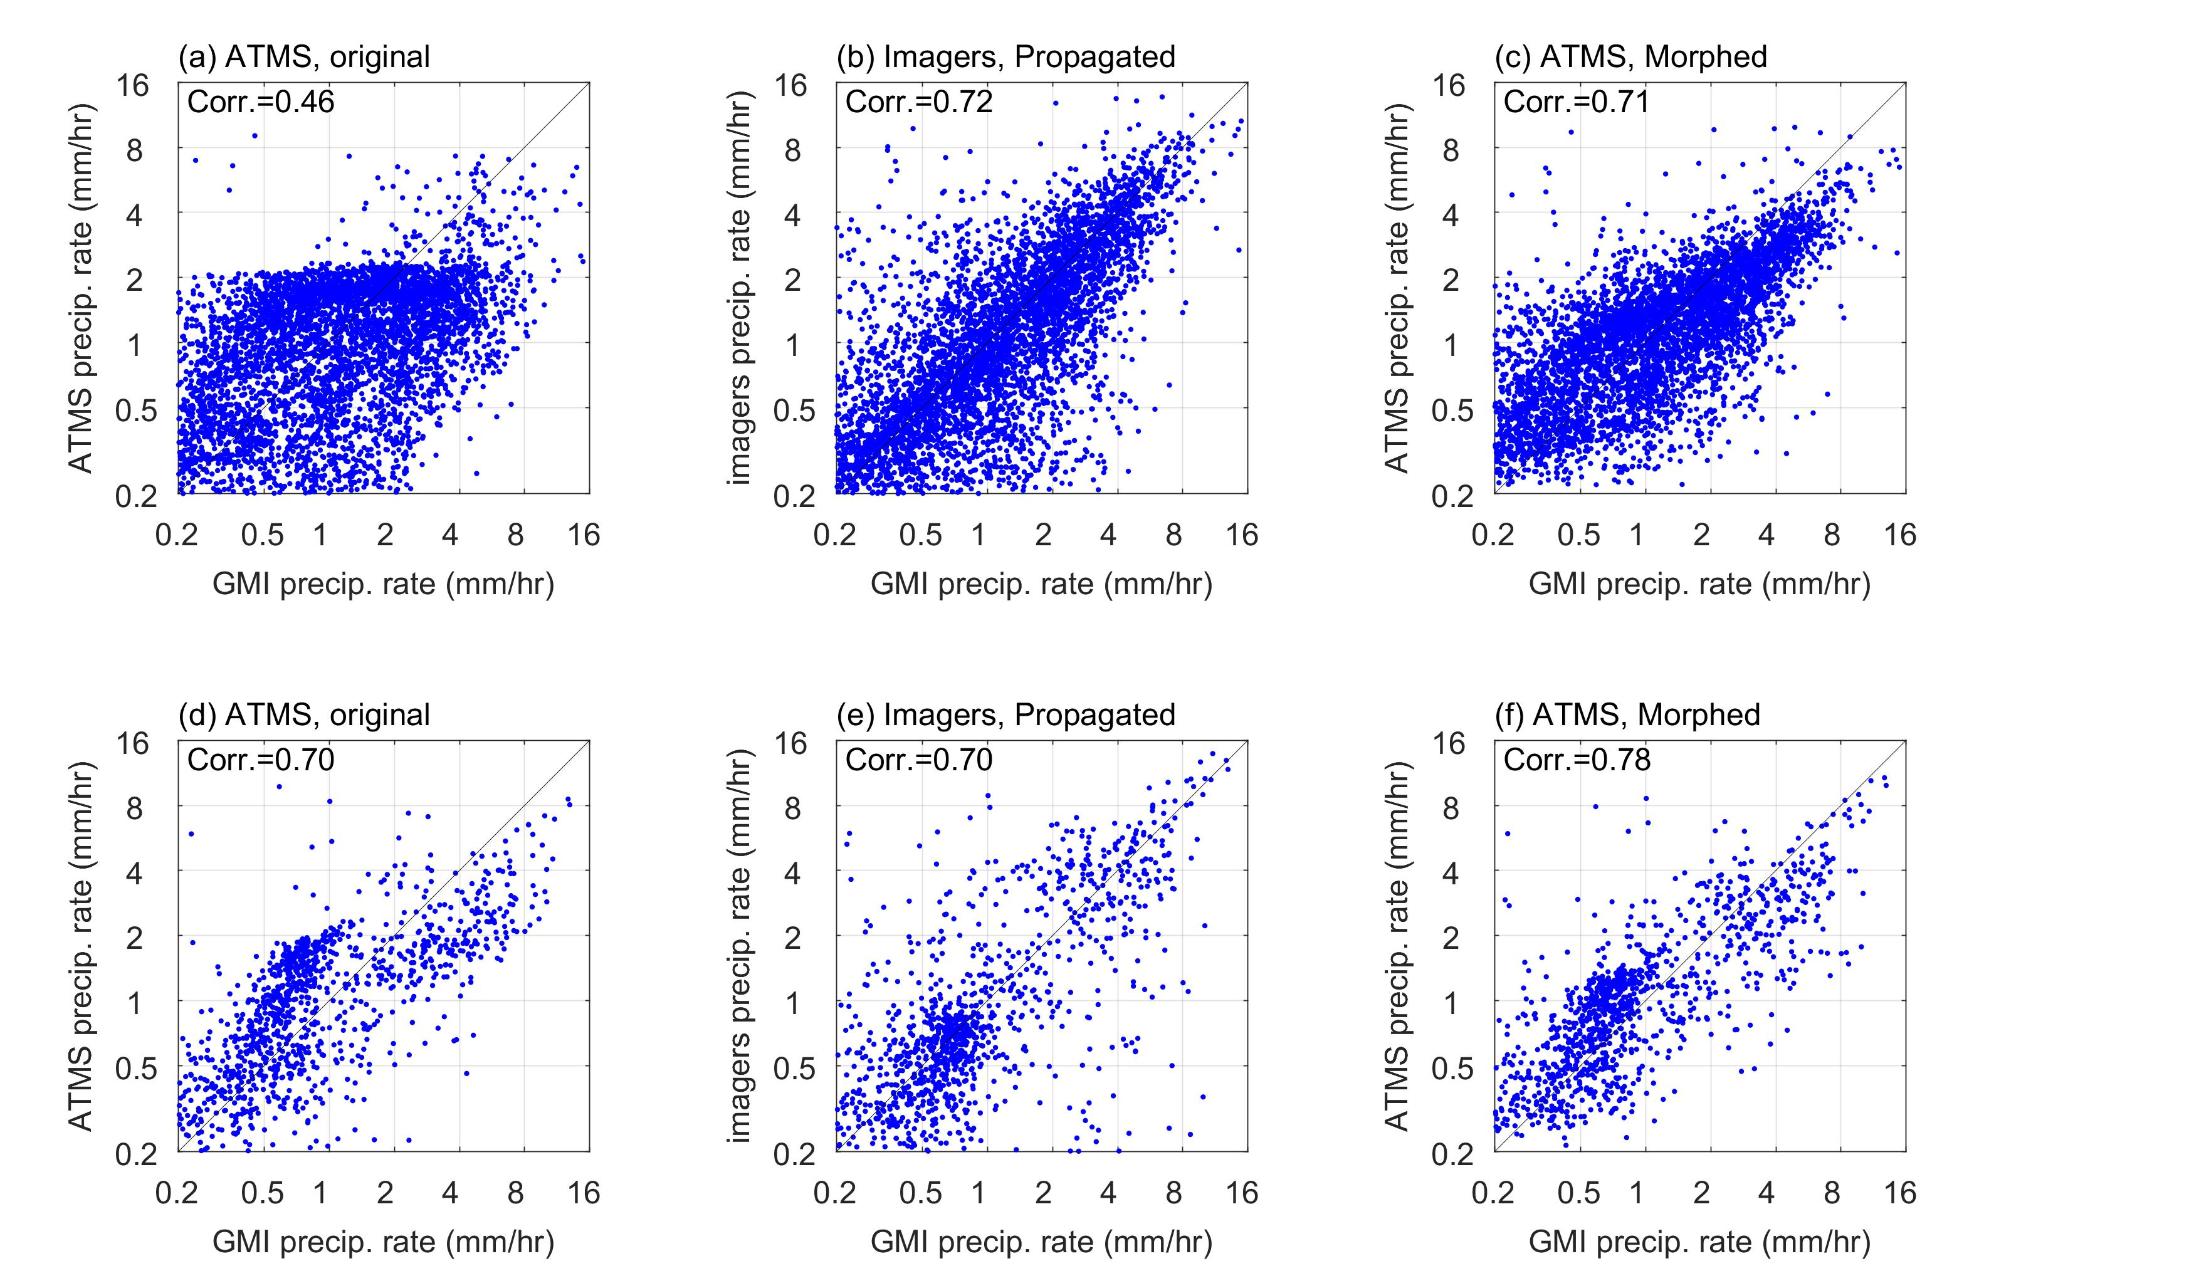

Slide 32
GPROF
IMERG
Our method

Slide 33
GPROF
GSMaP
Our method

Slide 34
GPROF
CMORPH
No AMSR2/GMI
Our method

