Slide 1
Quantitative Investigation of Radiometric Interactions between Snowfall, Snow Cover, and Cloud Liquid Water over Land
Authors: Zeinab Takbiri, Lisa Milani, Clement Guilloteau, Efi Foufoula-Georgiou
Acknowledgement: F. Joe Turk, Ardeshir M. Ebtehaj, Gail Skofronick Jackson
Sep 2021

Slide 2
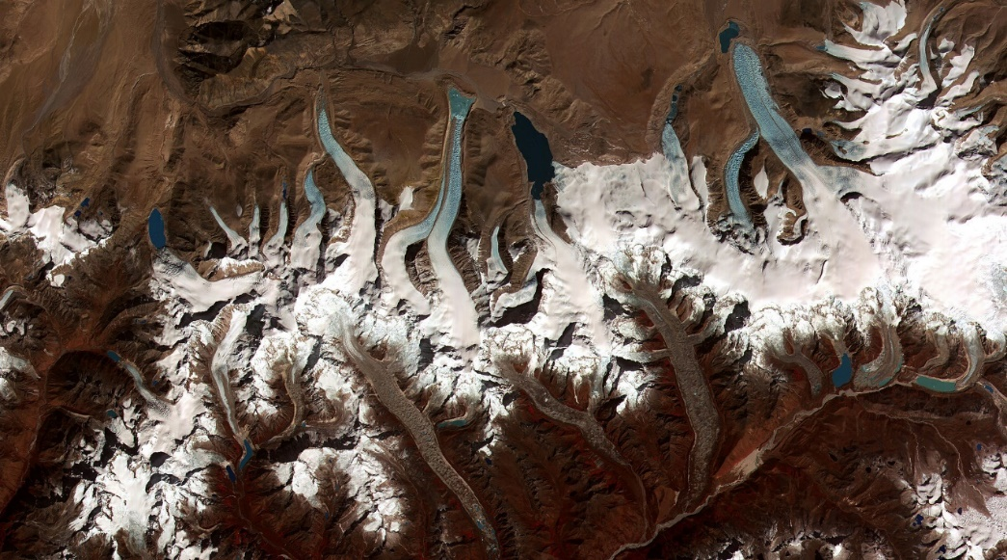
Snowfall and Hydrologic Water Cycle
Snowpack reservoirs have declined worldwide and are projected to further decline in the 21st century (Pederson et al. 2011).
Climate-scale projections demonstrate that more than 2 billion people worldwide will be at snowmelt water scarcity during the 21st century (Mankin et al, 2015)
Snowfall is the main input to the accumulation processes of snowpack reservoirs (Radíc et al. 2014).
30-90% of global precipitation falls as snow over mid to high-latitudinal regions (Levizzanie et al., 2011).
Global monitoring of snowfall from space is a key for improved water resources and food management, especially mountainous basins.
Receding glaciers in Bhutan-Himalaya (credit, NASA)
(Levizzanie et al., 2011)
Notes:
But snowpack reservoir have declined and are projected to even further decline during 21st century , which could potentially put around 2 billion people at the risk of water scarcity
Snowfall plays a key role in understanding the hydrologic cycle and also improved water resources management

Slide 3
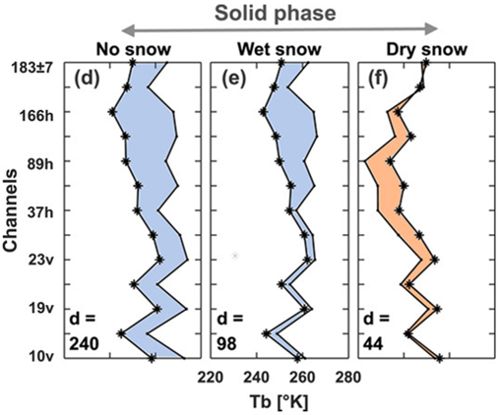
Challenges in the passive microwave snowfall retrievals
Snowfall scattering is much weaker than rainfall and depends on complex microphysics of snowflakes.
The cloud liquid water increases the brightness temperature, thus masks the snowfall scattering signal.
Snow cover weakens the snowfall scattering. Snow cover and snowfall scattering are similar at high frequencies.
How can we unmix snow-cover, cloud liquid water and snowfall signals?
Notes:
Let’s talk a little bit about the microwave retrieval of snowfall ... Making its physical radative transfer modelling very challenging
There is also another challenge that the snow cover adds to the snowfall detection: which is

Slide 4
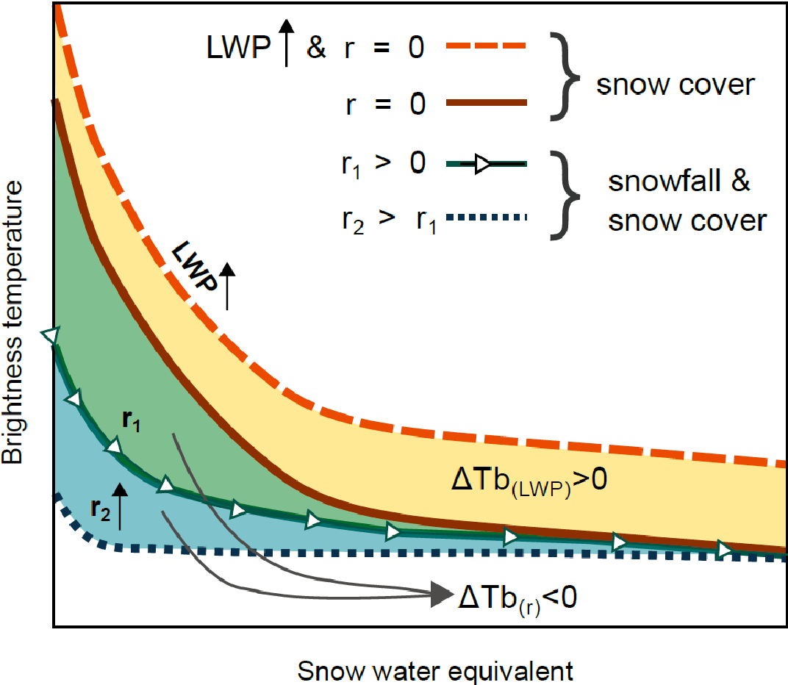
Snow Cover & Snowfall Interactions
Key Questions:
How does the snow-cover scattering affect GMI brightness temperatures?
To what extent the liquid water content of snowy clouds can mask the snowfall signals?
At which boundary conditions can the snow cover obscure the snowfall signatures?
Are there any land-atmospheric blind spots for GPM microwave snowfall retrievals?
Notes:
Quantifying the radiometric effects of snow cover and cloud liquid water content on the microwave signatures of snowfall at high-frequency channels, largely focusing on observations from the GPM core satellite:

Slide 5
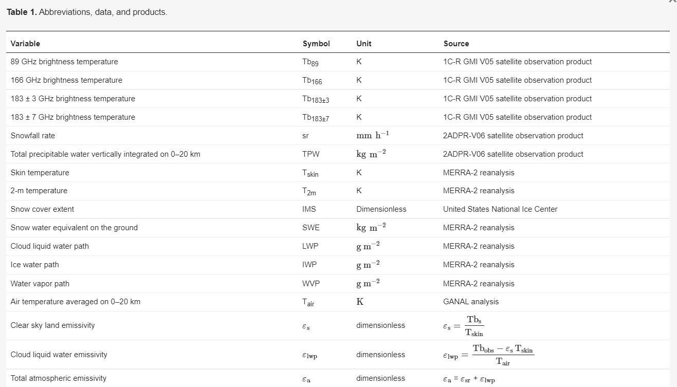
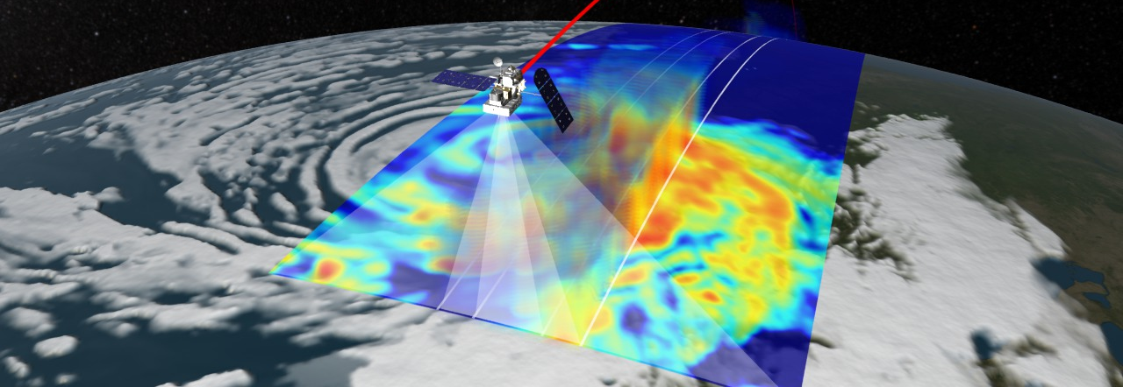
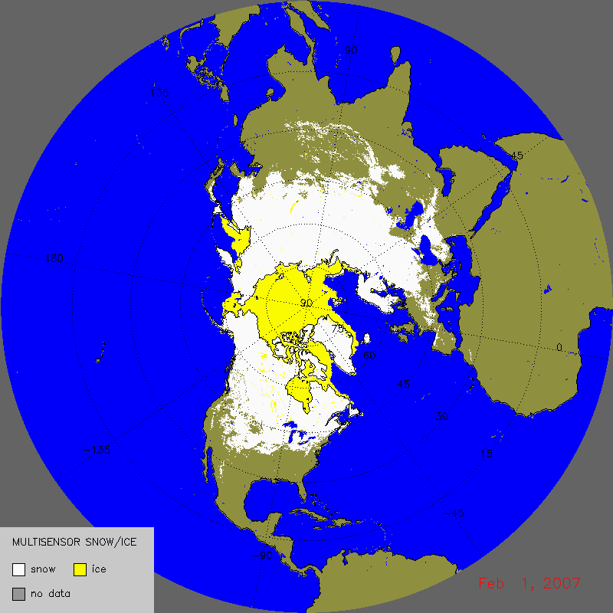
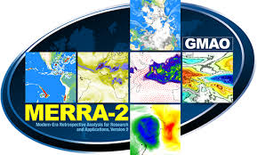
Datasets

Slide 6
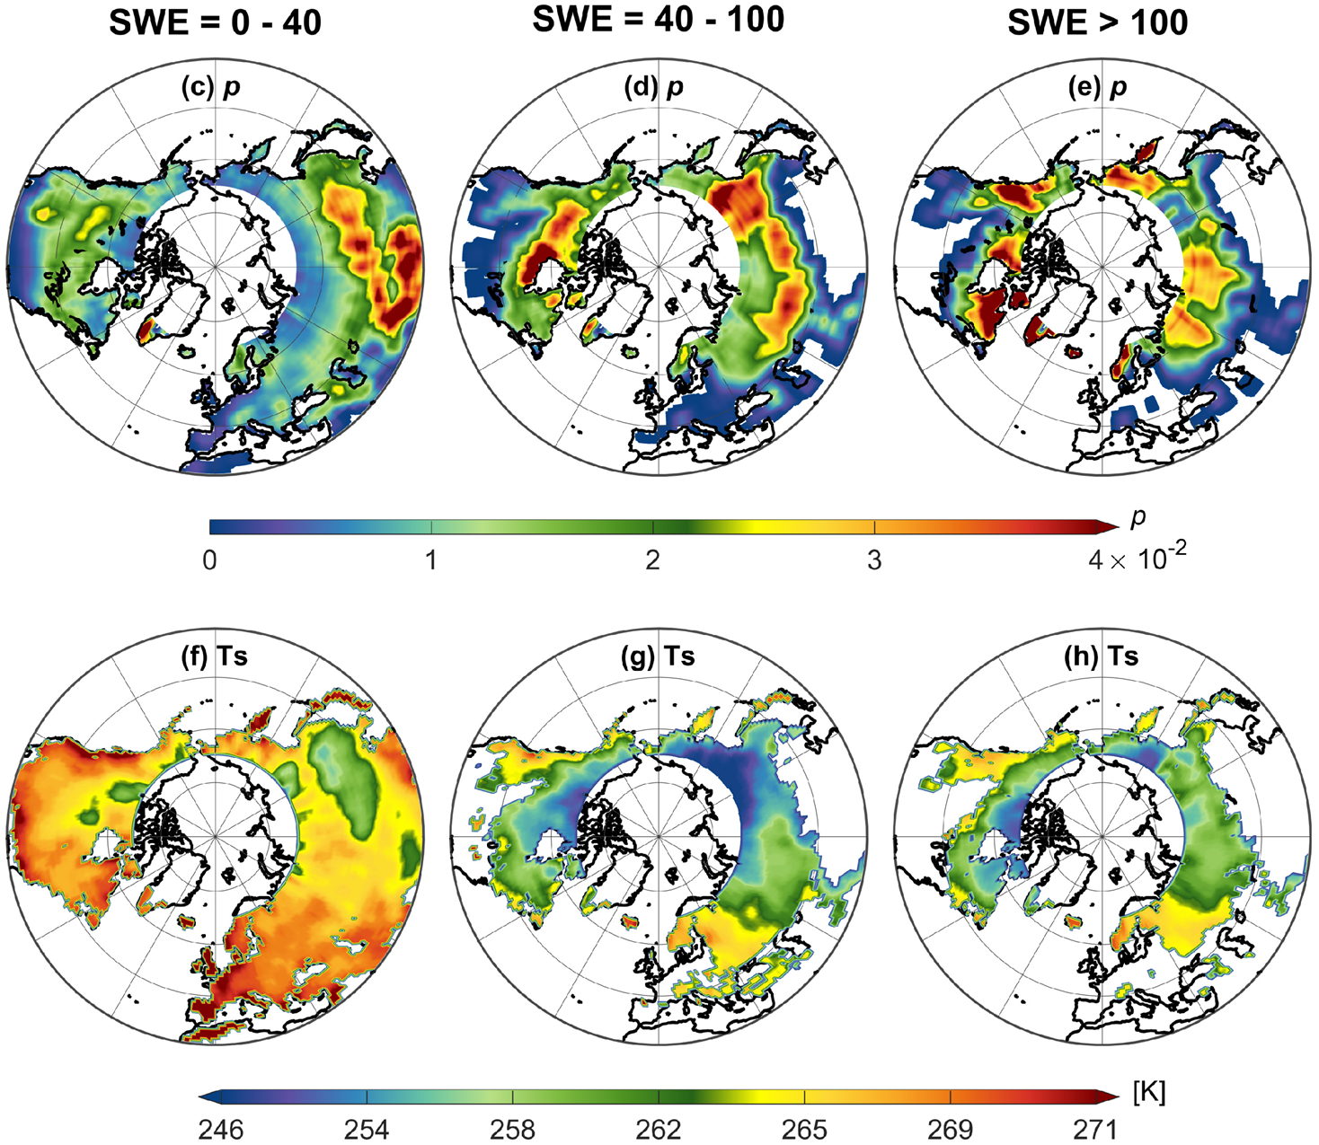
Spatial and Marginal Distributions of SWE & Average Surface Temperature (Ts)
SWEs 0-40 kgm⁻² are for early wintertime fresh snow over Himalayas.
SWEs 40-100 kgm⁻² are largely from Siberian plateau and northern Canada with extremely colder surface temperature.
SWEs >100 kgm⁻² are for late winter and early spring with warmer surface temperature.

Slide 7
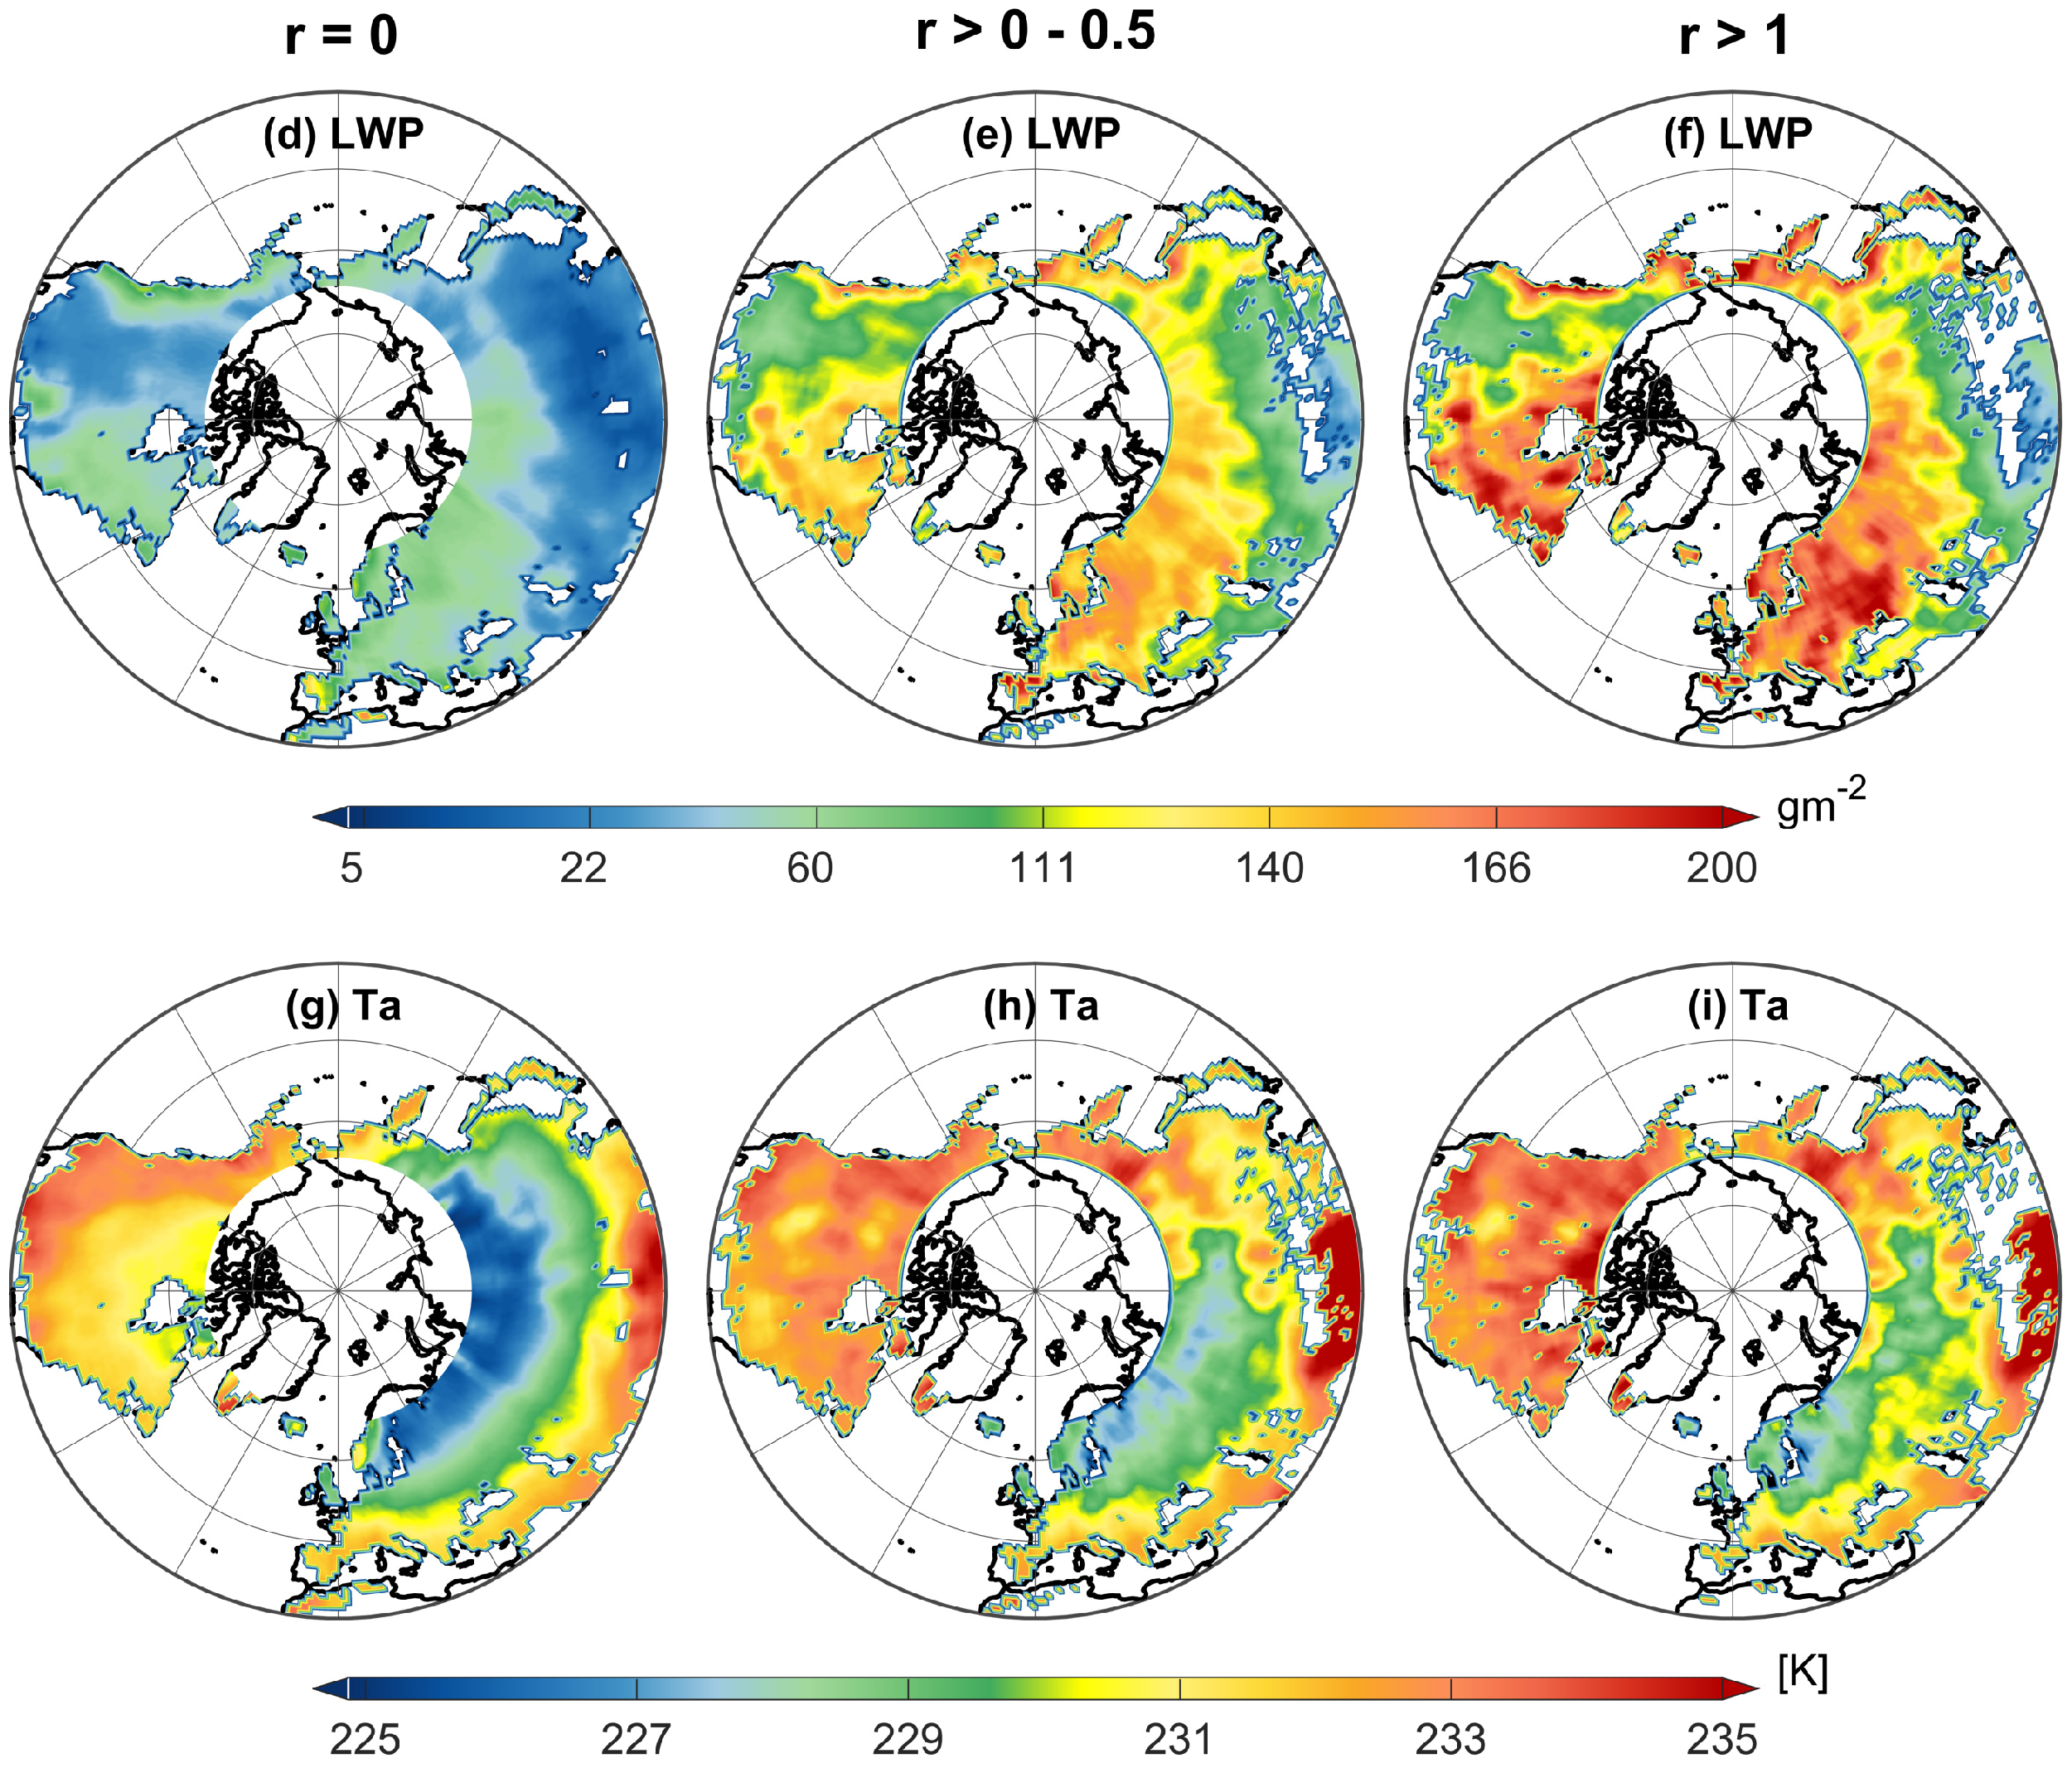
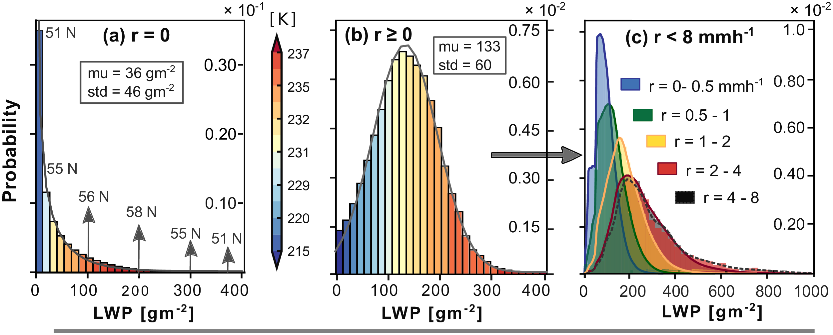
Multi-year average of Cloud LWP & Atmospheric Temperature (Ta)
The temperature increases as LWP values increase, which makes the observed anomaly less pronounced.
Cloud LWP PDF changes its shape in response to snowfall occurrence and its rate: The mean LWP increases from 40 gm⁻² to 150 gm⁻².

Slide 8
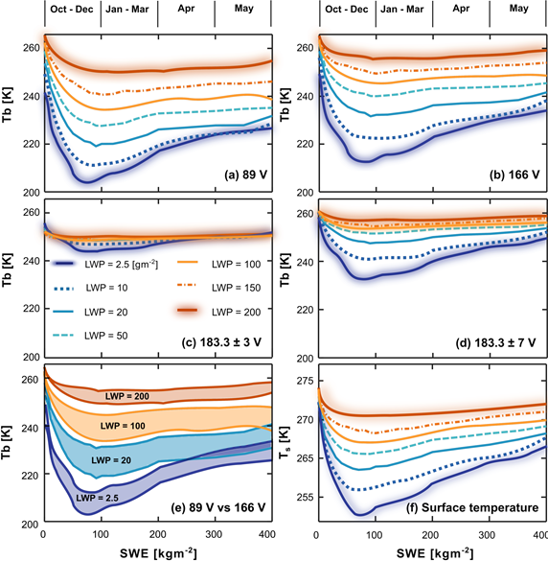
Snow Cover, LWP, & Snowfall Radiometric Interactions
There is an anomaly in the response of the Tb values for SWE.
The anomaly is due to snow-cover metamorphism and global climatology of snow-cover and surface and atmospheric temperature.
To separate the snowfall and snow-cover signals, land and atmospheric emissivity values need to be studied.
Notes:
The main reason is that the snow cover temperature and its metamorphic changes of grain size are not independent.

Slide 9
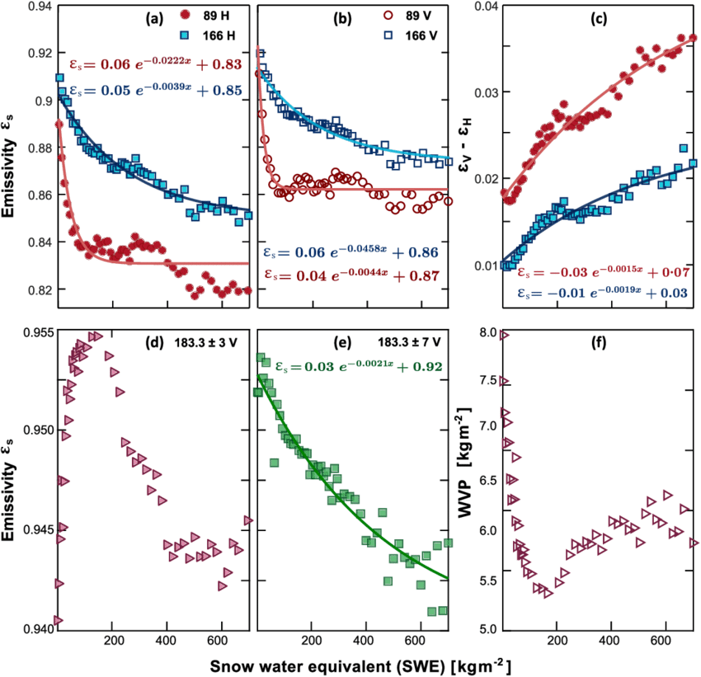
Snow-Cover Emissivity -- Clear Sky

Slide 10
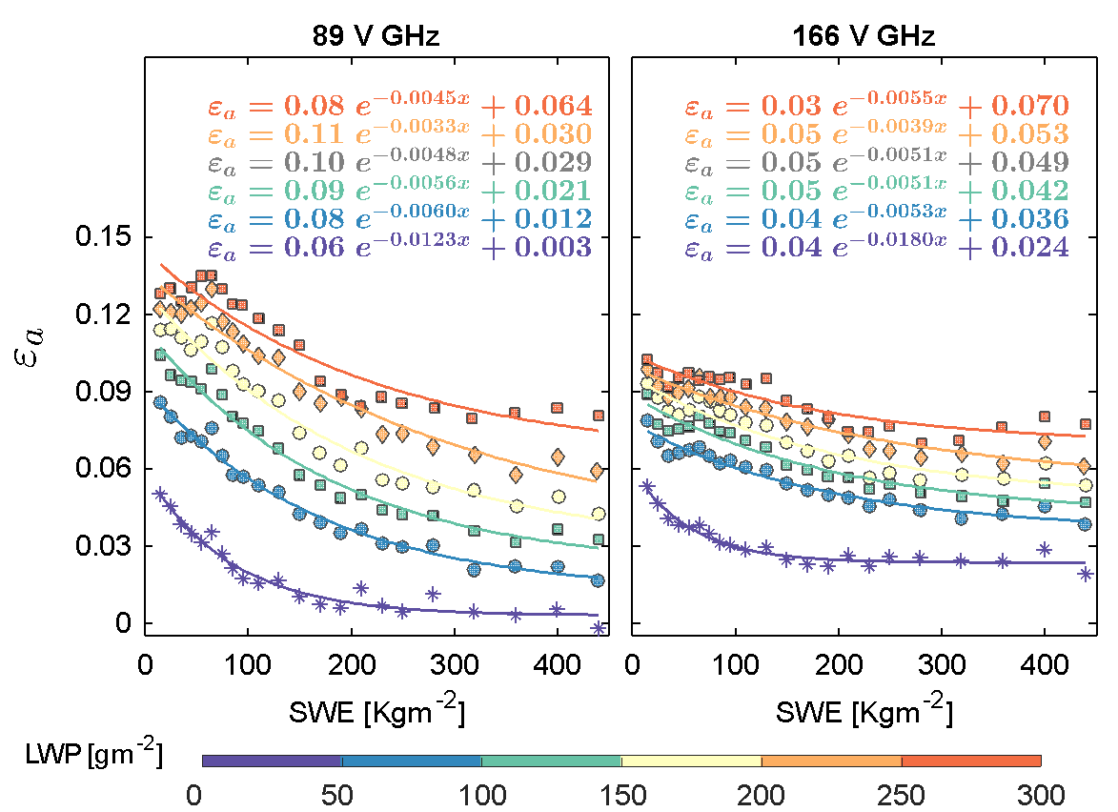
Atmospheric Emissivity -- Cloud LWP
The rate of emissivity increase due to the increase of the liquid water path is higher at channel 89 GHz than that of channel 166 GHz.

Slide 11
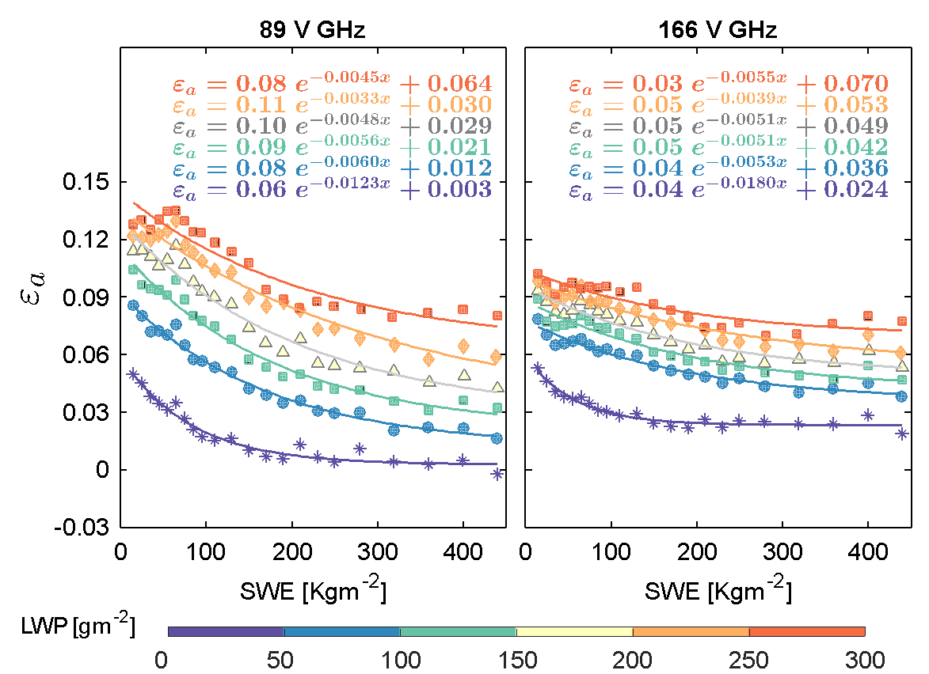
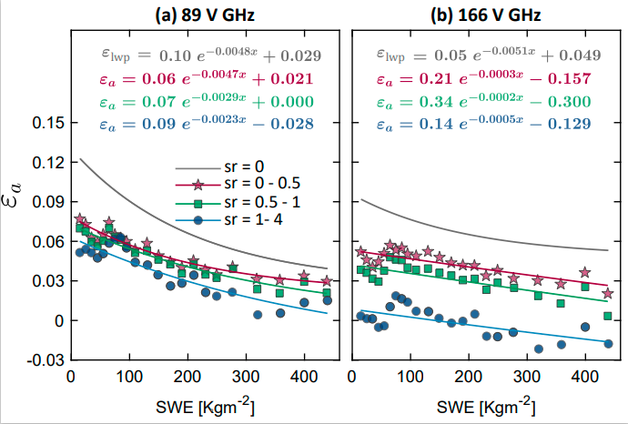
Atmospheric Emissivity -- Snowfall and Cloud LWP
Atmospheric emissivity of the cloud LWP
Atmospheric emissivity of the LWP and snowfall

Slide 12
Findings
The channel 166 GHz could better capture the scattering signature of light snowfall events because it responds less strongly to the increase of the cloud LWP than the 89 GHz channel.
Larger snowfall events could be captured better at 89 GHz when both LWP and SWE are small, while 166 GHz becomes more advantageous at capturing this scattering when LWP increases up to about 100–150 g m⁻².
Over deeper snow-cover regions (SWE > 200 kg m⁻² ) and larger LWP values (≥100–150 gm⁻²), the scattering of snowfall, even with large intensity, is masked by the comparable scattering contribution from the large accumulation of snow cover and the emission from liquid water at both 89 and 166 GHz channels: the snowfall dominant signature becomes its emission that can be distinguished from the very low plateaued emissivity of the surface at channel 89 GHz.
Over latitudes above 60°N with SWE > 200 kg m⁻² and LWP < 100–150 g m⁻², the snowfall microwave signal could not be detected with GPM without considering a priori data about SWE and LWP. Our findings provide quantitative insights for improving retrieval of snowfall in particular over snow-covered terrain.
Acknowledgment: NASA PMM (NNX16AO56G) and a NIP award (80NSSC18K0742).

Slide 13
Limitations
At the daily or sub-daily time scales, large variability around these multi-year averages is expected.
For instantaneous precipitation retrievals, one should consider the use of the dynamic surface emissivity database developed by Munchak et al., 2020.
We acknowledge potential errors and inaccuracies in DPR measurements regarding light precipitation intensities. An additional investigation, if it does not require high space-time coverage, should consider measurements from CloudSat Cloud Profiling Radar (CPR, Turk et al., 2021).
We only used total precipitable water to screen the clear-sky Tbs. This can add some uncertainties regarding the calculated emissivities of LWP and snowfall. Future research needs to investigate the effects of total precipitable water on the radiometric signal during the snowfall events (Milani et al., 2021).
Notes:
The relations between Tbs, snowfall, cloud liquid water with emphasis on snow-covered regions were established as multi-year averages from four years of colocated GPM and MERRA-2 reanalysis data. The immediate goal here was to investigate the challenging zones of snowfall retrieval over the snow cover at high-frequency GPM channels regarding the confounding effects of these atmospheric constituents over the snow-covered regions. However, at

Slide 14
References
Takbiri, Zeinab, Lisa Milani, Clement Guilloteau, and Efi Foufoula-Georgiou. 2021. "Quantitative Investigation of Radiometric Interactions between Snowfall, Snow Cover, and Cloud Liquid Water over Land" Remote Sensing 13, no. 13: 2641. https://doi.org/10.3390/rs13132641
Takbiri, Z., Ebtehaj, A., Foufoula-Georgiou, E., Kirstetter, P., & Turk, F. J. (2019). A Prognostic Nested k-Nearest Approach for Microwave Precipitation Phase Detection over Snow Cover, Journal of Hydrometeorology, 20(2), 251-274. https://journals.ametsoc.org/view/journals/hydr/20/2/jhm-d-18-0021_1.xml
Email: takbi001@gmail.com

