Slide 1
Precipitation Retrieval and Profiling Scheme (PRPS)
Chris Kidd, Toshi Matsui & Sarah Ringerud
Earth System Science Interdisciplinary Center (ESSIC), University of Maryland &
NASA/Goddard Space Flight Center

Slide 2
Background
Originally (2014) developed out of the need to expand GPROF to other GPM constellation sensors – i.e. cross-track sensors.
Initially developed for the MHS sensors within the GPROF ‘specifications’.
Retrievals for the at-launch GPM MHS products used a MMF-derived database (aka GPROF-MHS PPS V03) – see Kidd et al. 2017.
GPROF PPS V04+ took over the MHS & ATMS retrievals using the common GMI-based database.
PRPS refined for SAPHIR (PPS V06 product) – see Kidd et al 2021.
PRPS adapted for all PMW sensors (imagers and sounders).
LSWG, 16-March-2022
Goddard Space
Flight Center

Slide 3
PRPS outline
PRPS Concept – Keep It Simple Stupid!
Simplicity (straightforward coding and no dynamic external data)
Efficient (computationally fast and compact)
Flexible (to allow experimentation, testing and evaluation)
It does not aim to be the best (that would be nice though!).
PRPS Basics:
Observational, indexed a priori databases for each sensor (DPR/PR/surface vs radiometer).
No external dynamic ancillary data (except SAPHIR)
Constant retrieval resolution of ca.16.2x16.2 km (3x3 DPR/PR footprints).
Measures of ‘fit’ and error generated together with surface type and MLP.
Vertical profiles of precipitation available using the full PRPS version.
LSWG, 16-March-2022
Goddard Space
Flight Center

Slide 4
GPROF vs PRPS for the GPM constellation sensors
GMI-DPR
GPROF
PRPS
co-located/
co-temporal
GMI DATABASE
GMI DATABASE
GMI-DPR
Snow
Modelled frequency/resolution
AMSR2 DATABASE
AMSR2-DPR
AMSR2 DATABASE
sfctype
SSMIS DATABASE
SSMIS-DPR
SSMIS DATABASE
TPW
SAPHIR DATABASE
SAPHIR-DPR
MHS DATABASE
T2m
MHS DATABASE
MHS-DPR
ATMS DATABASE
Altitude
ATMS DATABASE
ATMS-DPR
GPPROF retrieval
L1C
Tbs
PRPS retrieval
PRPS captures the nuances of each sensor (vv. assumptions)
LSWG, 16-March-2022
Goddard Space
Flight Center

Slide 5
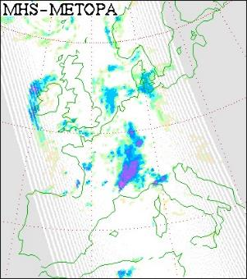
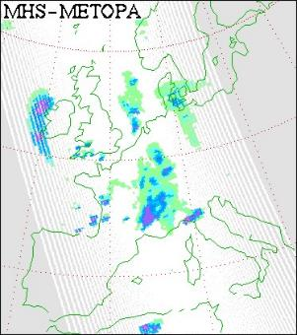
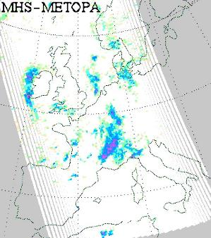
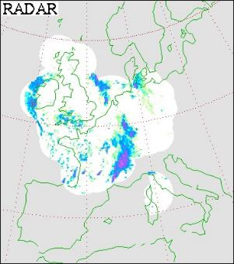
PRPS applied to MHS sensors
GPROF2017v2
HSAF-H02
PRPS-MHS
2015-09-13
20:34 UTC
PRPS-MHS is quite similar to GPROF but with slightly less rain area;
PRPS-MHS more dynamic than HSAF-H02 product;
All ‘reasonable’ with respect to the surface radar product.
LSWG, 16-March-2022
Goddard Space
Flight Center

Slide 6
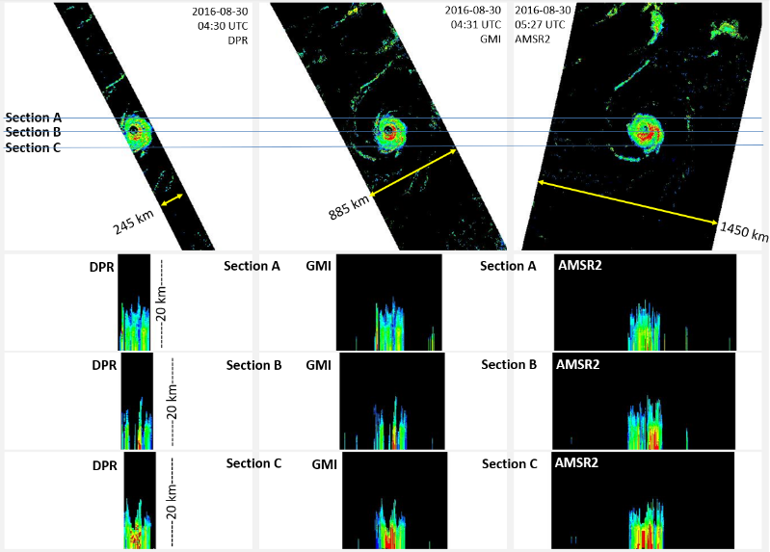
PRPS – 3D precipitation retrievals
Full PRPS version extracts vertical profiles of precipitation across the full swath of each radiometer.
Example here shows the DPR, PRPS-GMI and PRPS-AMSR2.
BUT: computationally expensive (particularly disk space).
Kidd, IPWG, 2016
LSWG, 16-March-2022
Goddard Space
Flight Center

Slide 7
PRPS Processing stream
Generation of a priori databases and index file
orbital crossing points
matching FOVs
full database
operational database
index files
2) Retrieval scheme
Input data
channel selection
cross-track consideration
measures of fit and error
LSWG, 16-March-2022
Goddard Space
Flight Center

Slide 8
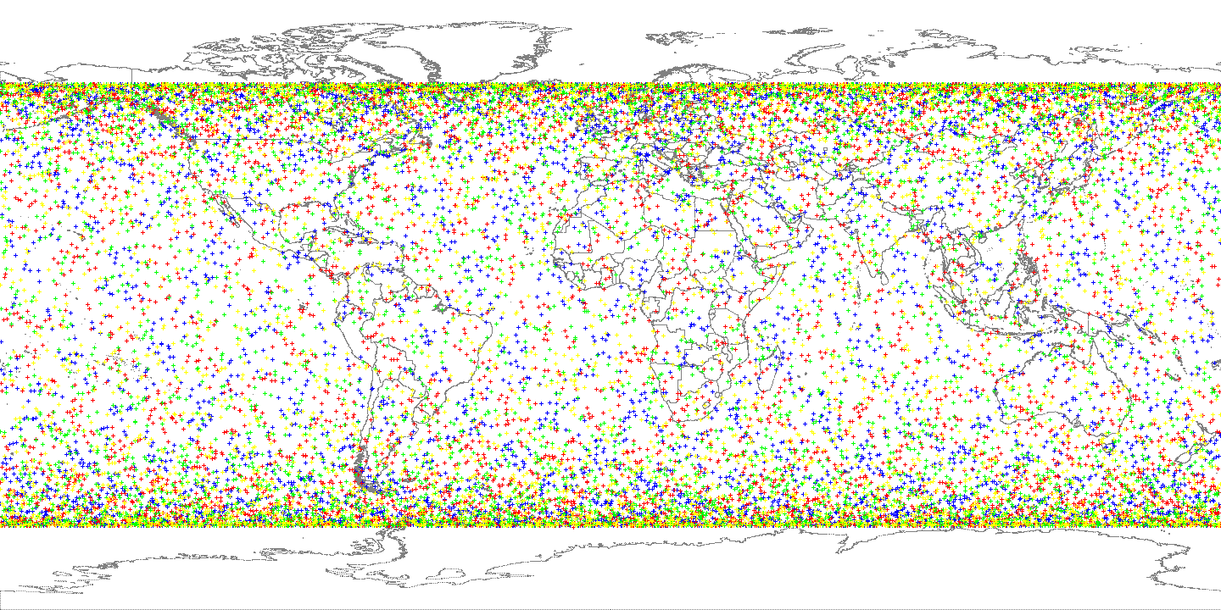
Orbital crossings
Radar:radiometer orbital crossing locations extracted
For time = 01/01/year to 31/12/year
Read/update geolocation data
L2A DPR data
L1C sensor data
DRP nadir
sensor nadir
if <5km & <300s record xing
DPR:MHS matches (coloured)
DPR:SAPHIR matches (black)
Matches within 300s of each other (2014-2019)
LSWG, 16-March-2022
Goddard Space
Flight Center

Slide 9
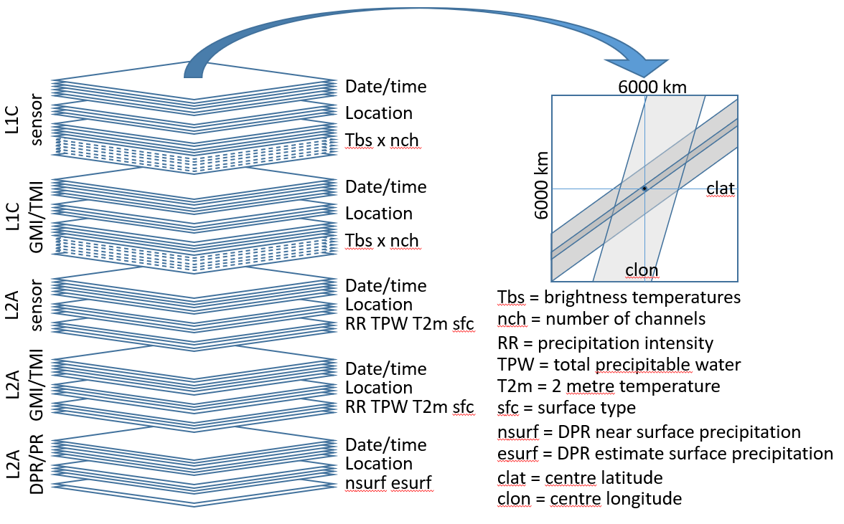
PRPS Observational a priori database
co-located data
Full database:
Source filenames
ex1C.NOAA19.MHS.XCAL2016-V.20170428-S190725-E204925.042368.V05A.dat
ex1C.GPM.GMI.XCAL2016-C.20170428-S190846-E204121.017987.V05A.dat
ex2A.NOAA19.MHS.GPROF2017v1.20170428-S190725-E204925.042368.V05A.dat
ex2A.GPM.GMI.GPROF2017v1.20170428-S190846-E204121.017987.V05A.dat
exNSMSHS.GPM.DPR.V7-20170308.20170428-S190846-E204121.017987.V05A.dat
6.277 103.559 5.000
17 4 28 20 18 36 19.365 98.006 1602 85 283.32 281.98 242.26 257.39 267.37 17 4 28 20 11 34 19.338 98.001 2010 105 279.49 276.72 281.50 278.65 283.62 281.03 279.34 284.81 284.81 17 4 28 20 11 42 19.358 98.000 2014 105 280.04 279.55 258.12 269.88 17 4 28 20 18 36 19.365 98.006 1602 85 0.00 3. 195. 35. 17 4 28 20 11 34 19.338 98.001 2010 105 0.00 3. 195. 35. 17 4 28 20 12 43 19.367 97.969 5481 27 0.00
17 4 28 20 18 38 19.210 97.975 1603 85 282.94 281.27 242.45 256.00 267.21 17 4 28 20 11 36 19.210 98.000 2011 104 278.67 276.92 280.75 279.88 283.64 281.90 280.54 284.73 284.60 17 4 28 20 11 44 19.232 98.005 2015 104 277.71 279.22 257.63 268.50 17 4 28 20 18 38 19.210 97.975 1603 85 0.00 3. 195. 36. 17 4 28 20 11 36 19.210 98.000 2011 104 0.00 3. 195. 36. 17 4 28 20 12 45 19.223 97.982 5484 28 0.00
17 4 28 20 18 38 19.128 98.691 1603 83 278.30 273.71 232.75 251.53 261.06 17 4 28 20 11 42 19.129 98.695 2014 115 275.34 273.81 278.14 276.09 279.08 275.83 275.70 276.00 274.28 17 4 28 20 11 49 19.146 98.680 2018 116 266.95 263.50 251.62 258.89 17 4 28 20 18 38 19.128 98.691 1603 83 0.18 3. 194. 34. 17 4 28 20 11 42 19.129 98.695 2014 115 0.34 3. 194. 34. 17 4 28 20 12 51 19.132 98.702 5493 15 0.00
17 4 28 20 18 41 19.098 97.554 1604 86 285.79 283.77 246.93 262.02 271.43 17 4 28 20 11 36 19.073 97.583 2011 96 280.40 276.89 282.26 280.79 284.65 282.90 281.58 285.94 285.63 17 4 28 20 11 44 19.099 97.588 2015 95 280.77 281.76 265.15 273.76 17 4 28 20 18 41 19.098 97.554 1604 86 0.00 3. 195. 35. 17 4 28 20 11 36 19.073 97.583 2011 96 0.00 3. 195. 35. 17 4 28 20 12 44 19.074 97.577 5483 37 0.00
17 4 28 20 18 44 18.989 97.110 1605 87 285.29 285.36 249.60 264.70 274.22 17 4 28 20 11 36 18.965 97.100 2011 87 281.15 279.03 281.88 282.17 282.67 282.05 281.02 284.39 283.45 17 4 28 20 11 44 19.001 97.111 2015 85 283.28 283.54 268.15 275.94 17 4 28 20 18 44 18.989 97.110 1605 87 0.00 3. 195. 30. 17 4 28 20 11 36 18.965 97.100 2011 87 0.00 3. 195. 30. 17 4 28 20 12 42 18.978 97.074 5480 47 0.00
17 4 28 20 18 44 18.944 97.523 1605 86 285.62 283.63 246.83 261.06 270.90 17 4 28 20 11 38 18.937 97.527 2012 94 279.70 276.90 282.62 280.34 284.33 282.38 280.07 286.29 285.83 17 4 28 20 11 46 18.966 97.544 2016 93 282.21 281.82 266.37 274.48 17 4 28 20 18 44 18.944 97.523 1605 86 0.00 3. 195. 35. 17 4 28 20 11 38 18.937 97.527 2012 94 0.00 3. 195. 35. 17 4 28 20 12 45 18.950 97.527 5485 39 0.00
17 4 28 20 18 44 18.818 98.627 1605 83 278.79 274.97 233.65 252.25 262.17 17 4 28 20 11 46 18.814 98.599 2016 111 275.65 274.38 278.14 276.05 279.01 276.98 275.14 277.89 277.11 17 4 28 20 11 53 18.840 98.607 2020 112 269.49 269.33 252.96 262.40 17 4 28 20 18 44 18.818 98.627 1605 83 0.13 3. 194. 35. 17 4 28 20 11 46 18.814 98.599 2016 111 0.29 3. 194. 35. 17 4 28 20 12 55 18.843 98.623 5498 19 0.07
17 4 28 20 18 49 18.549 98.217 1607 84 280.91 279.68 234.76 254.70 264.99 17 4 28 20 11 47 18.538 98.246 2017 103 277.33 274.20 278.78 275.36 280.16 277.46 276.36 280.47 280.24 17 4 28 20 11 55 18.562 98.256 2021 103 279.57 278.46 257.84 269.29 17 4 28 20 18 49 18.549 98.217 1607 84 0.00 3. 195. 37. 17 4 28 20 11 47 18.538 98.246 2017 103 0.00 3. 195. 37. 17 4 28 20 12 56 18.550 98.236 5500 29 0.00
17 4 28 20 18 52 18.436 97.819 1608 85 284.97 284.56 243.58 259.60 270.91 17
yr mo dy hr mn sc lat lon scanline/pos Tc(1:5)
One entry per matched fov
Datacube - co-located observations centred on orbital xing:
- equal area projection, 5 km resolution
- (e.g.) sensor L1C, GMI L1C, sensor L2A, GMI L2A, DPR L2A
Operational database contains a bare minimum of sensor Tbs, DPR precipitation
LSWG, 16-March-2022
Goddard Space
Flight Center

Slide 10
A priori database orbit and FOV matches
PRPS-sensor | Orbital matches | FOV matches | Resolution | Ancillary data?
PRPS-SAPHIR | 3,237 | 14,115,806 | 5.4 km | TPW#/T2m#/LS
PRPS-MHS$ | 22,802 | 32,412,404 | 16.2 km | LS
PRPS-ATMS | 10,009 | 9,436,387 | 16.2 km | LS
PRPS-SSMIS | 14,386 | 31,718,079 | 16.2 km | LS
PRPS-AMSR2* | 3,812 | 14,804,012 | 16.2 km | LS
PRPS-GMI* | 3,812 | 14,802,012 | 16.2 km | LS
PRPS-TMS | 140 | 2,835,000 | 16.2 km | LS
# TPW/T2m used to match GPROF retrievals
* AMSR2 & GMI use the same matched database
$METOPA | 5,580 | 8,029,736
METOPB | 5,806 | 8,353,189
NOAA18 | 5,770 | 8,255,956
NOAA19 | 5,783 | 8,168,129
Non sun-synchronous GPM sensors intersects with other sensors frequently
LSWG, 16-March-2022
Goddard Space
Flight Center

Slide 11
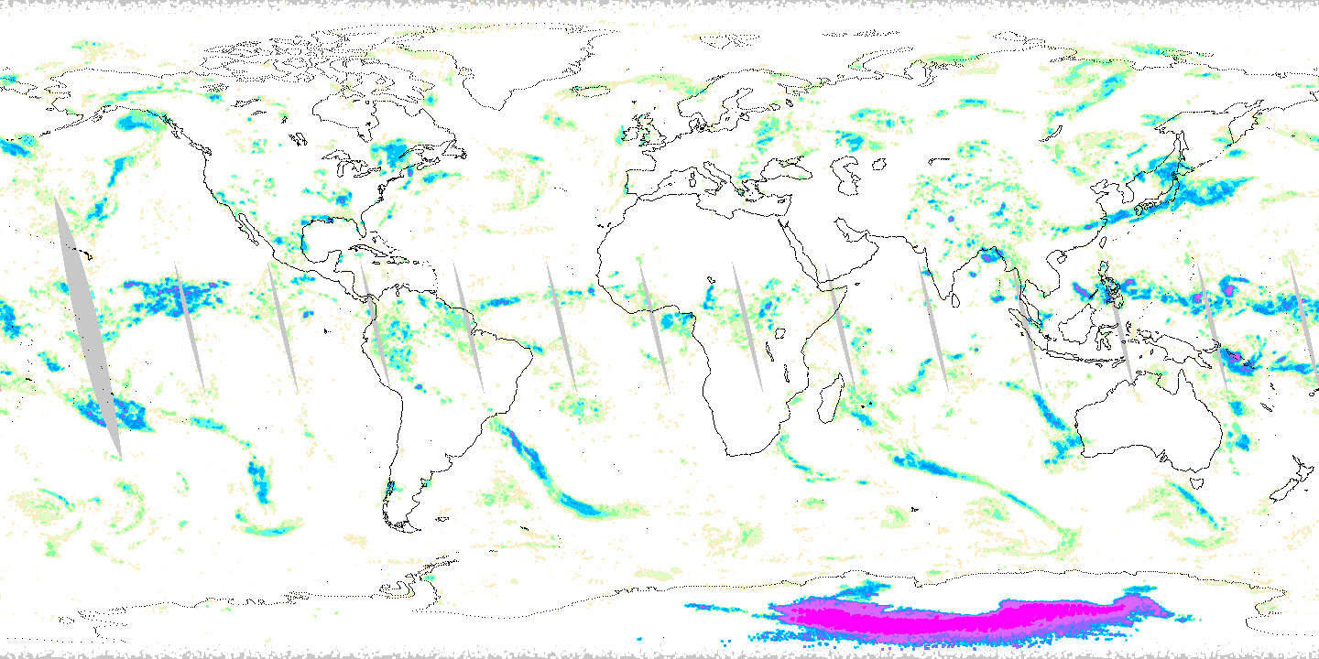
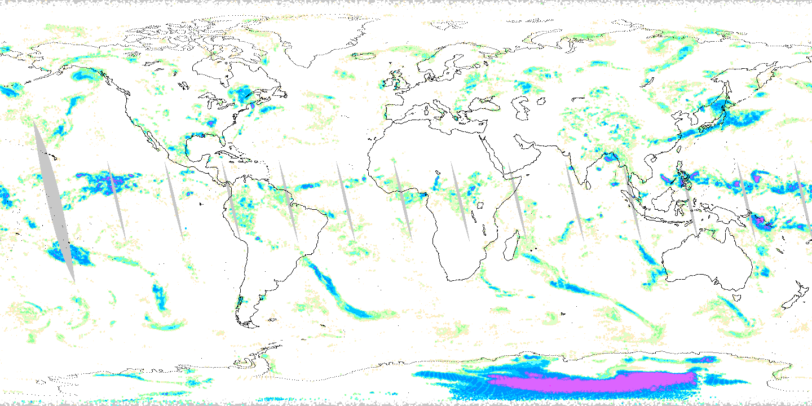
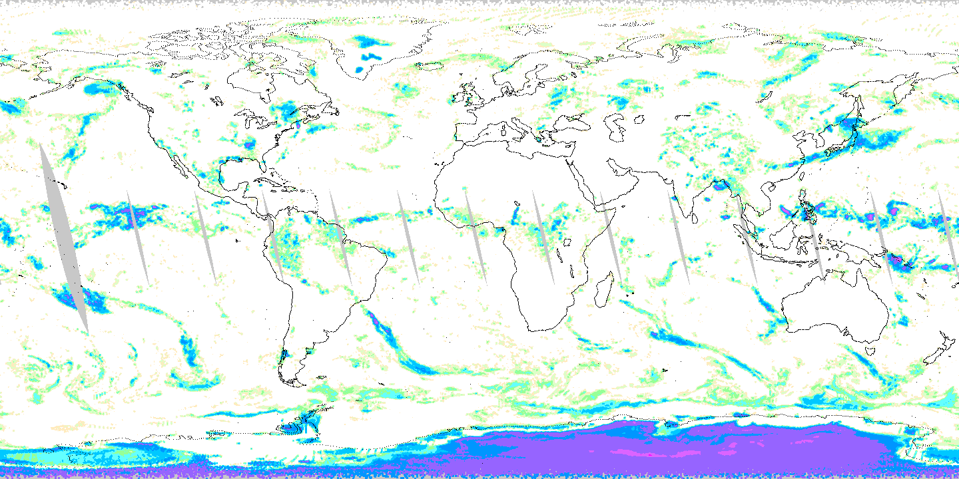
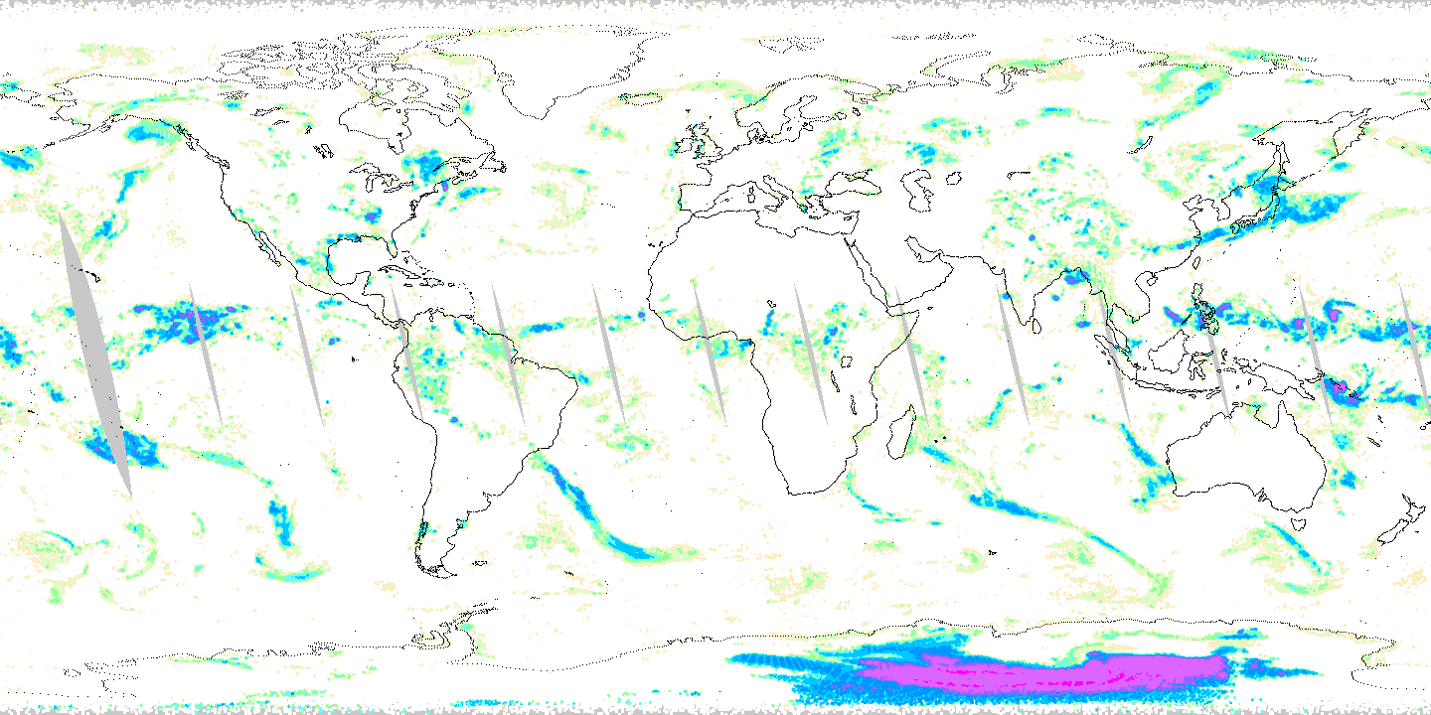
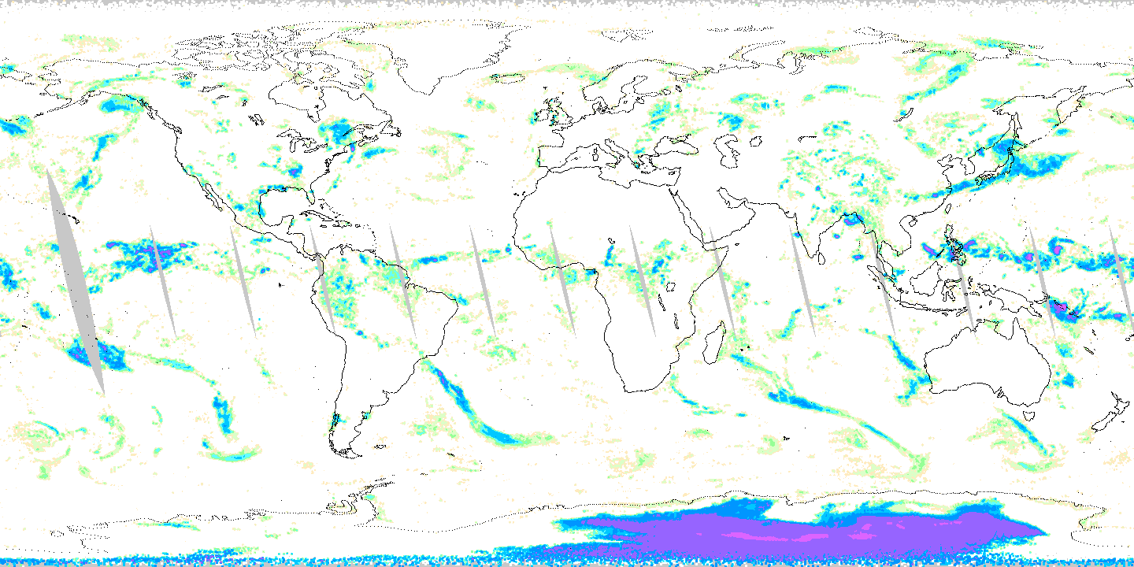
Database size and extent
DPR
Different radar:radiometer databases
Greatest difference relates to representativeness, with subtle differences;
Database size has little impact above ca. 4M entries.
PR
NOAA-20-DPR c.4M entries
Both-DPR+PR c. 18M entries
NOAA-20 & NPP NPP NOAA-20
DPR & PR
1 July 2015 Ascending passes
Mean of 6 closest database entries
(satellite names refer to database)

Slide 12
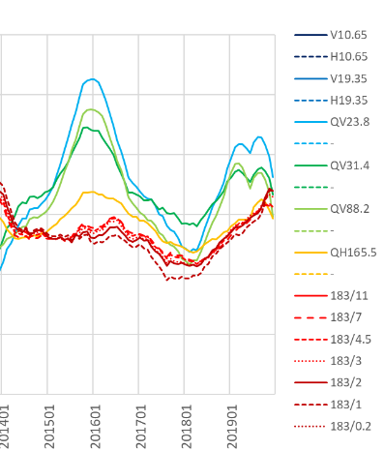
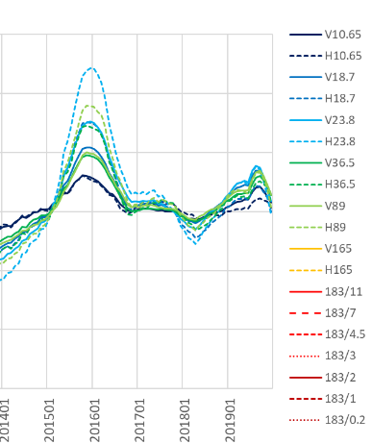
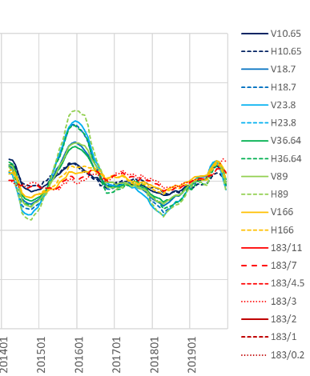
Database Generation – period of record
Climate-scale variations necessitate a representative period to generate the database
ATMS
AMSR2
GMI
v
v
v
Tb departures from longterm Tb mean (K)
(Mean Tbs 30°S-30°N)
v
v
v
LSWG, 16-March-2022
Goddard Space
Flight Center

Slide 13
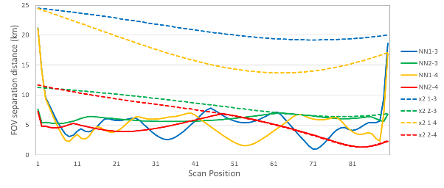
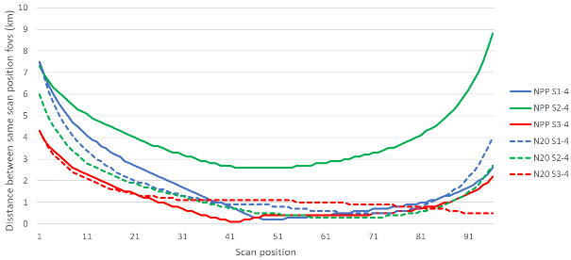
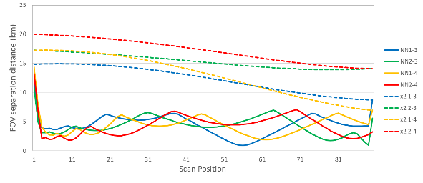
Why individual sensors? Feedhorns have co-location differences
GMI has a L1C-R to ‘correct’ for co-location differences between LF/HF feedhorns
Other sensors don’t:
ATMS on NPP and NOAA-20 differ
Although < 1 FOV, still significant shifts
More critical for SSMIS with shifts of up to 4 scan lines and 4 scan positions
F16 SSMIS
NPP = ATMS on NPP
N20 = ATMS on NOAA20
S1-4 = Group S1 (23.8) - Group S4 (165.5/183)
S2-4 = Group S2 (31.4) - Group S4 (165.5/183)
S3-4 = Group S3 (88.2) - Group S4 (165.5/183)
F18 SSMIS
For SSMIS retrievals, about 4% variation depending upon co-location strategy
LSWG, 16-March-2022
Goddard Space
Flight Center

Slide 14
Database index files (MHS example)
157 183.31±1 183.31±3 190.31
Two channels used as index to database to identify suitable entries (for land & sea).
75K
325K
start
Two land/sea arrays, each bin containing start/end location of database entries
end
325K
89 157 183.31±1 183.31±3
L
S
L
75K
S
range
Mean DPR rainrate (mmh⁻¹)
Index file is a simple 2D text array
LSWG, 16-March-2022
Goddard Space
Flight Center

Slide 15
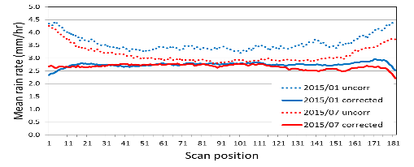
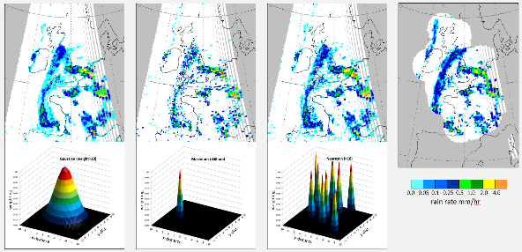
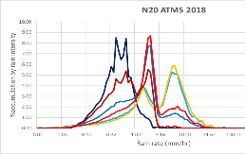
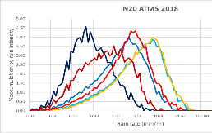
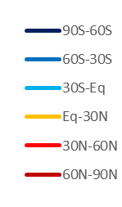
Observation-database entry selection
Databases and associated index are loaded into memory (for efficiency).
Each sensor observation is compared to database entries to find closest match (mean of closest 6 as well as most likely precip).
Cross-track scan position issues (variable EIA - resolution, path length, profile weightings) are handled by only considering DB scan positions within ±n scan positions of obs.
PRPS-SAPHIR v02
GPROF-ATMS NOAA-20 2018
PRPS-ATMS NOAA-20 2018
Kidd, MicroRad 2016
Different DB entry selection = different versions of reality…
GPROF (interpolated) has a double peak – Yalei You
LSWG, 16-March-2022
Goddard Space
Flight Center

Slide 16
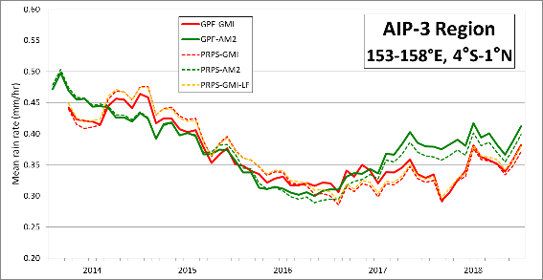
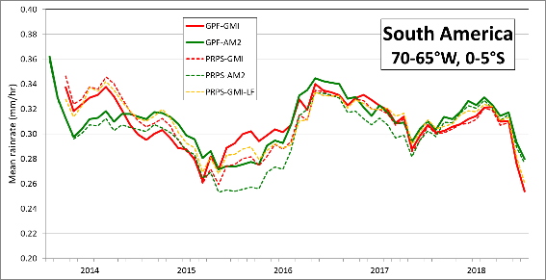
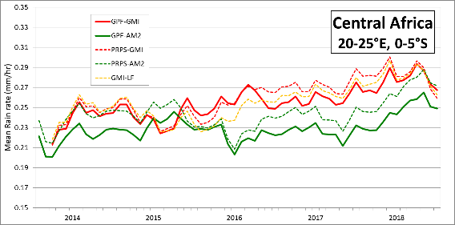
Some results…
Many results available – sometimes very good agreement with GPROF, other times, not – somewhat perplexing! (see Central Africa)
LSWG, 16-March-2022
Goddard Space
Flight Center

Slide 17
Useful implementations of PRPS
Simplicity
The code is relatively short – so it’s easier to read from end to end;
Retrieval is a single program – no external routines or libraries;
Very adaptable for testing different configurations, e.g. channel combinations, channel loss, etc.
Efficient
Code is efficient – e.g. can process 7 months of TROPICS data in about 50 minutes;
Quick processing and assessment of different scenarios.
LSWG, 16-March-2022
Goddard Space
Flight Center

Slide 18
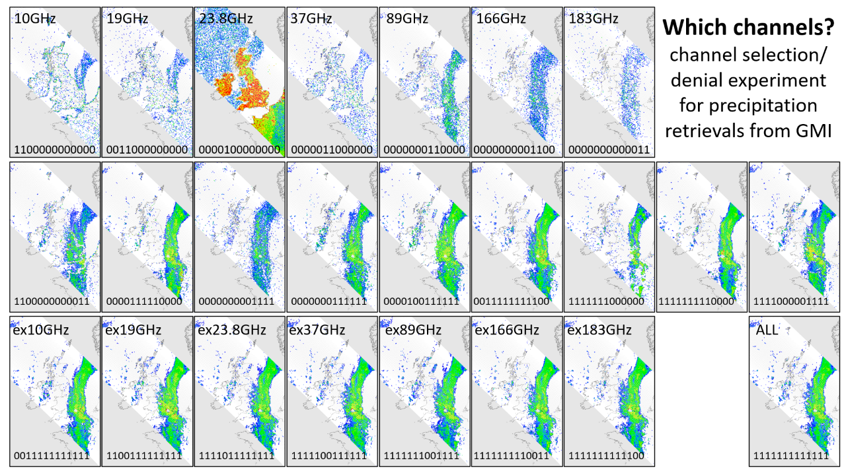

Slide 19
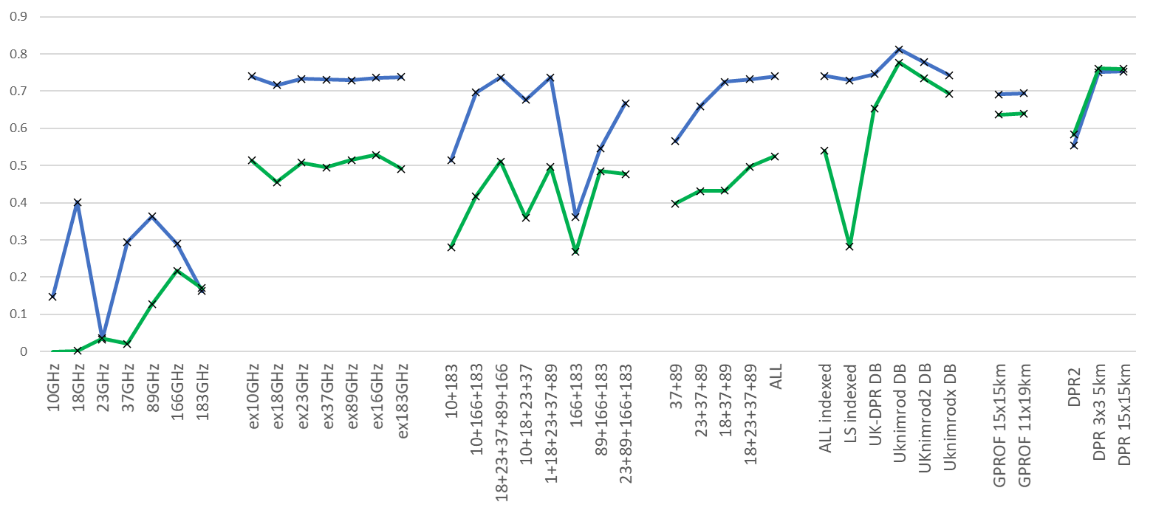
Channel combination performance: Correlation
A
B
C
D
E
G
F
DPR 15x15km
18 GHz
1
DPR
18 GHz
89 GHz
GPROF
Correlation
ATMS
2
MHS
SAPHIR
localised
nimrod DB
¹Over ocean the 18+37+89 combination is nearly as good as all channels (10-183 GHz)
²Over land the addition of the 23 GHz channel improves the 18+37+89 combination.

Slide 20
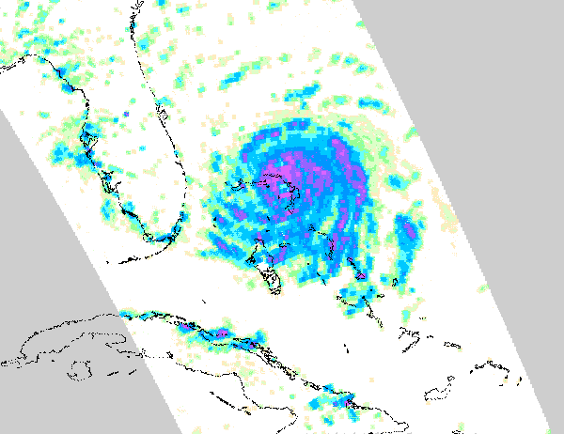
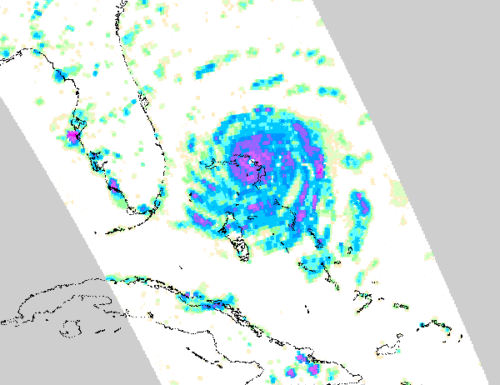
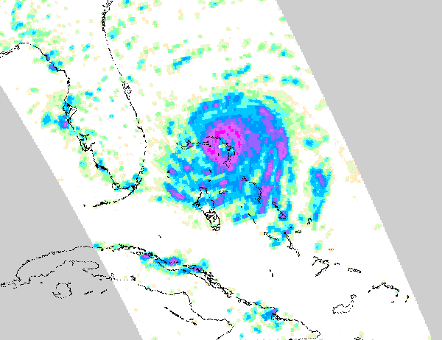
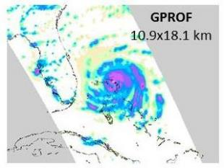
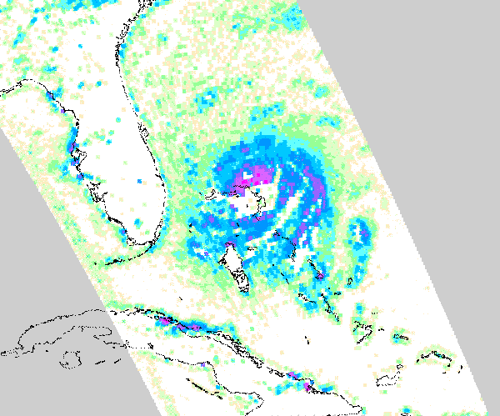
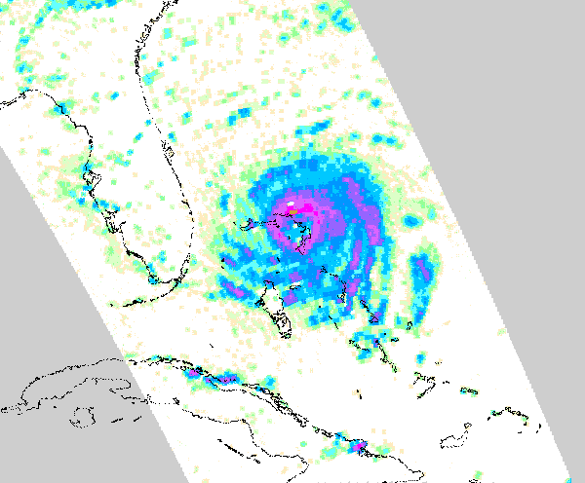
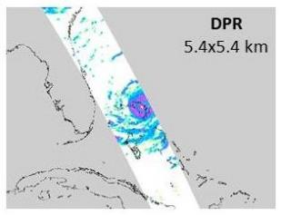
Hurricane Dorian 2019-09-01 S20:20
18+24+37+89+166 GHz
24+37+89 GHz
PRPS all channels
GMI retrievals
PRPS retrievals here are totally unconstrained based upon full 14 M DPR-GMI entry database
10+183 GHz
10+18+166+183 GHz
LSWG, 16-March-2022
Goddard Space
Flight Center

Slide 21
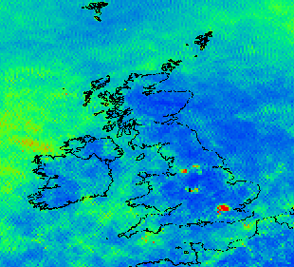
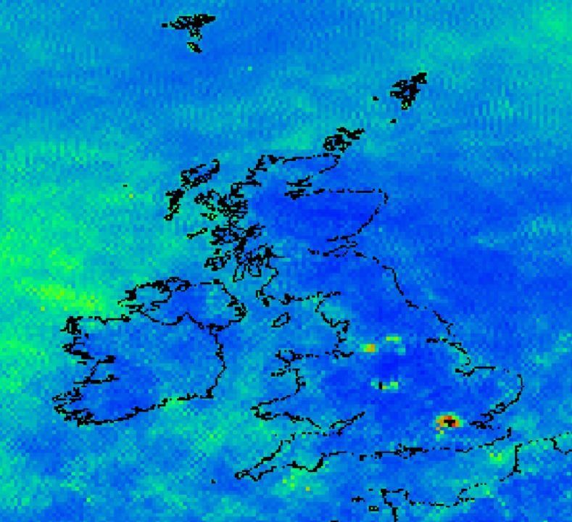
RFI Impacts on Precipitation
GMI L2A-CLIM GPROF2017
Mean daily precipitation rate
20210101-20211129
0.1x0.1 degree resolution
Manchester, Leeds, Sheffield
Birmingham, Coventry
(Black in these areas shows no data)
London
(100% of GMI
FOVs over London are RFI flagged)
RFI identification and exclusion is not perfect – and certainly would preclude any urban-area precipitation studies.

Slide 22
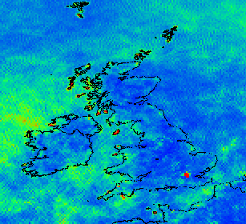
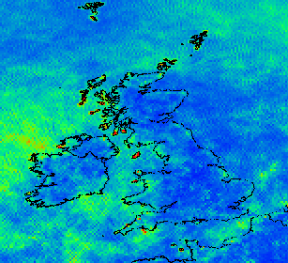
RFI Impacts on Precipitation
PRPS-V02
Mean daily precipitation rate
20210101-20211231
0.1x0.1 degree resolution
Manchester, Leeds, Sheffield
Birmingham, Coventry
(Black in these areas shows no data)
London
RFI effects can be reduced by excluding affected channels –
Good RFI detection of the brightness temperatures is needed

Slide 23
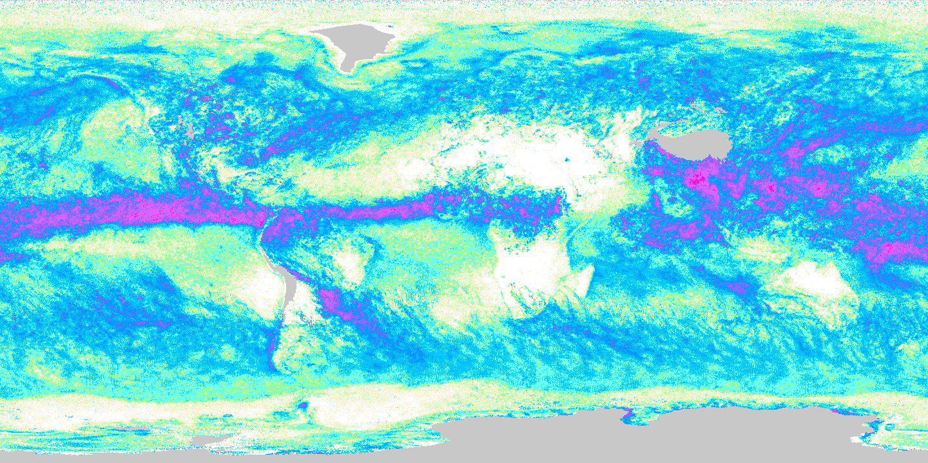
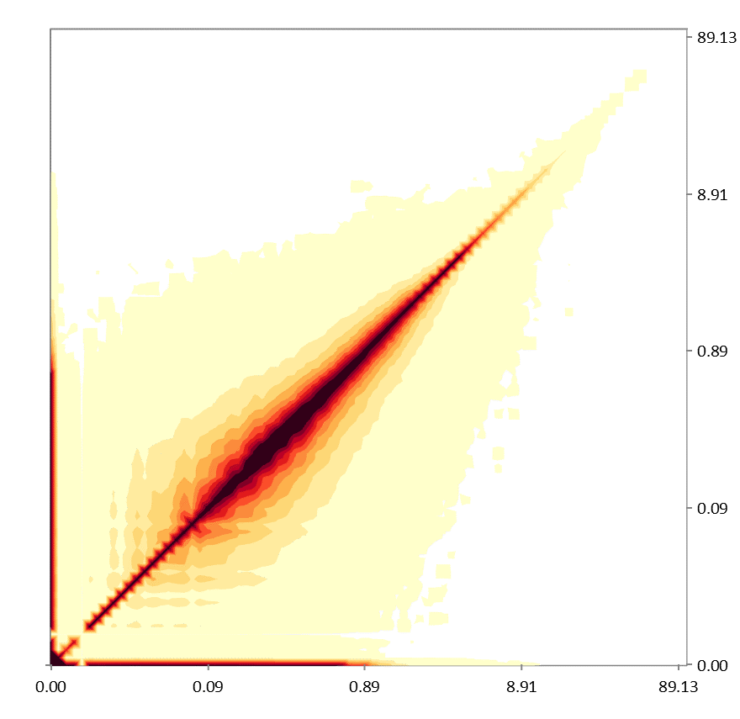
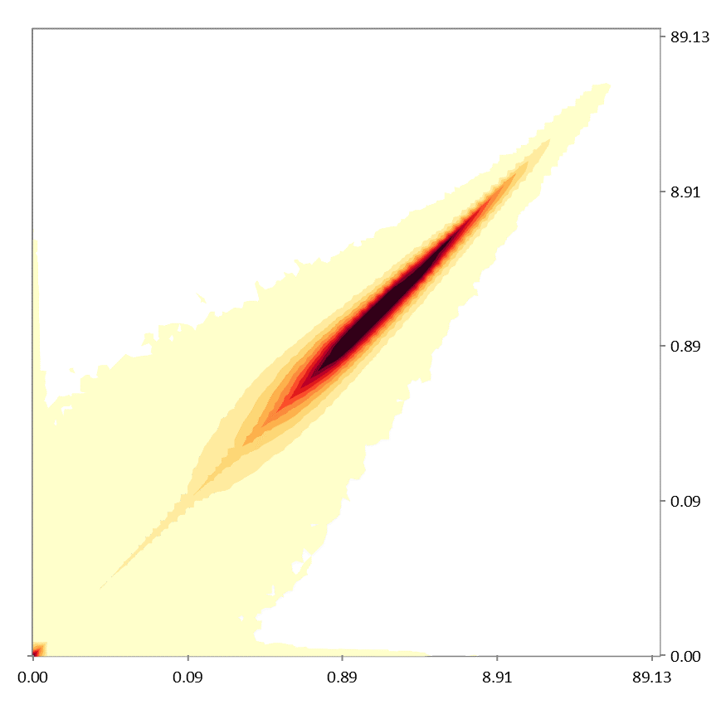
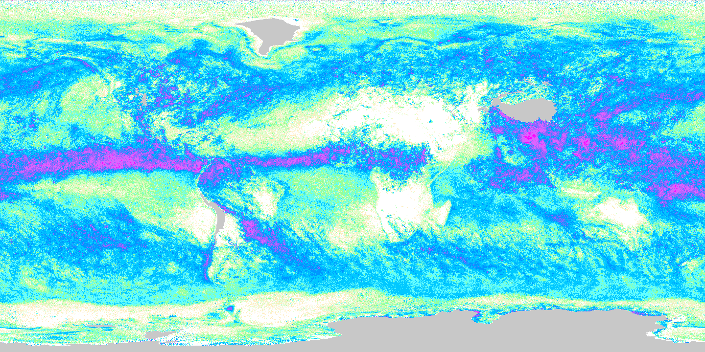
Precipitation retrieval with/without the 23.8 GHz channel
NOAA NPP ATMS sensor July 2015
RFI at frequencies around 24 GHz has the potential to impact precipitation retrievals.
Monthly differences are often subtle but, excluding the 23.8 GHz on ATMS (23/31/89/3x183 retrieval) would be equivalent to an increase in noise resulting from a loss of about 37.5% of the number of observations.
Precipitation retrievals with/without the 23.8 GHz. (NOAA NPP ATMS, July 2015).
Precipitation retrievals including the 23.8 GHz channel.
Instantaneous
Monthly
0.00 0.01 0.10 10.0 100.0
0.00 0.01 0.10 10.0 100.0
Precipitation retrievals excluding the 23.8 GHz channel.
0.00 0.01 0.10 10.0 100.0
0.00 0.01 0.10 10.0 100.0
LSWG, 16-March-2022
Goddard Space
Flight Center

Slide 24
Assessing new instrumentation and channels
“COWVR”
18,23,37
ME -0.18
Ratio 0.91
CC 0.488
“TEMPEST”
89-166
ME -1.12
Ratio 0.44
CC 0.469
“STP-H8”
ME -0.32
Ratio 0.84
CC 0.488
PRPS
10-183
ME 0.152
Ratio 1.05
CC 0.572
GPROF
10-183
ME 0.32
Ratio 1.21
CC 0.625
DPR
Hurricane Ida (Cat.4) GMI 17:41UTC 29-Aug-2021
LSWG, 16-March-2022
Goddard Space
Flight Center

Slide 25
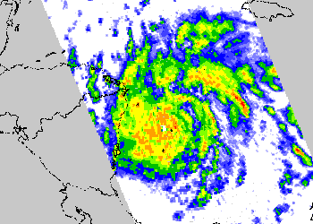
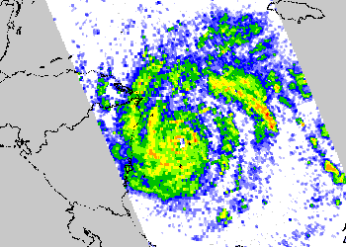
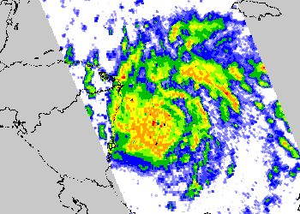
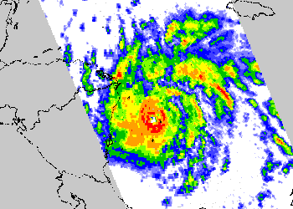
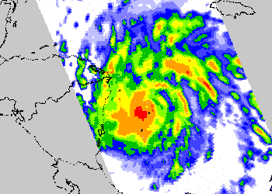
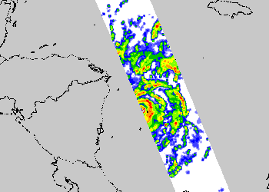
Assessing new instrumentation and channels
“COWVR”
18,23,37
ME -0.02
Ratio 0.99
CC 0.468
“TEMPEST”
89-166
ME -0.70
Ratio 0.51
CC 0.469
“STP-H8”
ME -0.04
Ratio 0.97
CC 0.488
PRPS
10-183
ME 0.15
Ratio 1.11
CC 0.487
GPROF
10-183
ME 0.30
Ratio 1.21
CC 0.513
DPR
Hurricane Iota (Cat.4) GMI 12:45UTC 16-Nov-2020
LSWG, 16-March-2022
Goddard Space
Flight Center

Slide 26
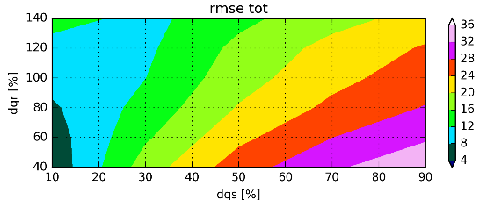
Ensemble Adjustment Approach
RMSE= sqrt[ Tb(obs)-Tb(sim) ]
RMSE
Derive mean Tb as a function of surface precipitation
Obs (MWHS II-DPR): Tb_{MHWS} – Precip_{DPR}
Sim (MMF-Forward): Tb_{MMF-Foward} – Precip_{MMF}
Calibrate model (MMF) hydrometeor mass toward best fits of Tb against the observed (MWHS II) Tb-Precip composites.
Rain % (dqr x 10)
Snow % (dqs x 10)
RMSE from 100 forward simulations
Best
Fit
Worst
Fit
Obs (MWHS II-DPR)
Sim (MMF-Forward)_{best fit}
Sim (MMF-Forward)_{worst fit}
LSWG, 16-March-2022
Goddard Space
Flight Center

Slide 27
Database Comparison
MHS database
MMF database
MOB DSC
16:24:03
GPROF – 400M database entries
PRPS-MHS – 20M database entries
PRPS-MMF – 9M database entries
GPROF
MOC DSC
15:37:13
0.0 0.05 0.1 0.25 0.5 1.0 2.5 5.0 10. 25.
Precipitation Intensity (mm/hr)
GPROF – smooth – missing data in eye
MHS – noisier - retrieves eye
MMF – very noisy – retrieves eye
N19 DSC
12:58:29
LSWG, 16-March-2022
Goddard Space
Flight Center

Slide 28
TROPICS
Time-Resolved Observations of Precipitation structure and storm Intensity with a Constellation of Smallsats
Each TROPICs satellite is a 3U cubesat with a cross-track 91-204 GHz passive microwave radiometer.
Pathfinder launched 30th June 2021 into a sun-synchronous polar orbit.
Six constellation satellites from 2022 in 3 low inclination orbital planes.
34cm
10cm
10cm
Hurricane Sam 1st October 2021 as viewed by the TROPICS pathfinder
TROPICS01.BRTT.L1B.Orbit01414.V02-01.ST20211001-180106.ET20211001-193623.CT20211002-115426.nc
At-launch PRPS retrieval scheme based upon MHS 4-channel observational data
Assessment of initial results switched database to a 4-channel ATMS-based observational database.
O₂ band observations not currently exploited – plans once sufficient DPR-TMS matches.
LSWG, 16-March-2022
Goddard Space
Flight Center

Slide 29
TROPICS (TMS) database
TMS vs MHS Tb:RR
TMS vs ATMS Tb:RR
LSWG, 16-March-2022
Goddard Space
Flight Center

Slide 30
PRPS-TROPICS
IMERG
IMERG
2021-08-08 to -14
0.002
0.004
0.010
0.022
0.050
0.112
0.250
0.500
1.000
2.236
5.000
0.002
0.004
0.010
0.022
0.050
0.112
0.250
0.500
1.000
2.236
5.000
TROPICS
TROPICS
0.002
0.004
0.010
0.022
0.050
0.112
0.250
0.500
1.000
2.236
5.000
0.002
0.004
0.010
0.022
0.050
0.112
0.250
0.500
1.000
2.236
5.000
2021-09-18 to -24
IMERG-TROPICS
IMERG-TROPICS
-1.0
-0.5
-0.2
-0.1
-0.05
-0.025
0.025
0.05
0.1
0.2
0.5
1.0
-1.0
-0.5
-0.2
-0.1
-0.05
-0.025
0.025
0.05
0.1
0.2
0.5
1.0

Slide 31
GPROF-NOAA19
IMERG
IMERG
2021-08-08 to -14
0.002
0.004
0.010
0.022
0.050
0.112
0.250
0.500
1.000
2.236
5.000
0.002
0.004
0.010
0.022
0.050
0.112
0.250
0.500
1.000
2.236
5.000
NOAA19
NOAA19
0.002
0.004
0.010
0.022
0.050
0.112
0.250
0.500
1.000
2.236
5.000
0.002
0.004
0.010
0.022
0.050
0.112
0.250
0.500
1.000
2.236
5.000
2021-09-18 to -24
IMERG-NOAA19
IMERG-NOAA19
-1.0
-0.5
-0.2
-0.1
-0.05
-0.025
0.025
0.05
0.1
0.2
0.5
1.0
-1.0
-0.5
-0.2
-0.1
-0.05
-0.025
0.025
0.05
0.1
0.2
0.5
1.0

Slide 32
Statistics
Period | ME | Ratio | RMSE | Correlation | Nobs
20210808-14 | -0.0004 | 0.9968 | 0.0945 | 0.8921 | 4609.
20210918-24 | -0.0049 | 0.9606 | 0.1010 | 0.8407 | 4609.
IMERG vs
GPROF NOAA19
Period | ME | Ratio | RMSE | Correlation | Nobs
20210808-14 | -0.0073 | 0.9382 | 0.0993 | 0.8802 | 4609.
20210918-24 | -0.0013 | 0.9891 | 0.1000 | 0.8535 | 4609.
IMERG vs
PRPS-TMS
GPROF-MHS
GPROF-MHS

Slide 33
Instantaneous comparisons
Top plots: MRMS vs PRPS-TMS retrievals, vs Bottom plots: MRMS vs GPROF-ATMS retrievals
GPROF generally better at instantaneous retrievals with ATMS – but 23/31 GHz provides a greater dynamic range in the frequencies of observation.
GPROF also smears the rain area which always improves statistical measures.
LSWG, 16-March-2022
Goddard Space
Flight Center

Slide 34
Conclusions
The PRPS:
is designed to be, simple, flexible and efficient
can be used on a variety of both conical and cross track sensors;
has generally good performance – and can be better than GPROF in certain circumstances.
May be used for:
general precipitation retrievals;
testing of channel selection/impact studies;
error and uncertainty testing.
If sufficient interest, I would be happy to provide a course/software
LSWG, 16-March-2022
Goddard Space
Flight Center

